Slide 1
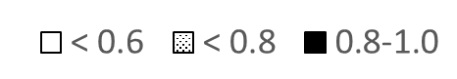
Supplemental Figure
The correlation between TWA F_{I}O₂ and the minimum SpO₂
Percentage of cases by F_{I}O₂ category
F_{I}O₂
(%)
(49) | (18) | (14) | (24) | (28) | (23) | (19) | (12) | (5)
Minimum SpO₂
(Number of patients)
In 111 patients (56%), intraoperative minimum SpO₂ was ≥ 95%, with 83% of them receiving TWA F_{I}O₂ of ≥ 0.6.
TWA Time weighted average, F_{I}O₂ Fraction of inspiratory oxygen
Notes:
In 111 patients (56%), intraoperative minimum SpO₂ was more than or equal to 95%. Among them, 90 patients (46%) were managed with TWA F_{I}O₂ ≥ 0.6.

