Slide 1
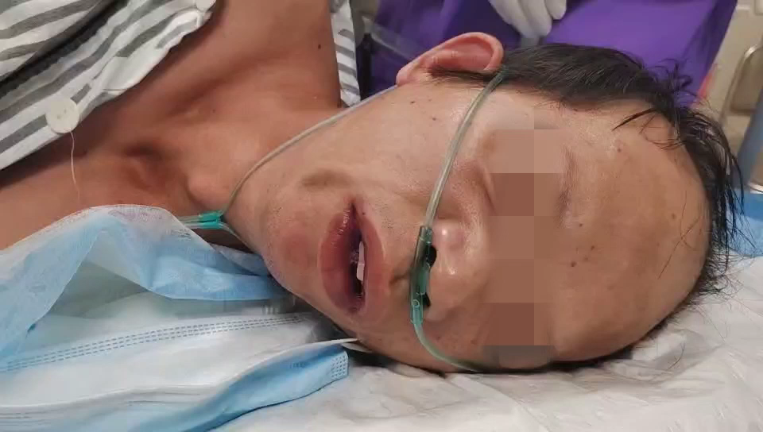
Supplementary：the video for the patient’s airway manifestations following remimazolam administration under procedural sedation.

