Slide 1
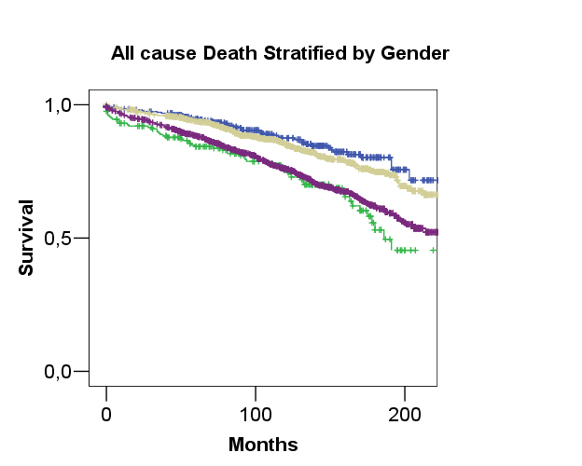
28
34
48
55
Subjects at risk
320 198 21
202 105 6
1033 648 87
1217 705 96

