Slide 1
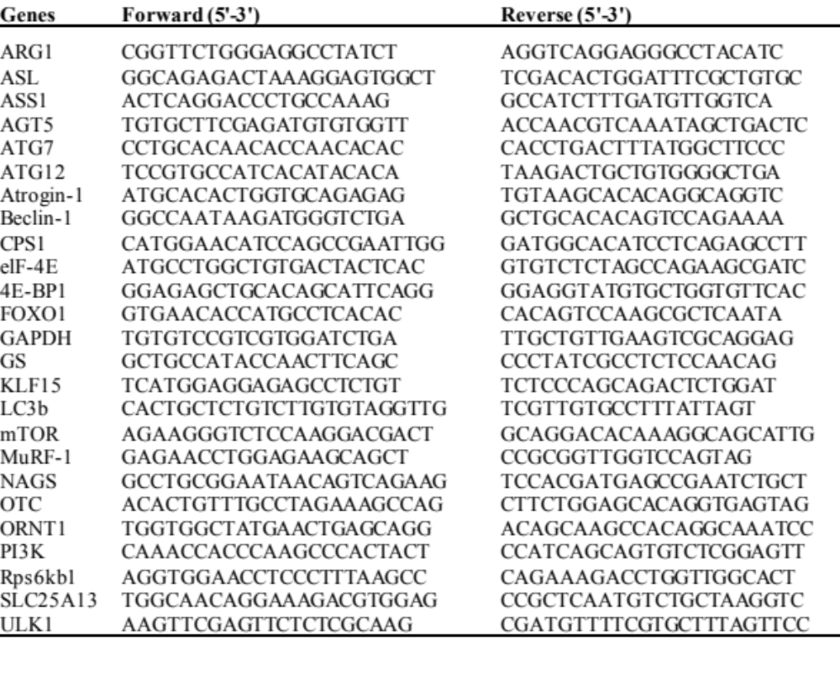
Notes:
Table S1. The sequences of primers used in the present study.
ARG1, arginase 1; ASL, arginosuccinate lyase; ASS1, arginosuccinate synthase 1; ATG, Autophagy related; CPS1, carbamoyl-phosphate synthase 1; eIF4E, eukaryotic translation initiation factor 4E; 4E-BP1, Eukaryotic translation initiation factor 4E-binding protein 1; FOXO1, forkhead box protein O1; GAPDH, glyceraldehyde 3-phosphate dehydrogenase; GS, glutamine synthetase; KLF15, Kruppel Like Factor 15; mTOR, mammallian target of rapamycin; MuRF-1, Muscle RING-finger protein-1; NAGS, N-acetylglutamate synthetase; OTC, ornithine transcarbamylase; ORNT1, mitochondrial ornithine transporter; PI3K, phosphatidylinositol-3 kinase; Rps6kb1, Ribosomal Protein S6 Kinase B1; SLC25A13, Solute Carrier Family 25 Member 13; ULK1, Unc-51 Like Autophagy Activating Kinase. 1..

