Slide 1
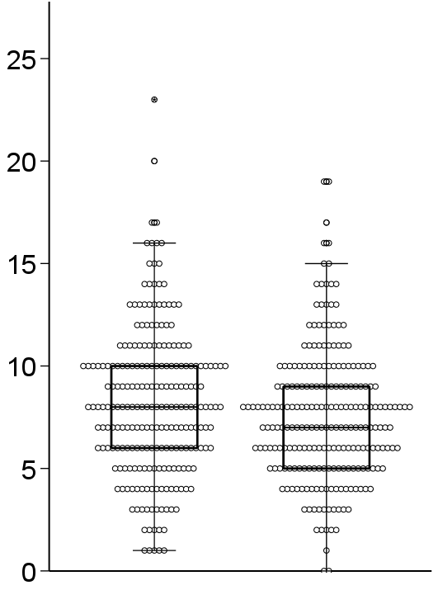
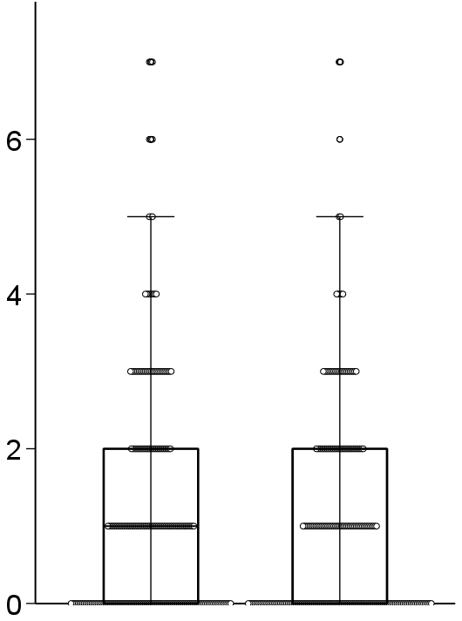
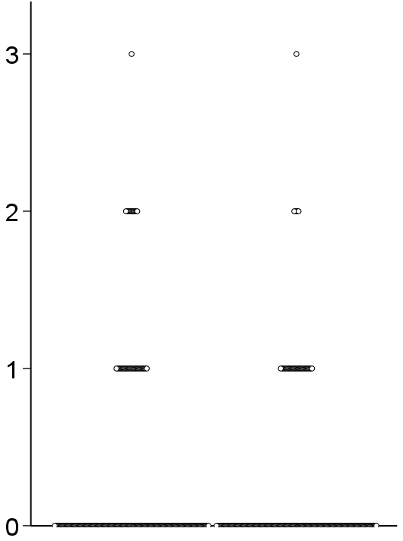
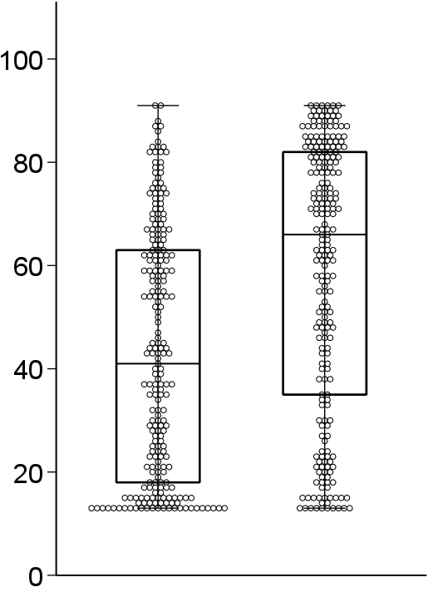
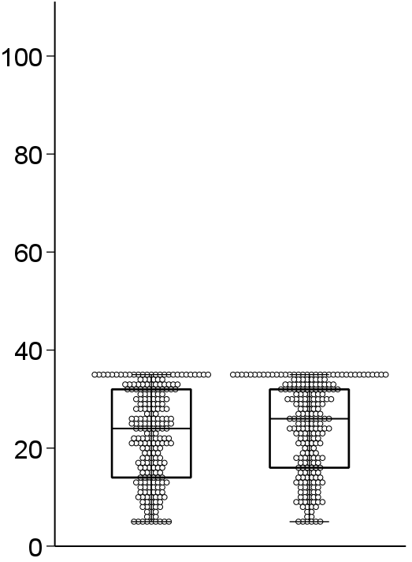
All subjects (n = 229)
Number of medications
ACB
Number of BZDs
*
*
*
Number of medications
ACB score
Number of BZDs
Baseline
Endpoint
Baseline
Endpoint
Baseline
Endpoint
Motor FIM
Cognitive FIM
*
Motor FIM score
Cognitive FIM score
*
Baseline
Endpoint
Baseline
Endpoint
Supplementary Fig. 1. Medication, ACB score, and number of BZDs, and motor and cognitive FIM changes from admission to discharge.
Boxes indicate the median and interquartile range; whiskers indicate 1.5 × interquartile range.
*P <0.05, for within-group comparison between baseline and endpoint by the Wilcoxon signed-rank test. ACB, Anticholinergic Cognitive Burden Scale; BZD, benzodiazepine receptor agonist; FIM, functional independence measure.

Slide 2
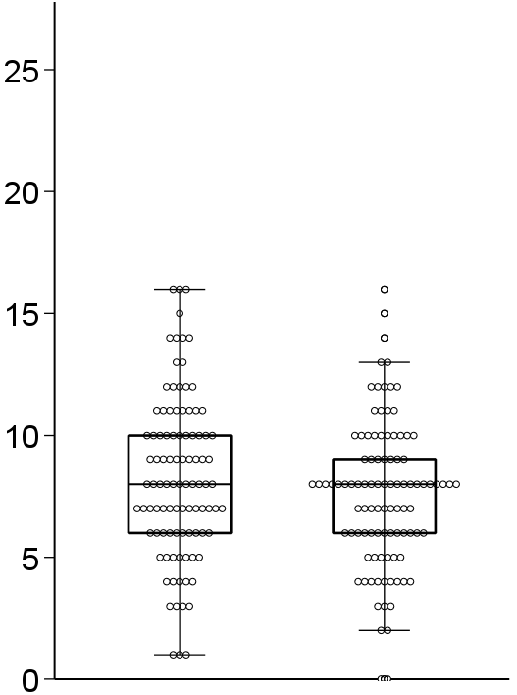
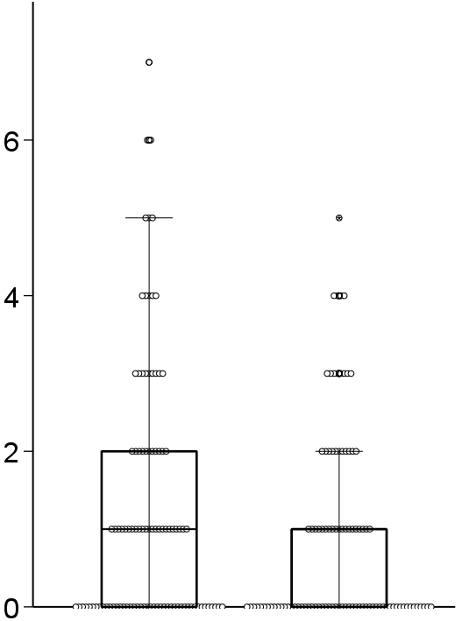
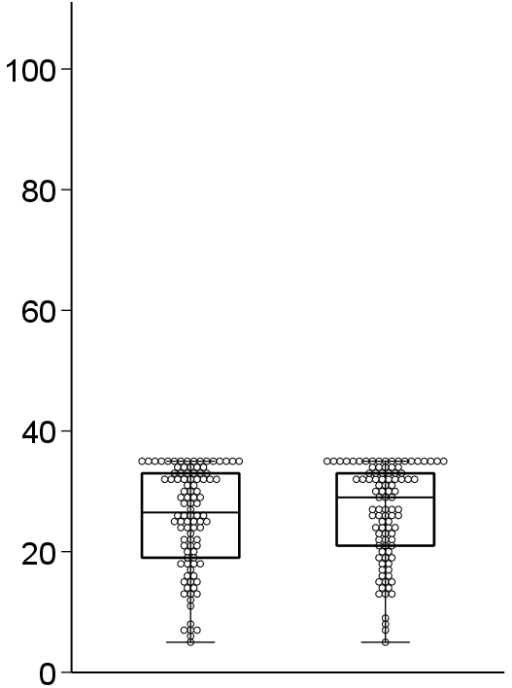
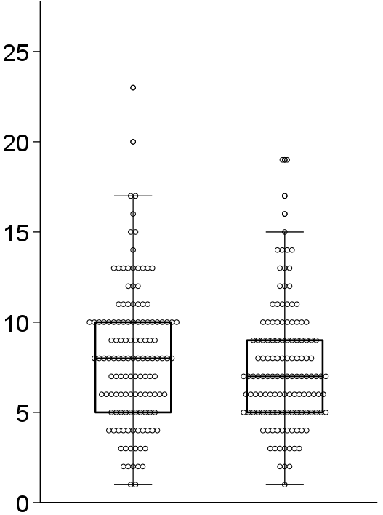
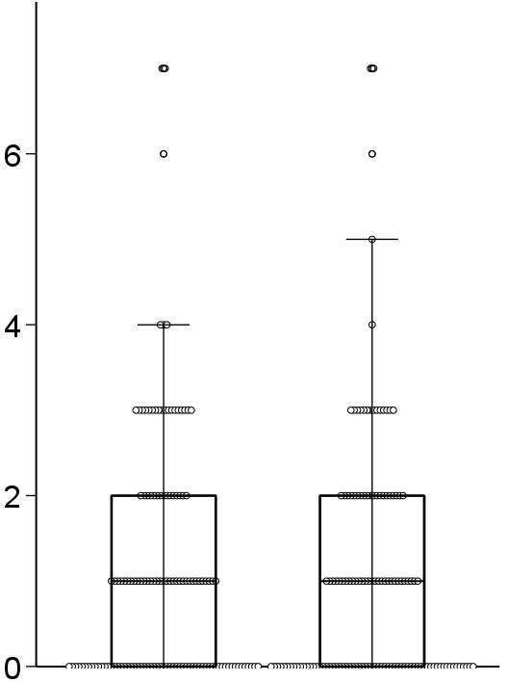
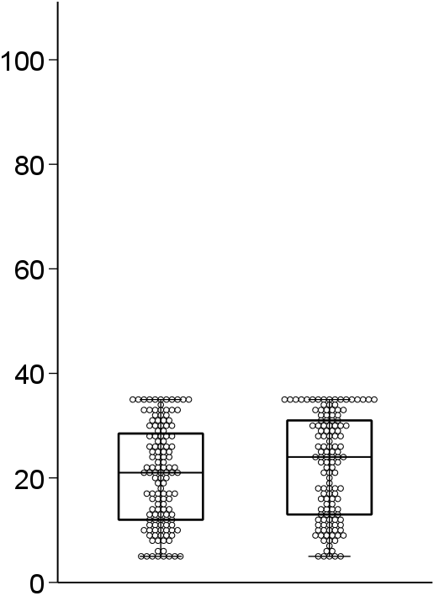
Patient with musculoskeletal disease (n = 98)
Number of medications
ACB
Cognitive FIM
*
*
Number of medications
ACB score
Cognitive FIM score
*
Baseline
Endpoint
Baseline
Endpoint
Baseline
Endpoint
Patient without musculoskeletal disease (n = 131)
Number of medications
ACB
Cognitive FIM
*
Number of medications
ACB score
Cognitive FIM score
*
Baseline
Endpoint
Baseline
Endpoint
Baseline
Endpoint
Supplementary Fig. 2. Medication, ACB score, and cognitive FIM score changes stratified by musculoskeletal disease status.
Boxes indicate the median and interquartile range; whiskers indicate 1.5 × interquartile range.
*P <0.05, for within-group comparison between baseline and endpoint by the Wilcoxon signed-rank test.
ACB, Anticholinergic Cognitive Burden Scale; FIM, functional independence measure.

Slide 3
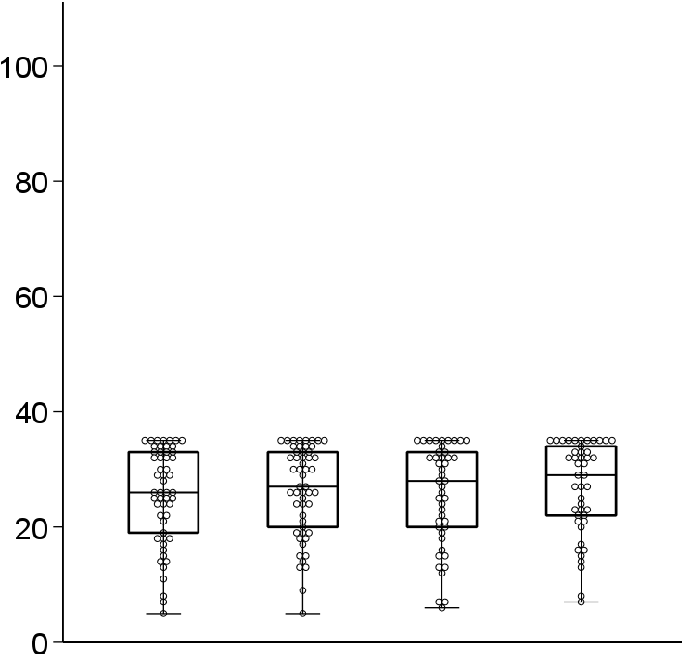
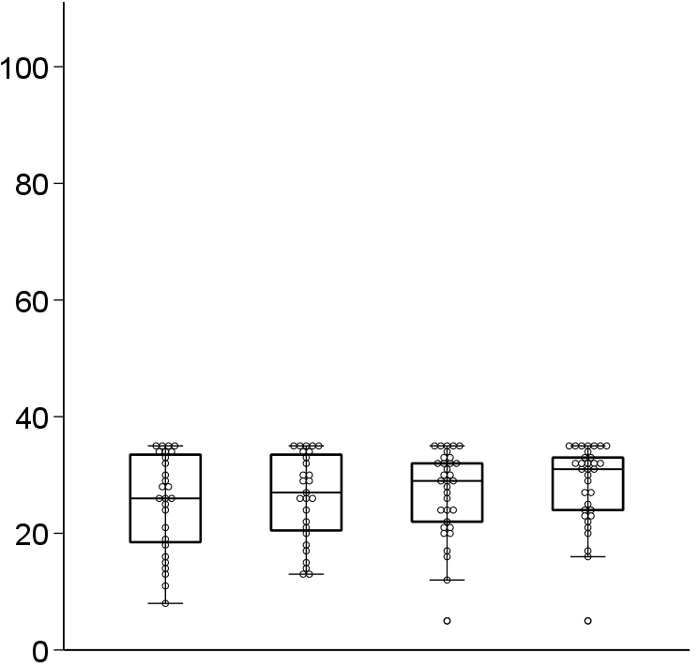
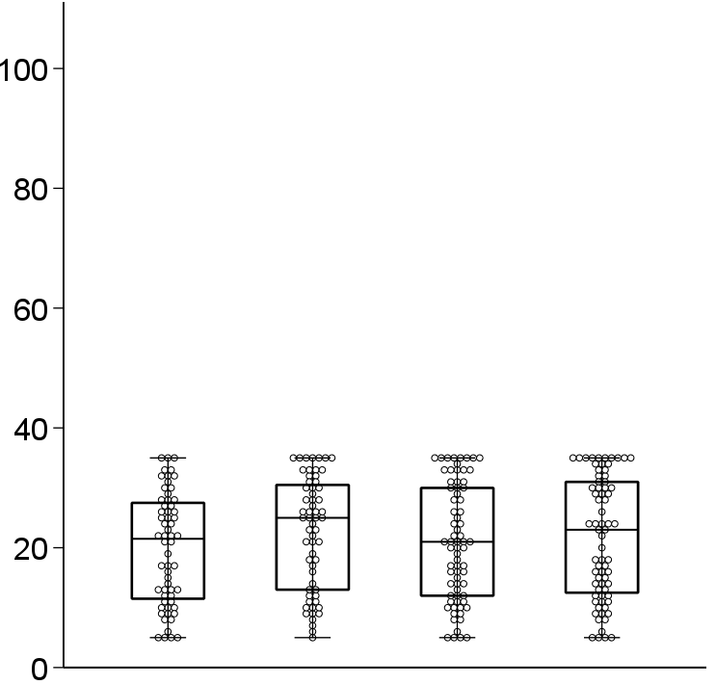
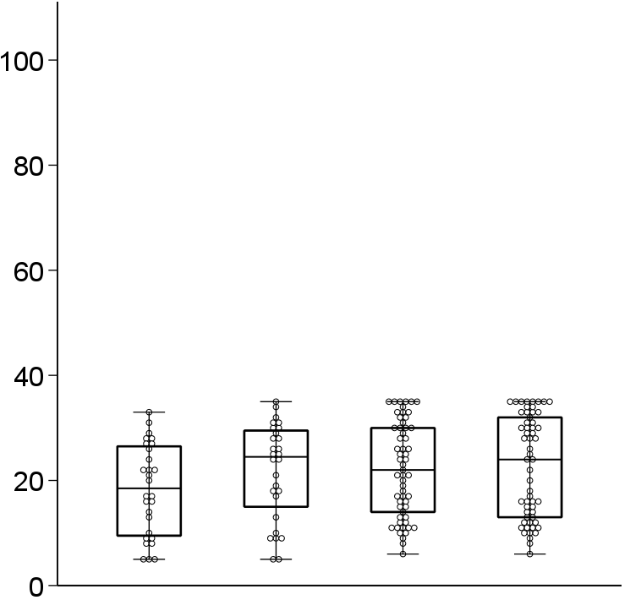
Patient with musculoskeletal disease (n = 98)
Cognitive FIM score
Cognitive FIM score
*
*
*
*
Baseline
Endpoint
Baseline
Endpoint
Baseline
Endpoint
Baseline
Endpoint
Decreased
number of medications
Non-decreased number of medications
Decreased
ACB score
Non-decreased ACB score
Patient without musculoskeletal disease (n = 131)
Cognitive FIM score
Cognitive FIM score
†
†
*
*
*
*
Baseline
Endpoint
Baseline
Endpoint
Baseline
Endpoint
Baseline
Endpoint
Decreased
number of medications
Non-decreased number of medications
Decreased
ACB score
Non-decreased ACB score
Supplementary Fig. 3. Cognitive FIM score changes in patients with medication or ACB score reductions, stratified by musculoskeletal disease status.
Boxes indicate the median and interquartile range; whiskers indicate 1.5 × interquartile range.
*P <0.05, for within-group comparison between baseline and endpoint by the Wilcoxon signed-rank test.
FIM, functional independence measure; ACB, Anticholinergic Cognitive Burden Scale.

