Slide 1
1. Urinary NGAL percentiles distribution

Slide 2
2. Distribution of uNGAL values for each AKIN stage and no AKI
no AKI

Slide 3
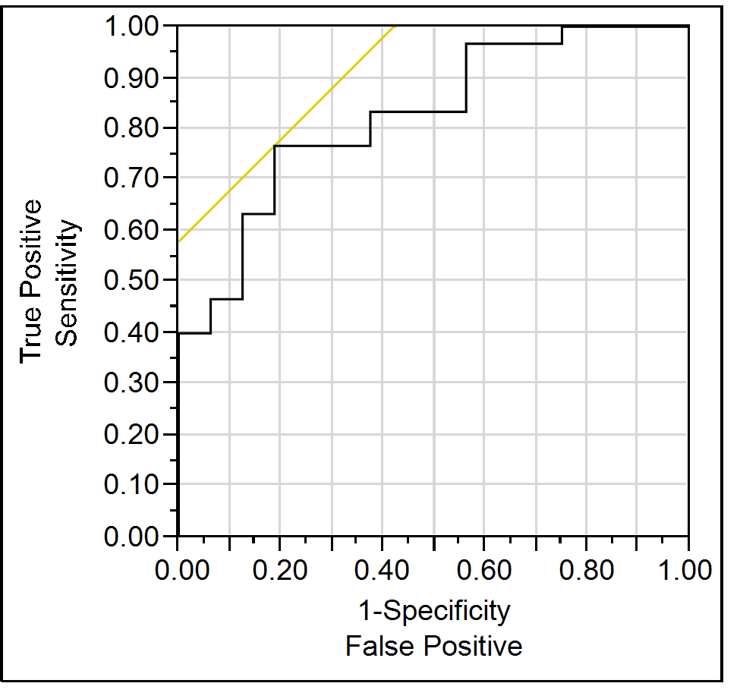
3. ROC-analysis for uNGAL cutoff of >220 ng/ml predicting a AKI stage 3

