Slide 1
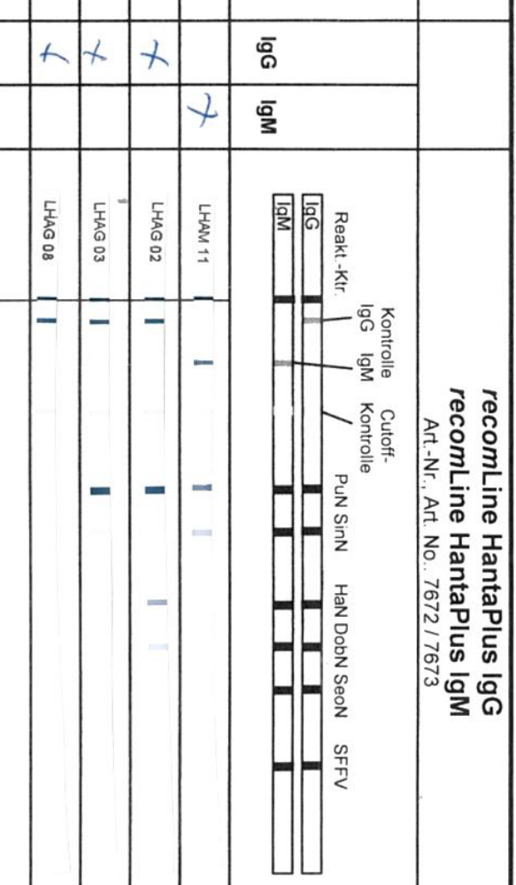
Supplemental figure
control
IgG IgM
control
reaction
Pat. IgM
Pat. IgG
PC
NC

