Slide 1
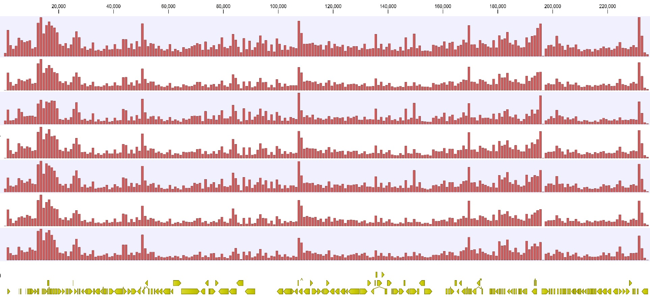
Genomic Position
717
All variants
0
Asymptomatic
618
0
360
Symptomatic
0
Normal Hearing
530
Variants/1000bp
0
SNHL
456
0
Asymptomatic Normal Hearing
537
0
Asymptomatic SNHL
363
0
UL1
UL6-9
UL11
UL20
UL33
UL37
UL56
UL73-74
UL55
UL147-142
UL119-120
UL150
IRS1
TRS1
Coding Regions
Supplemental Figure 1

