Slide 1
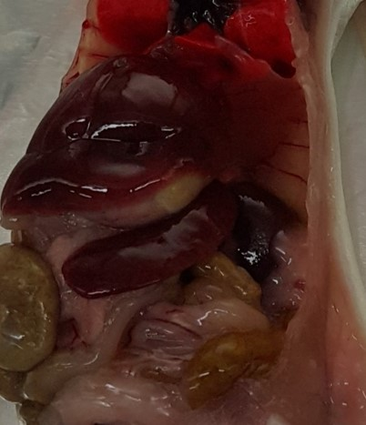
Normal
KZQ2
KZQ3
Notes:
Supplemental Figure 1. Spleen of a Balb/c mouse infected with the patient’s buffy coat; day 49; splenomegaly. The spleen is twice as large as normal.

