Slide 1
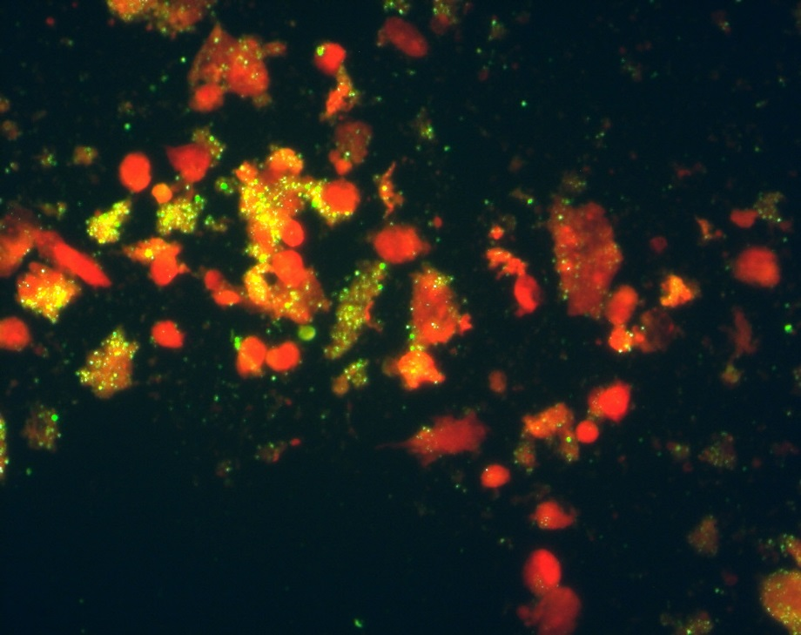
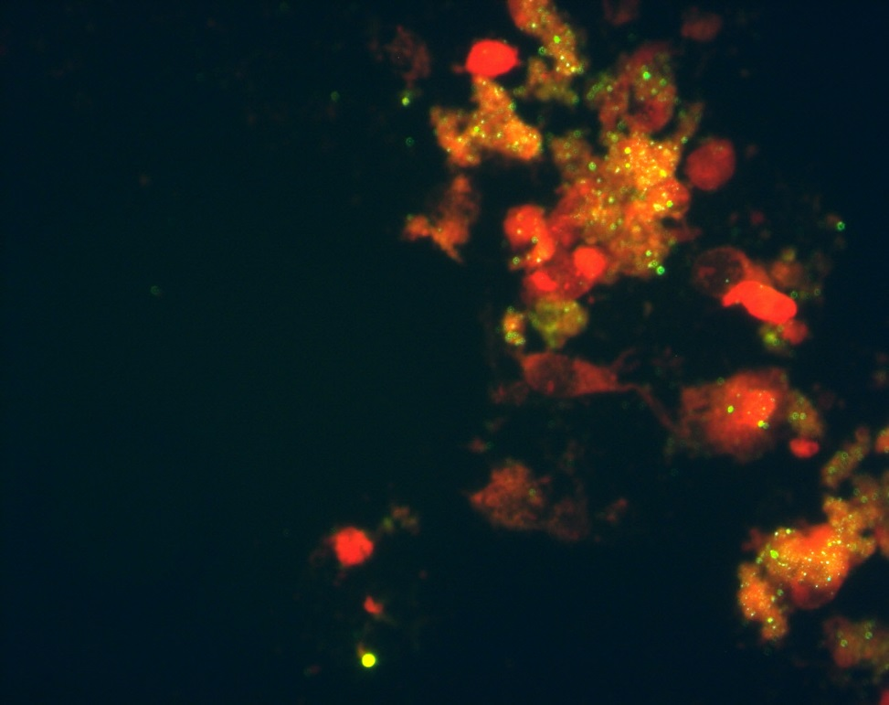
Notes:
Supplemental Figure 3. In-house immunofluorescence staining of isolate Coxiella burentii from patient within African green monkey kidney epithelial cell line (Vero) (dpi 3). Culture preparations stained by IFA, using a anti-Coxiella burnetii serum. The arrow indicates intracytoplasmic inclusions filled with numerous bacteria. Fluorescence magnification (A-B; X400).

