Slide 1
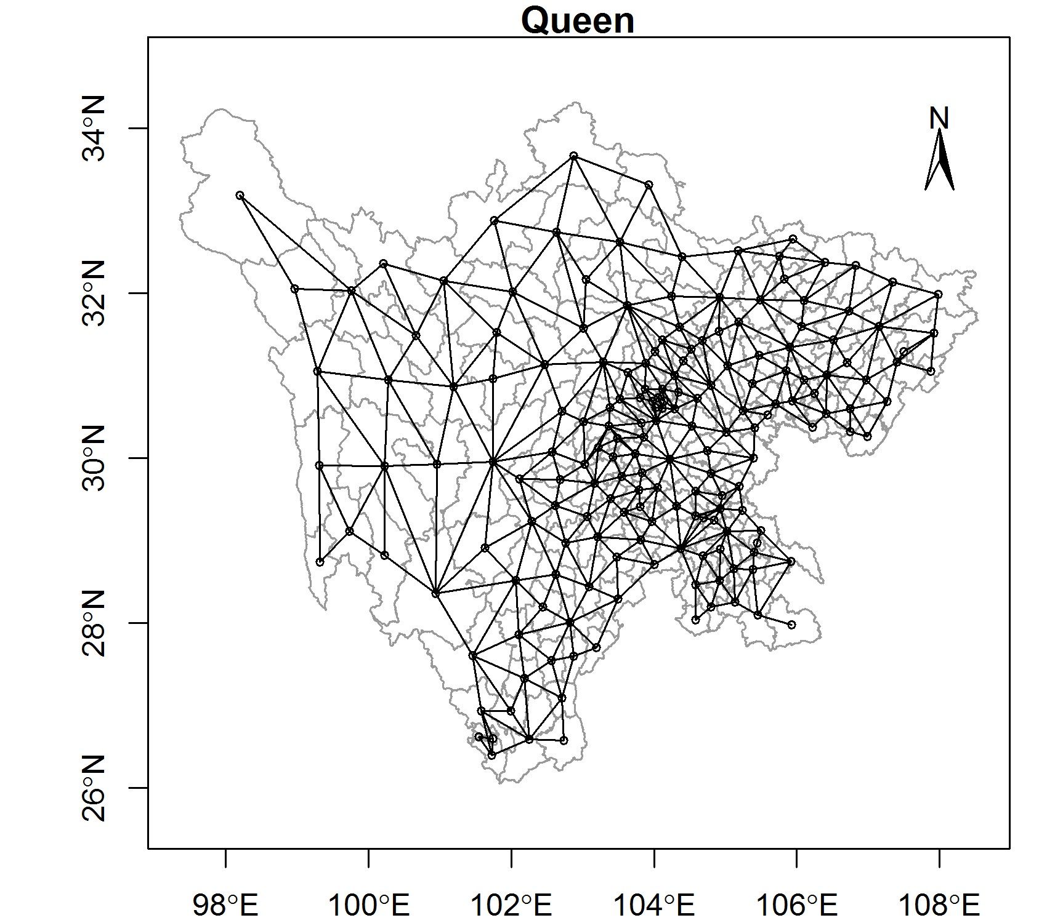
Additional file 1. The weights plot of Queen in 181 counties of Sichuan Province. The common boundaries in 181 counties of Sichuan province can be clearly distinguished, so the queen weights were used in this manuscript.

