Slide 1
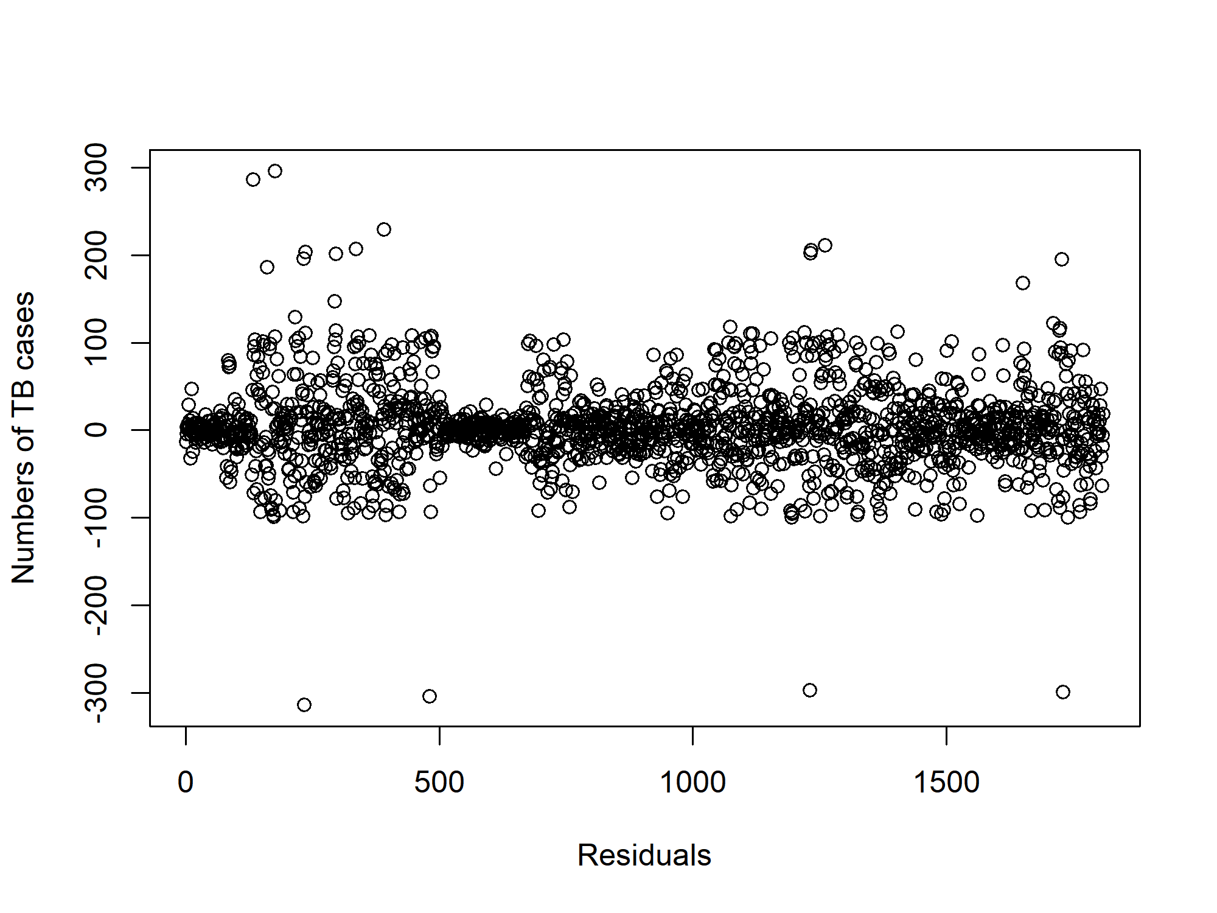
Additional file 4. The residuals plot of the fitted spatio-temporal model after adjusting for education year and proportion of age group in Sichuan province.

