Slide 1
Forest plots
Comparison 1: Self-management interventions with 1 to 2 components vs. control

Slide 2
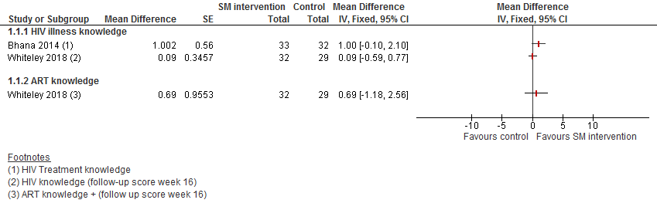
1. Knowledge and understanding of illness (3-month follow-up)

Slide 3
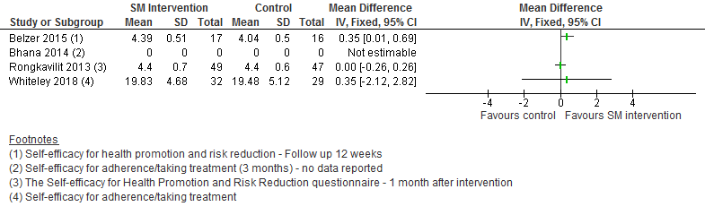
2. Confidence (self-efficacy for taking treatment): 3-month follow-up

Slide 4
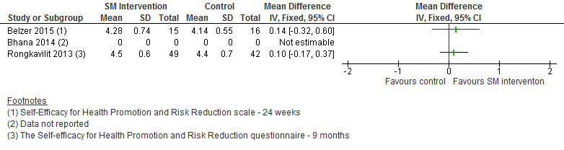
3. Confidence (self-efficacy for taking treatment): 6-month follow-up

Slide 5
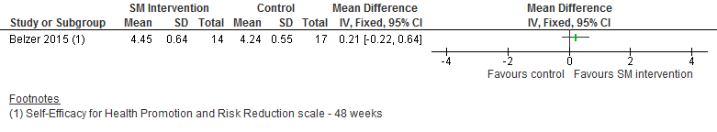
4. Confidence (self-efficacy for taking treatment): 12-month follow-up

Slide 6
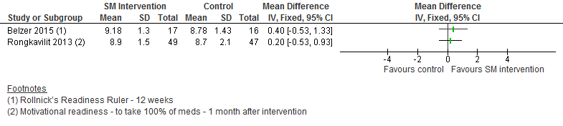
5. Motivation for taking ART: 3-month follow-up

Slide 7
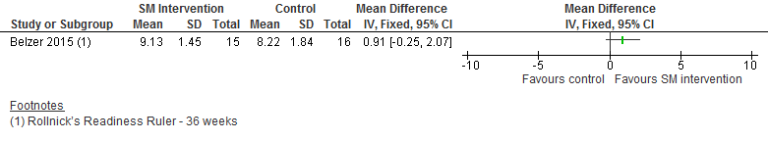
6. Motivation for taking ART: 6-month follow-up

Slide 8
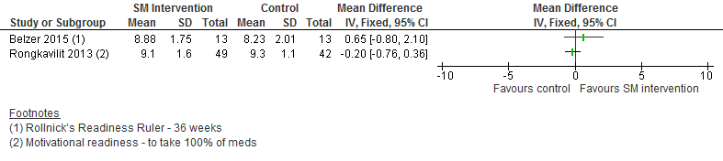
7. Motivation for taking ART: 9-month follow-up

Slide 9
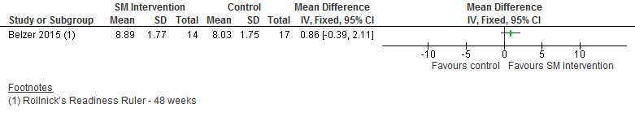
8. Motivation for taking ART: 12-month follow-up

Slide 10
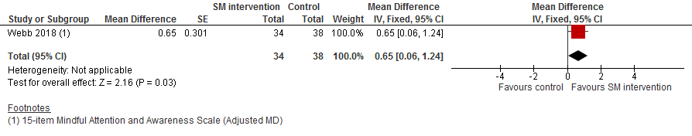
9. Mindfulness: 3-month follow-up

Slide 11
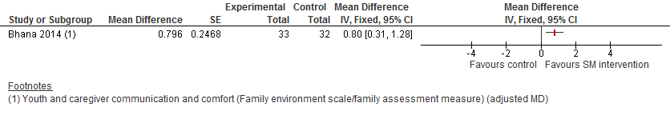
10. Social support: 3-month follow-up

Slide 12
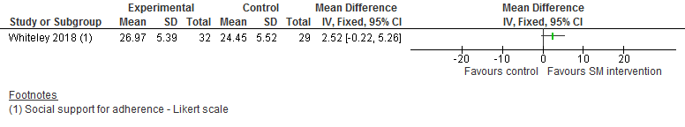
11. Social support: 4-month follow-up

Slide 13
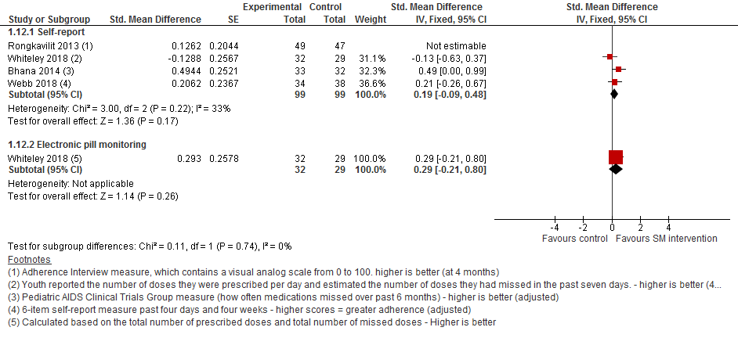
12. Adherence: 3-4 month follow-up

Slide 14
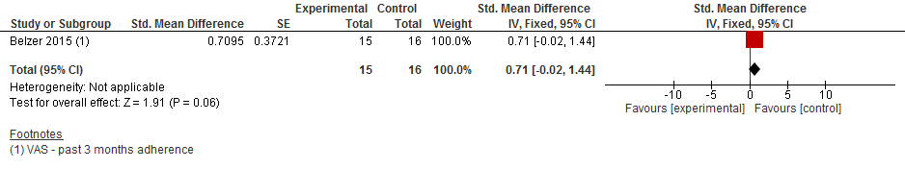
13. Adherence: 6-month follow-up

Slide 15
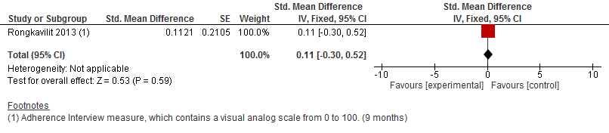
14. Adherence: 9-month follow-up

Slide 16
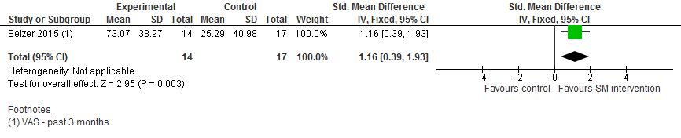
15. Adherence: 12-month follow-up

Slide 17
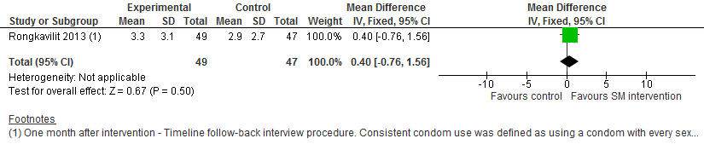
16. Sexual risk behaviour: 4-month follow-up

Slide 18
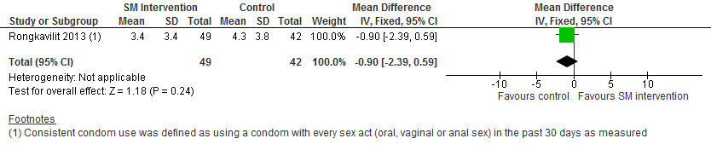
17. Sexual risk behaviour: 9-month follow-up

Slide 19
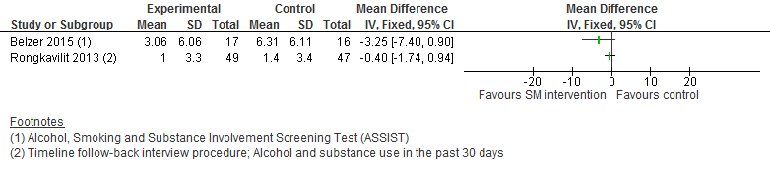
18. Self-care abilities (substance use): 3-month follow-up

Slide 20
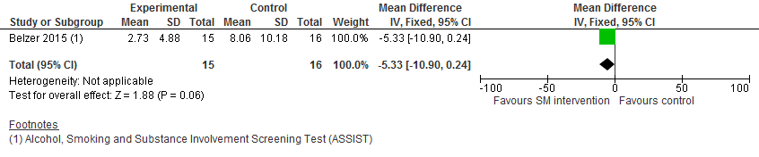
19. Self-care abilities (substance use): 6-month follow-up

Slide 21
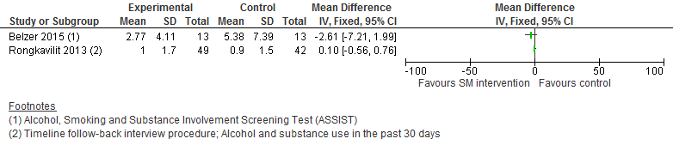
20. Self-care abilities (substance use): 9-month follow-up

Slide 22
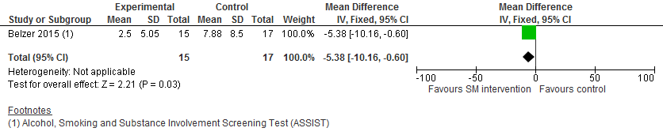
21. Self-care abilities (substance use): 12-month follow-up

Slide 23
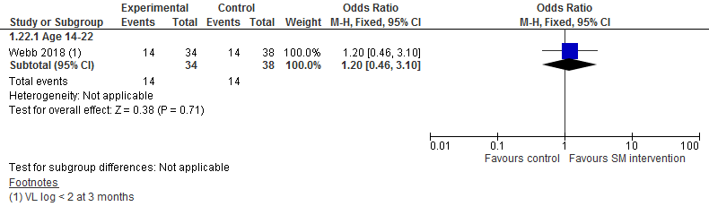
22. Viral load log10 (log<2): 3-month follow-up

Slide 24
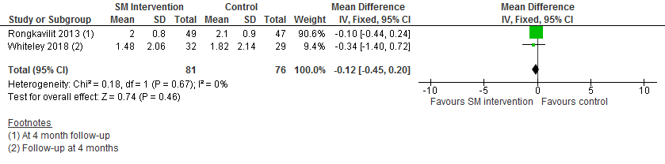
23. Viral load log10: 4-month follow-up

Slide 25
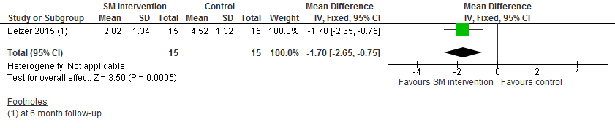
24. Viral load log10: 6-month follow-up

Slide 26
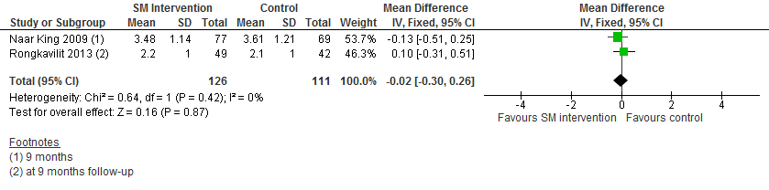
25. Viral load log10: 9-month follow-up

Slide 27
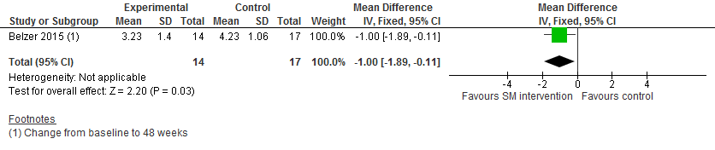
26. Viral load log10: 12-month follow-up

Slide 28
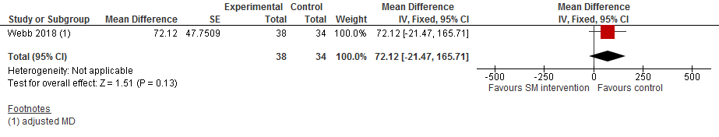
27. CD4 count: 3-month follow-up

Slide 29
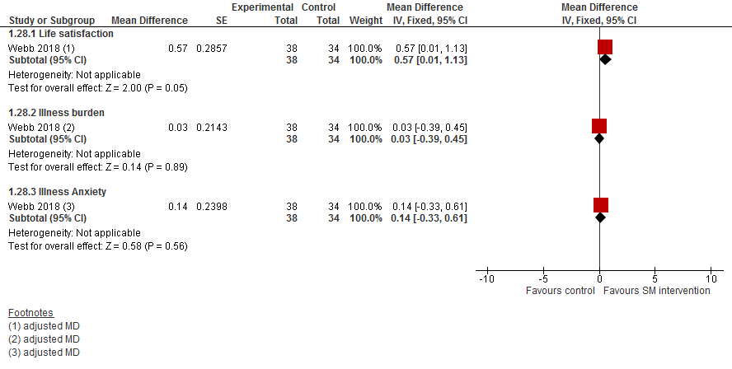
28. Quality of life: 3-month follow-up

Slide 30
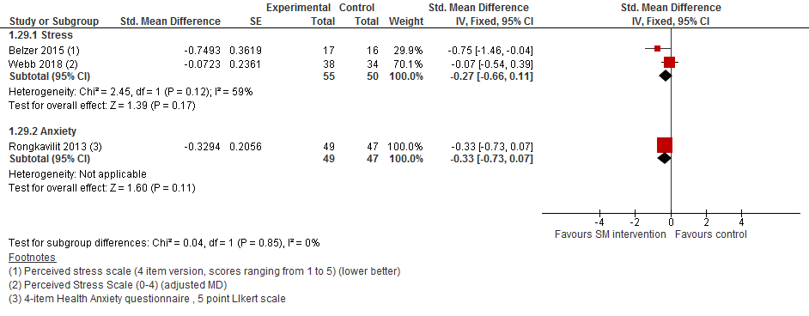
29. Emotional health: 3-month follow-up

Slide 31
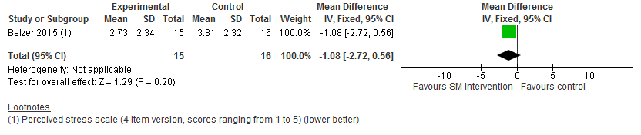
30. Emotional health: 6-month follow-up

Slide 32
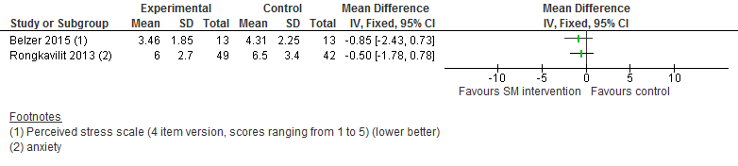
31. Emotional health: 9-month follow-up

Slide 33
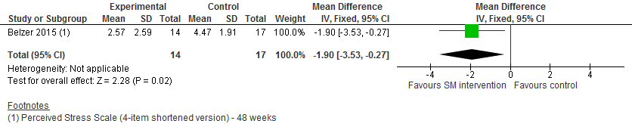
32. Emotional health: 3-month follow-up

Slide 34
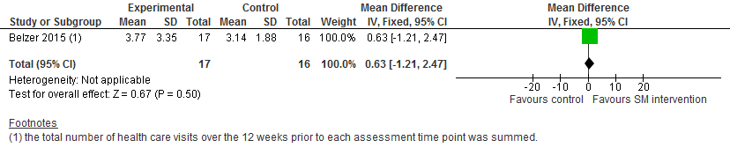
33. Healthcare utilisation: 3-month follow-up

Slide 35
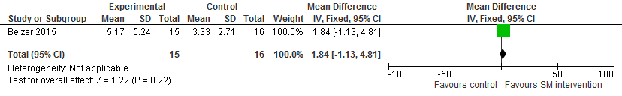
34. Healthcare utilisation: 6-month follow-up

Slide 36

35. Healthcare utilisation: 9-month follow-up

Slide 37
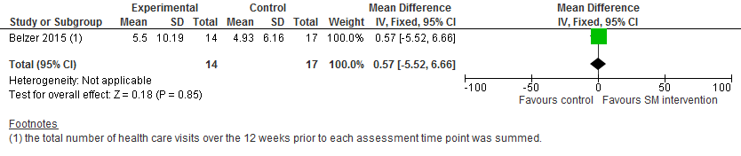
36. Healthcare utilisation: 12-month follow-up

Slide 38
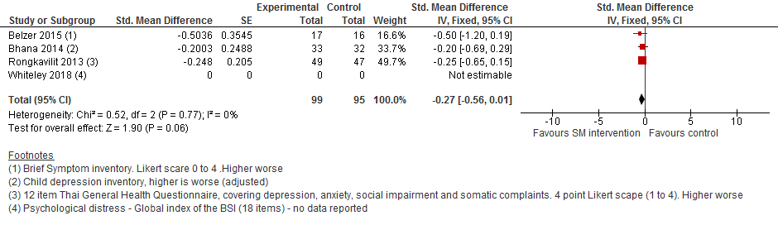
37. Mental Health (depression): 3-month follow-up

Slide 39
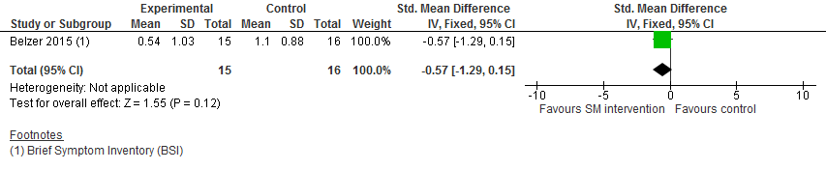
38. Mental Health (depression): 6-month follow-up

Slide 40
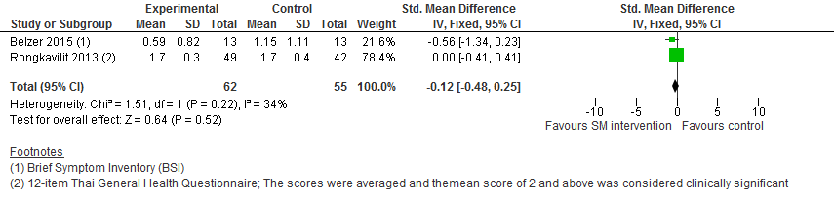
39. Mental Health (depression): 9-month follow-up

Slide 41
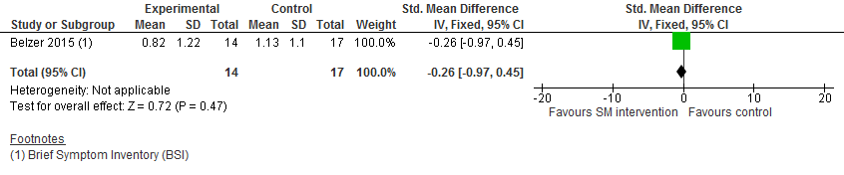
40. Mental Health (depression): 12-month follow-up

Slide 42
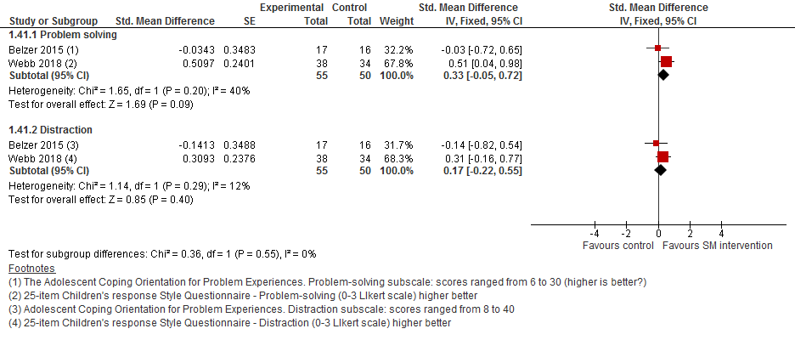
41. Psychological health (coping): 3-month follow-up

Slide 43
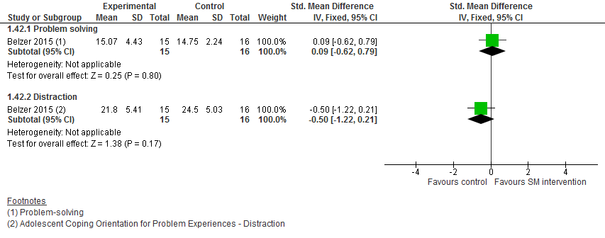
42. Psychological health (coping): 6-month follow-up

Slide 44
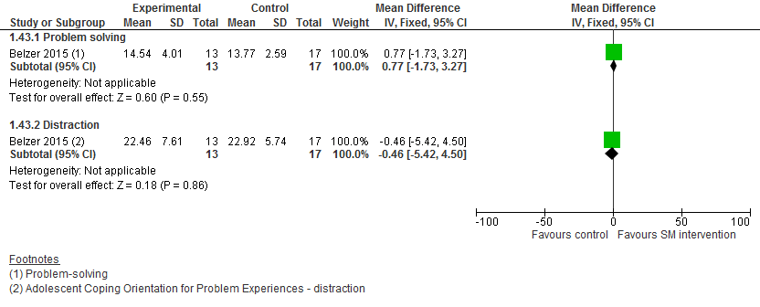
43. Psychological health (coping): 9-month follow-up

Slide 45
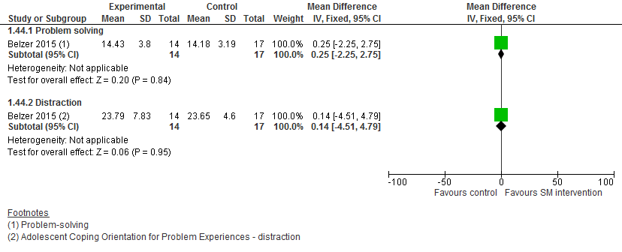
44. Psychological health (coping): 12-month follow-up

Slide 46
Forest plots
Comparison 2: Self-management interventions with all 3 components vs. control

Slide 47
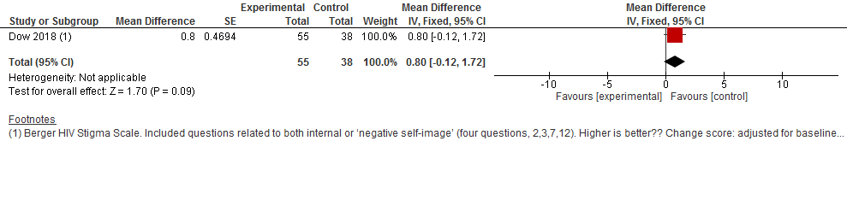
1. Confidence

Slide 48
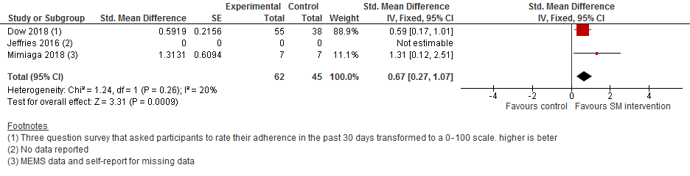
2. Adherence at 6 months follow-up

Slide 49
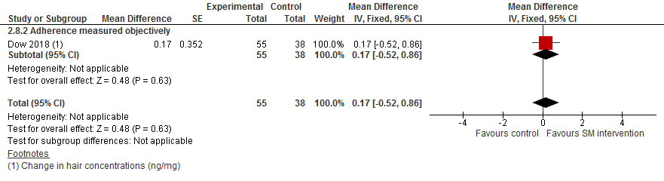
3. ART hair concentrations

Slide 50
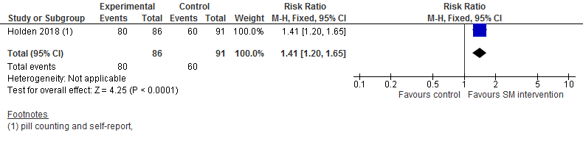
4. Adherence >95% at 9 months follow-up

Slide 51
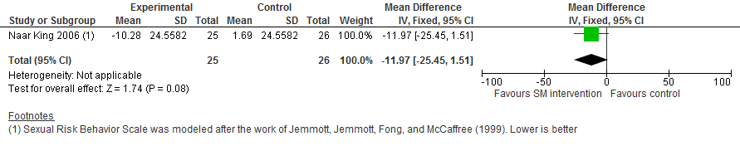
5. Sexual risk behaviour at 3-months follow-up

Slide 52
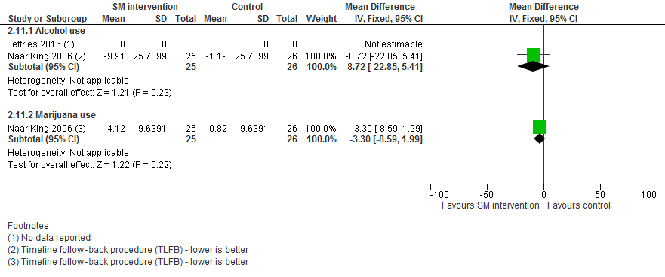
6. Self-care abilities (substance use) at 3-months follow-up

Slide 53
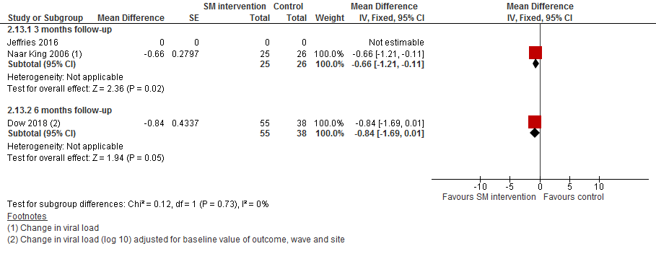
7. Viral suppression at 3- and 6-months

Slide 54

8. CD4 count

Slide 55

9. Mental/psychological health at 6-month follow-up

