Slide 1
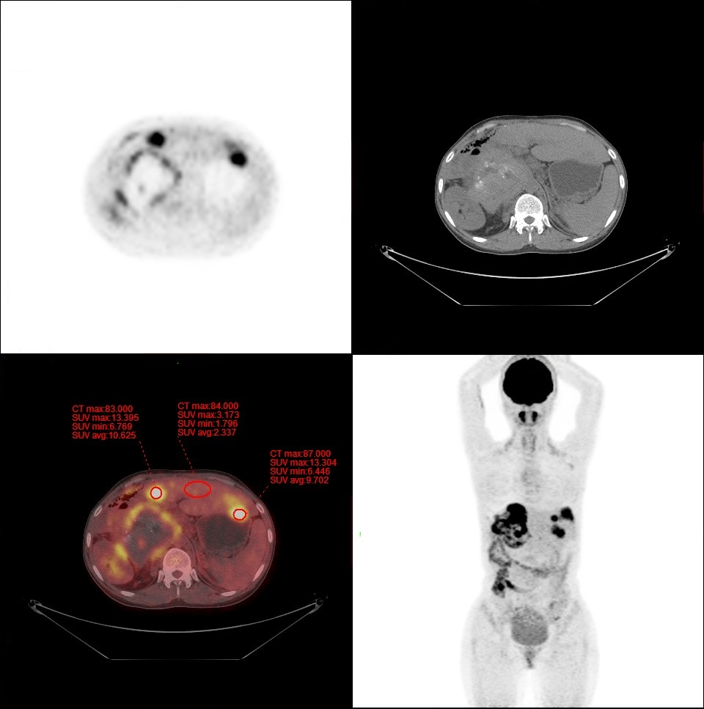
Figure S2
a
b
c
Figure S2. Calculation of TBR value based on SUV measurements
a-c: Three high ¹⁸F-FDG-uptaking lesions (respectively at right lobe, left medial lobe and left lateral lobe) in this patient;
a: CT;
b: PET;
c: Measurement of SUV_{max} at LME and SUV_{ave} at background liver in the same PET/CT slide;
Example: SUV_{max} for lesions at left medial lobe and left lateral lobes respectively were 13.395 and 13.304, while SUV_{ave} for background liver was 2.337, thus, TBR= SUV_{max} / SUV_{ave} = for corresponding lesions respectively were 13.395/2.337=5.73 and 13.304/2.337=5.69.

