Slide 1
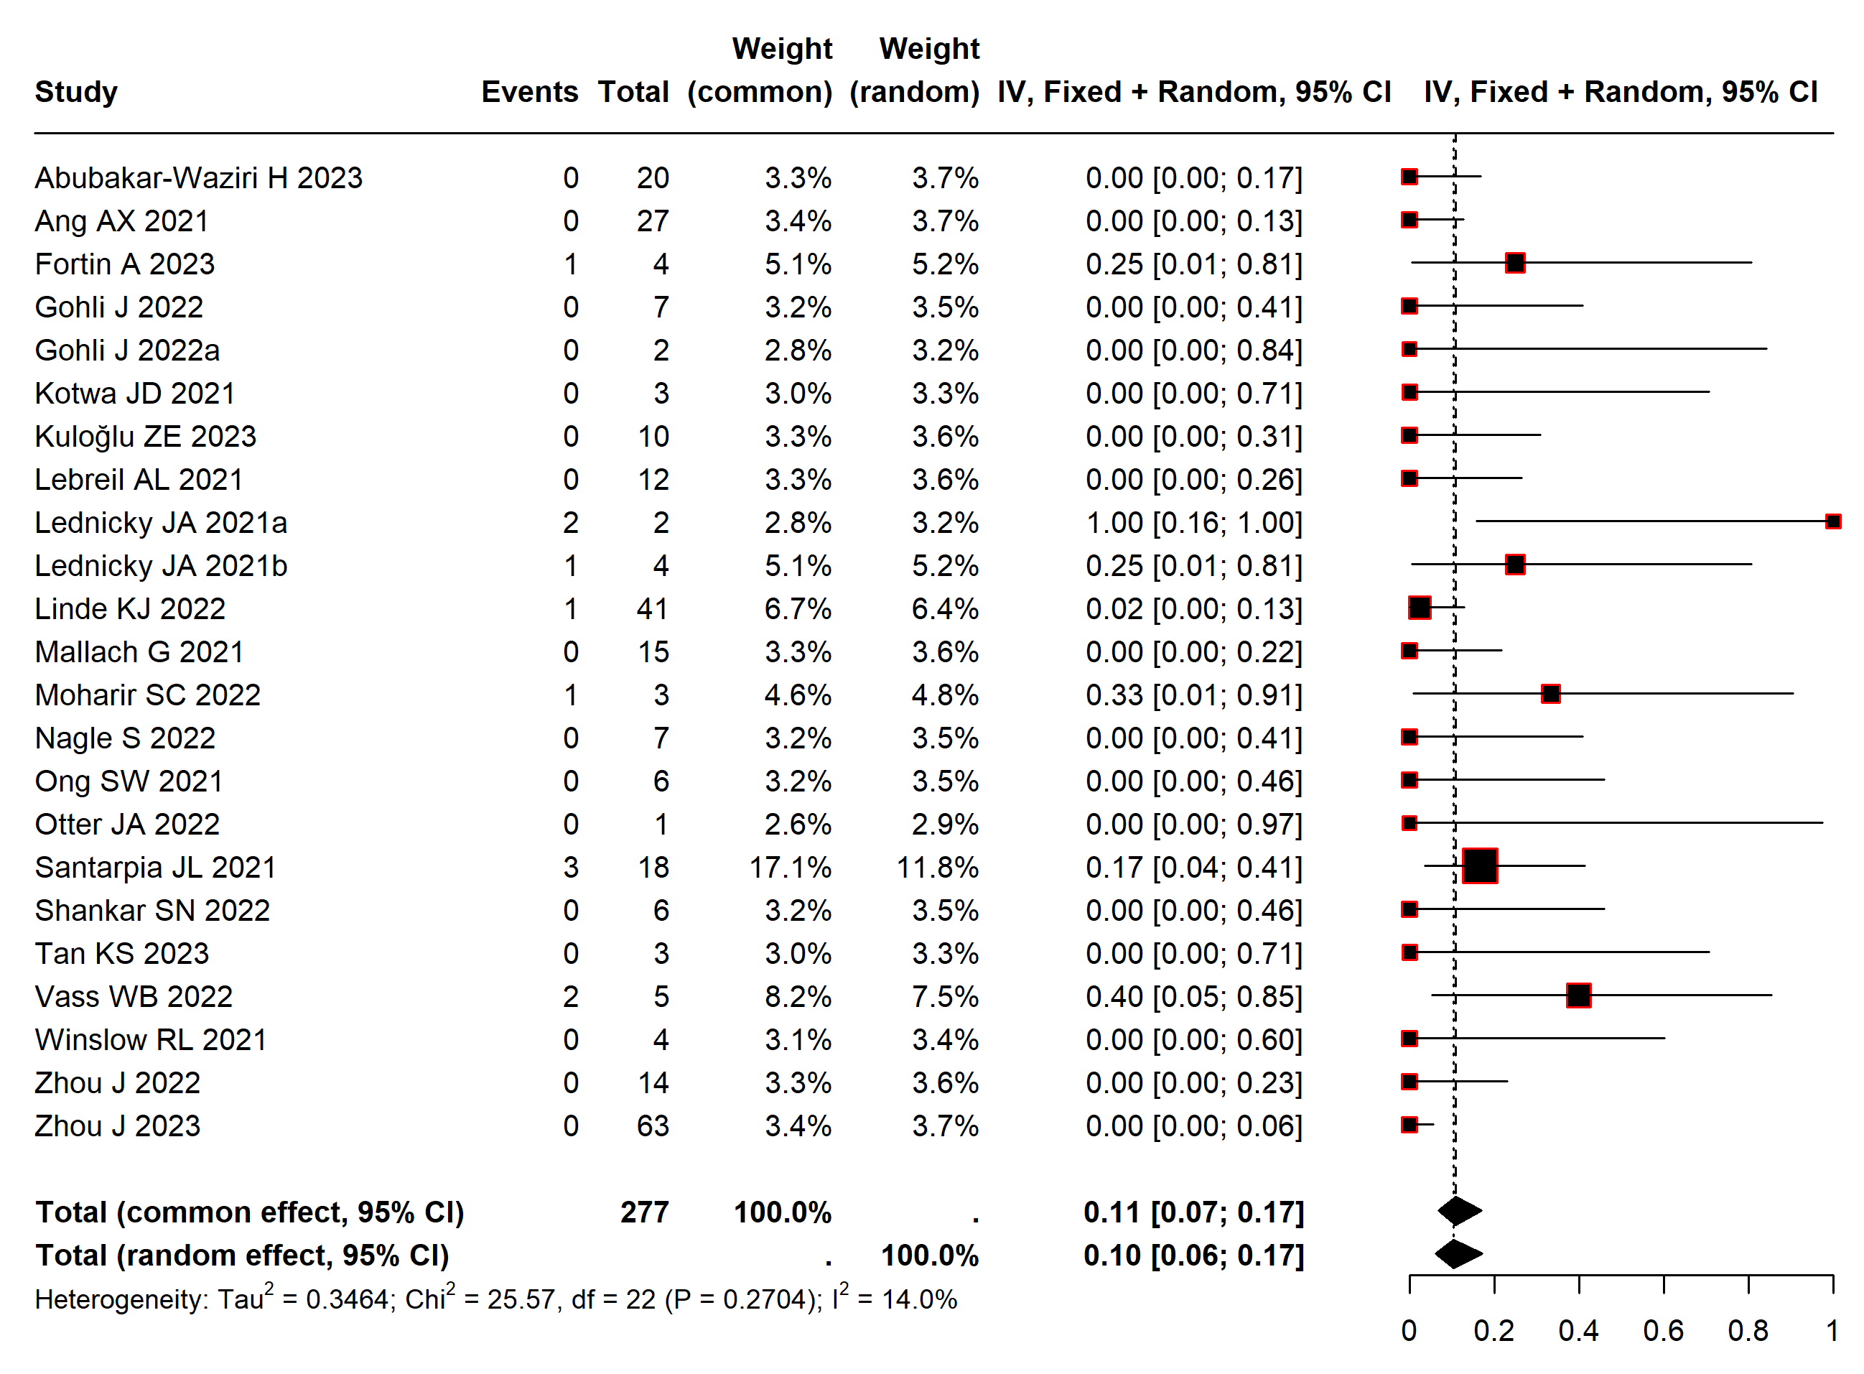
Appendix Figure 1: Forest plot showing the frequency of positive SARS-CoV-2 viral culture results following positive PCR. This analysis excludes 3 studies.

