Slide 1
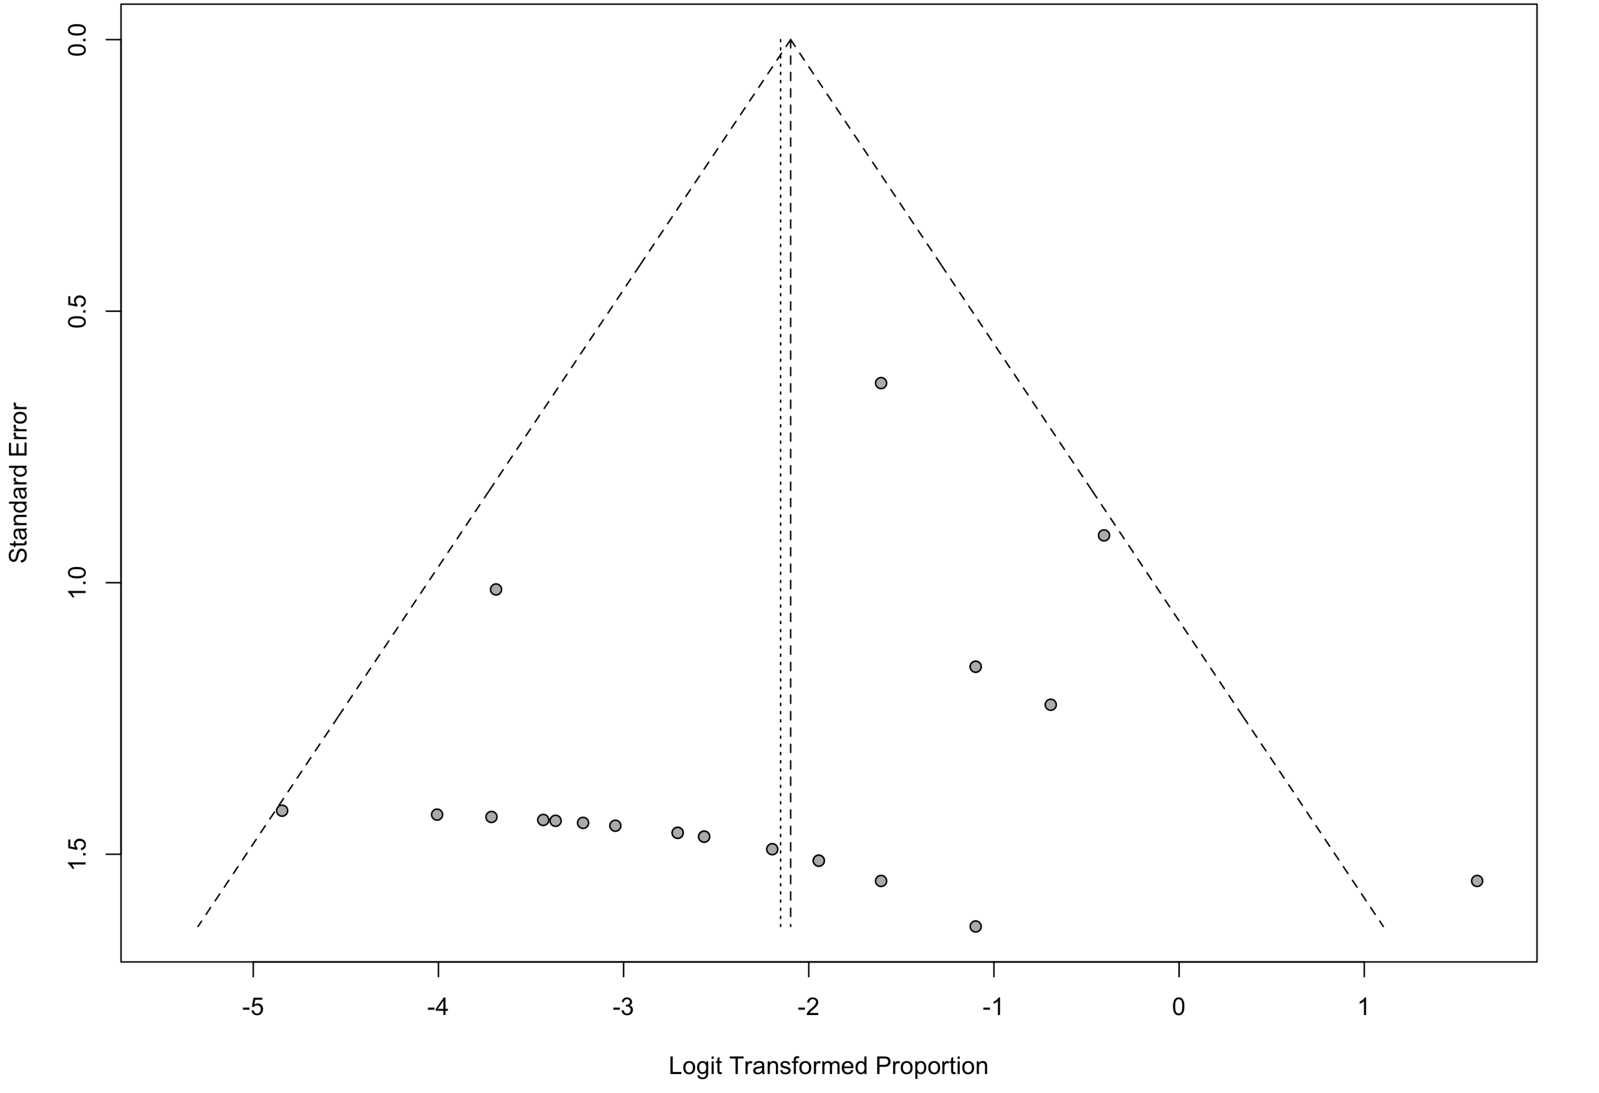
Appendix Figure 2: Funnel plot of studies that investigated airborne transmission of SARS-CoV-2 through Viral Cultures

