Slide 1
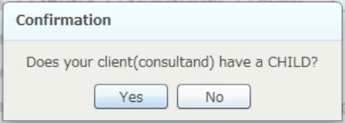
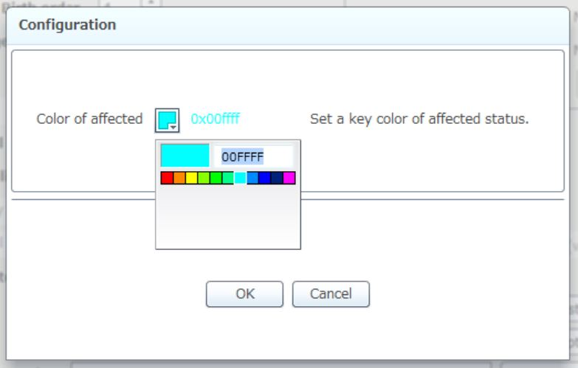
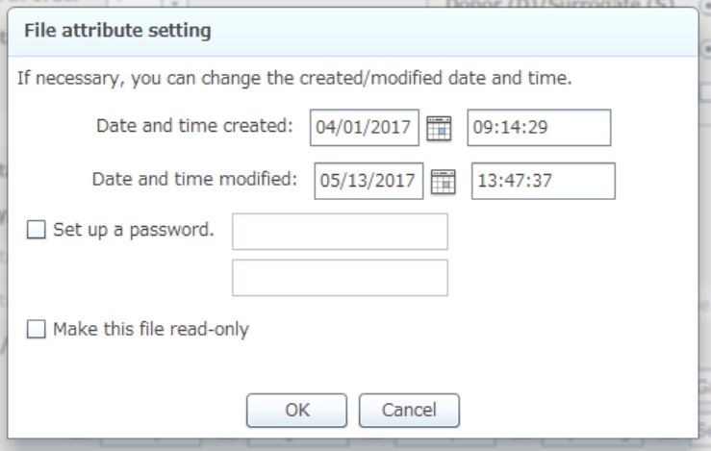
a
b
c
Notes:
Additional file 1. Dialog boxes of f-treeGC (a) Confirmation of whether or not the client has a child at system startup, (b) Configuration of the color for affected individuals, (c) File attribute setting for changing the created/modified date and time, setting a password, and converting to read-only.

