Slide 1
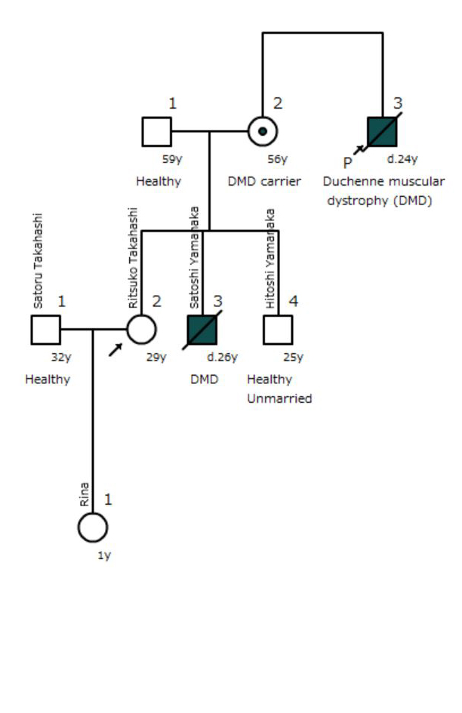
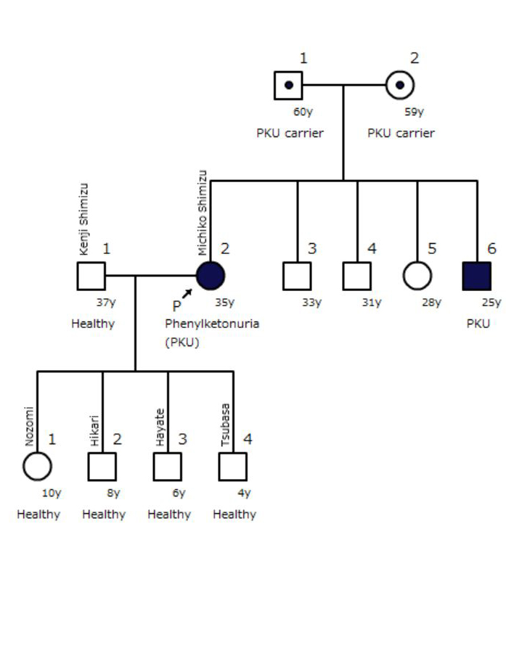


a
b
Notes:
Additional file 9. Model pedigrees of scenarios outlined (a) Scenario D, (b) scenario P.

