Slide 1
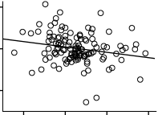
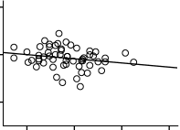
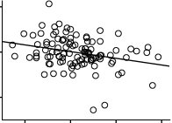
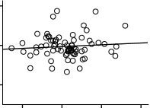
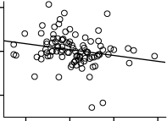
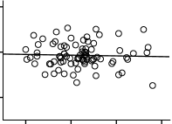
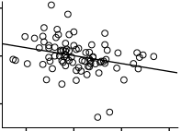
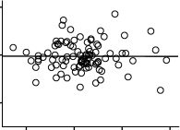
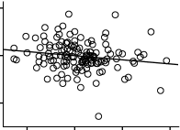
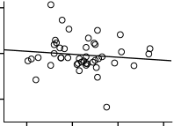
a
Men
Women
20
r = -0.21
p = 0.019
20
r = -0.23
p = 0.08
0
0
6mΔeGFR
6mΔeGFR
-20
-20
10
4
6
10
4
6
8
8
mUA
mUA
b
Age < 70
Age ≥ 70
20
r = -0.26
p = 0.006
20
r = -0.09
p = 0.93
0
6mΔeGFR
6mΔeGFR
0
-20
-20
4
6
10
8
8
4
6
10
mUA
mUA
c
sBP < 130
sBP ≥ 130
20
r = -0.27
p = 0.009
20
r = 0.00
p = 0.96
0
0
6mΔeGFR
6mΔeGFR
-20
-20
4
6
10
4
6
8
8
10
mUA
mUA
d
Without abnormal cholesterol levels
With abnormal cholesterol levels
20
r = -0.32
p = 0.002
20
r = -0.00
p = 0.97
0
0
6mΔeGFR
6mΔeGFR
-20
-20
4
6
10
8
4
6
10
mUA
8
mUA
e
Without diabetes mellitus
With diabetes mellitus
20
r = -0.18
p = 0.037
20
r = -0.09
p = 0.55
0
6mΔeGFR
0
6mΔeGFR
-20
-20
4
6
10
8
4
6
10
mUA
8
mUA

