Slide 1
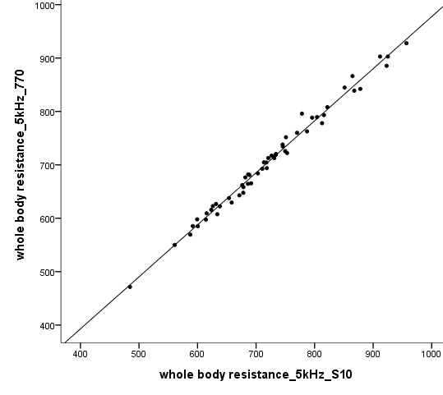
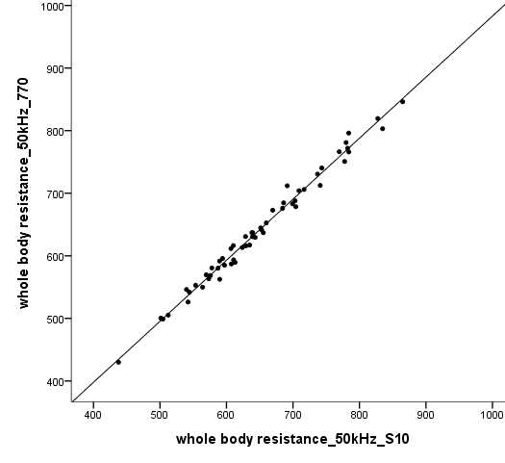
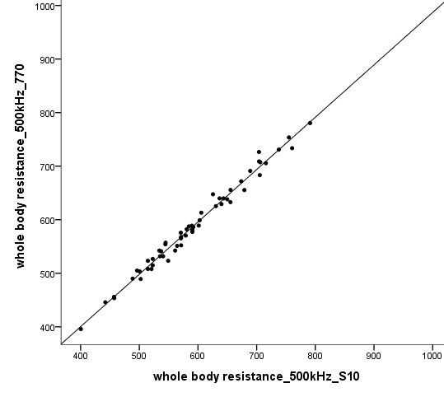
Supplementary Figure 2. Correlations of resistances after HD with patients in the lying (S10) and standing (770) positions
A
1000
900
800
700
600
500
400
R2=0.989
B
1000
900
800
700
600
500
400
R2=0.987
C
1000
900
800
700
600
500
400
R2=0.985
Whole body resistance 5kHz 770
Whole body resistance 50kHz 770
Whole body resistance 500kHz 770
Whole body resistance 5kHz S10
Whole body resistance 50kHz S10
Whole body resistance 500kHz S10
400 500 600 700 800 900 1000
400 500 600 700 800 900 1000
400 500 600 700 800 900 1000

