Slide 1
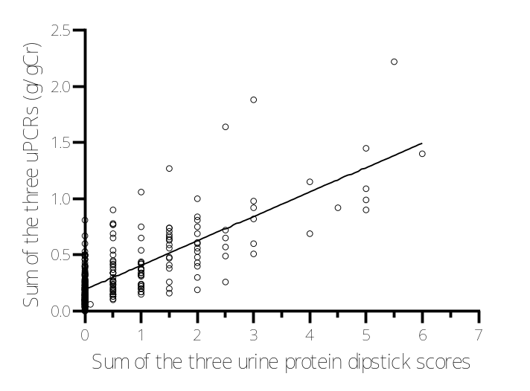
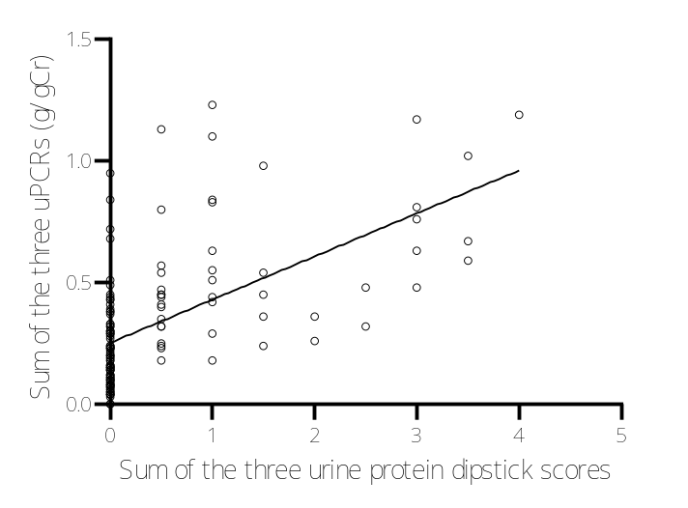
Supplemental Fig.1a
Supplemental Fig. 1b

Slide 2
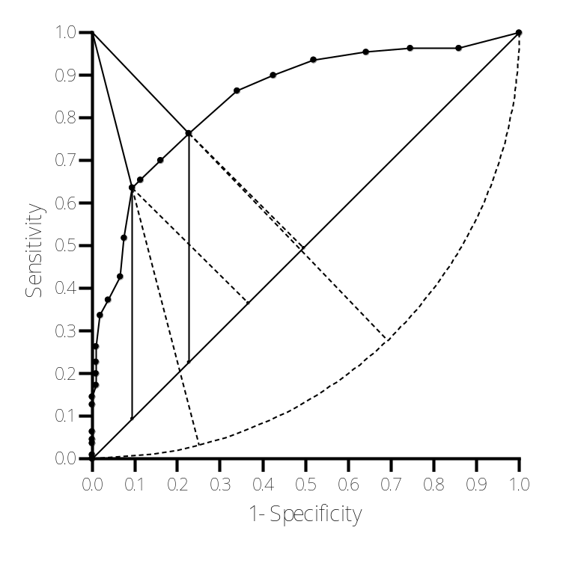
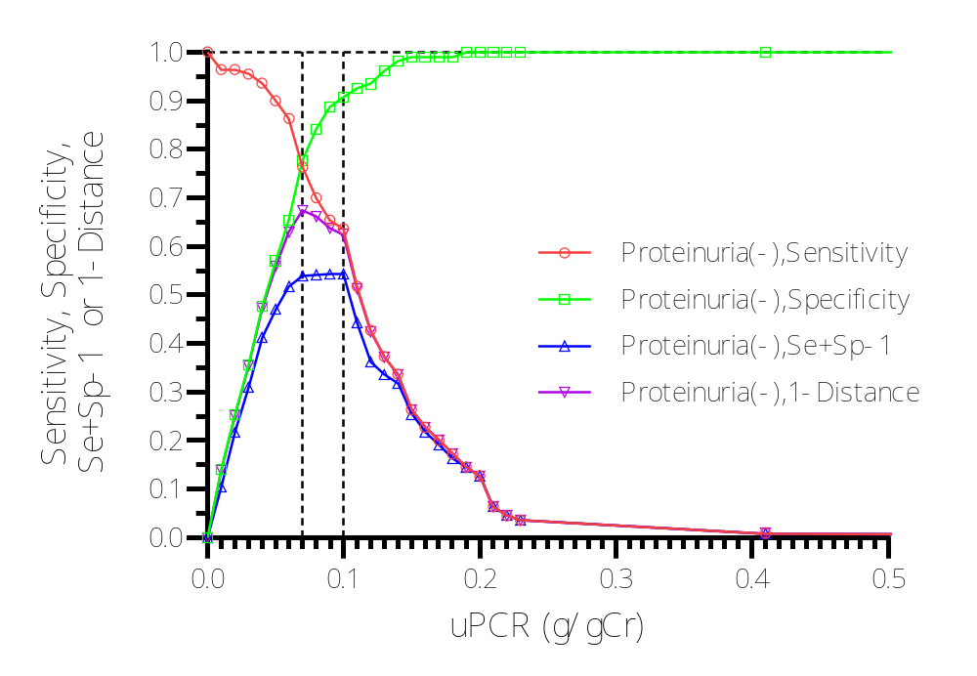
Supplemental Fig. 2a
Supplemental Fig. 2b
A
B
E
D
C
G
F

Slide 3
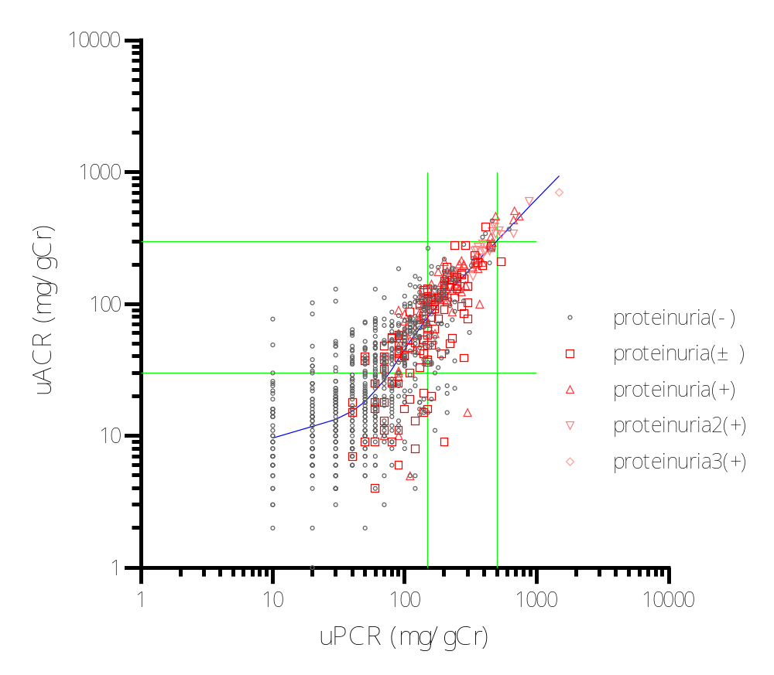
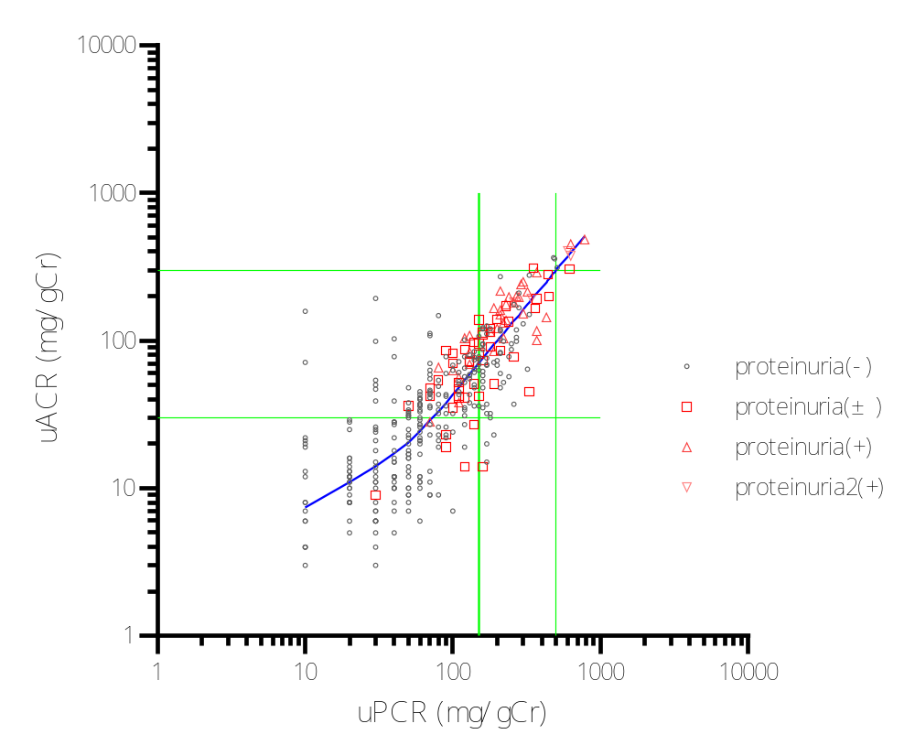
Supplemental Fig. 3a
Supplemental Fig. 3b

Slide 4
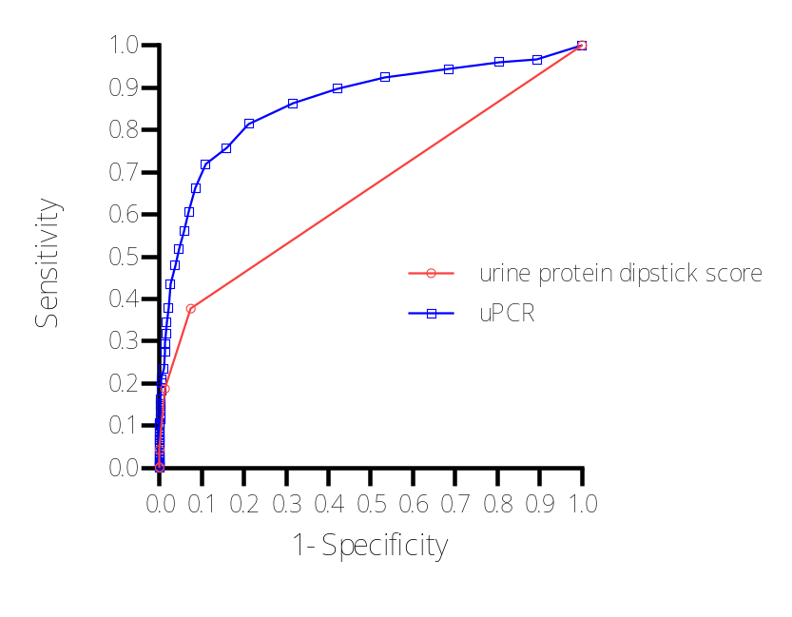
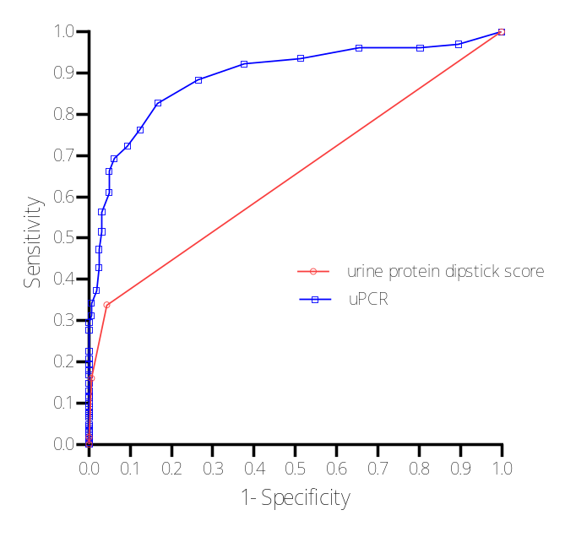
Supplemental Fig. 4a
Supplemental Fig. 4b

Slide 5
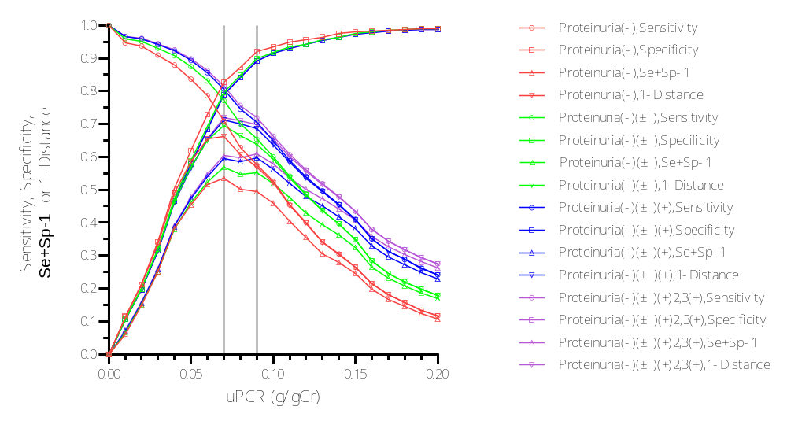
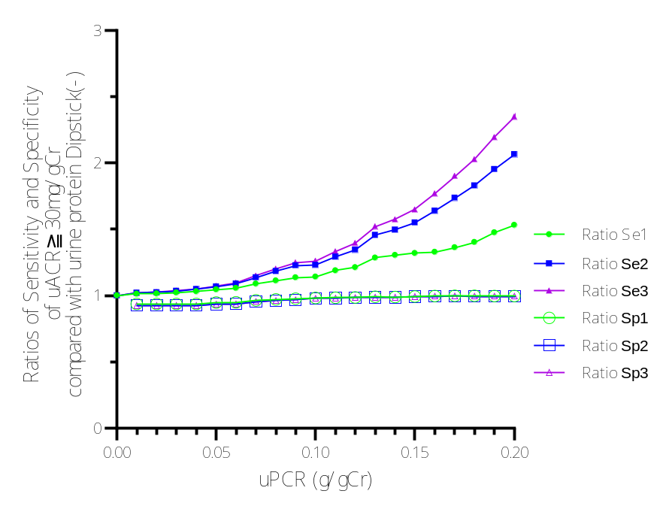
Supplemental Fig. 5a
Supplemental Fig. 5b

Slide 6
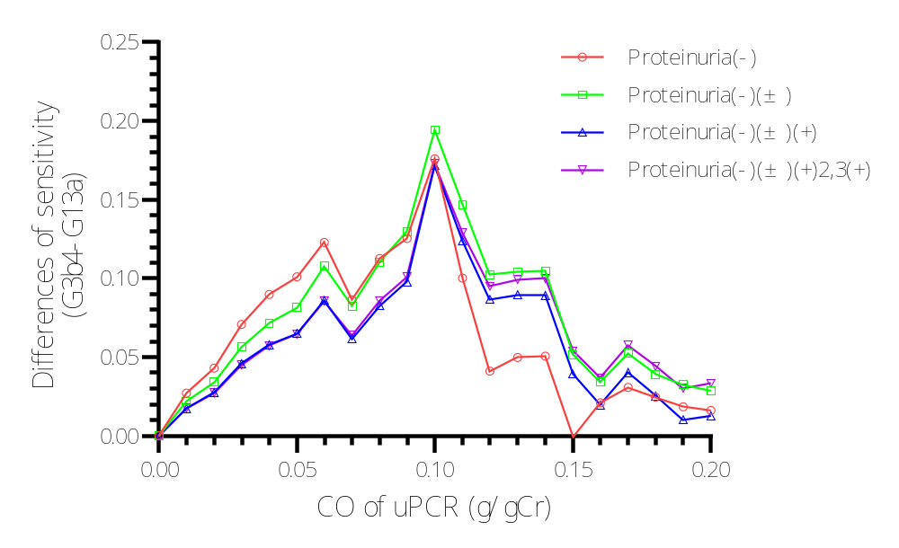
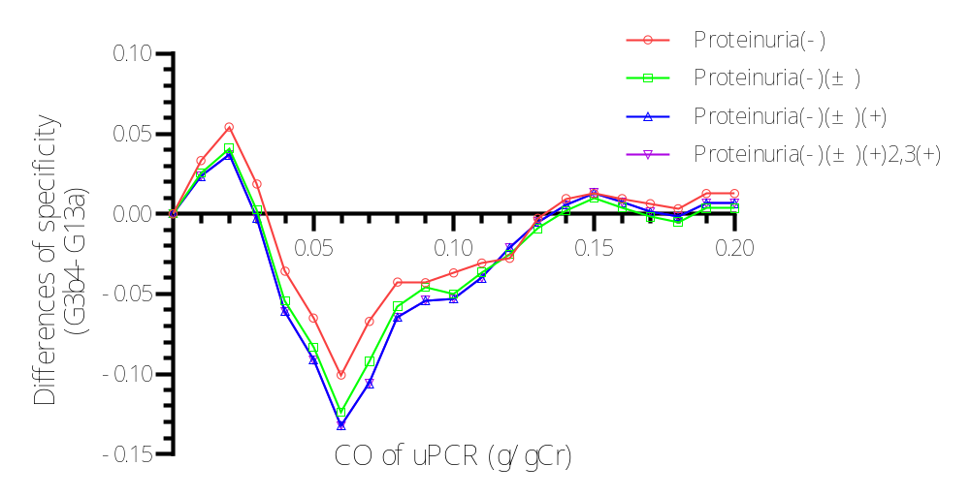
Supplemental Fig. 6a
Supplemental Fig. 6b

Slide 7
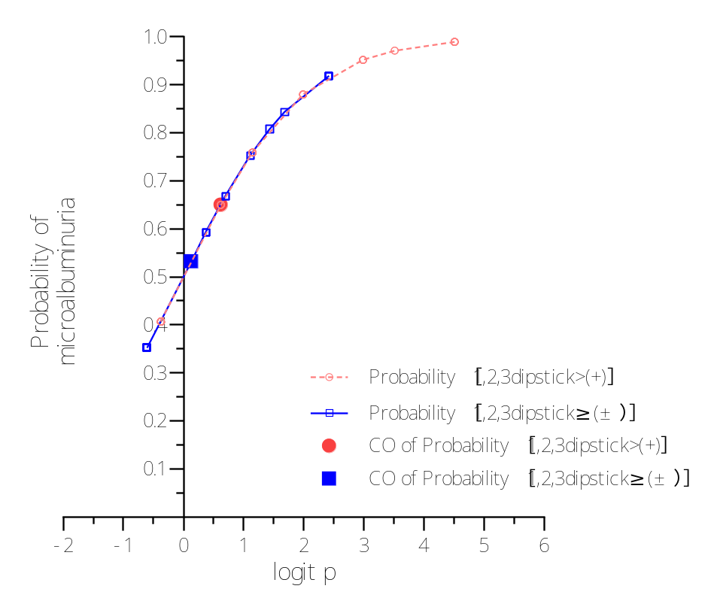
Supplemental Fig.7

Slide 8
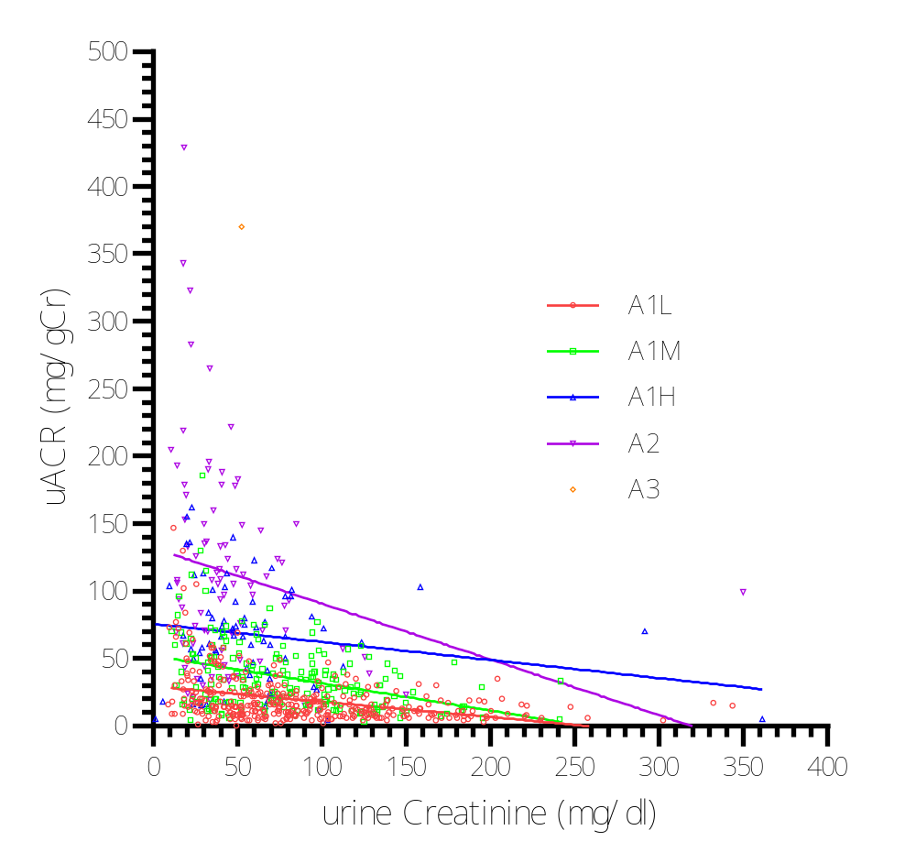
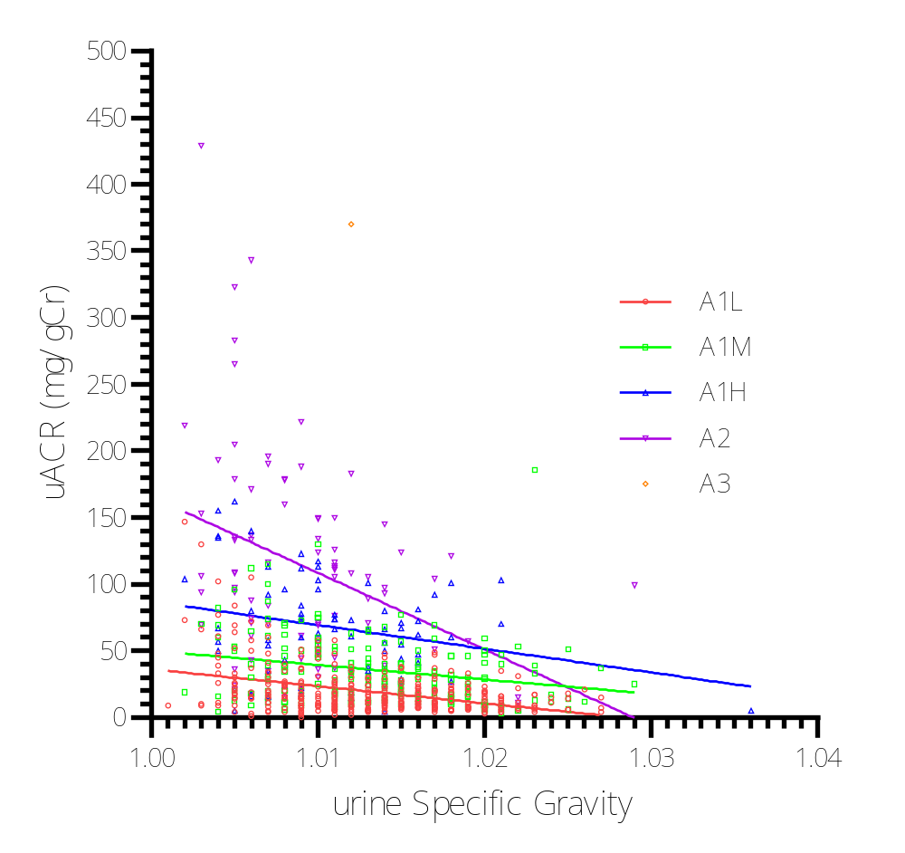
Supplemental Fig. 8a
Supplemental Fig. 8b

Slide 9
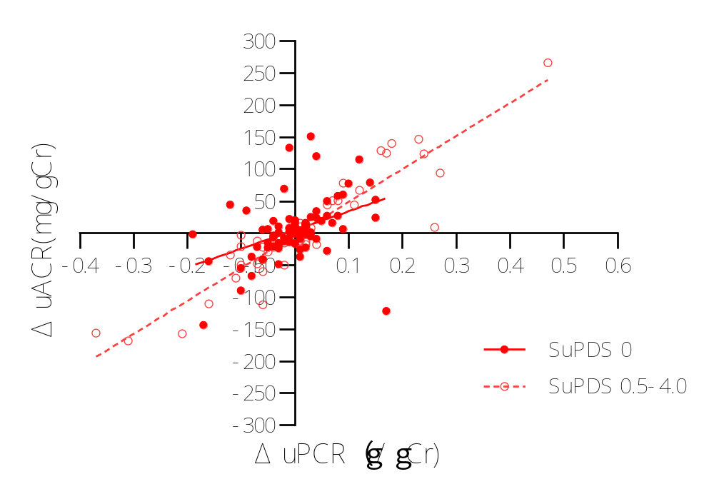
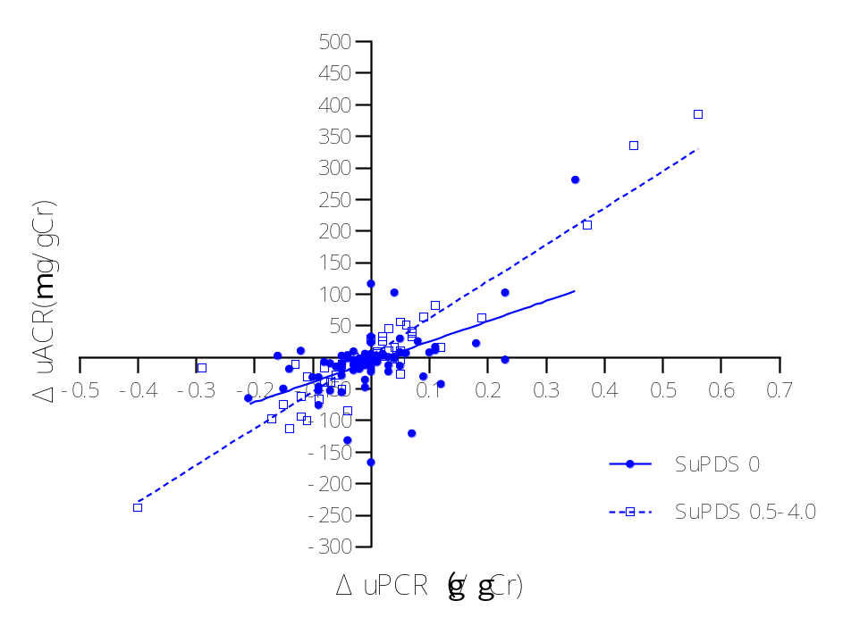
Supplemental Fig. 9a
Supplemental Fig. 9b

