Slide 1
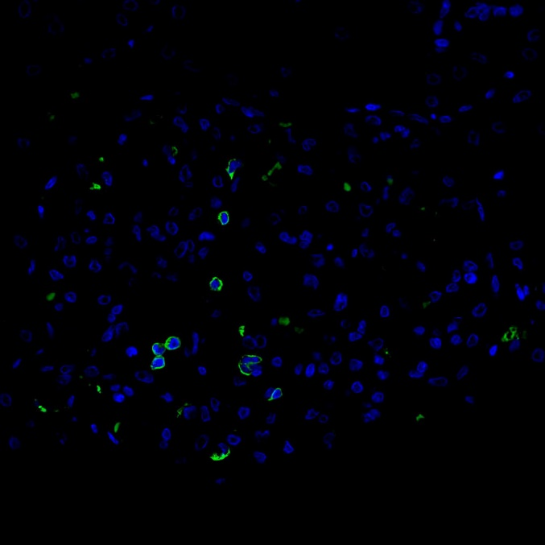
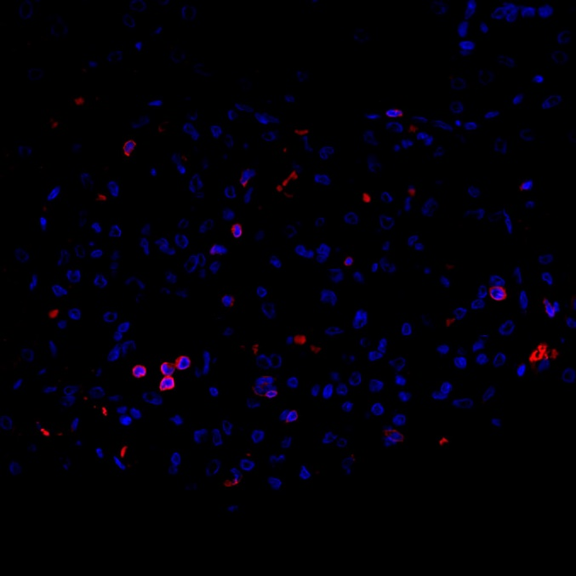
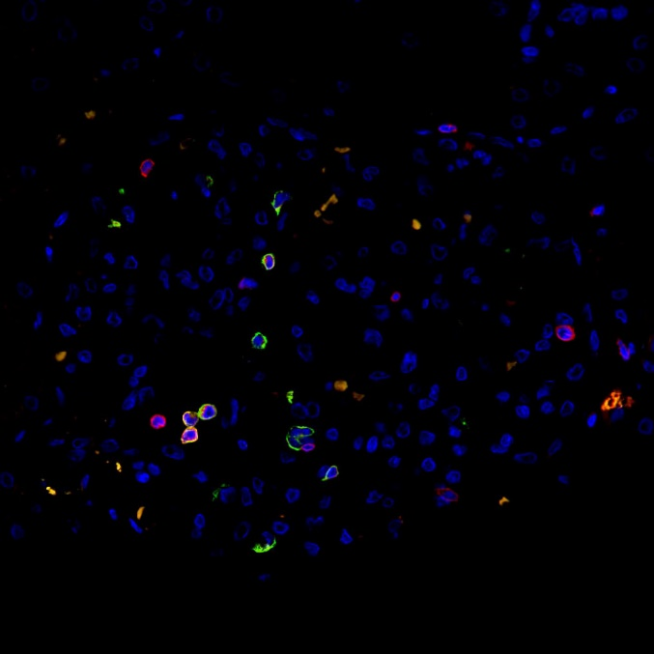
Supplementary Figure S2.
A
B
C
Legend
Supplementary Figure S2. Double immunofluorescence staining for CD8 (A; Alexa Fluor 488, green) and CD3 (B; Alexa Fluor 594, red), together with DAPI (blue) nuclear staining in the renal biopsy tissue performed 6 months after the transplantation. The merged image (C) demonstrated that the population of CD8⁻ CD3⁺ cells were minor (red cells, indicated by arrows) and most cells (more than 80%) were double positive for CD8 and CD3 (yellow~green cells) within glomeruli. Scale bar = 10.0 μm.

