Slide 1
Supplementary file – uncropped blots

Slide 2
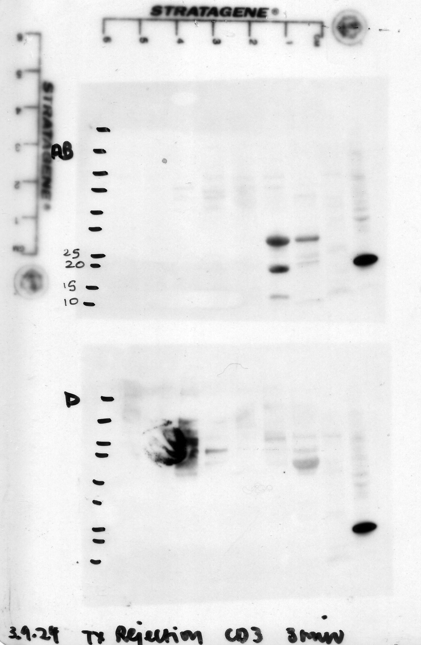
Representative Western blot 1-2 CD3 03/09/2024
Membrane 1
All blue marker
No tubulitis
No tubulitis
No tubulitis
Tubulitis
Tubulitis
Tubulitis
Tubulitis
Kidney lysate
Peripheral blood mononuclear cells
Membrane 2
Dual
No tubulitis
No tubulitis
No tubulitis
Tubulitis
Tubulitis
Tubulitis
Tubulitis
Kidney lysate
Peripheral blood mononuclear cells
Membrane 2 was cropped to form Figure 2 as a representative immunoblot
CD3 (23kDa)
CD3 (23kDa)

Slide 3
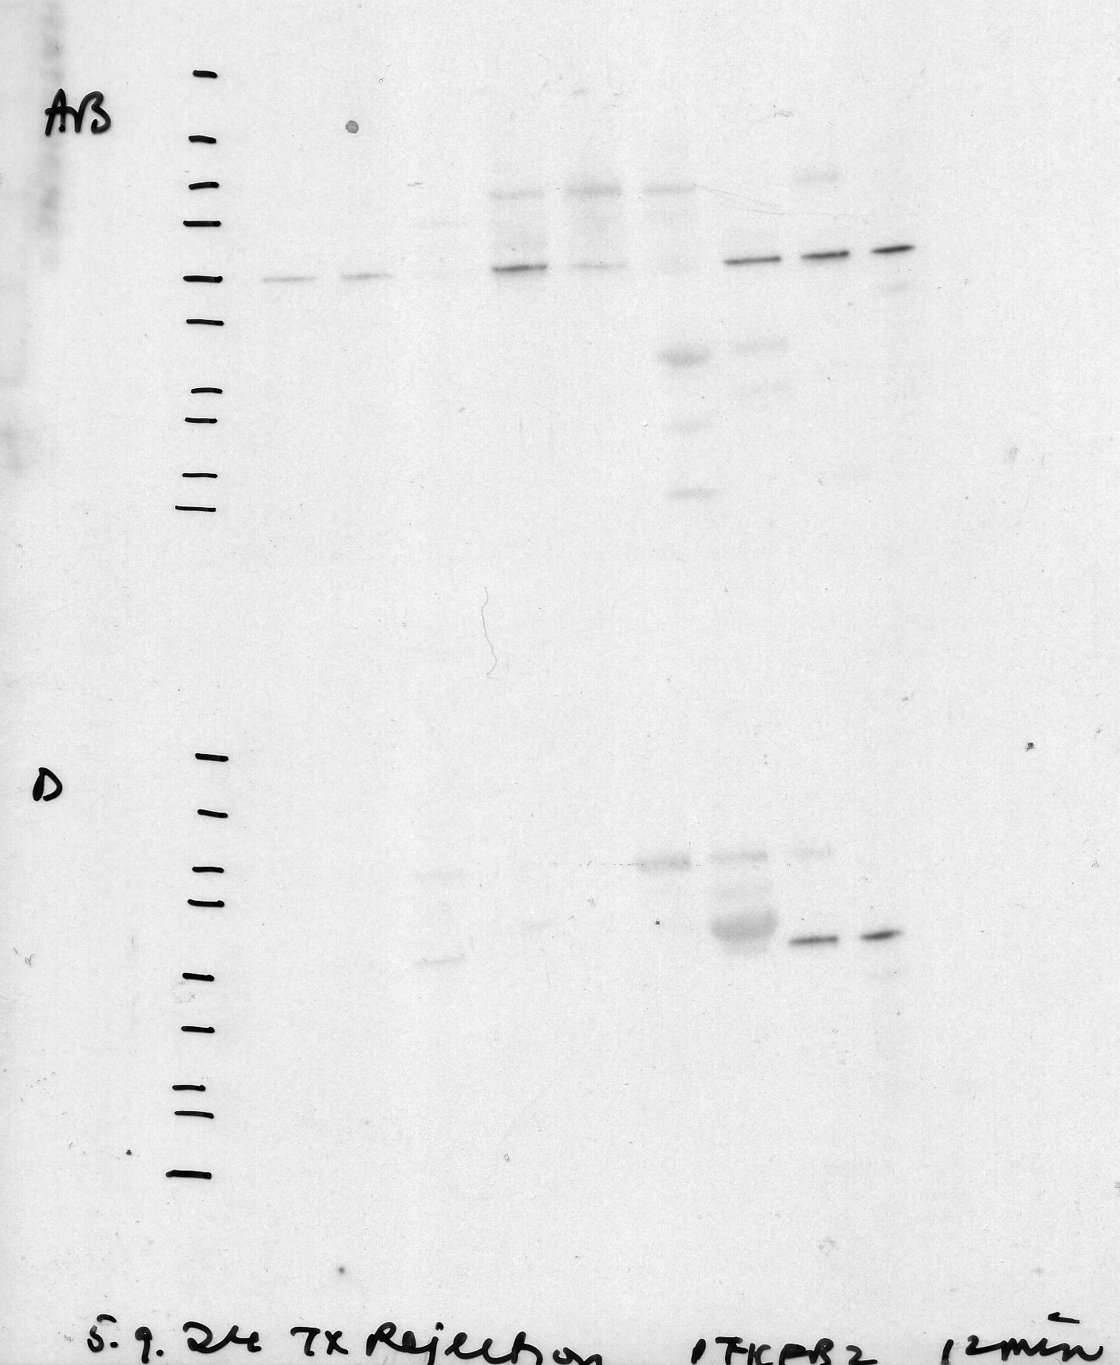
Representative Western blot 1-2 PFKFB2 05/09/2024
Membrane 1
All blue marker
No tubulitis
No tubulitis
No tubulitis
Tubulitis
Tubulitis
Tubulitis
Tubulitis
Kidney lysate
Peripheral blood mononuclear cells
Membrane 2
Dual
No tubulitis
No tubulitis
No tubulitis
Tubulitis
Tubulitis
Tubulitis
Tubulitis
Kidney lysate
Peripheral blood mononuclear cells
Membrane 2 was cropped to form Figure 2 as a representative immunoblot
PFKFB2 (54kDa)
PFKFB2 (54kDa)

Slide 4
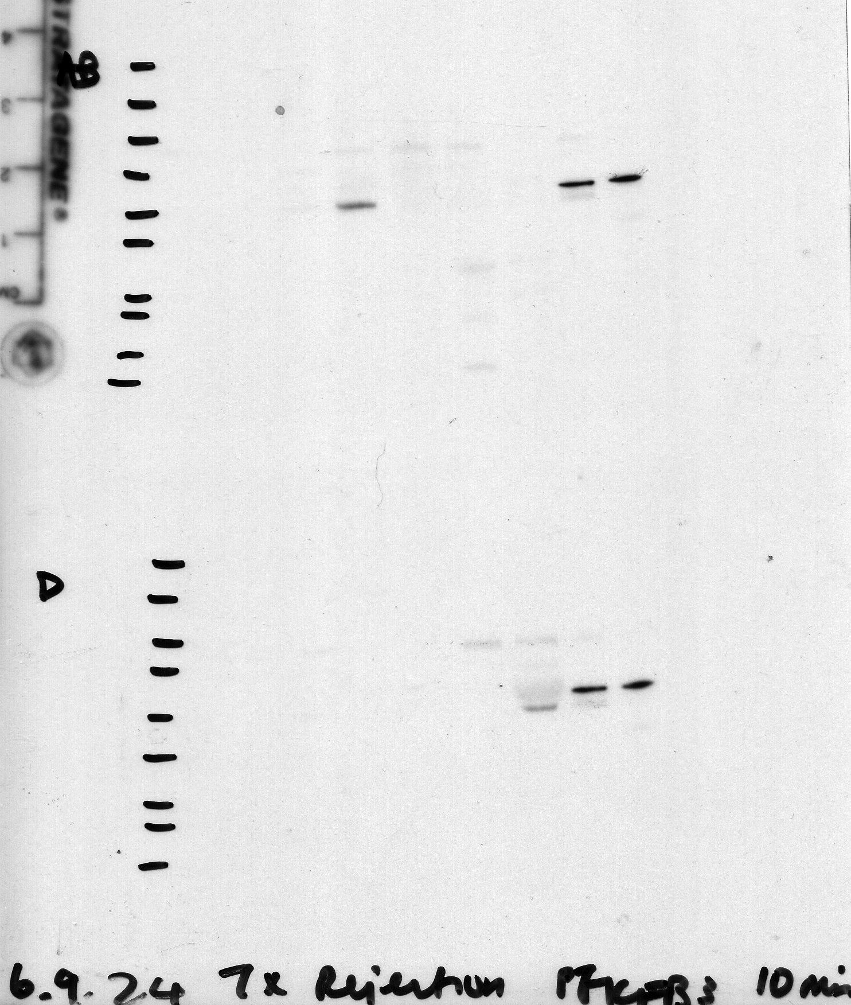
Representative Western blot 1-2 PFKFB3 06/09/2024
Membrane 1
All blue marker
No tubulitis
No tubulitis
No tubulitis
Tubulitis
Tubulitis
Tubulitis
Tubulitis
Kidney lysate
Peripheral blood mononuclear cells
Membrane 2
Dual
No tubulitis
No tubulitis
No tubulitis
Tubulitis
Tubulitis
Tubulitis
Tubulitis
Kidney lysate
Peripheral blood mononuclear cells
Membrane 2 was cropped to form Figure 2 as a representative immunoblot
PFKFB3 (60kDa)
PFKFB3 (60kDa)

Slide 5
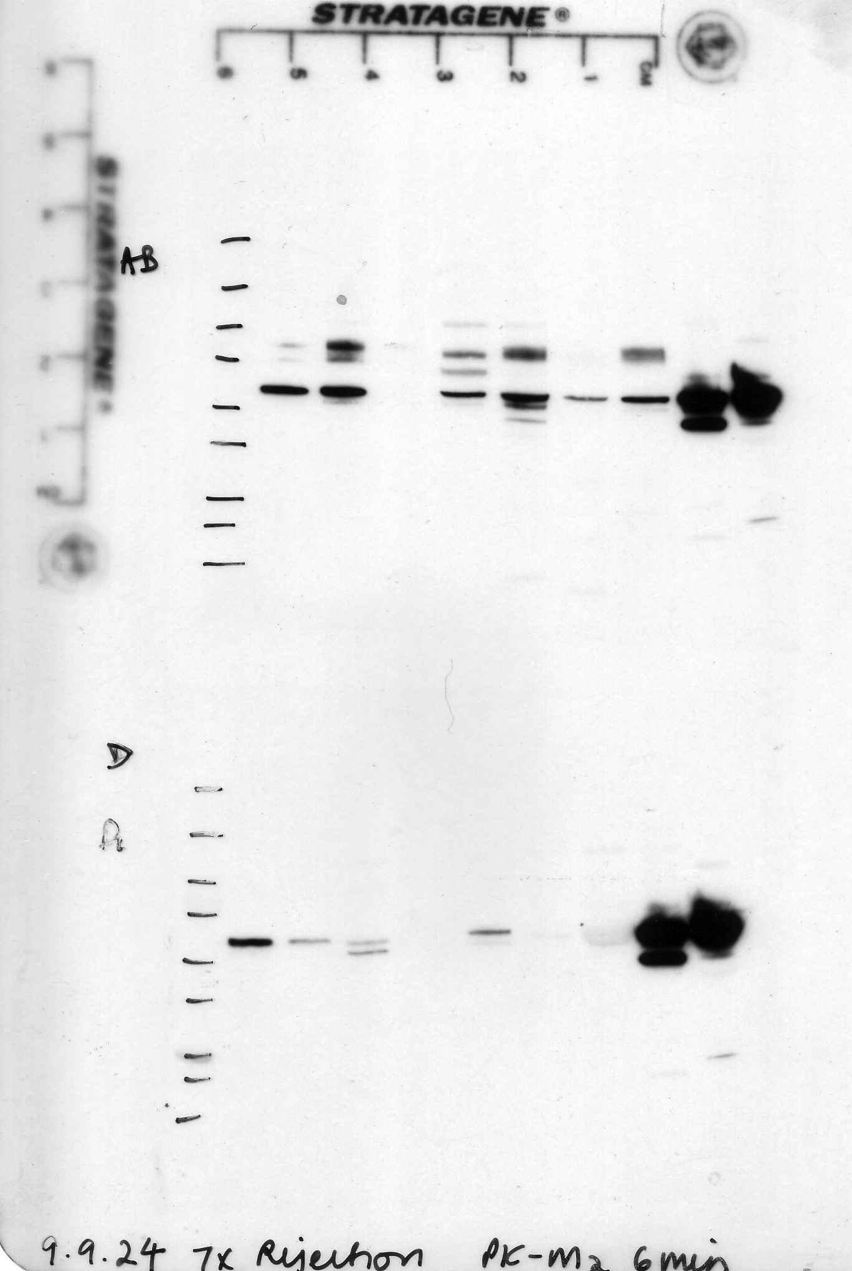
Representative Western blot 1-2 PK-M2 09/09/2024
Membrane 1
All blue marker
No tubulitis
No tubulitis
No tubulitis
Tubulitis
Tubulitis
Tubulitis
Tubulitis
Kidney lysate
Peripheral blood mononuclear cells
Membrane 2
Dual
No tubulitis
No tubulitis
No tubulitis
Tubulitis
Tubulitis
Tubulitis
Tubulitis
Kidney lysate
Peripheral blood mononuclear cells
Membrane 2 was cropped to form Figure 2 as a representative immunoblot
PK-M2 (60kDa)
PK-M2 (60kDa)

Slide 6
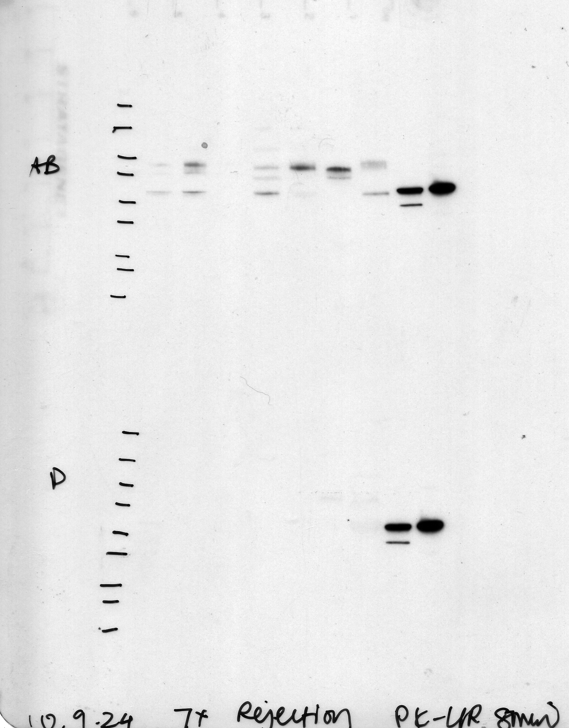
Representative Western blot 1-2 PK-L/R 10/09/2024
Membrane 1
All blue marker
No tubulitis
No tubulitis
No tubulitis
Tubulitis
Tubulitis
Tubulitis
Tubulitis
Kidney lysate
Peripheral blood mononuclear cells
Membrane 2
Dual
No tubulitis
No tubulitis
No tubulitis
Tubulitis
Tubulitis
Tubulitis
Tubulitis
Kidney lysate
Peripheral blood mononuclear cells
Membrane 2 was cropped to form Figure 2 as a representative immunoblot
PK-L/R (62kDa)
PK-L/R (62kDa)

Slide 7
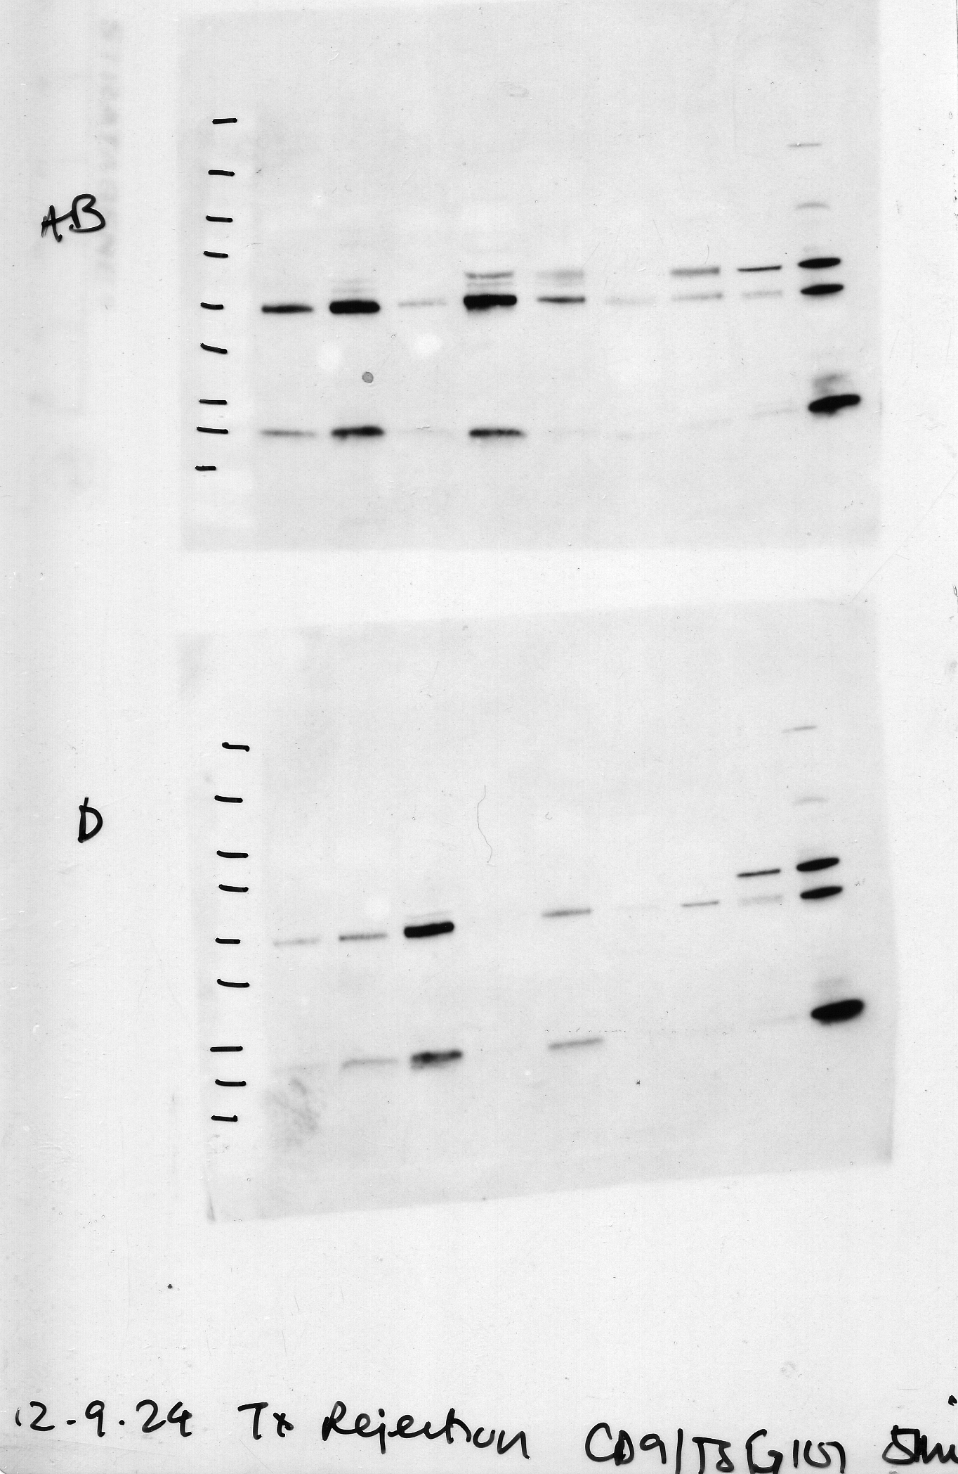
Representative Western blot 1-2 CD9 and TSG101 12/09/2024
Membrane 1
All blue marker
No tubulitis
No tubulitis
No tubulitis
Tubulitis
Tubulitis
Tubulitis
Tubulitis
Kidney lysate
Peripheral blood mononuclear cells
Membrane 2
Dual
No tubulitis
No tubulitis
No tubulitis
Tubulitis
Tubulitis
Tubulitis
Tubulitis
Kidney lysate
Peripheral blood mononuclear cells
Membrane 2 was cropped to form Figure 2 as a representative immunoblot
TSG101 (46kDa)
CD9 (22kDa)
TSG101 (46kDa)
CD9 (22kDa)

Slide 8
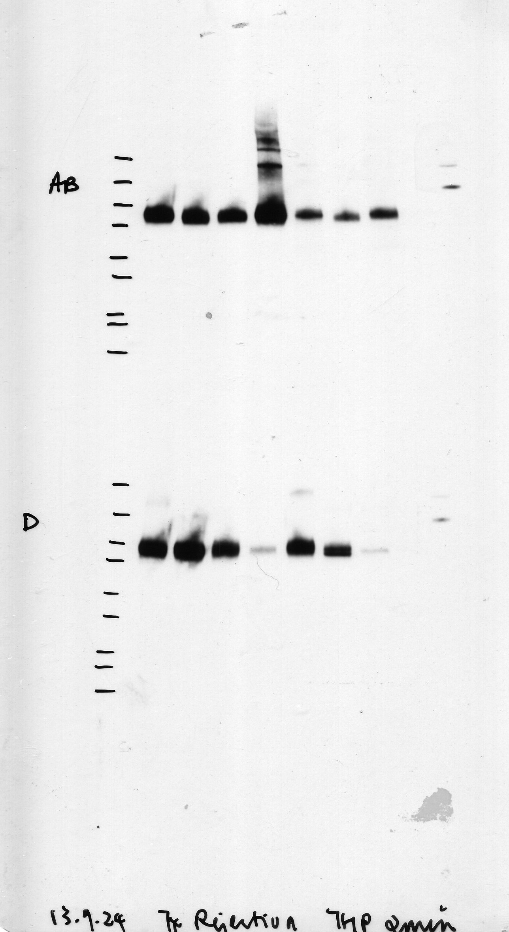
Representative Western blot 1-2 uromodulin 13/09/2024
Membrane 1
All blue marker
No tubulitis
No tubulitis
No tubulitis
Tubulitis
Tubulitis
Tubulitis
Tubulitis
Kidney lysate
Peripheral blood mononuclear cells
Membrane 2
Dual
No tubulitis
No tubulitis
No tubulitis
Tubulitis
Tubulitis
Tubulitis
Tubulitis
Kidney lysate
Peripheral blood mononuclear cells
Membrane 2 was cropped to form Figure 2 as a representative immunoblot
Uromodulin (90kDa)
Uromodulin (90kDa)

Slide 9
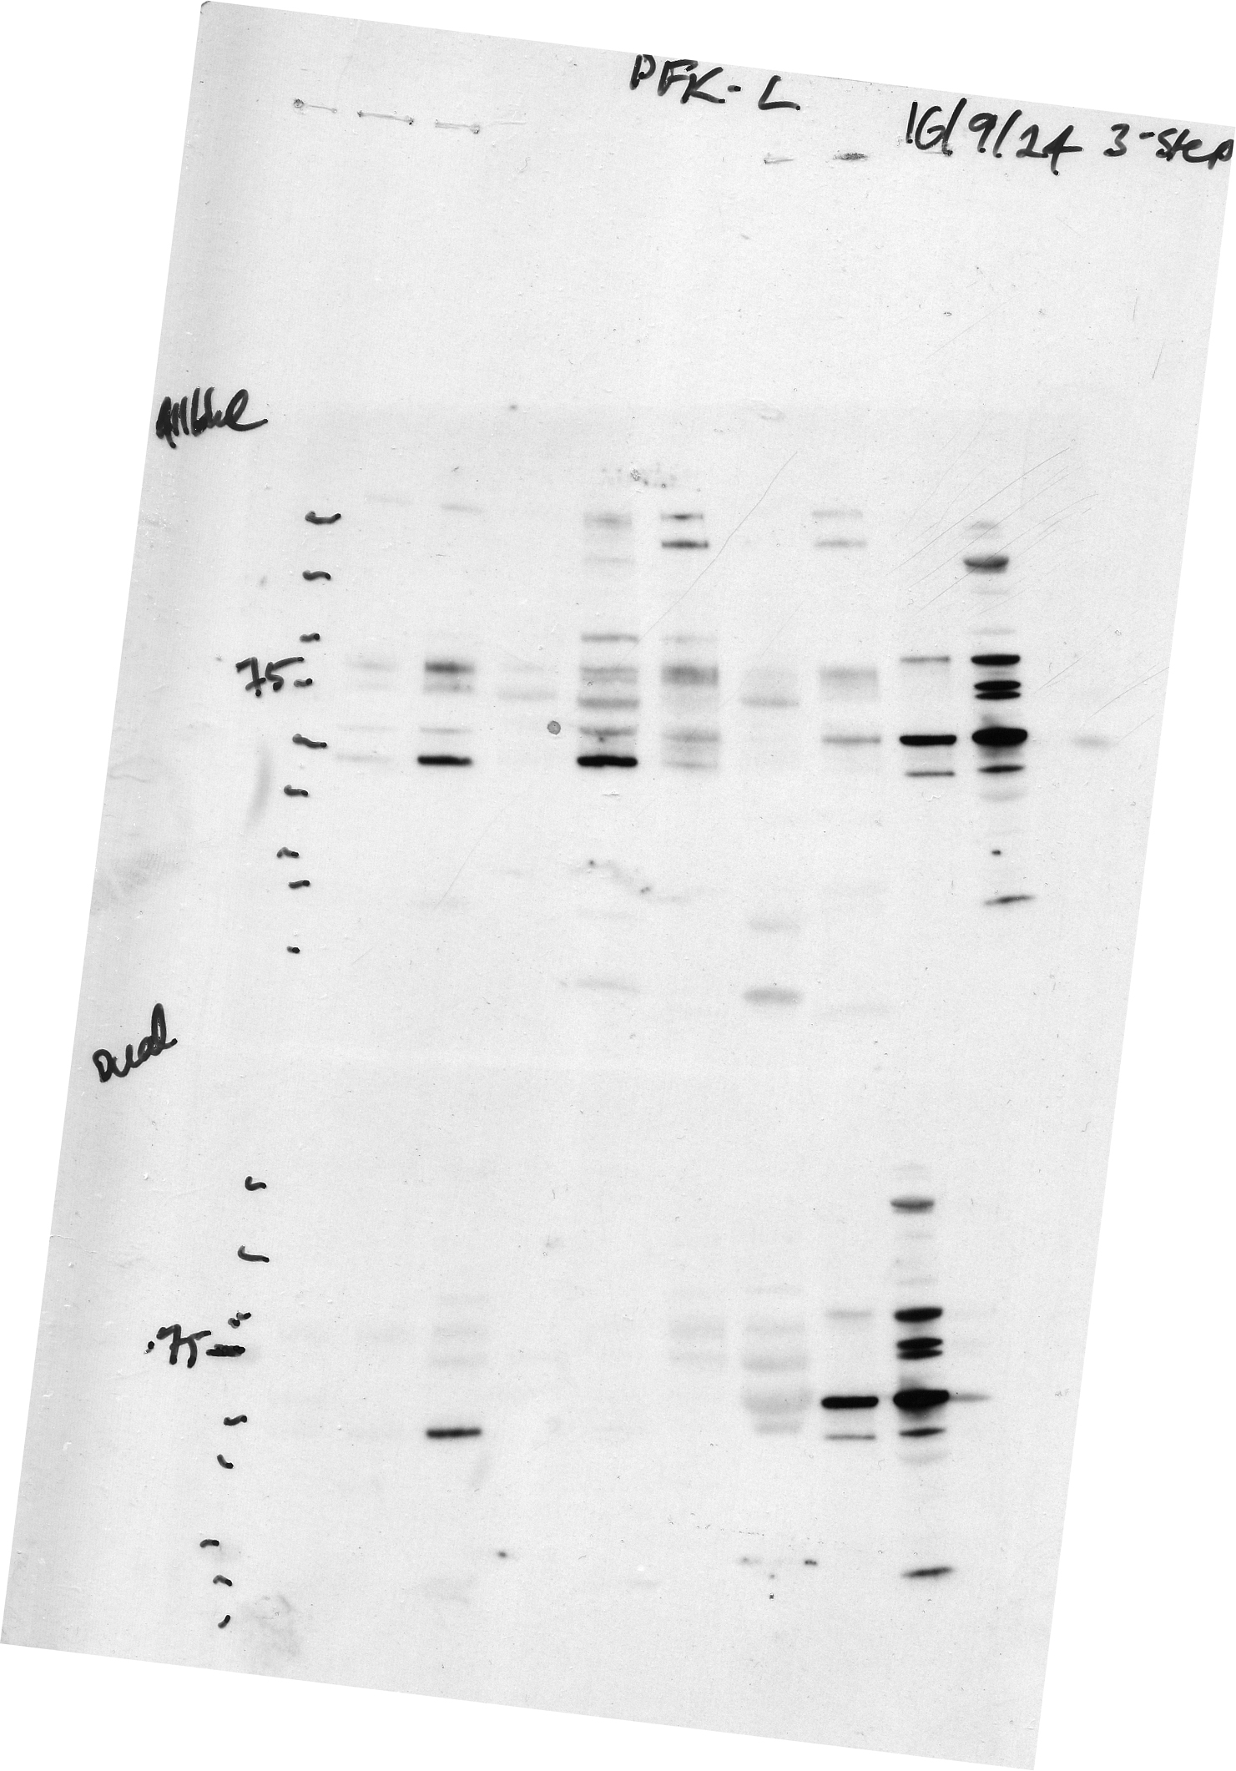
Representative Western blot 1-2 PFK-L 16/09/2024
Membrane 1
All blue marker
No tubulitis
No tubulitis
No tubulitis
Tubulitis
Tubulitis
Tubulitis
Tubulitis
Kidney lysate
Peripheral blood mononuclear cells
Membrane 2
Dual
No tubulitis
No tubulitis
No tubulitis
Tubulitis
Tubulitis
Tubulitis
Tubulitis
Kidney lysate
Peripheral blood mononuclear cells
Membrane 2 was cropped to form Figure 2 as a representative immunoblot
PFK-L (64kDa)
PFK-L (64kDa)

Slide 10
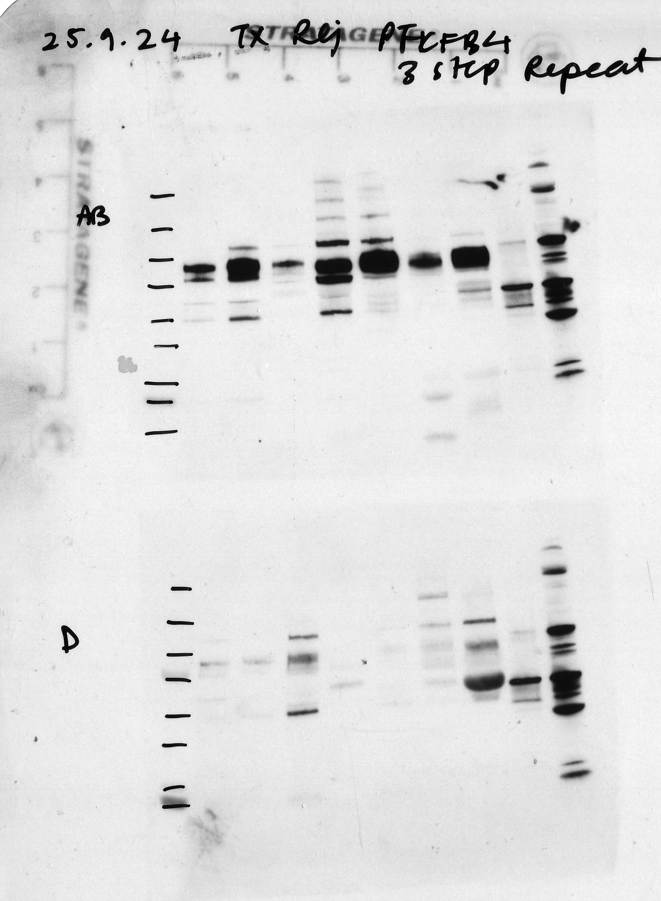
Representative Western blot 1-2 PFKFB4 25/09/2024
Membrane 1
All blue marker
No tubulitis
No tubulitis
No tubulitis
Tubulitis
Tubulitis
Tubulitis
Tubulitis
Kidney lysate
Peripheral blood mononuclear cells
Membrane 2
Dual
No tubulitis
No tubulitis
No tubulitis
Tubulitis
Tubulitis
Tubulitis
Tubulitis
Kidney lysate
Peripheral blood mononuclear cells
Membrane 2 was cropped to form Figure 2 as a representative immunoblot
PFKFB4 (54kDa)
PFKFB4 (54kDa)

