Slide 1
Patient #1
- Female, 60-years-old
Aneurysm: AcomA, SAH: HH I, Fisher 3(CCT day 4 and DSA day 5)
Aneurysm treatment: coil occlusion (DSA day 5)
Severe Vasospasm: ACA left (DSA day 5)
Treatment: -Periprocedural medication: 6 mg milrinone IA, 5000 IU non-fractionated Heparin IV, 500 mg ASA IV
-Stent implantation: ACA left A1-A2
- Microcatheter: Headway21
-Stent: Solitaire 4 x 15 mm
-TCD: 50 cm/s ACA left one day later (day 6)
- No additional vasospasm treatment required
- Aneurysm re-coiling on days 465 and 1395
- Control MRI (day 3320): gliotic scar of the left frontal lobe; mRS 0

Slide 2
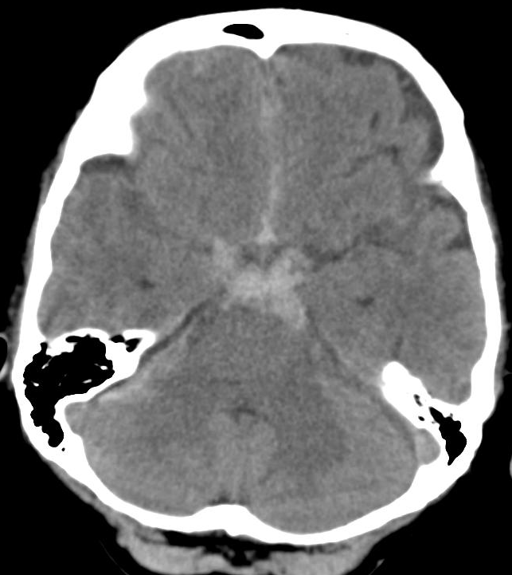
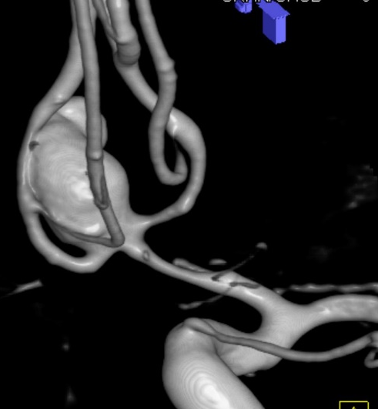
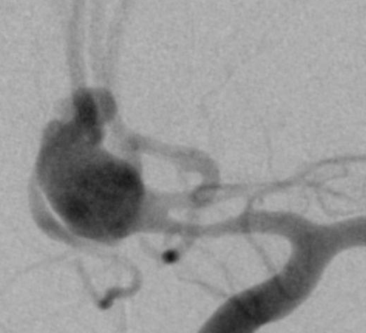
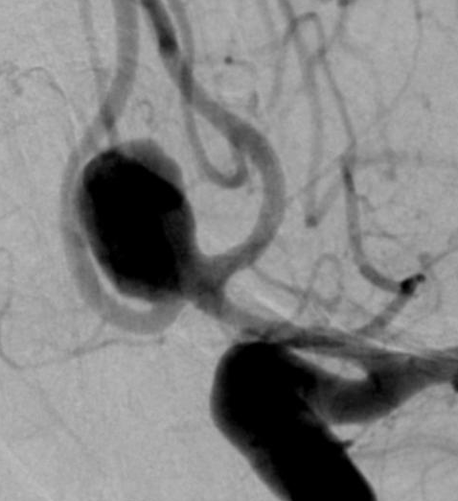
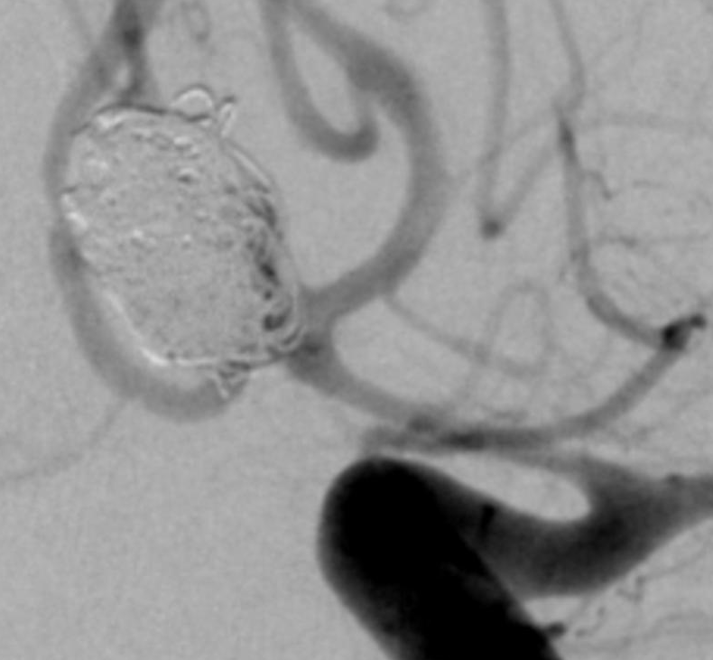
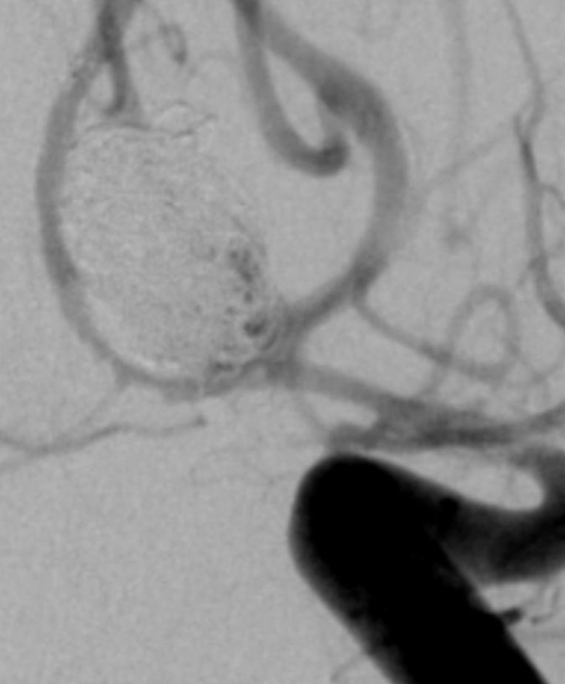
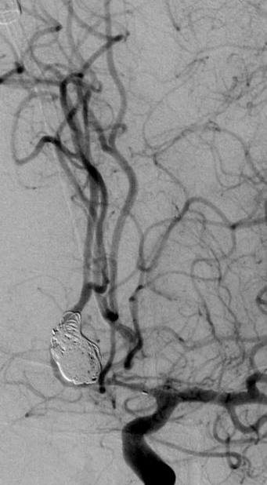
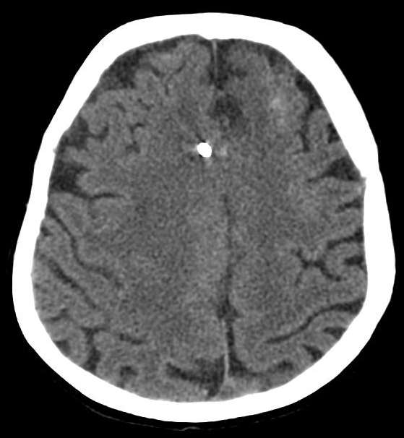
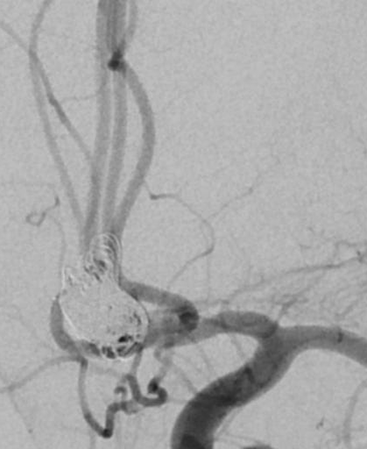
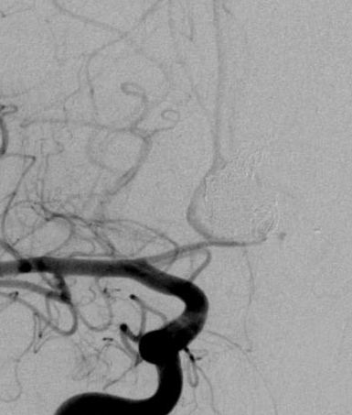
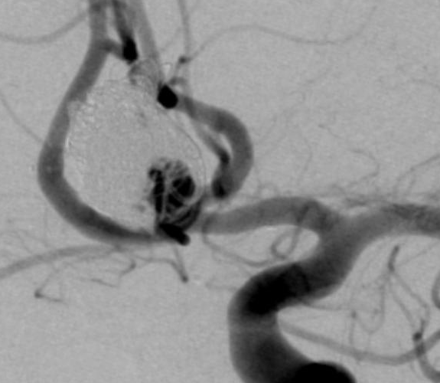
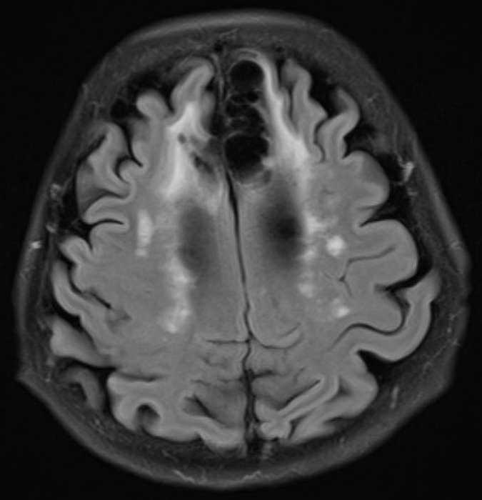
Day 4
Day 5
Day 5
Day 5
Day 5
Day 5
Day 5
Day 14
Day 112
Day 3221
Day 3320

Slide 3
Patient #2
- Female, 48-years-old
- Aneurysm: MCA, SAH: HH I, Fisher 1 (DSA day 7, DAS day 8)
Aneurysm treatment: Coil occlusion, coil protrusion (DSA day 9)
periprocedural medication: 1000 mg ASA IV, 600 mg Clopidogrel PO, 3000 IU non-fractionated Heparin IV,
4 mg eptifibatide IA
- Moderate Vasospasm: M1, M2 left, A1, A2 left and BA, severe Vasospasm: M1 and M2 right (DSA day 9)
Treatment: Periprocedural medication: 6 mg milrinone IA
Stent-implantation: ICA- M1-M2 right
Microcatheter: Headway17
Stent: LVIS Jr. 2,5 x 24 mm
TCD: 90 cm/s MCA right one day later (day 10)
moderate Vasospasm: M1, M2 left, A1, A2 left , severe Vasospasm: ACA right (DSA day 10)
Treatment: Periprocedural medication: 10 mg milrinone IA
- control MRI (day 123): moderate gliotic scars in the supply area of the right ACA
Last DSA (day 1984); mRS 0

Slide 4
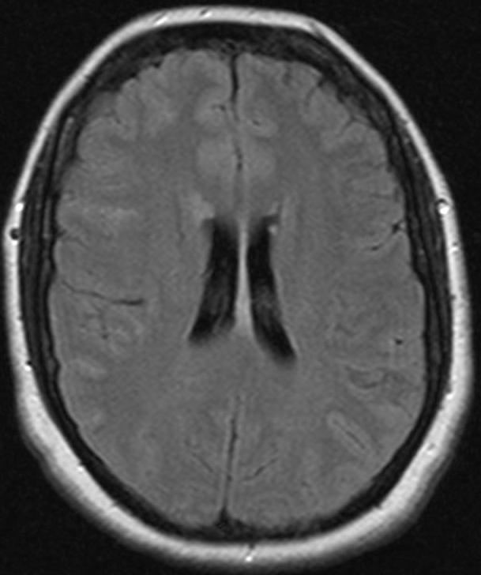
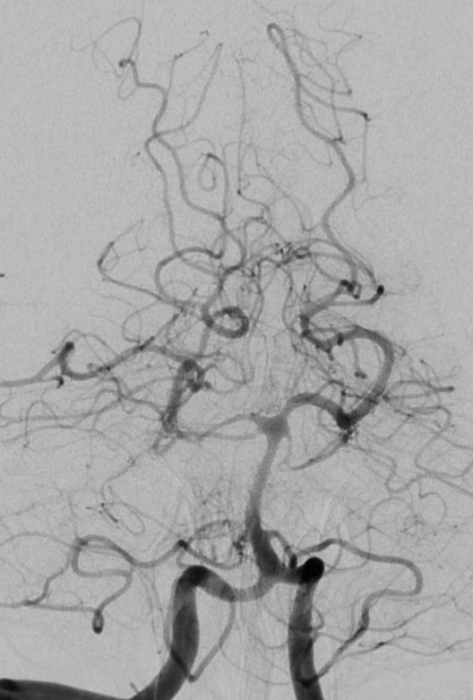
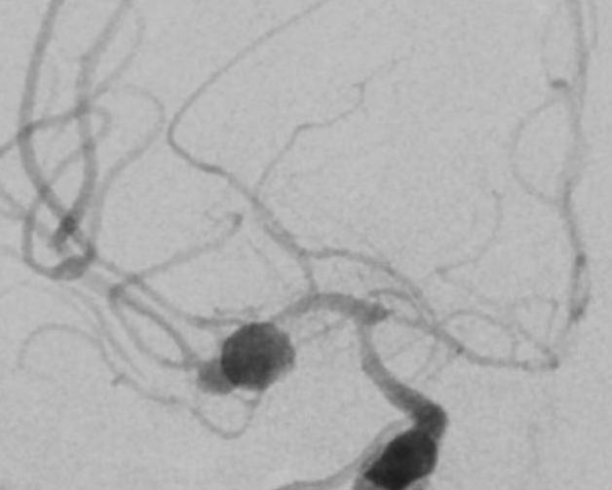
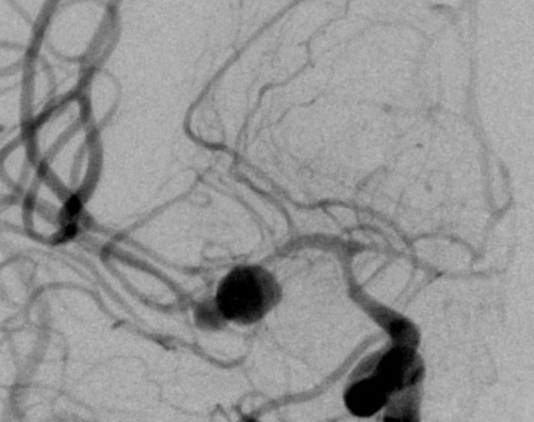
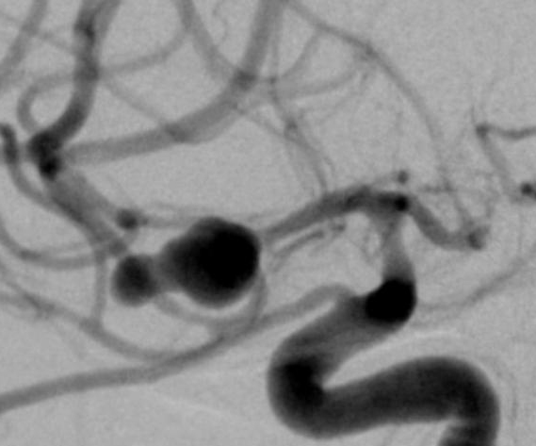
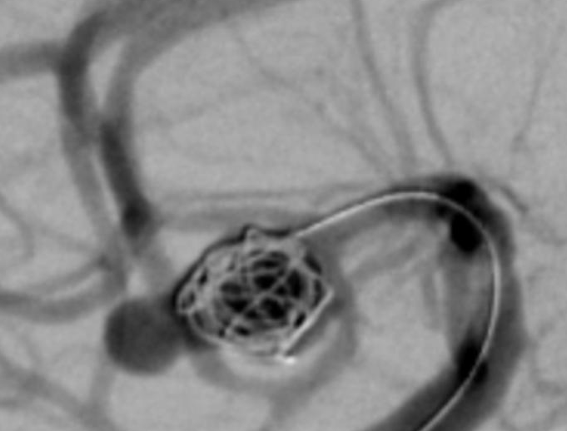
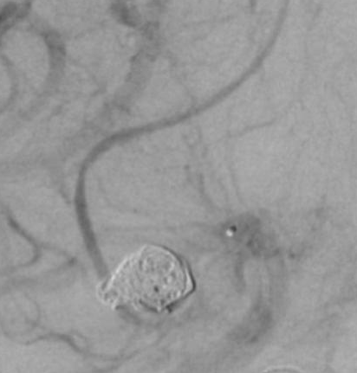
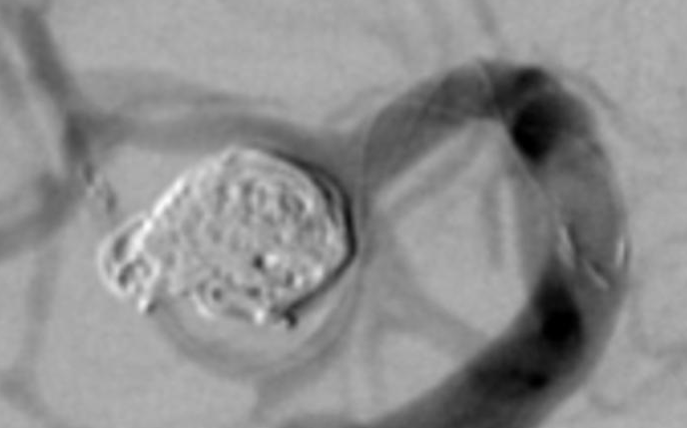
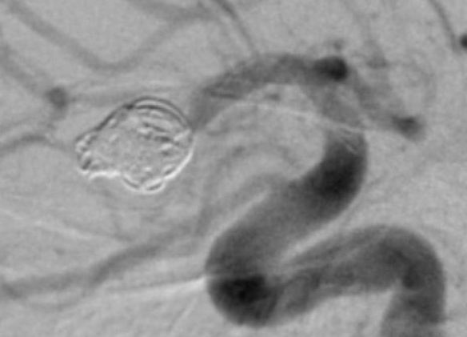
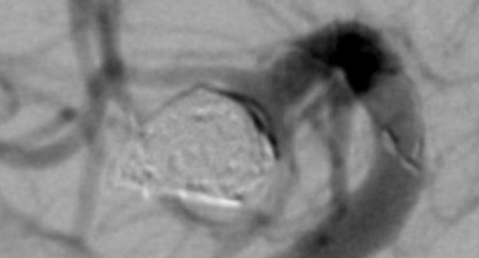
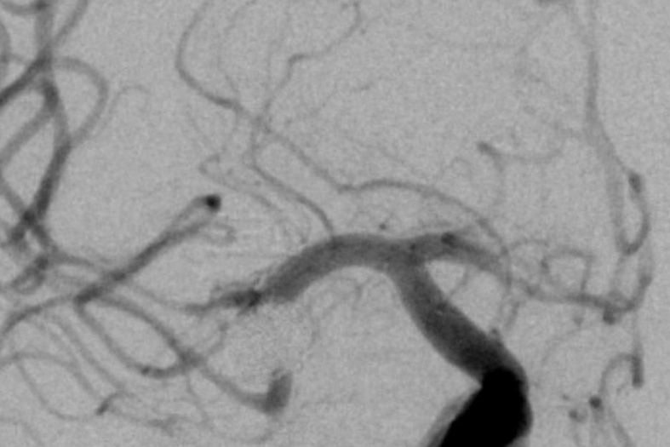
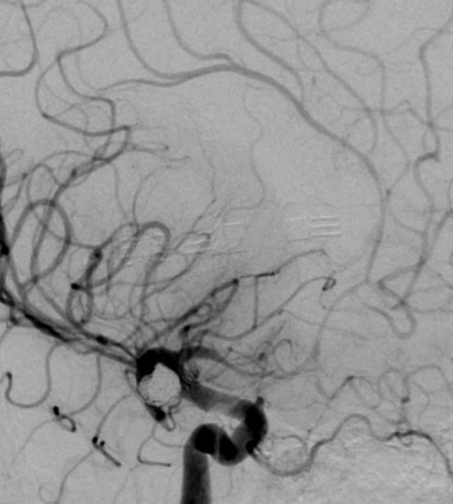
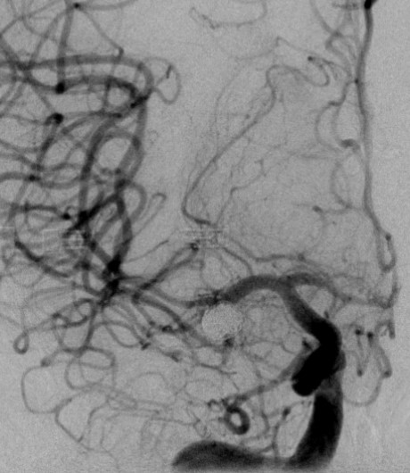
Day 7
Day 8
Day 8
Day 9
pre milrinone
post milrinone IA
slow
Day 9
Day 9
LVIS Jr 2.5/4
Day 9
Thrombus pre LIF
Day 9
MCA M2 superior tr
no stent, vasospasm
MCA M2 inferior tr
with stent, no vasospasm
Thrombus post LIF
Day 9
Day 9
Day 10
pre milrinone
Day 10
post milrinone IA

Slide 5
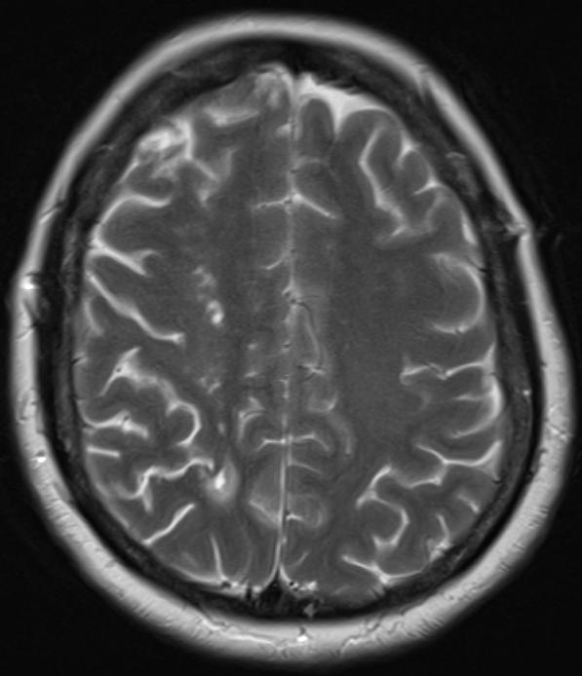
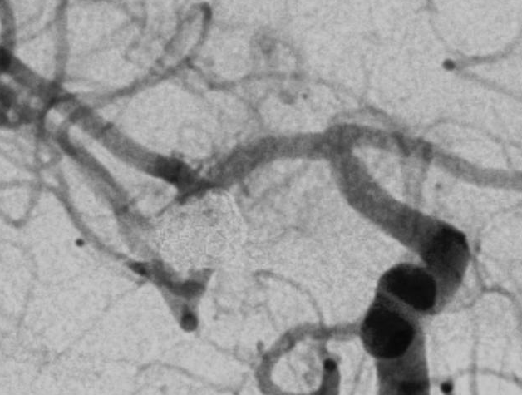
Day 123
Day 1984

Slide 6
Patient #3
- Female, 50-years-old
- Aneurysm: ICA paraophthalmic, SAH: HH III, Fisher 4 (CCT and DSA day 1)
Aneurysm treatment: Flow Diverter-Assisted Coil Embolization: 1 x p64 3.5/18 (phenox) and 19 coils
periprocedural medication: 500 mg ASA IV, 180 mg Ticagrelor PO, 11,2 mg Eptifibatid IV (DSA day 1)
Day 5: clinic: Hemiparesis of the left side (DSA day 5)
DSA: Occlusion of the Flow Diverter due to Vasospasm; moderate Vasospasm: MCA left and BA, severe Vasospasm: MCA right
Treatment: -periprocedural medication: 3000 IU non-fractionated Heparin IV, 5 mg Eptifibatid IV, 3 mg milrinone IA
- Balloon PTA : pITA 1.25/15 mm (phenox), pITA 2/15 mm (phenox), pITA 3/15 mm (phenox) ,
Scepter C 4/20 mm (Microvention)
- massive parenchymal hemorrhage after EVD insertion from the right side (CCT day 6)
Hematoma clearance (CCT day 8)
moderate Vasospasm: M1, M2 left, A1, A2 left and BA ; severe Vasospasm: M1 and M2 right (DSA day 9)
Treatment: Periprocedural medication: 10 mg milrinone IA, 3000 IU non-fractionated Heparin IV
- moderate Vasospasm: M1, M2 left, A1, A2 left and BA ; severe Vasospasm: M1 and M2 right (DSA day 10)
Treatment: Periprocedural medication: 8 mg milrinone IA, 3000 IU non-fractionated Heparin IV
- moderate Vasospasm: M1, M2 left and BA ; severe Vasospasm: M1 and M2 right, A1, A2 left (DSA day 11),
Treatment: - Periprocedural medication: 12 mg milrinone IA, 3000 IU non-fractionated Heparin IV
- mechanical dilatation using pRELAX-Device (pRELAX 4/20, Phenox), long-term intra-arterial selective infusion of nimodipine for 3 days
ICA both sides
Control DSA (day 12): no severe Vasospasm
Change of Microcatheter for long-term intra-arterial selective infusion of nimodipine (DSA day 15); control CCT day 15: No rebleeding
Day 17 TCD: 250 cm/s MCA right ; severe Vasospasm: M1 and M2 right (DSA 17)
Treatment: - Periprocedural medication: 8 mg milrinone IA
- Bail out Stenting MCA right M1-M2
Microcatheter: Prowler Select Plus
Stent: Codman Enterprise 4 x 39mm
TCD: 100 cm/s MCA right one day later (day 18)

Slide 7
Control DSA (day 20): no Vasospasm
Control CCT (day 47): after cerebral shunt
Control DSA (day 218)
last control MRI (day 905): moderate gliotic scars in the supply area of the right MCA and posthemorhagic lesion of the right frontal lobe; mRS 2

Slide 8
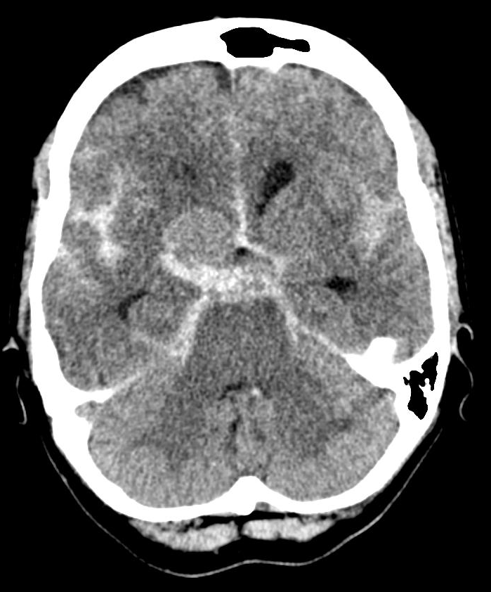
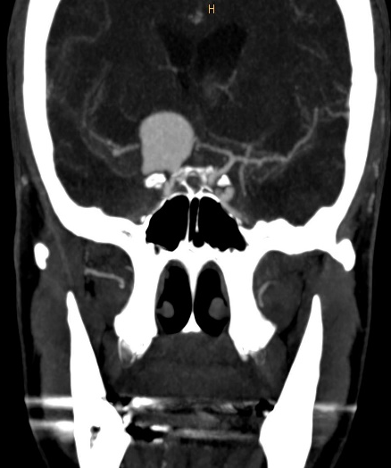
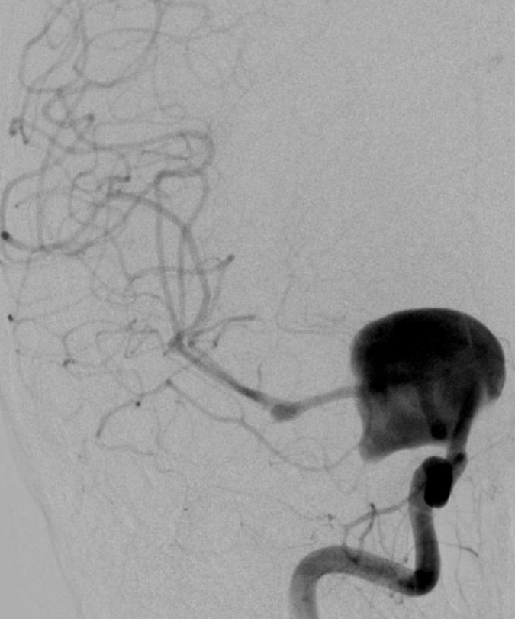
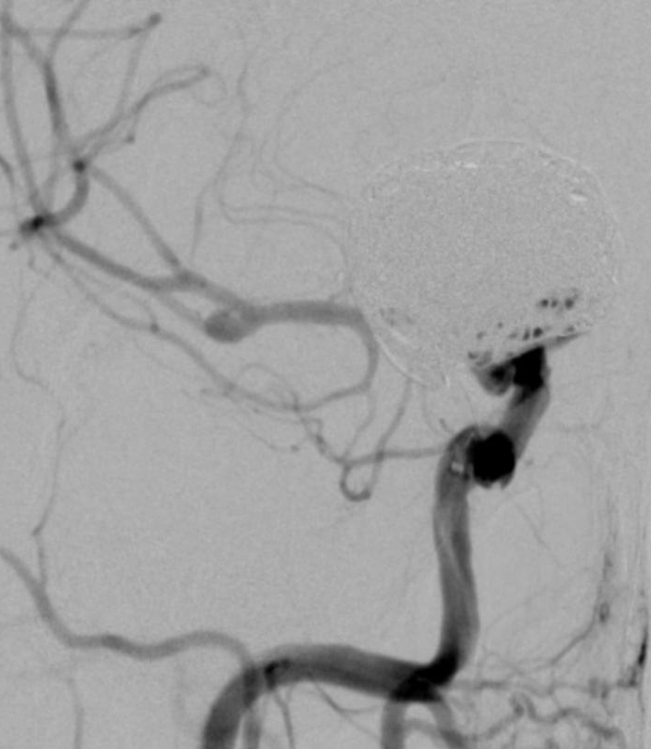
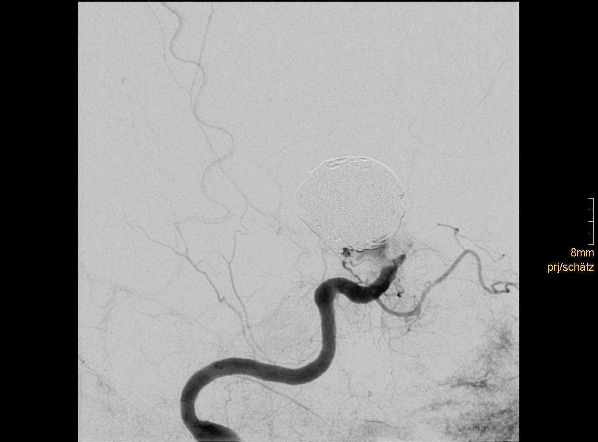
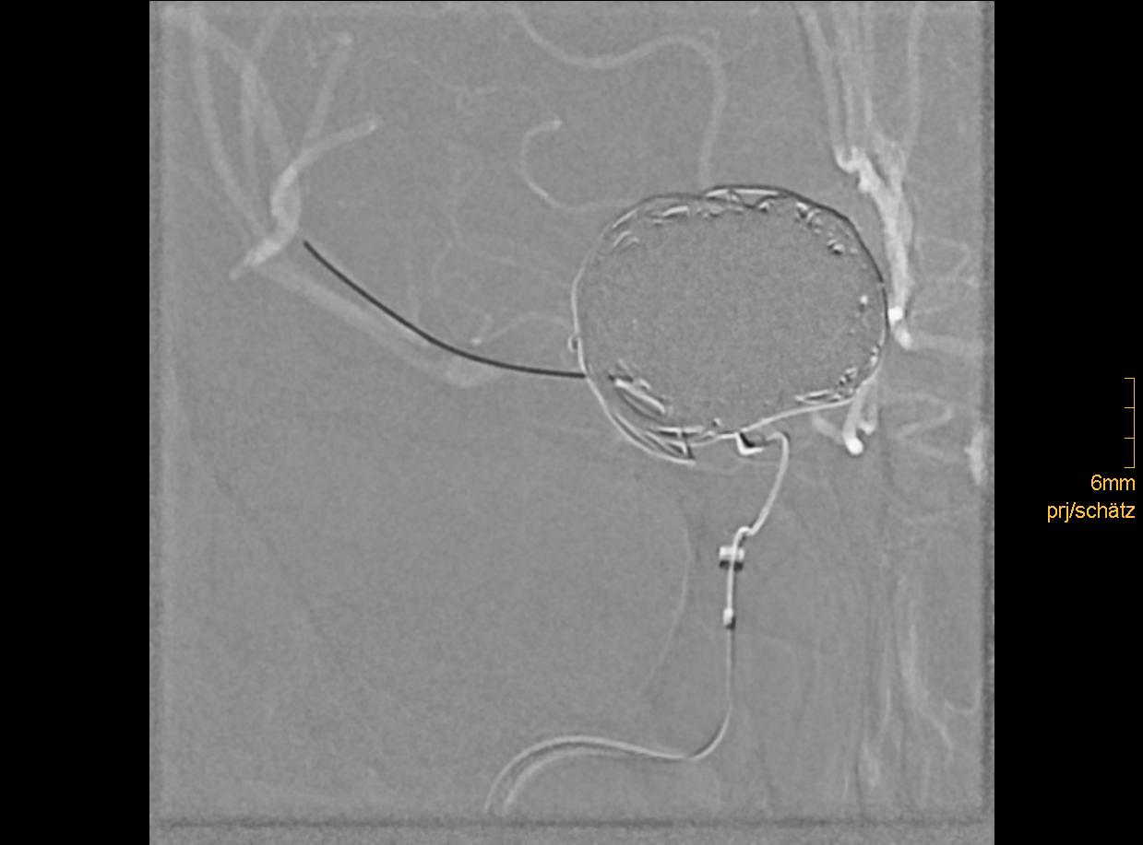
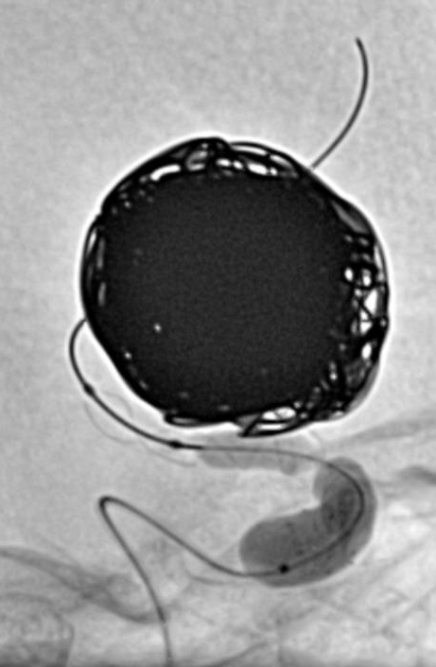
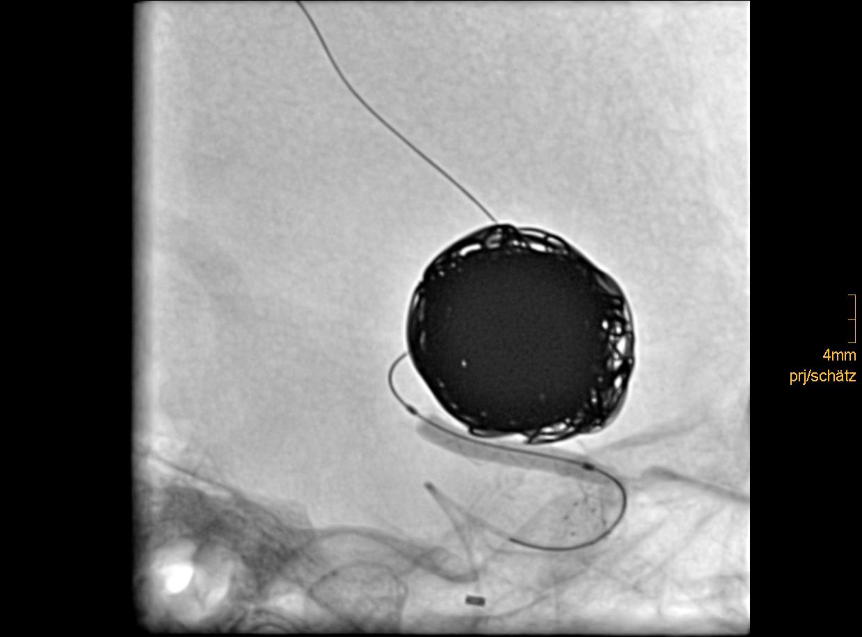
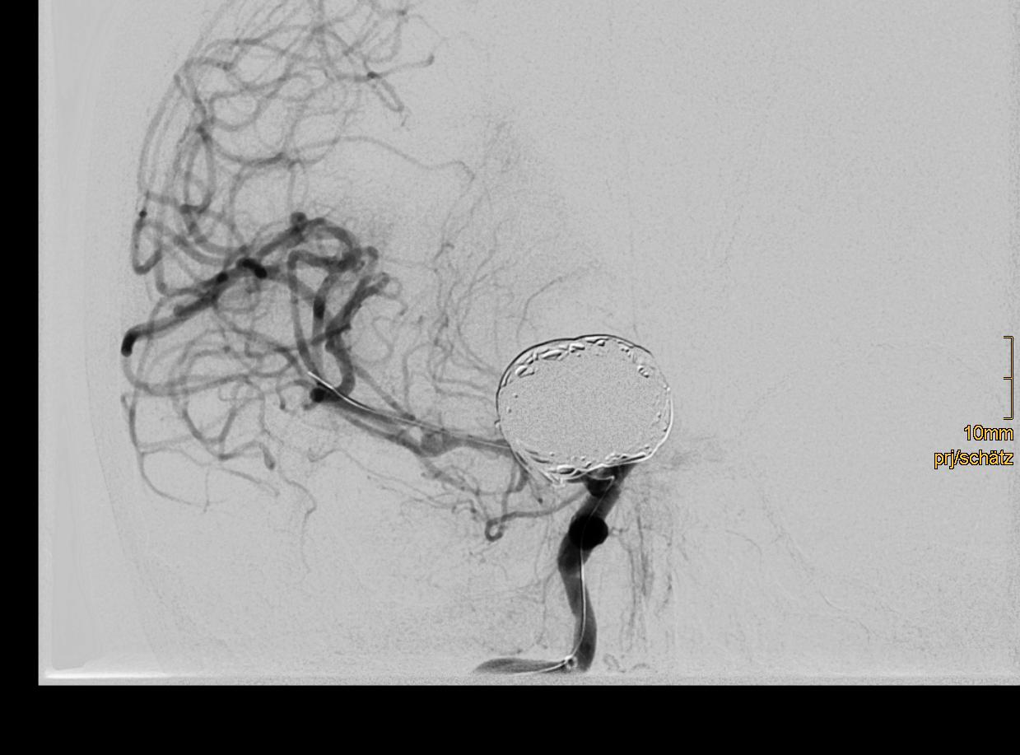
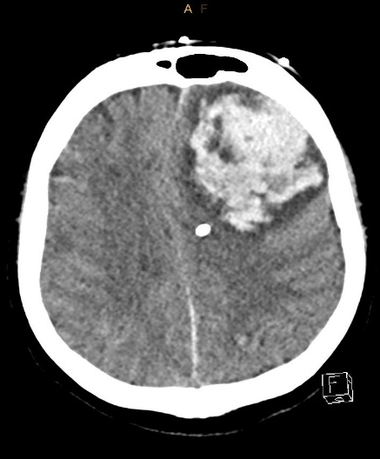
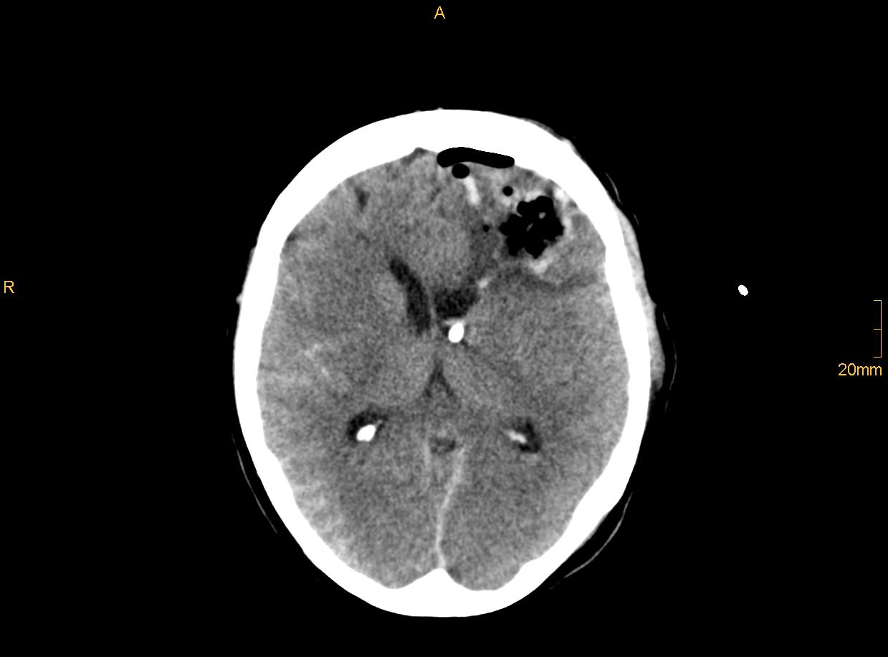
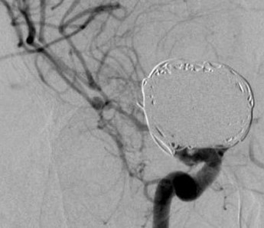
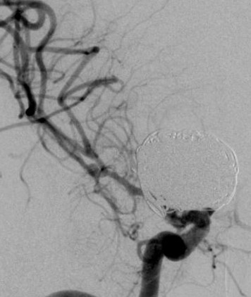
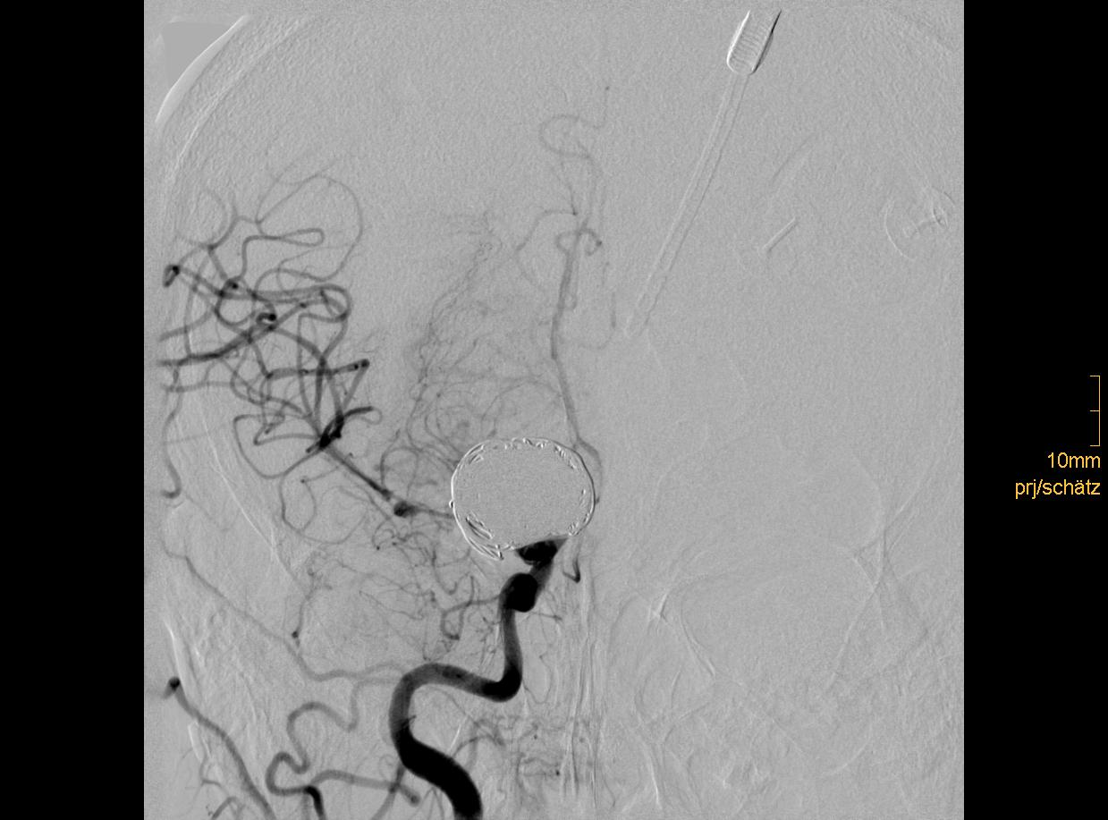
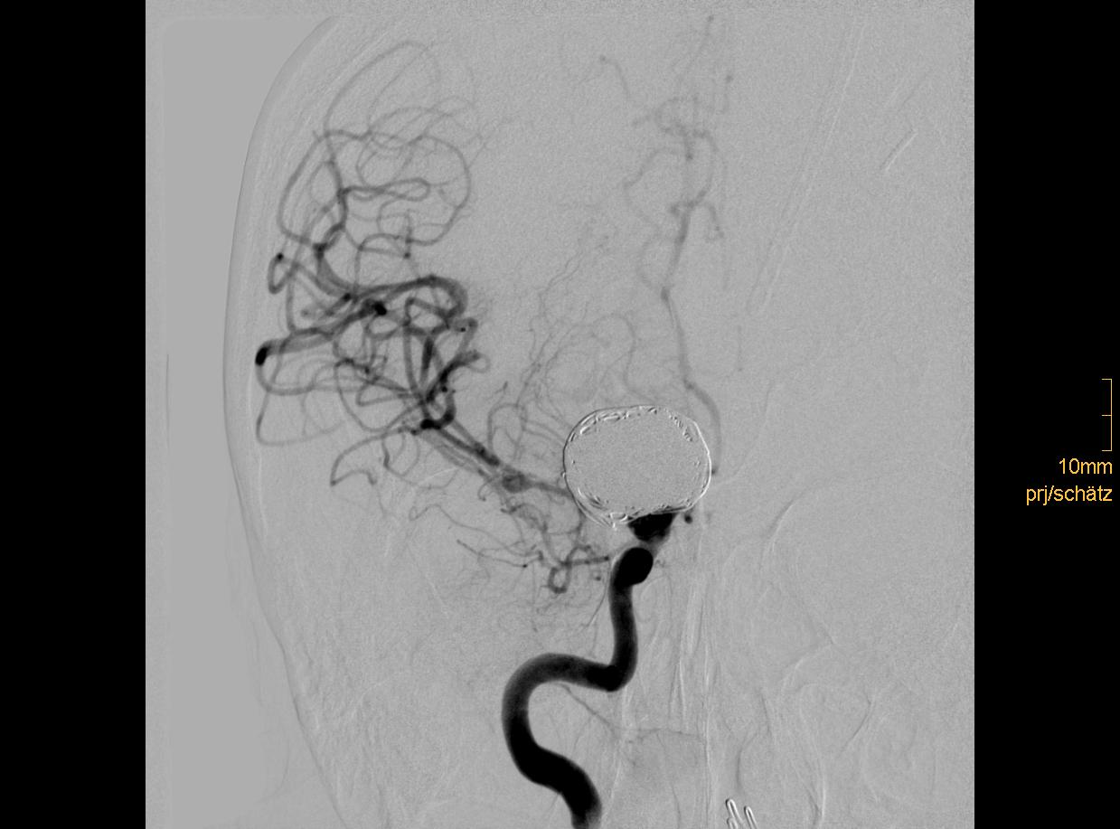
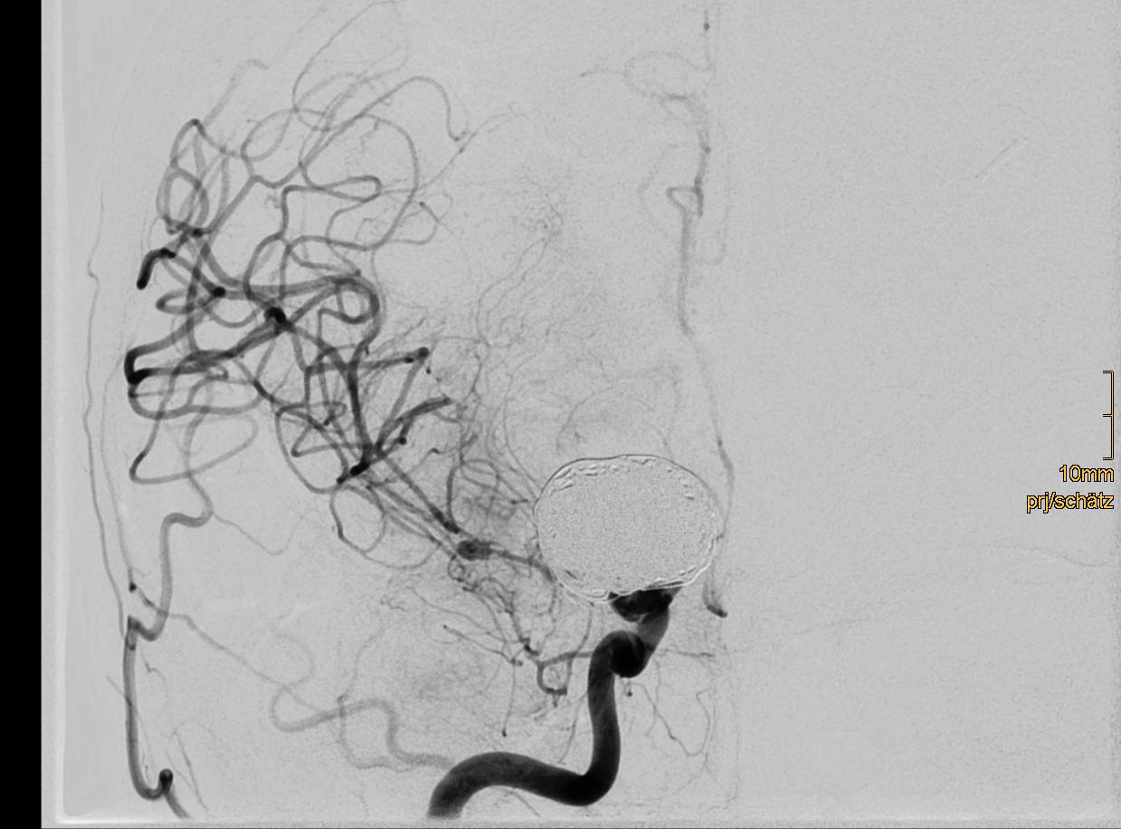
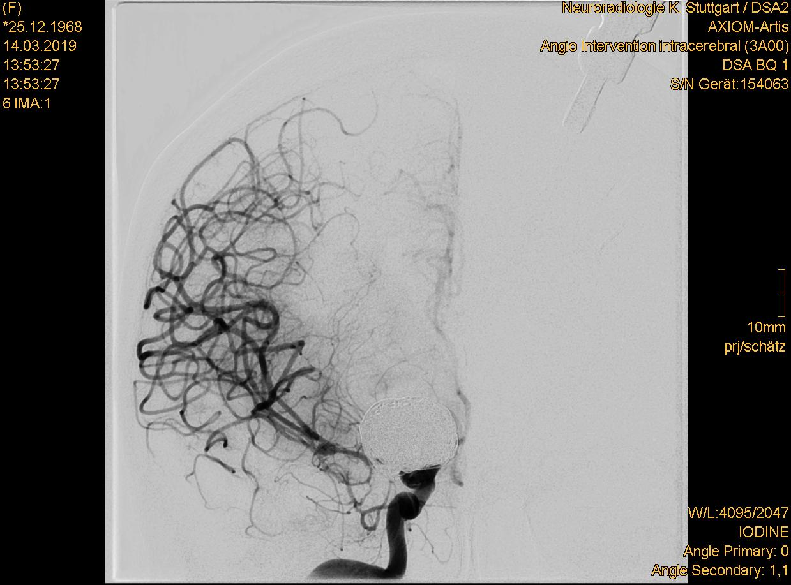
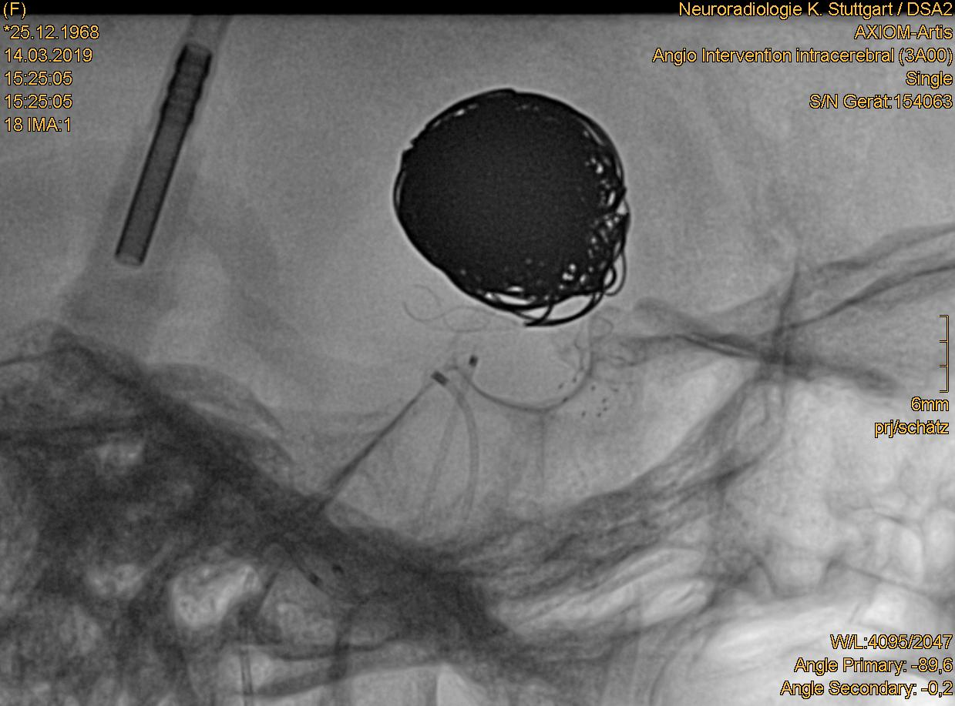
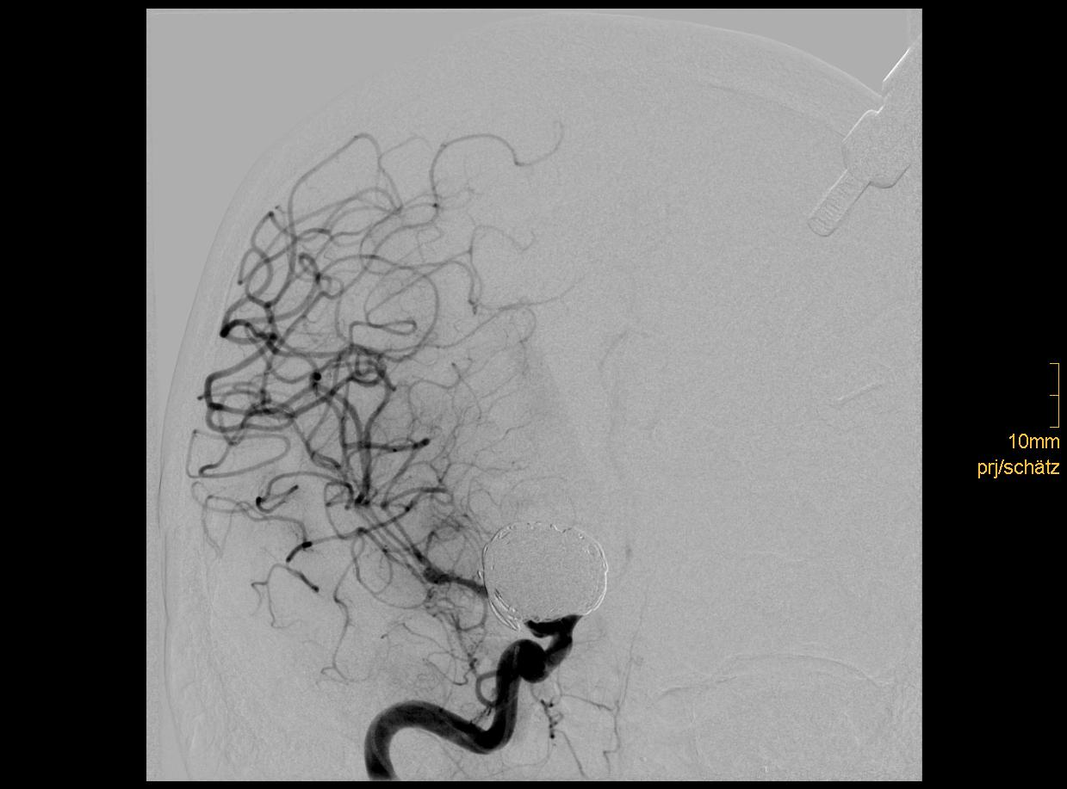
Day 1
Day 1
Day 1
Day 5
Day 5
Day 1
Day 1
Day 5
Day 5
Day 5
Day 6
Day 8
Day 9
pre milrinone
Day 9
post milrinone IA
Day10
Day10
post milrinone IA
Day11
pre milrinone
Day11
post milrinone IA
Day11
Day12
pre milrinone
Thrombus post LIF

Slide 9
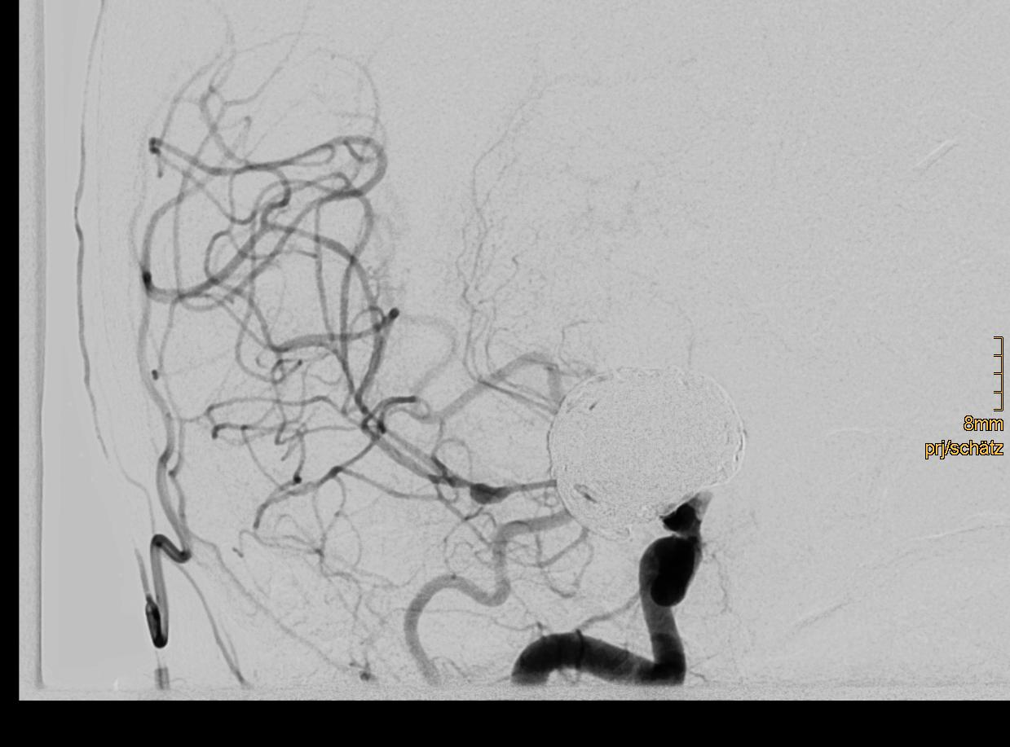
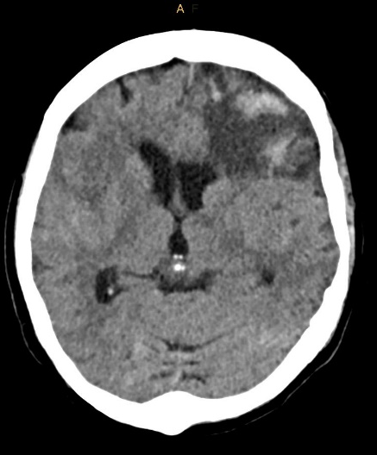
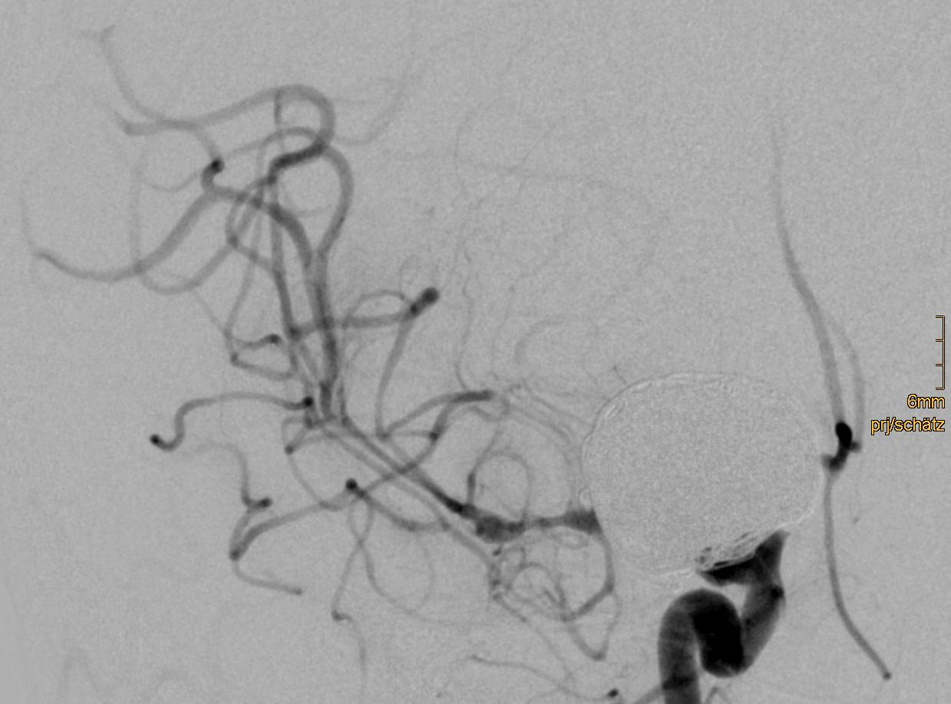
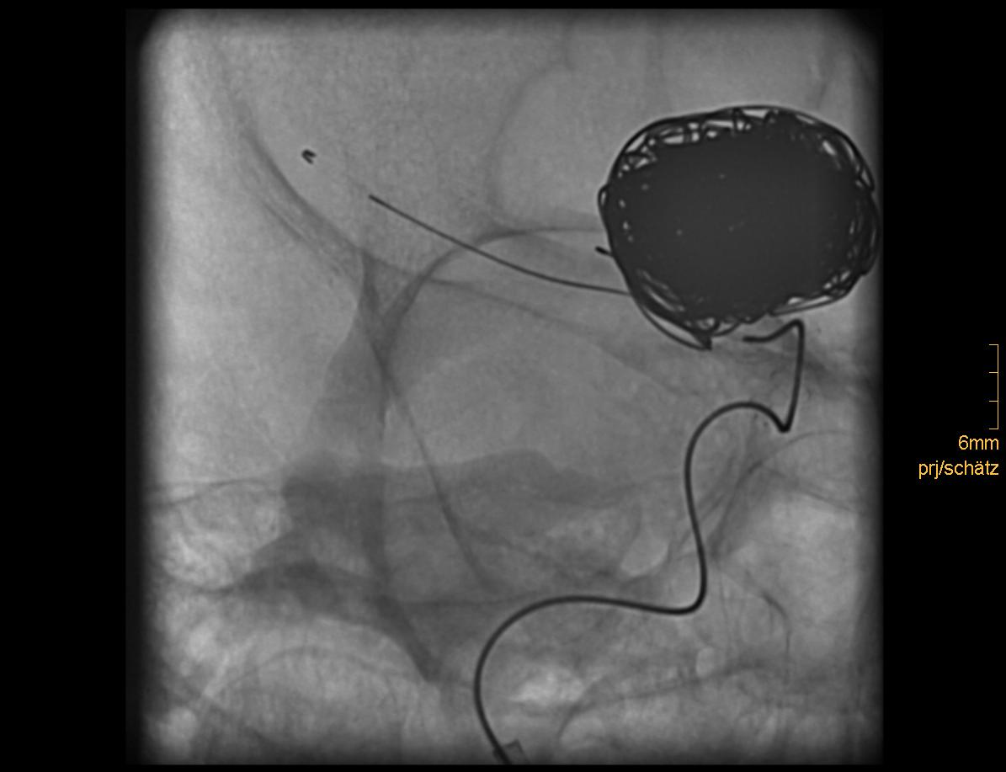





Enterprise 4 x 39mm
Day 15
Day 15
Day 17
Day 17
Day 17
Day 20
Day 47
Day 218
Day 905

Slide 10
Patient #4
- Female, 47-years-old
- Aneurysm: ICA paraophthalmic, SAH: HH V, Fisher 4 (CCT and DSA day 1)
- Aneurysm treatment: Bifurcation Stent-Assisted Coil Embolization: 1x pCONus2_HPC (phenox) and 18 coils
periprocedural medication: 1000 mg ASA IV, 3000 IU non-fractionated Heparin IV
- rebleeding (CCT day 2)
- Extracranial dissection of the left ICA and Vasospasm: M1, M2, A1 and A2 left (DSA day 6)
Treatment: -periprocedural medication: 180 mg Ticagrelor PO, 10 mg Eptifibatid IV, 4 mg milrinone IA, 1 x 20 µg Prostaglandin E1 IA
-Stent-PTA: pITA 4/40 mm (phenox), Carotid Wallstent 5/30 mm
Severe Vasospasm: MCA and ACA right (DSA day 7)
Treatment: -Periprocedural medication: 5000 IU non-fractionated Heparin IV, 1 x 20 µg Prostaglandin E1 IA
- long-term intra-arterial selective infusion of nimodipine ICA left
- Moderate Vasospasm: M1, M2 left ; severe Vasospasm: M1 and M2 right, A1, A2 left (DSA day 11),
Treatment: - Periprocedural medication: 12 mg milrinone IA, 3000 IU non-fractionated Heparin IV
- mechanical dilatation using pRELAX Device (pRELAX 4/20, Phenox), long-term intra-arterial selective infusion of nimodipine for 3 days
ICA both sides
Bail out Stenting MCA right M1-M2
Microcatheter: Prowler Select Plus
Stent: Codman Enterprise 2 x 30 mm
TCD: 95 cm/s MCA right one day later (day 9)
- moderate Vasospasm: M1, M2 left and ACA right (DSA day 12),
Treatment: - Change of Microcatheter for long-term intra-arterial selective infusion of nimodipine , ICA both sides
Control CCT (day 14): Brain Defekt after ICA dissection
moderate Vasospasm: M1, M2 left and ACA right (DSA day 14)
Treatment: - Change of Microcatheter for long-term intra-arterial selective infusion of nimodipine , ICA both sides

Slide 11
Control DSA (day 17): no Vasospasm
Control CCT (day 29)
Control DSA (day 211): Aneurysm reperfusion; Retreatment after 253 days Flow Diverter-Assisted Coil Embolization: 1 x p64 4/15 (phenox) and 8 coils
Control DSA (day 855)
last control MRI (day 860): no relevant gliotic scars in the supply area of the right MCA; mRS 2

Slide 12













Day 1
Day 1
Day 1
Day 1
Day 2
dissection
stent
Day 6
Day 6
Day 6
pre milrinone
Day 6
Day 6
post milrinone IA
Day 7
Day 7
Day 7
Thrombus post LIF

Slide 13














pRELAX
Enterprise 2 x 30 mm
Stent
Day 9
Day 9
Day 9
Day 9
Day 9
Enterprise 2 x 30 mm
Day 12
Day 12
Day 14
Day 14
Day 14
Day 14
Day 17
Day 17
Day 29

Slide 14





Day 211
Day 211
Day 855
Day 855
Day 860

Slide 15
Patient #5
- Male, 39-years-old
Aneurysm: MCA, SAH: HH V, Fisher 4 (CCT day 1)
Treatment: Clipping (CCT day 1)
Control CCT (day 5): Minimal increase in SAB and diffuse parenchymal swelling
Control CCT (day 5): Craniotomy
Moderate Vasospasm: M1, M2 left, A1, A2 left and BA ; severe Vasospasm: M1, M2, A1 and A2 right (DSA day 7)
Treatment: -Periprocedural medication: 4 mg milrinone IA, 3000 IU non-fractionated Heparin IV, 500 mg ASA IV, 180 mg Ticagrelor PO
- for long-term intra-arterial selective infusion of nimodipine
Moderate Vasospasm: M1, M2 left, A1, A2 left and BA ; severe Vasospasm: M1, M2, A1 and A2 right (DSA day 8)
Treatment: -Periprocedural medication: 8 mg milrinone IA, 3000 IU non-fractionated Heparin IV, 500 mg ASA IV, 10 mg Prasugrel PO
-Bail out Stenting MCA right M1
Microcatheter: Prowler Select Plus
Stent: Codman Enterprise 4 x 16 mm
TCD: 75 MCA right one day later (day 9)
-Bail out Stenting ACA right A1-A2
Microcatheter: Prowler Select Plus
Stent: Codman Enterprise 4 x 23 mm
TCD: 80 cm/s ACA right one day later (day 9)
Control CCT immediately after bail out stenting (day 8): increase of the parenchymal swelling.
Moderate Vasospasm: M1 and M2 left; severe Vasospasm: , A1 and A2 left (DSA day 9)
Treatment: -Periprocedural medication: 8 mg milrinone IA, 3000 IU non-fractionated Heparin IV, 500 mg ASA IV, 10 mg Prasugrel PO
- Mechanical dilatation using balloon catheter (Transform 3/10, stryker), ACA A1-A2 left

Slide 16
Control DSA (day 12): no severe Vasospasm
Control CCT (day 23): no new lesions after Bail out Stenting
Control DSA (day 105): no vessels injuries
Last control MRI (day 191): gliotic scars in the supply area of the right MCA
Last control DSA (day 282); mRS 2

Slide 17















Day 1
Day 1
Day 1
Day 5
Day 5
Enterprise 4 x 16
Enterprise 4 x 23
Day 7
Day 7
Day 8
Day 8
Day 8
Day 8
Day 9
Day 9
Day 9
Day 9
Day 9
Thrombus post LIF

Slide 18







Day 105
Day 12
Day 23
Day 191
Day 191
Day 191
Day 282

Slide 19
Patient #6
- Female, 67-years-old
- SAH: HH I, Fisher 1
- Female, 50-years-old
- SAH: HH III, Fisher 4 (CCT day 1)
Vasospasm: M1, M2 left and A1, A2 left (DSA day 7)
Treatment: Periprocedural medication: 7,5 mg milrinone IA, 3000 IU non-fractionated Heparin IV-
Vasospasm: M1, M2 both sides and A1, A2 both sides(DSA day 8)
Treatment: -Periprocedural medication: 2 x 8 mg milrinone IA, 3000 IU non-fractionated Heparin IV-, 500 mg ASA IV, 180 mg Ticagrelor PO
-mechanical dilatation using stent-retriever and Prelax-Device (pRESET-LT-4-20 and pRELAX 4/20, Phenox)
- Bail out Stenting ACA right A2
Microcatheter: Excelsior SL 10
Stent: Neuroform Atlas 3 x 15mm
TCD: 100 ACA right one day later (day 10)
- Bail out Stenting ACA right A1
Microcatheter: Excelsior SL 10
Stent: Baby Leo 2 x 12mm
TCD: 100 ACA right one day later (day 10)
- Bail out Stenting ACA left A1-A2
Microcatheter: Excelsior SL 10
Stent: Neuroform Atlas 4 x 24mm
TCD: 110 ACA left one day later (day 10)
- Bail out Stenting MCA left ICA-M1
Microcatheter: Excelsior SL 10
Stent: Neuroform Atlas 4,5 x 30 mm
TCD: 110 MCA left one day later (day 10)
Control DSA (day 19): no Vasospasm
Control CCT (day 21): no significant brain lesions
Control DSA (day 466); mRS 0
Periprocedural Vasospasm: M1, M2 right, coil protrusion
Microcatheter: Headway17
Stent: LVIS Jr; M2 rt inferior trunk (Ø 0.9 mm) => M1 right (Ø 1.2 mm)
Periprocedural medication: 8 mg milrinone IA, 2x 500 mg ASA IV, 600 mg Clopidogrel PO, 3000 IU non-fractionated Heparin IV,
4 mg eptifibatide IA
Postprocedural medication: 100 mg ASA PO daily for life, 75 mg Clopidogrel PO daily for 6 months
Nimotop IV: from day 5 through day ##
TCD: day #: vessel, value, day #: vessel, value, day #: vessel, value, day #: vessel, value
No additional vasospasm treatment required
MRI on day ### after the SAH showed gliotic scars of the right frontal lobe;
Clinical outcome: mRS 0, #### days after the SAH (telephone interview)

Slide 20















Day 1
Day 2
Day 2
Day 7
Day 7
pRESET-LT-4/20
Neuroform Atlas 3 x 15
Baby Leo
2 x 12
Day 8
Day 8
Day 8
Day 8
Day 8
Neuroform Atlas 4 x 24
Neuroform Atlas 4,5 x 30
Day 8
Day 8
Day 8
Day 19
Day 19
Thrombus post LIF

Slide 21



Day 21
Day 466
Day 466

