Slide 1
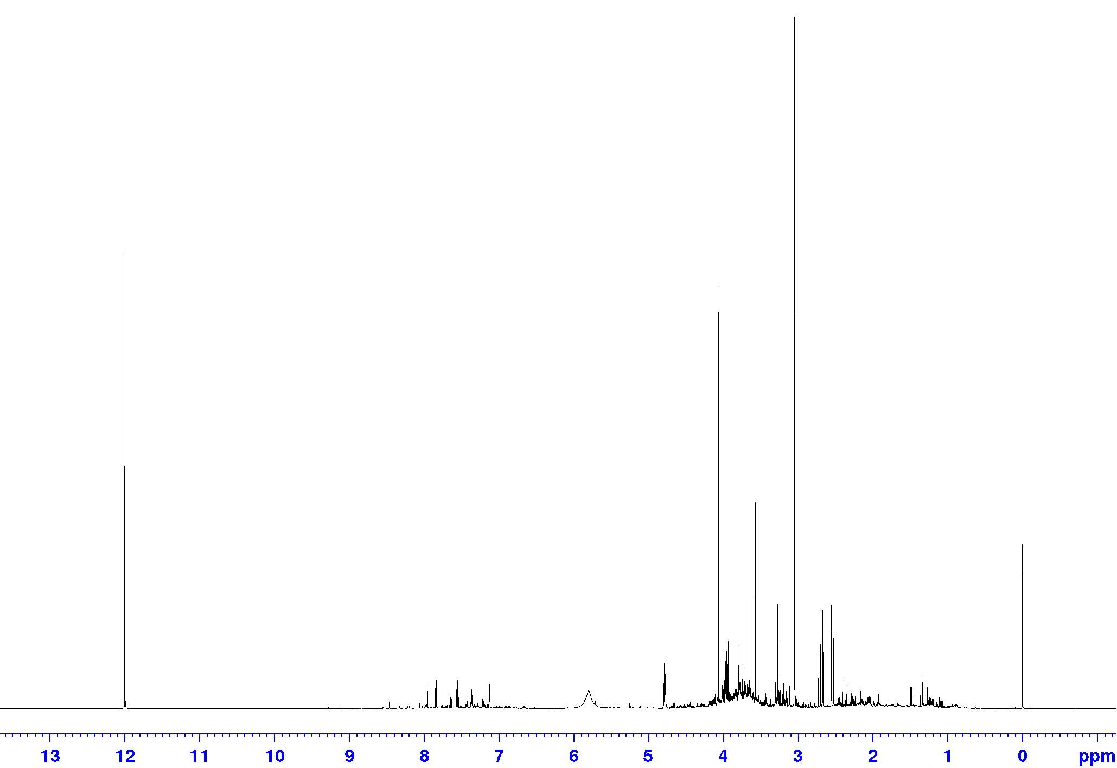
Creatinine
ERETIC signal
TSP-d₄
¹H NMR Bruker IVDr spectrum of pooled urine sample

Slide 2
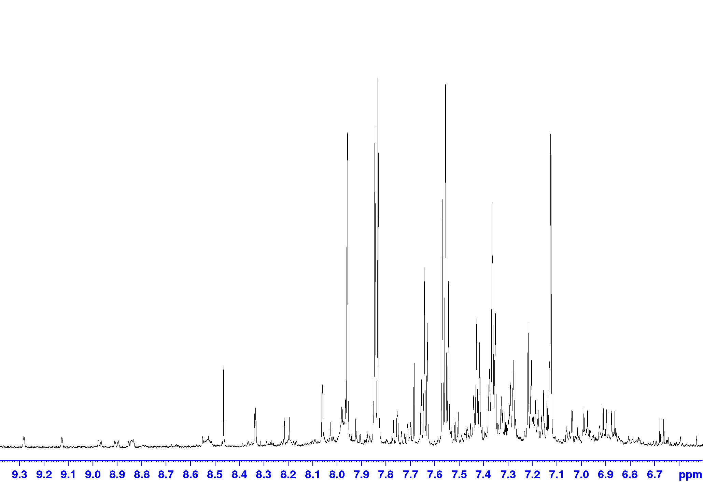
Hippurate
Histidine
Histidine
N-Phenylacetyl glutamine
p-Cresol sulfate
3-Indoxylsulfate
Pseudouridine
τ-Methylhistidine
1-Methylnicotinamide
Formate
4-Hydroxybenzoate
π-Methylhistidine
2Py
Tyrosine
Trigonelline
2Py
4-hydroxyphenylacetate
Hypoxanthine
2Py
Hippurate
HPHPA
Peak assignments in ¹H NMR spectrum of pooled urine sample (expansion 1)

Slide 3
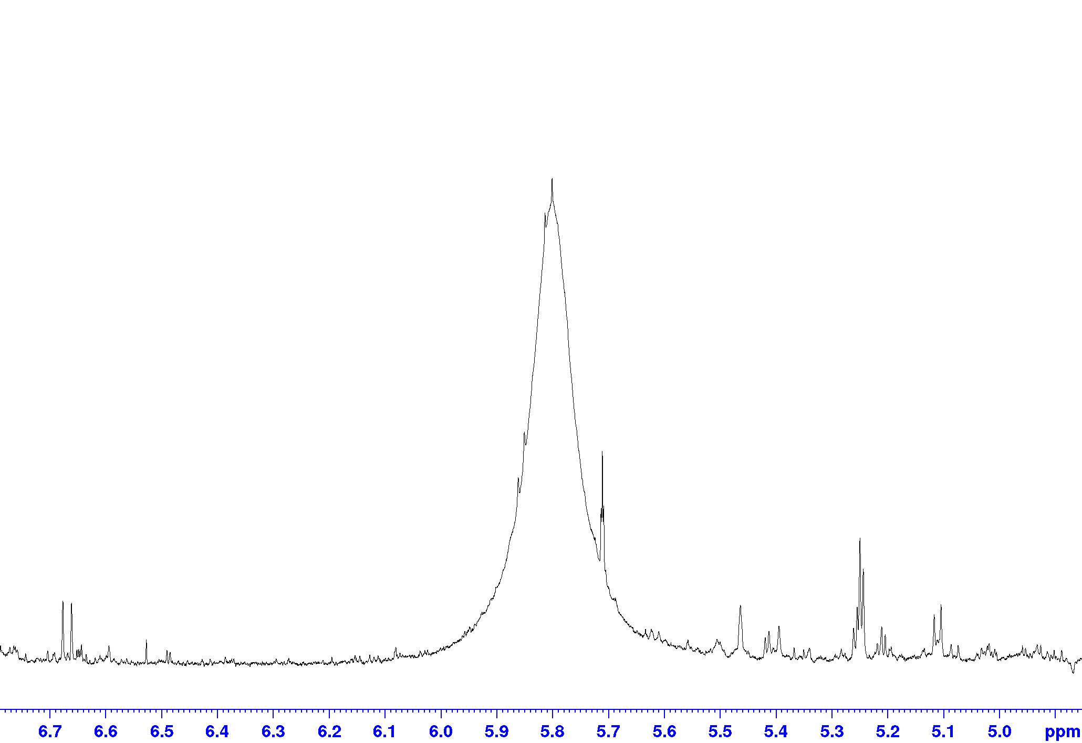
Uracil
Urea
cis-Aconitate
Xanthosine?
2-Furoylglycine
α-Glucose
α-Lactose
1,6-Anhydro- β-glucose
N-Acetylglucosamine
2Py
trans-Aconitate
Paracetamol glucuronide
Fumarate
O-Acetyl-carnitine
Sucrose
Allantoin
HPHPA
Sumiki’s acid
Peak assignments in ¹H NMR spectrum of pooled urine sample (expansion 2)

Slide 4
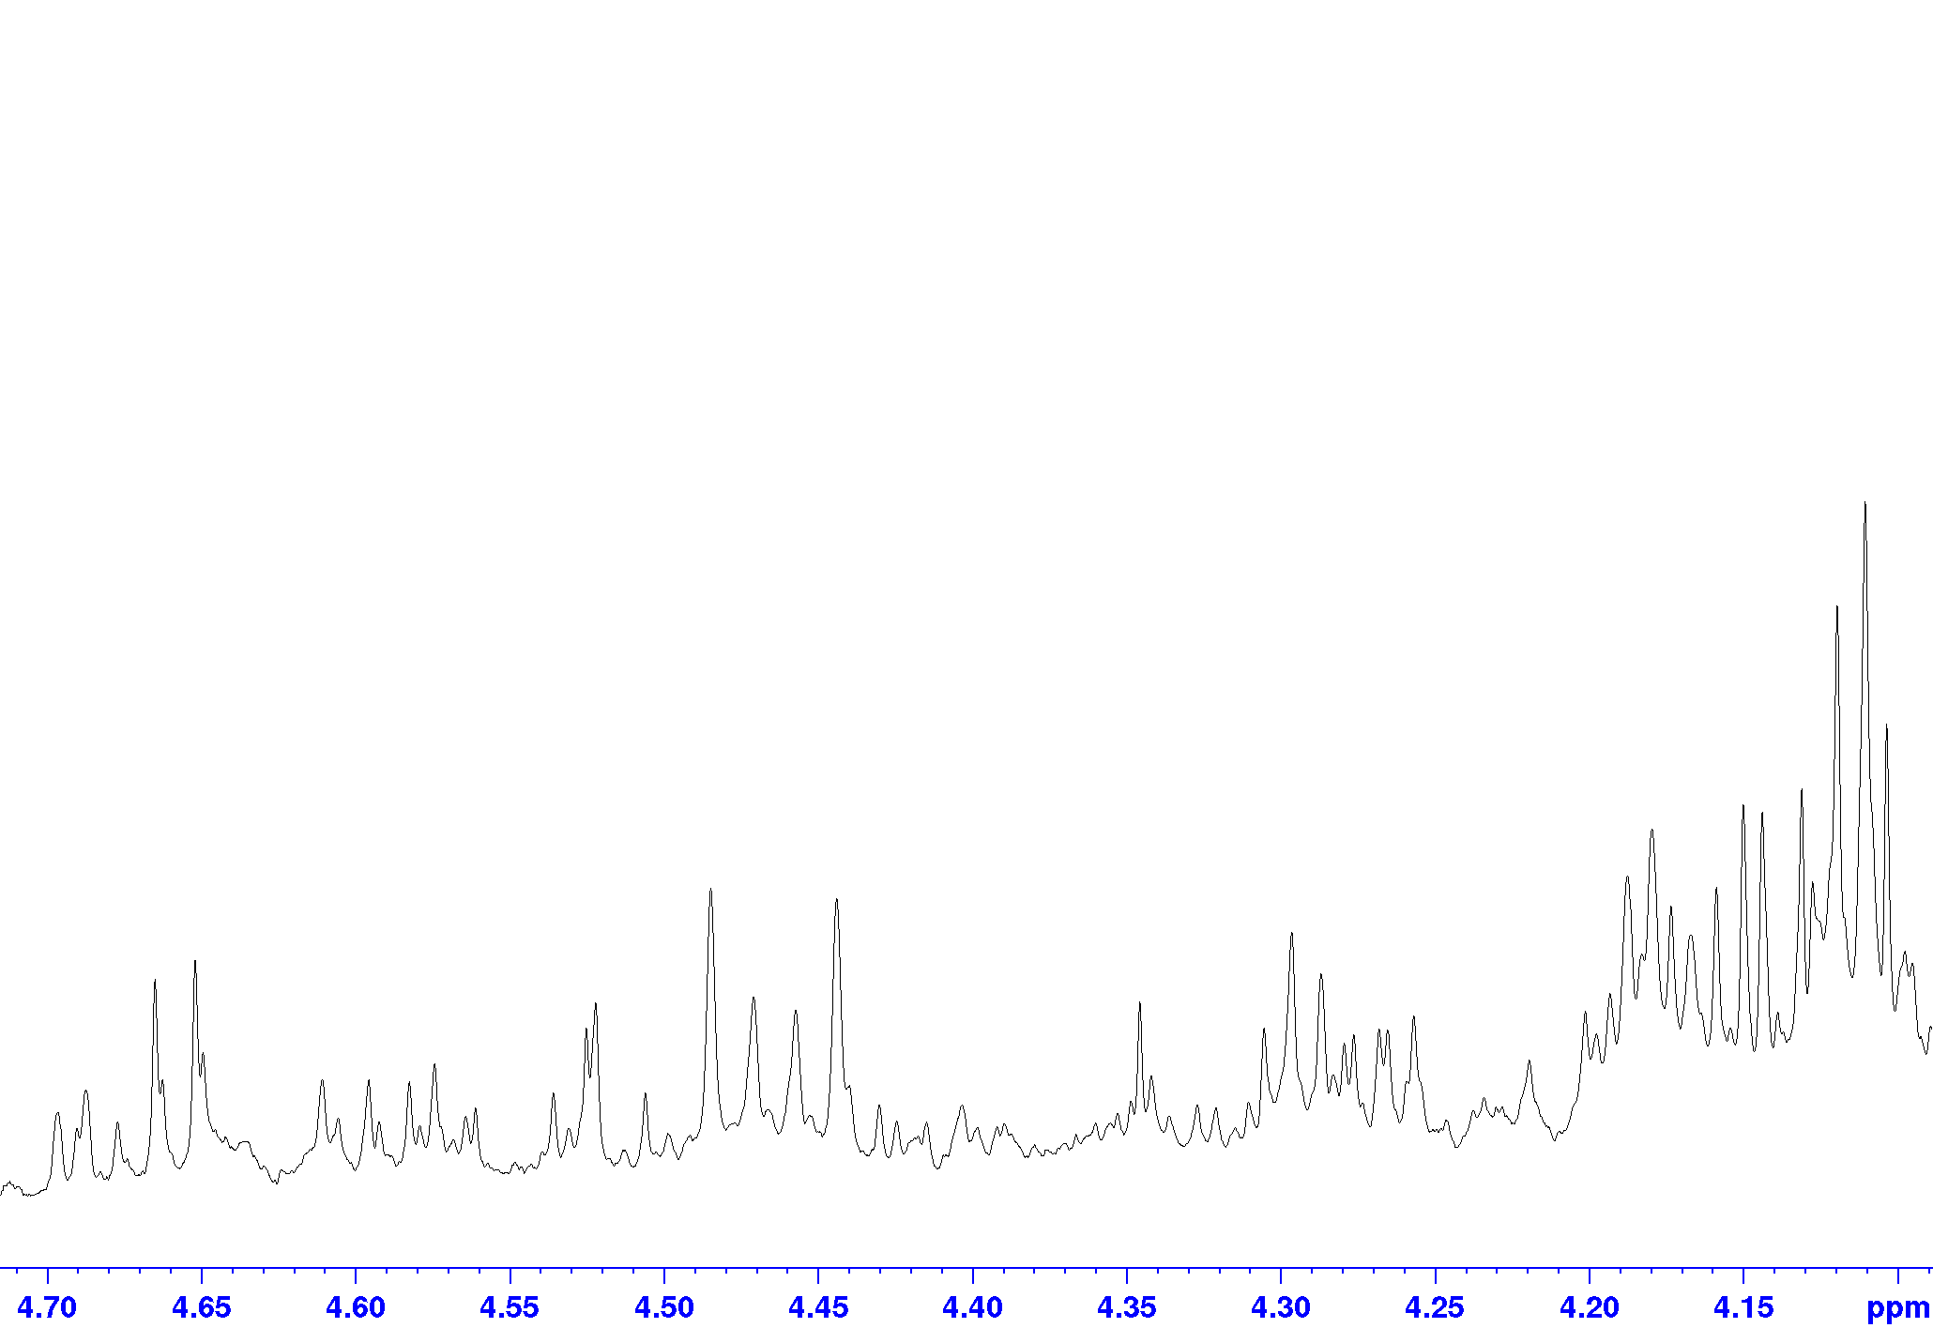
Lactate
?
N-Phenylacetyl-glutamine
Pseudouridine
1-Methylnicotinamide
Lactose
Trigonelline
β-Glucose
Pseudouridine
Tartrate
Threonine
Sumiki’s acid
?
Fucose
Xanthosine?
?
?
Peak assignments in ¹H NMR spectrum of pooled urine sample (expansion 3)

Slide 5
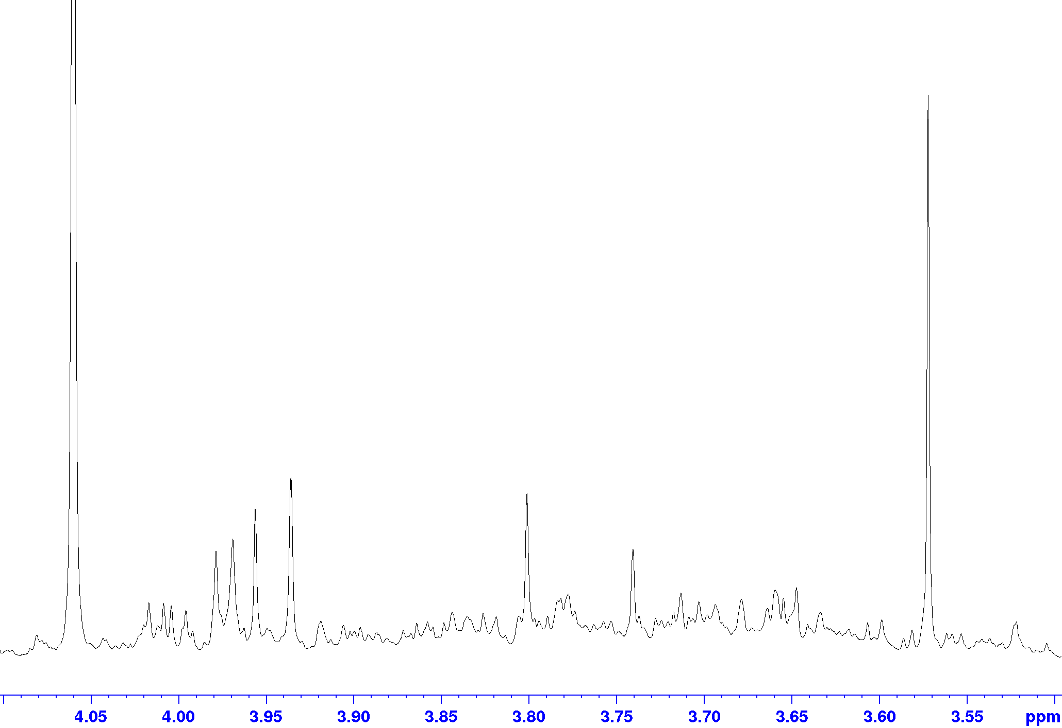
Creatinine
Glycine
Glycolate
Creatine
Hippurate
Guanidoacetate
π-Methylhistidine
Ethanolamine
N-Phenylacetyl-glutamine
Histidine
Threonine
Glucose, Lactose,
Pseudouridine,
Sucrose, Mannitol
Galactitol
Mannitol
Mannitol
Peak assignments in ¹H NMR spectrum of pooled urine sample (expansion 4)

Slide 6
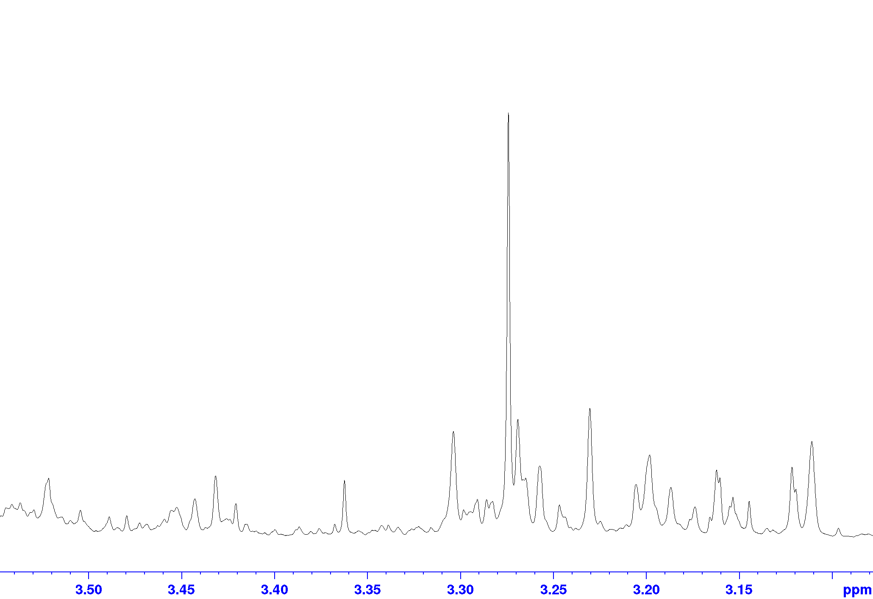
TMAO
Betaine
Proline betaine
Carnitine
Proline betaine
Taurine
Taurine
O-Acetylcarnitine
cis-Aconitate
scyllo-Inositol
Ethanolamine
Choline
Histidine
Peak assignments in ¹H NMR spectrum of pooled urine sample (expansion 5)

Slide 7
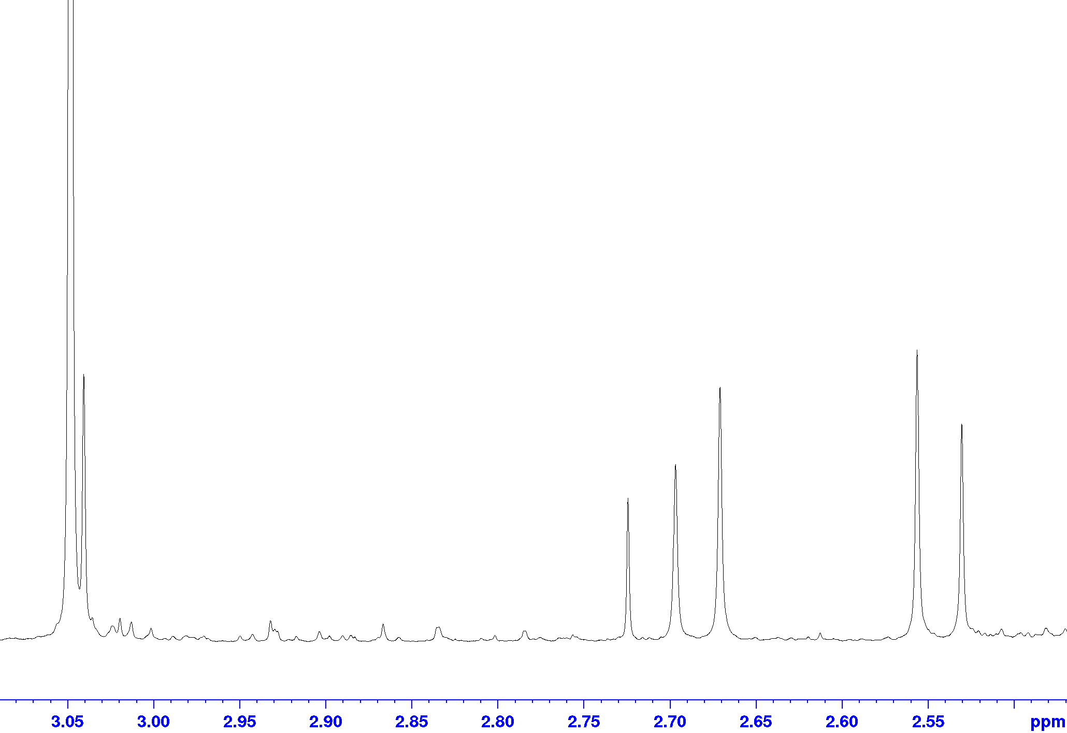
Creatinine
Citrate
Creatine
Citrate
Dimethylamine
Trimethylamine
N,N-Dimethylglycine
N,N-Dimethylformamide
Peak assignments in ¹H NMR spectrum of pooled urine sample (expansion 6)

Slide 8
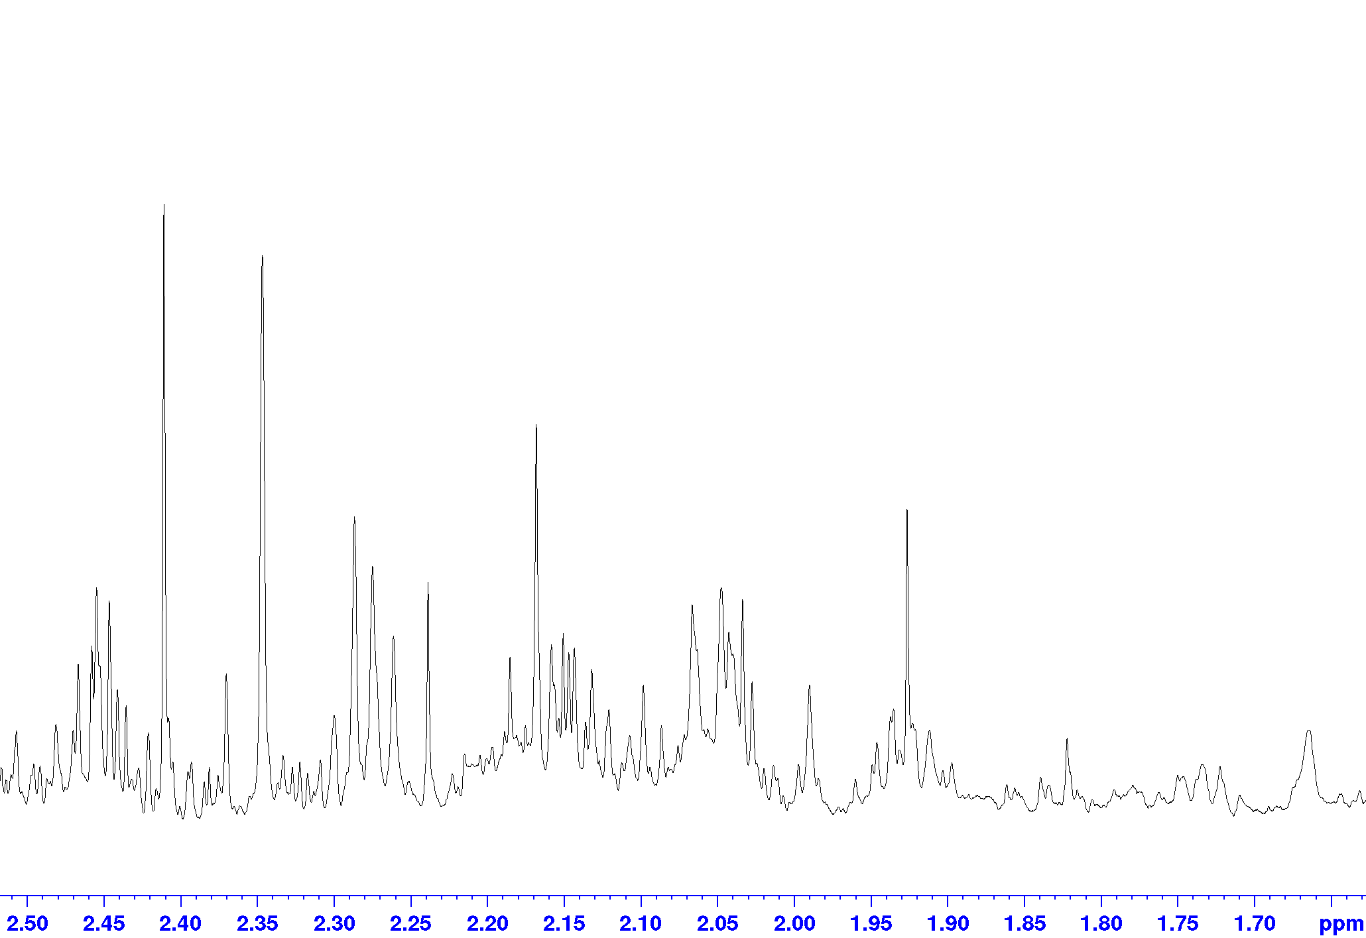
Succinate
p-Cresol sulfate
N-Phenylacetyl glutamine
O-Acetylcholine?
3-Hydroxyisovalerate
Acetate
N-Acetylneuraminic acid
Glutamine/Carnitine
Acetone
N-Phenylacetyl glutamine
Aceto acetate
Glutamine
N-Phenylacetyl glutamine
?
Lysine
Lipid
Peak assignments in ¹H NMR spectrum of pooled urine sample (expansion 7)

Slide 9
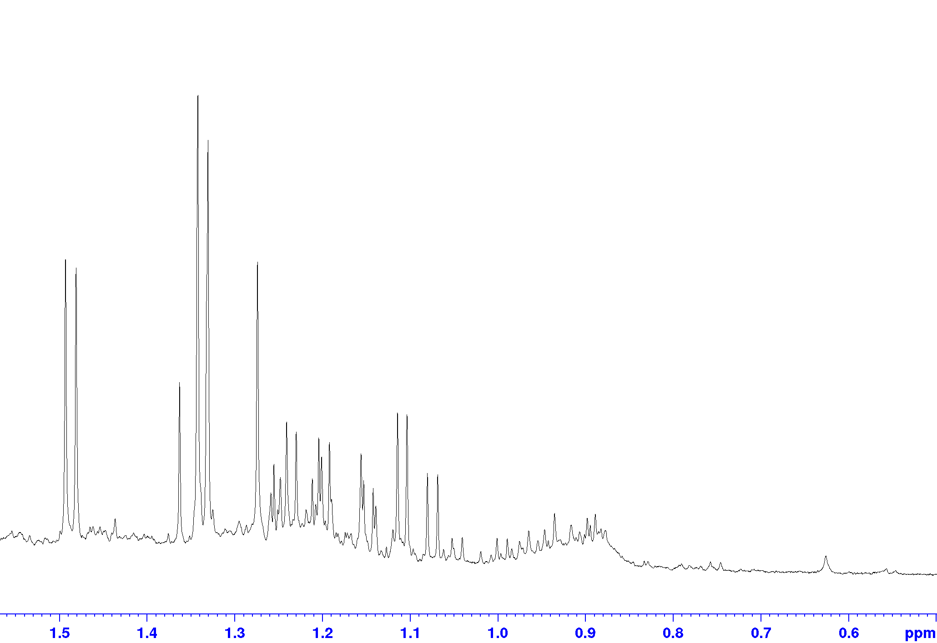
Lactate
Alanine
3-Hydroxyisovalerate
Threonine
4-Deoxythreonate
2-Hydroxy- isobutyrate
3-Hydroxybutyrate 3-Aminoisobutyrate
4-Deoxyerytronate
?
3-Hydroxyisobutyrate
Valine
Leucine
Estrogen metabolite
Pregnanediol-3G
??
Pregnanolone_3G
??
Fucose
Propylene glycol
Isoleucine
Peak assignments in ¹H NMR spectrum of pooled urine sample (expansion 8)

