Slide 1
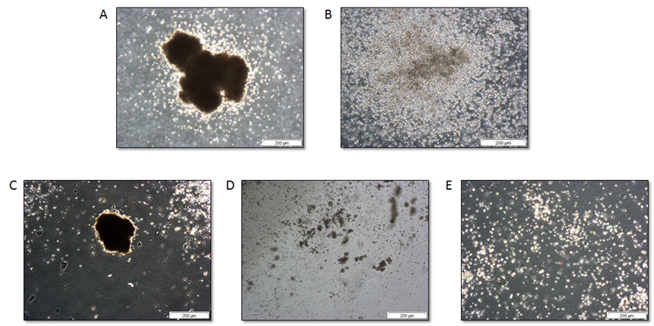
ADDITIONAL FILE 2

