Slide 1
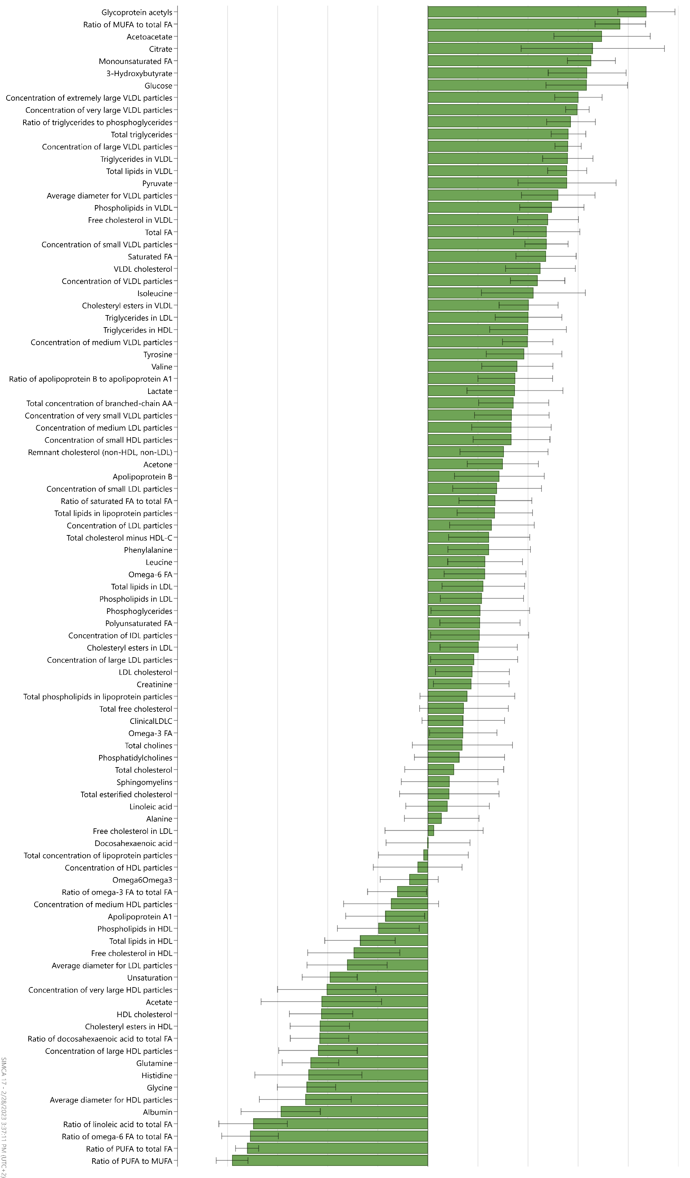
Supplemental Figure 1. Loadings of 95 metabolic measures on the maternal pre-pregnancy BMI-defined metabolome.
-0.20 -0.15 -0.10 -0.05 0.00 0.05 0.10 0.15 0.20 0.25

