Slide 1
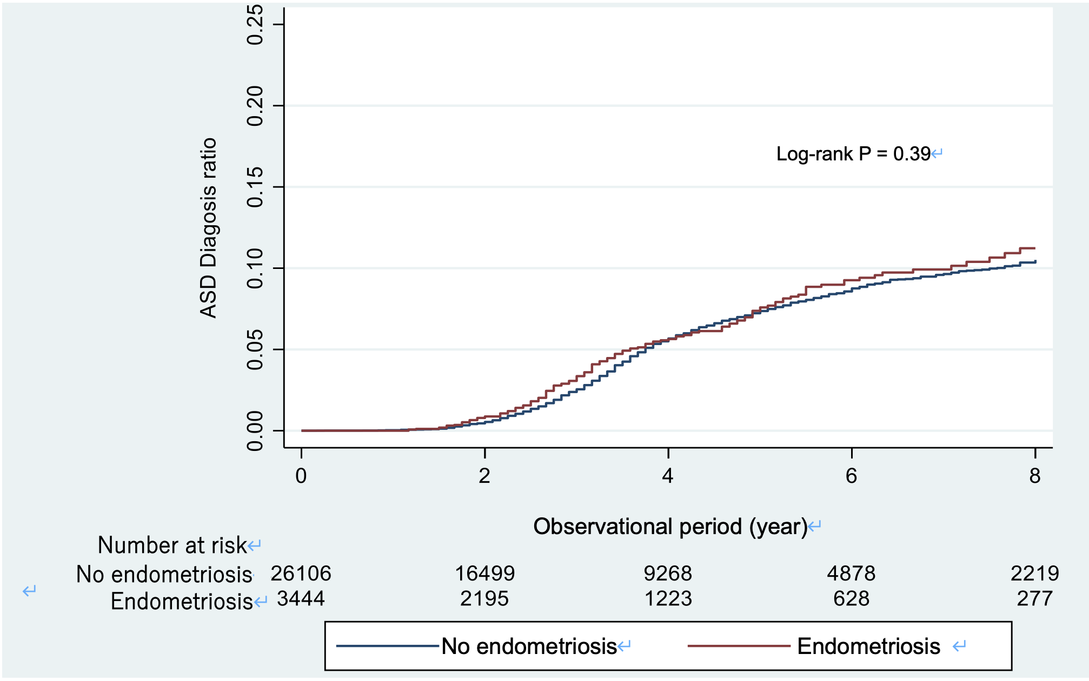
Notes:
Figure S1. Kaplan-Meier estimates for ASD diagnosis in offspring

Slide 2
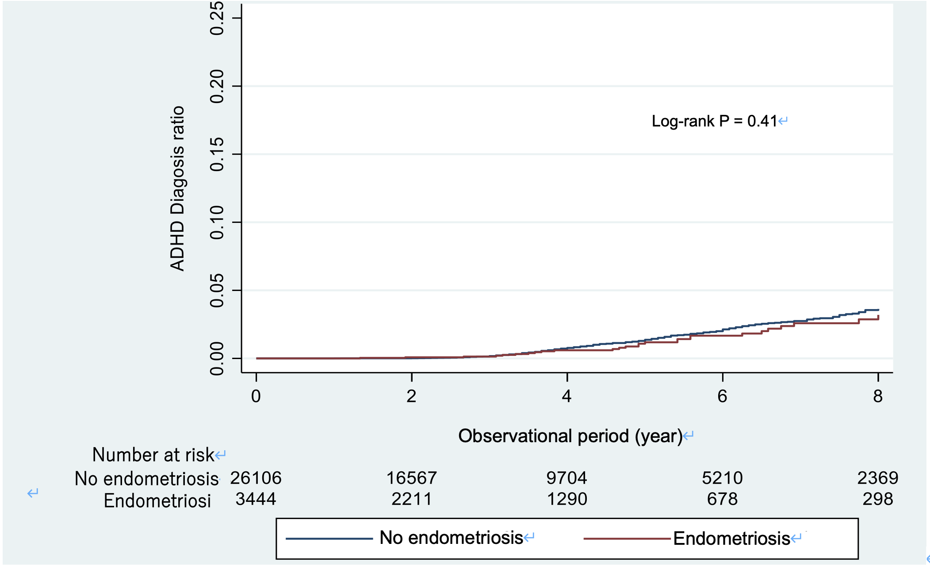
Notes:
Figure S2. Kaplan-Meier estimates for ADHD diagnosis in offspring

Slide 3
Mother–child dyads included
in the main analysis (n=30,020)
Excluded (n=25,618)
Mother’s data did not cover the 5 years prior to childbirth
Children whose mothers had been diagnosed with endometriosis in the 5 years before childbirth (n=856︎)
Children whose mothers had not been diagnosed with endometriosis in the 5 years before childbirth (n=3,546)
Mother–child dyads included
in sensitivity analysis (n=4,402)
Notes:
Figure S3. Flow diagram of included pairs in the sensitivity analysis

Slide 4
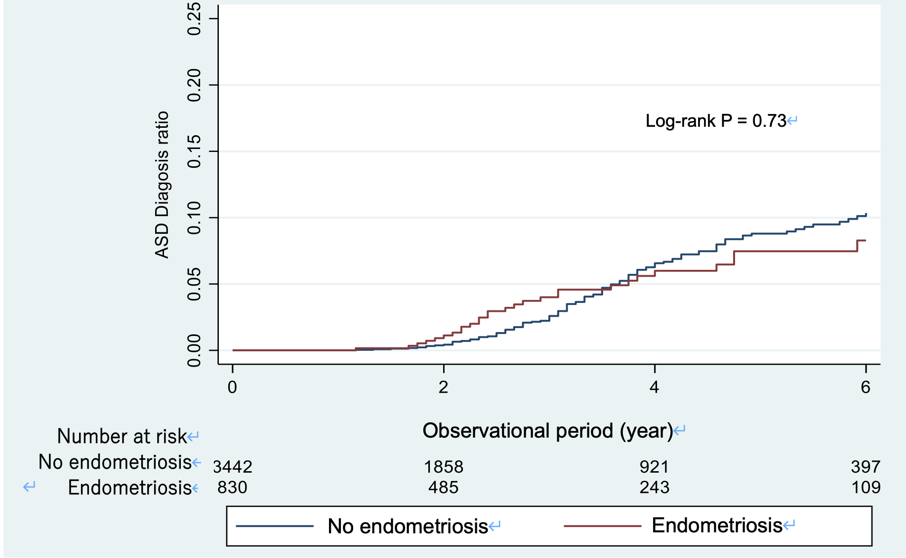
Notes:
Figure S4. Kaplan-Meier estimates for ASD diagnosis in offspring in sensitivity analysis

Slide 5
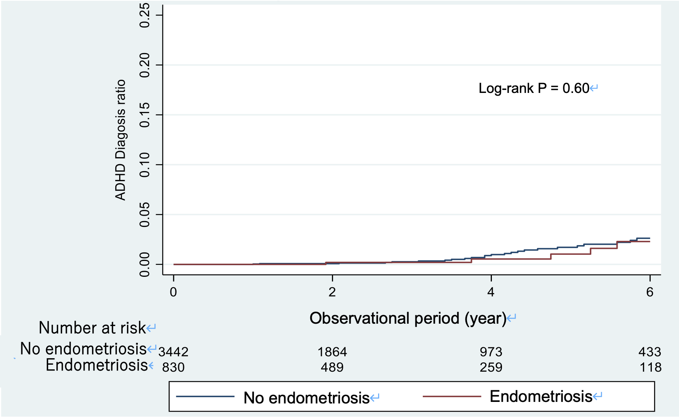
Notes:
Figure S5. Kaplan-Meier estimates for ADHD diagnosis in offspring in sensitivity analysis

