Slide 1
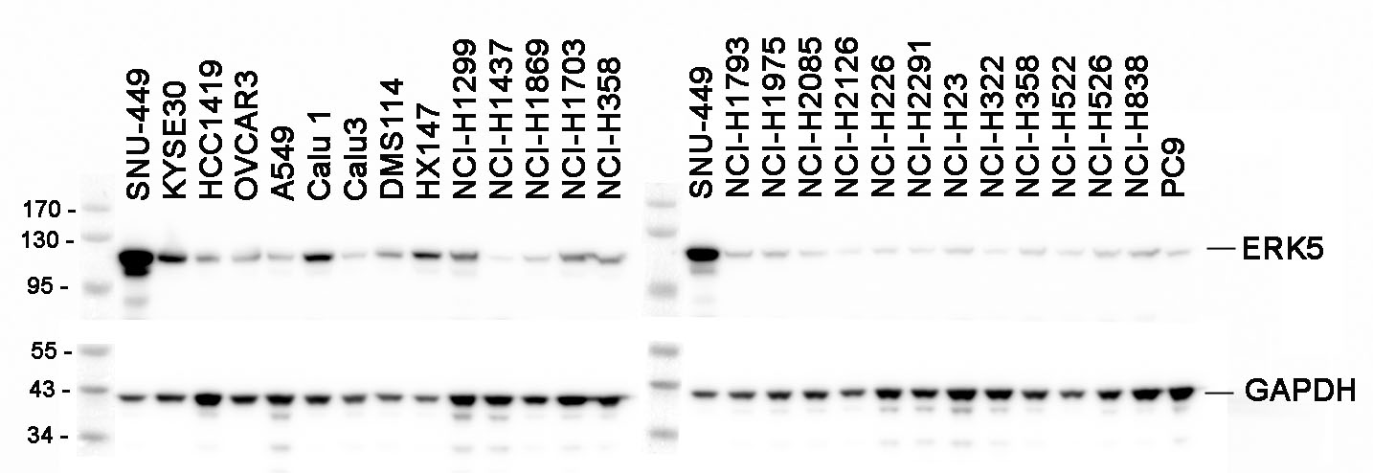
Supplemental Figure 2

