Slide 1
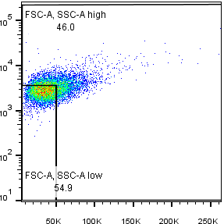
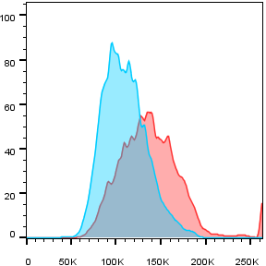
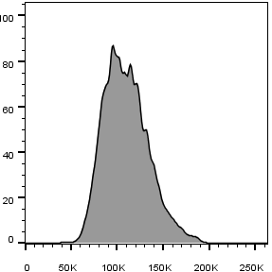
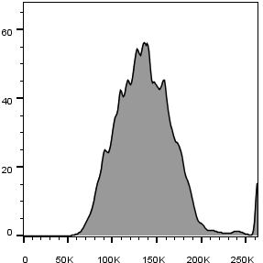
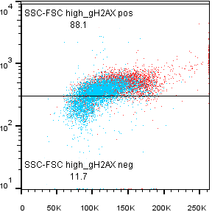
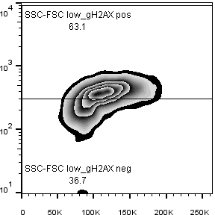
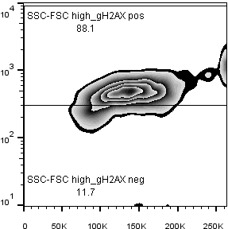
A
B
Treatment #1 d1
F/S-low
F/S-high
SSC
Count
FSC
DAPI
C
gH2AX
DAPI
Notes:
Supplementary Figure shift in FSC/SSC. Prolonged MTA pretreatment extends cisplatin-induced cell cycle arrest. A Flow cytometric analysis of A549 cells revealed that the treatment-induced logarithmic changes of forward (FSC-A) and side scatter (SSC-A) signal intensity correlate with the linear increase in DNA content (DAPI-A) signal intensity. B

