Slide 1
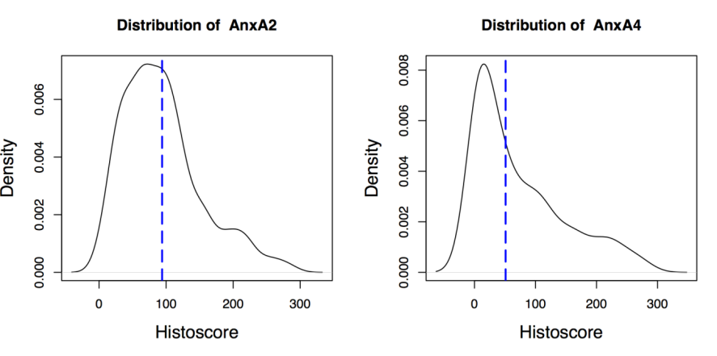
Figure S1

Slide 2
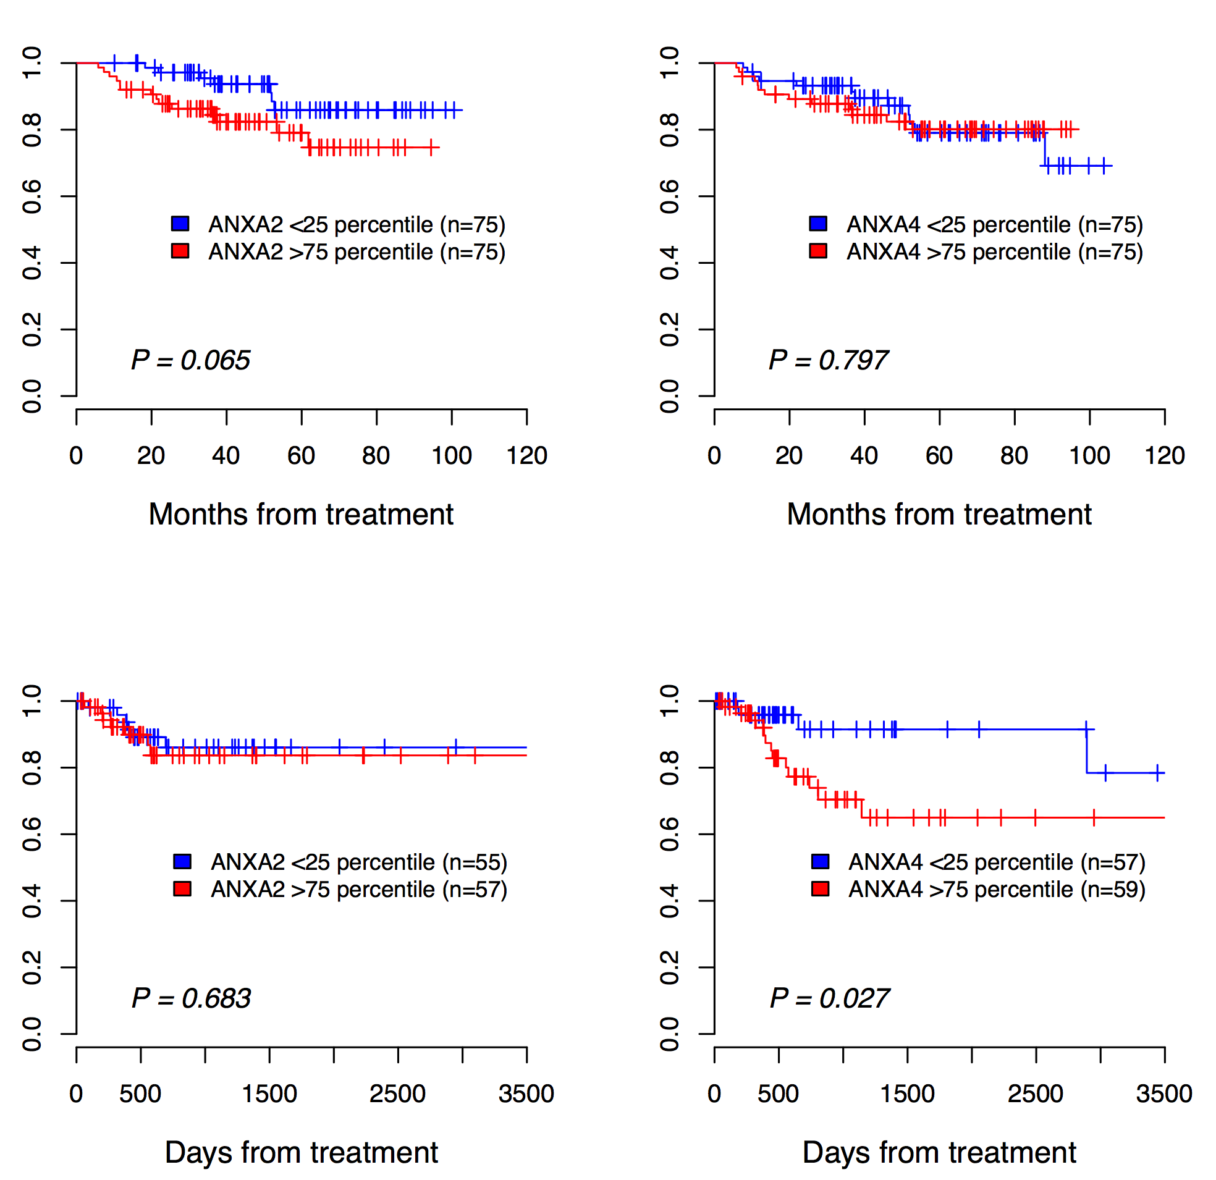
Annexin A2
Annexin A4
GSE44001
Disease-free survival
TCGA cervix
Disease-free survival
Figure S2

Slide 3
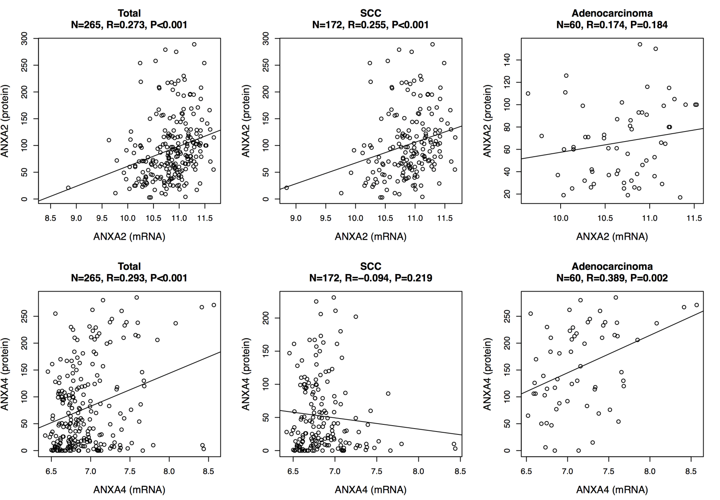
Total
SCC
AD
n = 265
r = 0.273
P < 0.001
n = 172
r = 0.255
P < 0.001
n = 60
r = 0.174
P = 0.001
ANXA2 protein expression
ANXA2 protein expression
ANXA2 protein expression
ANXA2 mRNA expression
ANXA2 mRNA expression
ANXA2 mRNA expression
Total
SCC
AD
n = 172
r = -0.094
P = 0.219
ANXA4 protein expression
ANXA4 protein expression
ANXA4 protein expression
n = 265
r = 0.293
P < 0.001
n = 60
r = 0.389
P = 0.002
ANXA4 mRNA expression
ANXA4 mRNA expression
ANXA4 mRNA expression
Figure S3

Slide 4
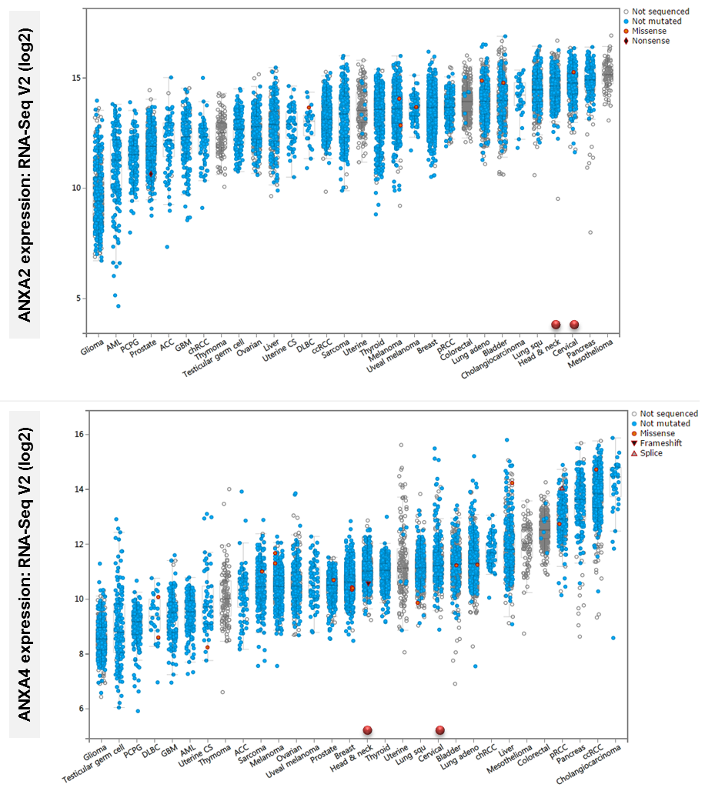
Figure S4

Slide 5
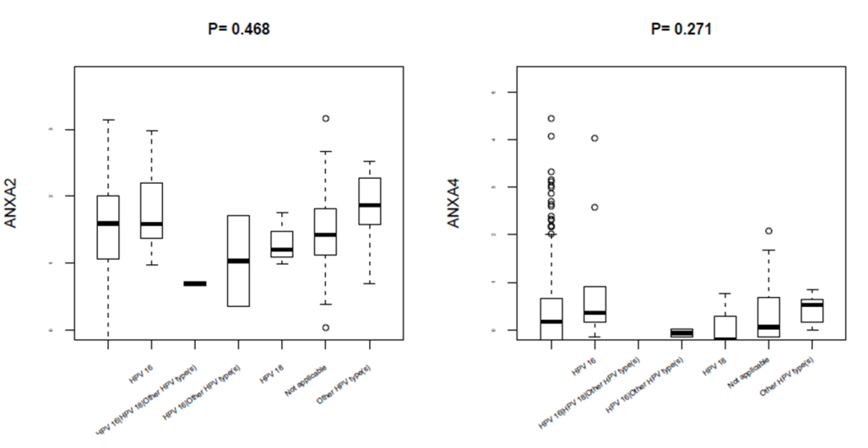
p = 0.468
5
p = 0.271
3
4
2
3
ANXA2 expression (Log²)
ANXA4 expression (Log²)
2
1
1
0
0
HPV16
HPV18
HPV16
HPV18
No data
Not applicable
No data
Not applicable
HPV16/Other types
Other HPV types
HPV16/Other types
Other HPV types
HPV16/HPV18/Other types
HPV16/HPV18/Other types
Figure S5

