Slide 1
S1
P<0.0001
P<0.001

Slide 2
P<0.05
S2
P<0.001
P<0.001
P=NS

Slide 3
S3
Control 2.5 5.0 10
3c (µM)

Slide 4
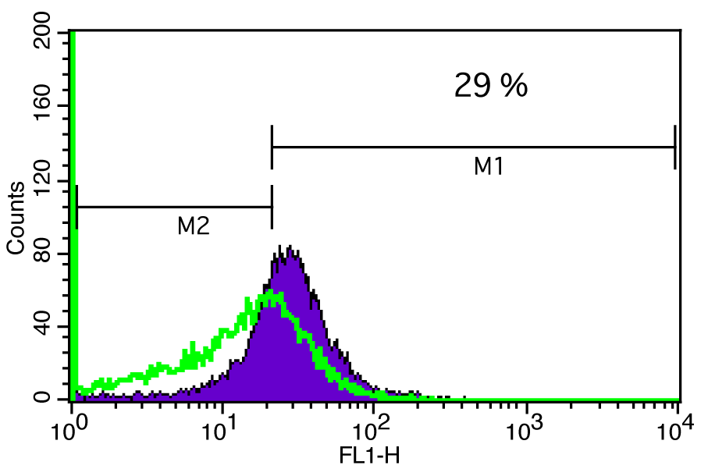
S4
ROS Production in SW620 cells
Control
3c

Slide 5
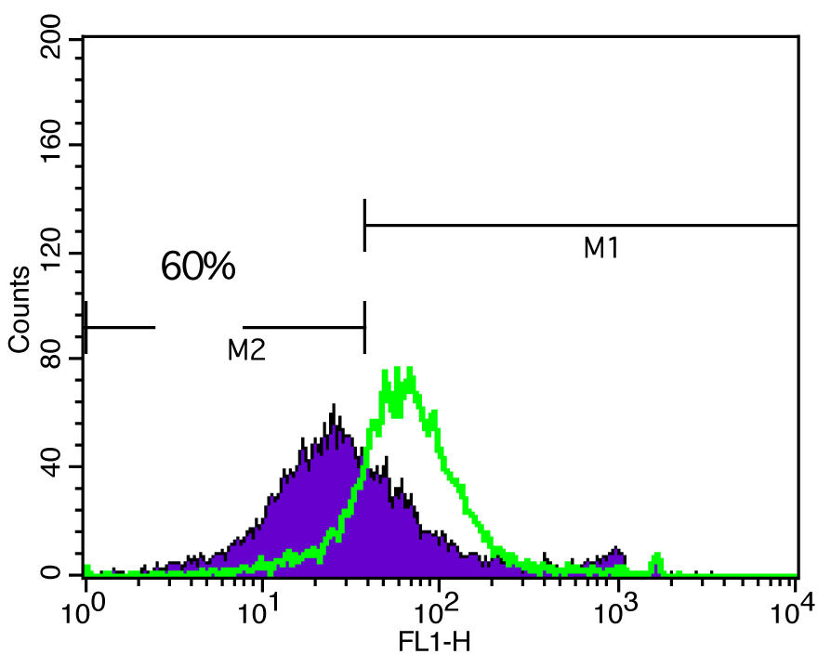
S5
Mitochondrial membrane potential in SW620 cells
Control
3c

