Slide 1
Supplemental Fig. 1
p=0.015
3x10⁰⁷
p=0.005
_
p=0.347
2x10⁰⁷
RLU per 1.0x10⁶ tumor cells
1x10⁰⁷
_
_
0
PyMT
PyMT+BALB/c Neutrophils
PyMT+BALB/c Neutrophils+CCL2

Slide 2
Supplemental Fig. 2
Treatment effect (p<0.001) adjusted for block
100
***
.
75
**
50
-
number of mets in lung
25
-
0
-
-25
MFP-PBS
MFP+TbR2KO
t.v TbR2KO

Slide 3
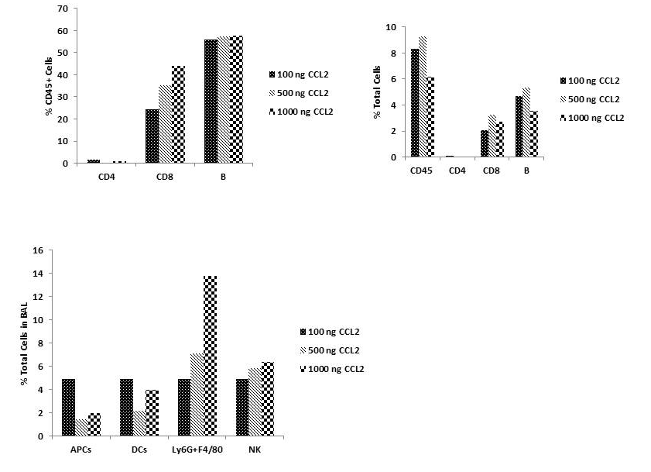
Supplemental Figure 3
A.
B.

Slide 4
Supplemental Figure 4

