Slide 1
Supplemental table 1

Slide 2
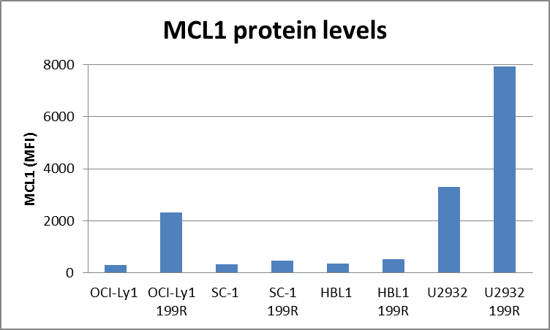
Supplemental Figure 1
*
*

