Slide 1
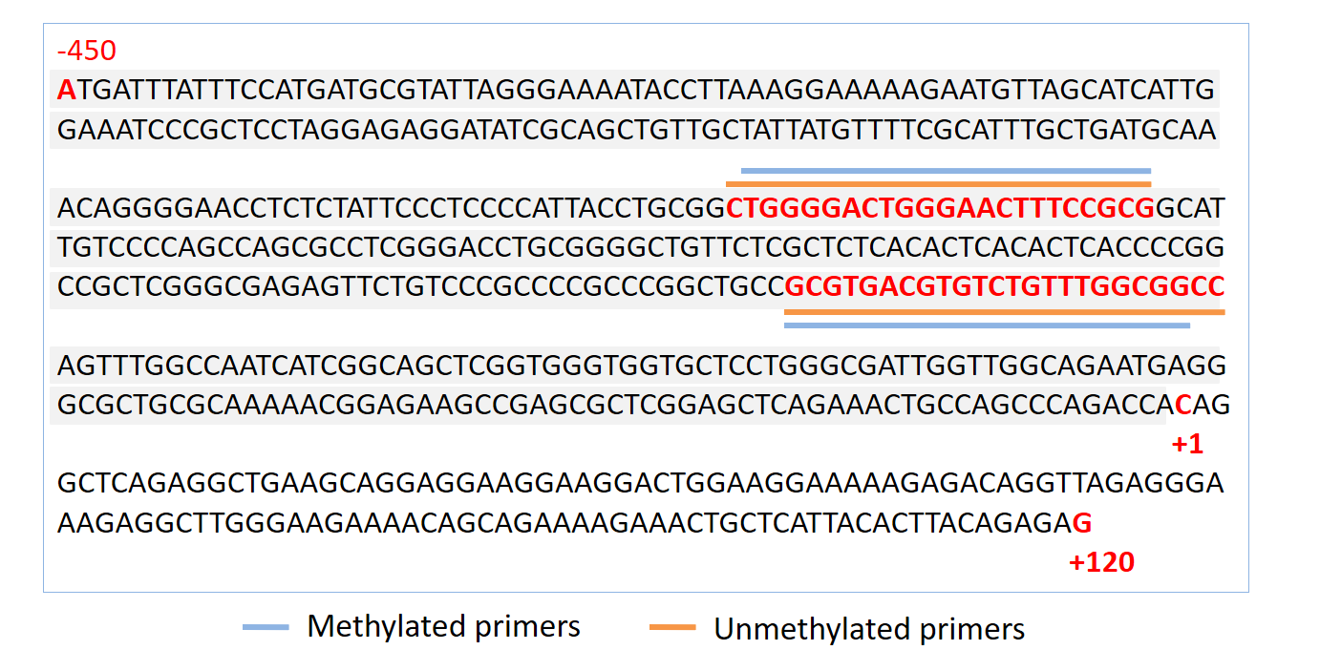
Diagram 1. The location of the primers in relation to the PCDH10 promoter and start site. The sequence with gray shading is the core promoter of PCDH10 (NM_032961). The blue line indicates the location of methylated primers, and the orange line indicates the location of unmethylated pimers.

