Slide 1
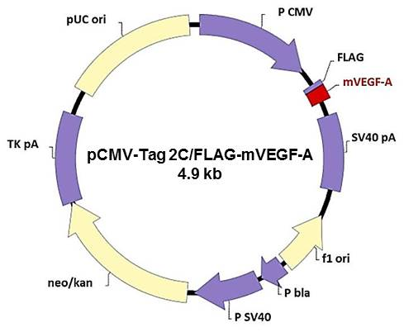

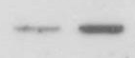

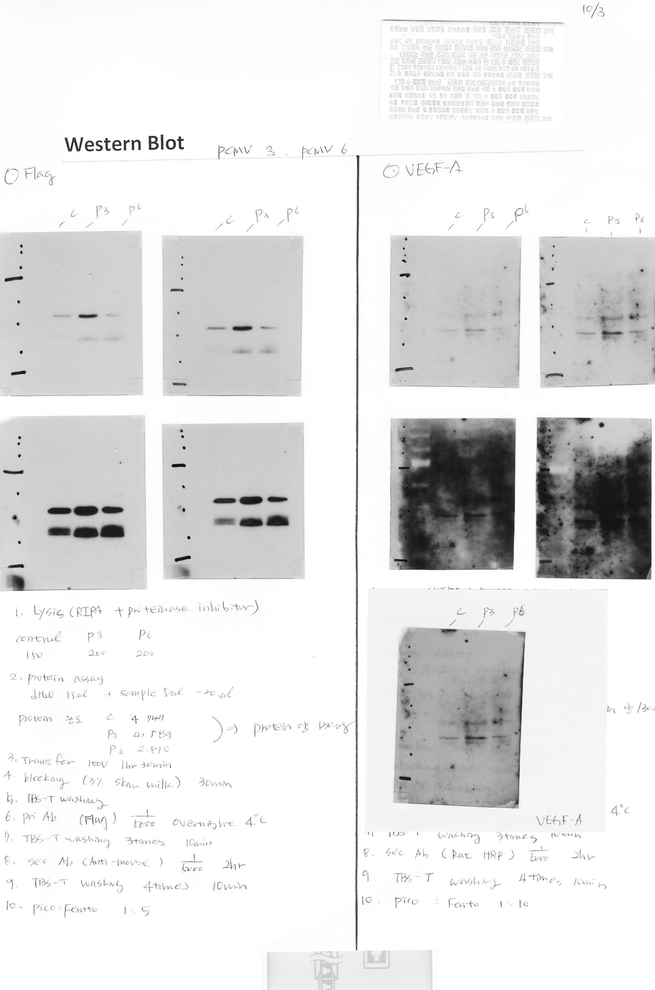
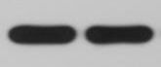
a
b
SCCVII/mVEGF-A
SCCVII/mVEGF-A
SCCVII
SCCVII
mVEGF-A
mVEGF-A
β-actin
FLAG
β-actin
Supporting information 1

