Slide 1
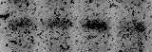
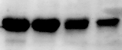
Neg control siRNA
GNB4 siRNA
Neg control siRNA
GNB4 siRNA
GNB4
Ratio: 1.00 0.94 1.00 0.53
Actin
182^{R}-6 TAM^{R}-1
Supplementary Fig. S2

