Slide 1
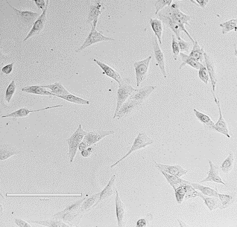
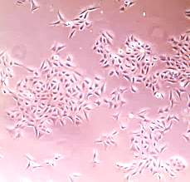
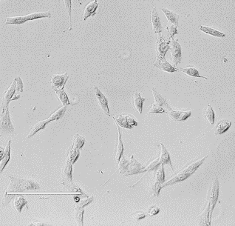
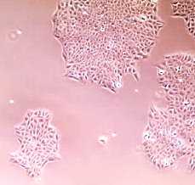
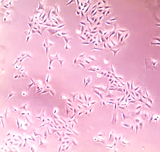
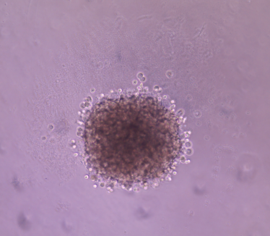
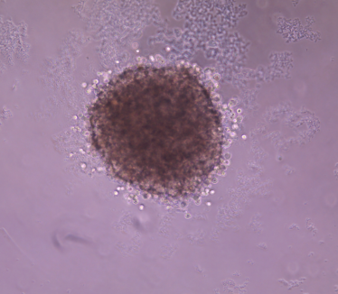
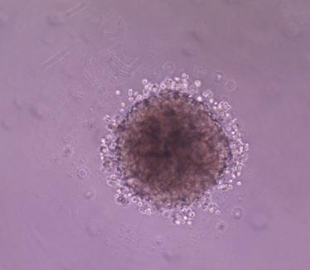
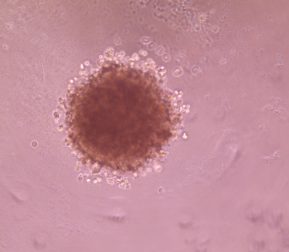
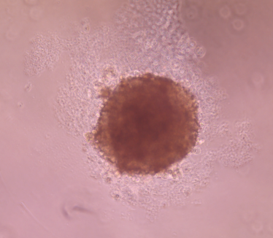
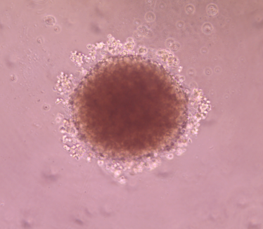
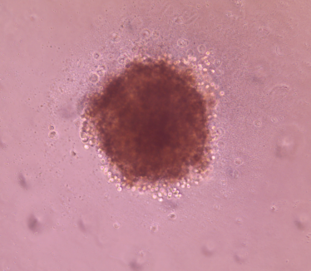
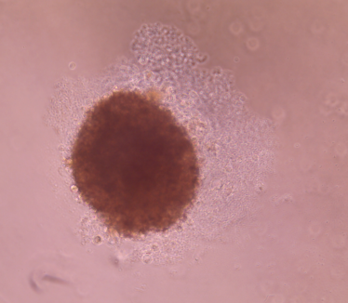
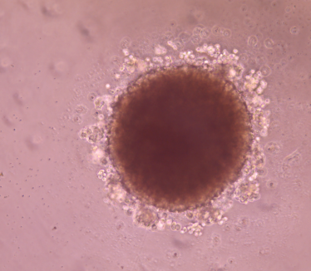
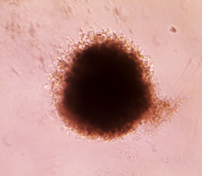
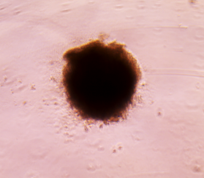
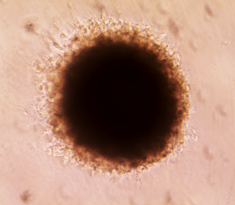
A
K7M2
U2OS
B
3.0
K7M2
Cyr61 mRNA Level (A.U.)
2.5
OE-CYR61
R²=0.9992
P value 0.02543
Control
2.0
1.5
Control
100µm
1.0
200µm
400µm
0.5
shCYR61
0
50
100
150
200
250
shCYR61
Maximal Cell Lengh (µm)
Cyr61 mRNA Level (A.U.)
2.0
U2OS
R²=0.999
P value 0.02809
1.5
OE-CYR61
1.0
Control
OE-CYR61
0.5
0
shCYR61
20
40
60
80
100
120
Maximal Cell Lengh (µm)
C
K7M2 Control
shCyr61
OE-CYR61
D
Control
shCYR61
a
100
OE-CYR61
Day 1
80
a
Surface (A.U.)
a
60
40
a
a
a
Day 2
20
0
1
2
3
4
5
6
7
8
E
Days
Adhesive Cell Number Log2(FC)
-0.8
-0.6
-0.4
-0.2
0
0.2
0.4
0.6
Day 3
Plastic
Laminin
Type I Collagen
a
a
Day 7
Fibronectin
shCYR61
OE-CYR61
FIGURE S2

