Slide 1
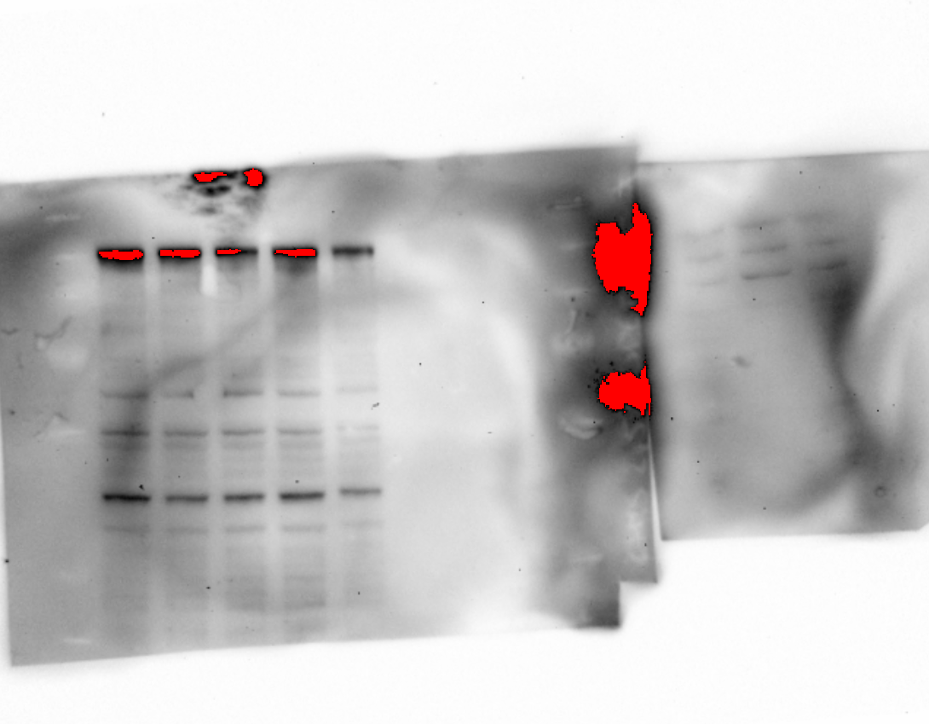
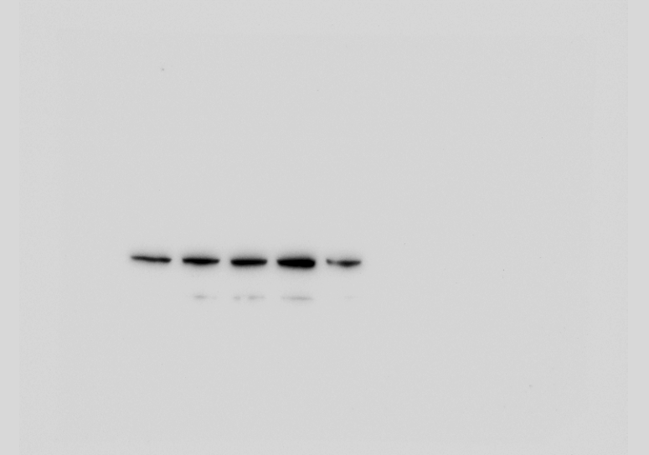
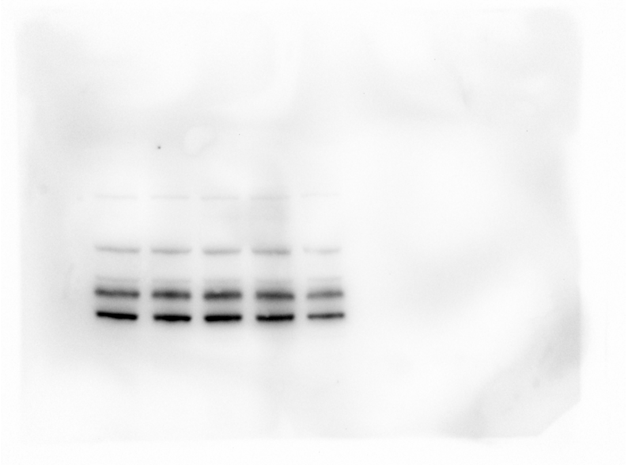
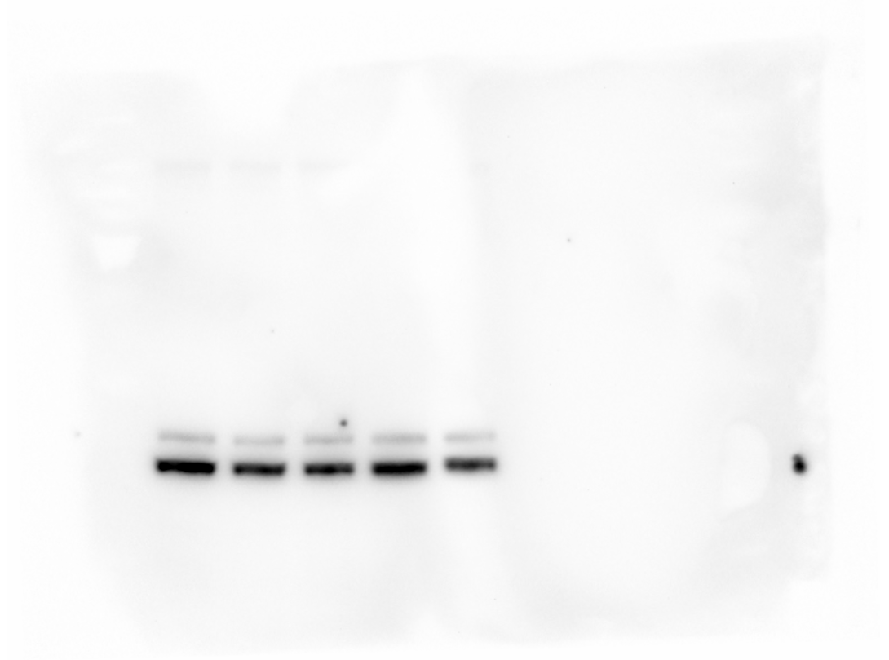
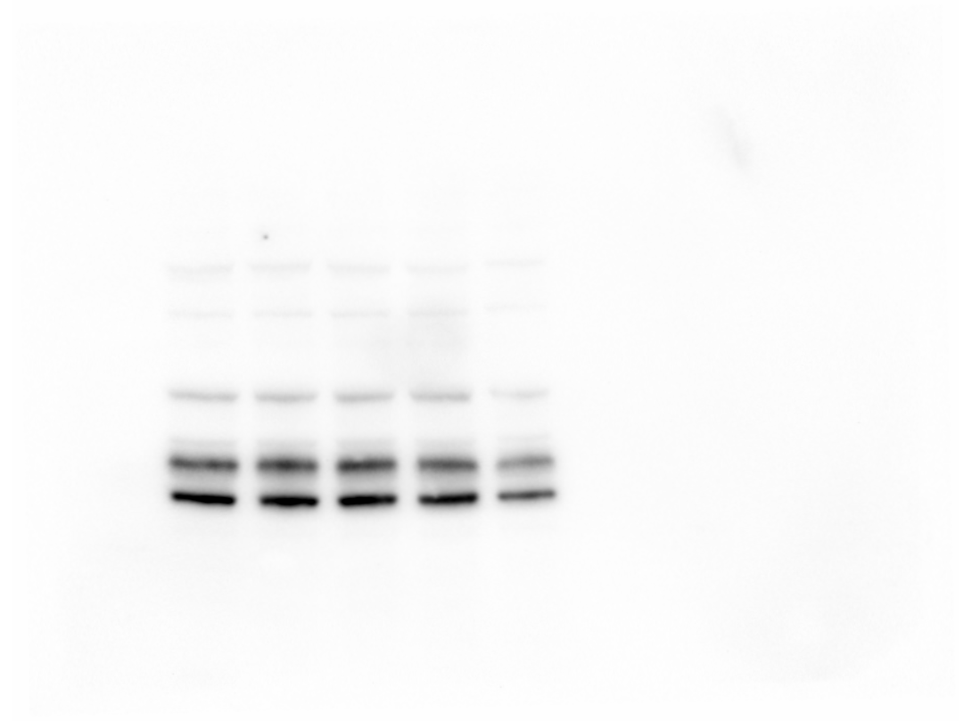
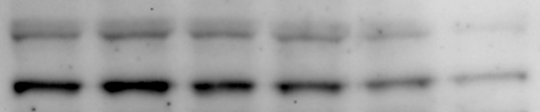
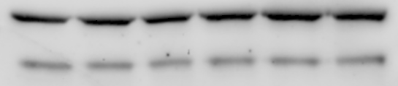
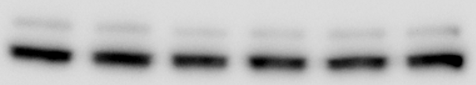
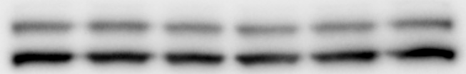
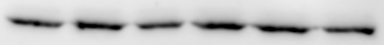
K7M2
SP600125 (µM)
0
1
5
10
15
p-JNK
(T183/Y185)
JNK
p-ERK1/2
(T202/Y206)
ERK1/2
Actin
U2OS
SP600125 (µM)
0
1
2
5
10
15
p-JNK
(T183/Y185)
JNK
p-ERK1/2
(T202/Y206)
ERK1/2
Actin
FIGURE S4

Slide 2
K7M2
SP600125 (µM)
0
1
5
10
15
p-JNK
(T183/Y185)
JNK
Actin
U2OS
SP600125 (µM)
0
1
2
5
10
15
p-JNK
(T183/Y185)
JNK
Actin
SUPPLEMENTAL FIGURE 4

