Slide 1
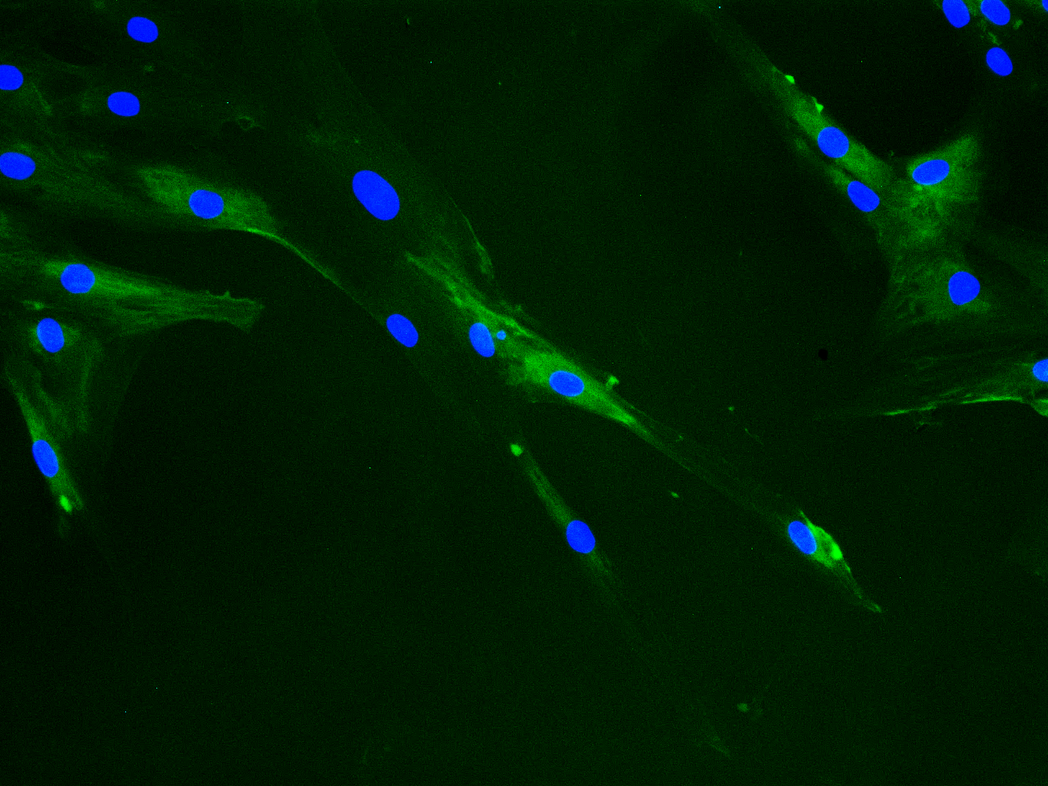
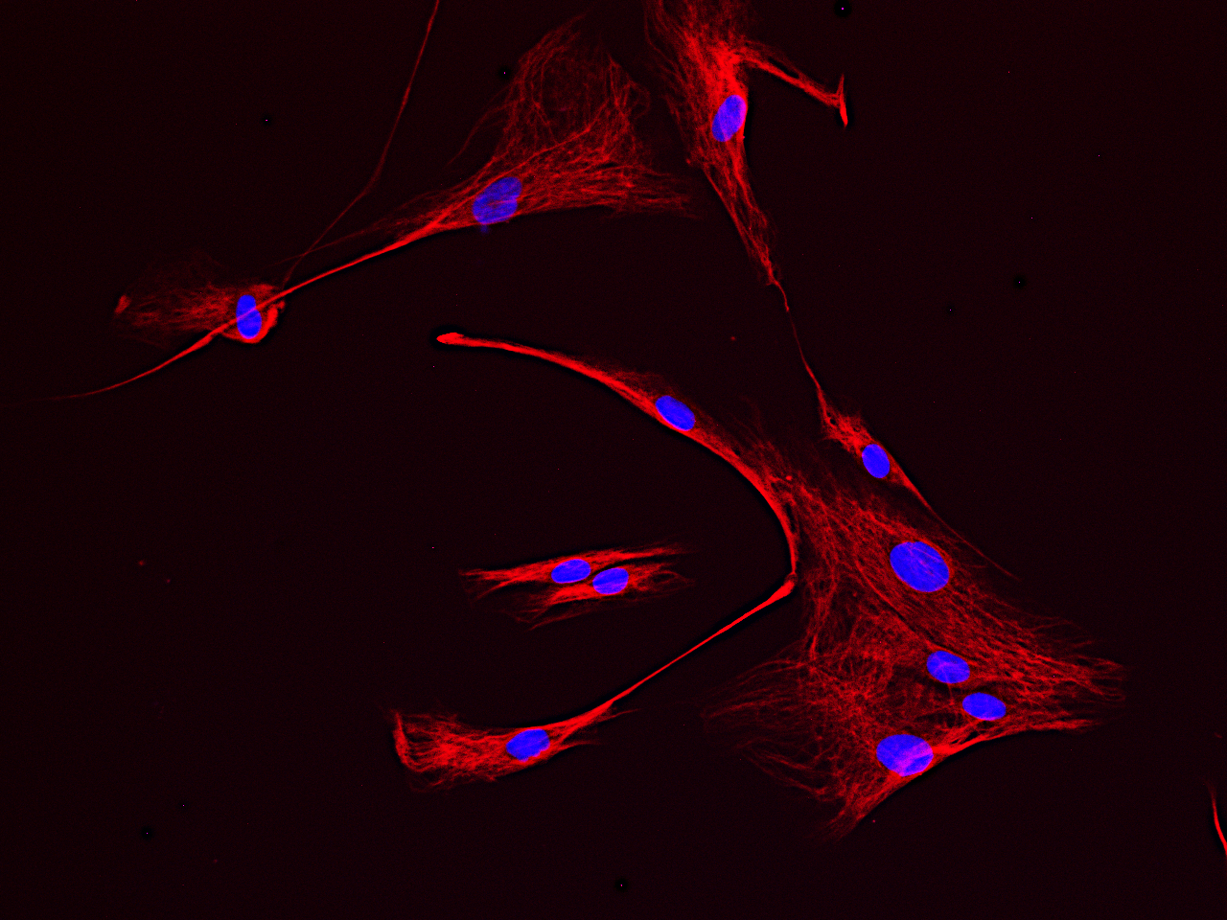
A
PSCs
B
PSC-1
PSC-2
PSC-3
PSC-4
PSC-5
PSC-6
PSC-7
PSC-8
PSC-9
PSC-10
ɑSMA
ɑSMA
Vimentin
Vimentin
GAPDH
Additional File 4_Figure S3. Characterization of human PSCs. (A) PSCs immunostained with anti-αSMA (green) and anti-vimentin (red) antibodies. Nuclei stained with DAPI (blue). Scale bar = 100 µM. (B) The cells were lysed and proteins subjected to immunoblotting using anti-αSMA and anti-vimentin antibodies. GAPDH was used as a loading control. PSC, pancreatic stellate cell; αSMA, α-smooth muscle actin.

