Slide 1
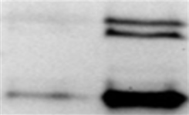
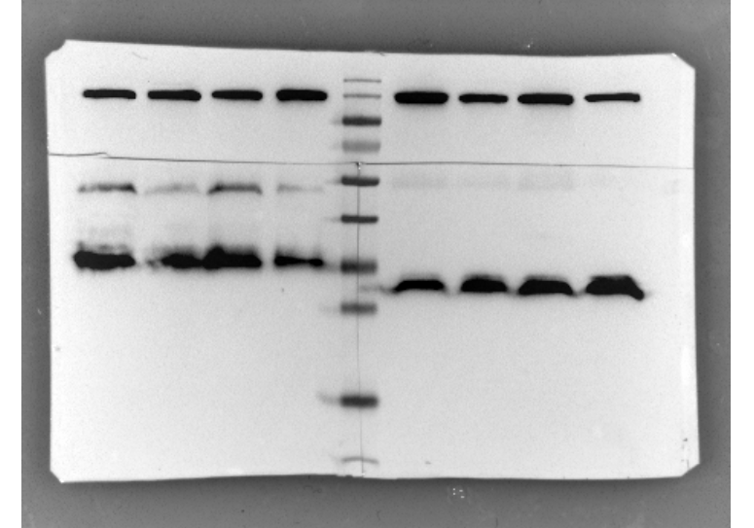
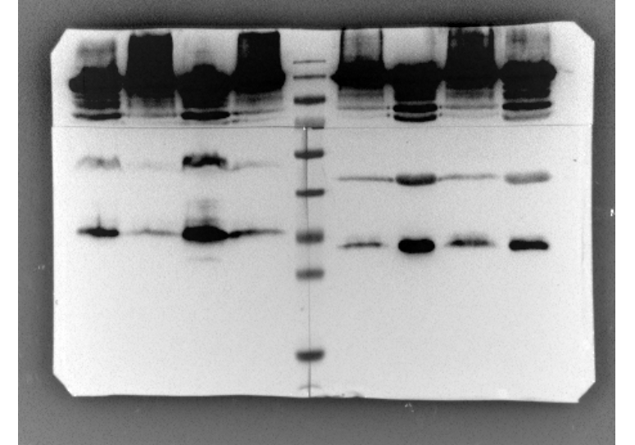
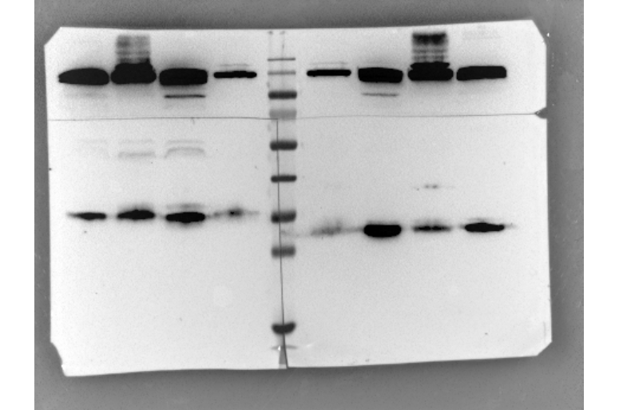
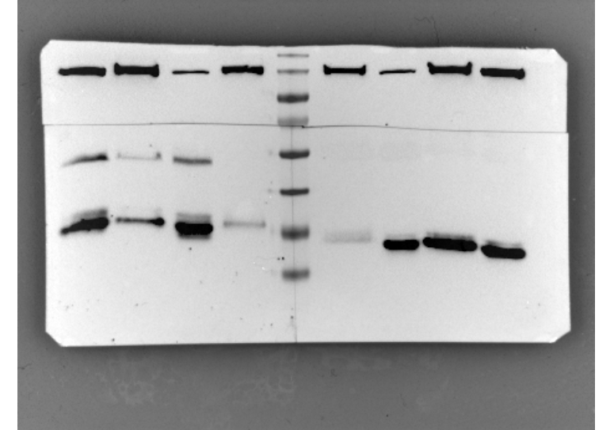

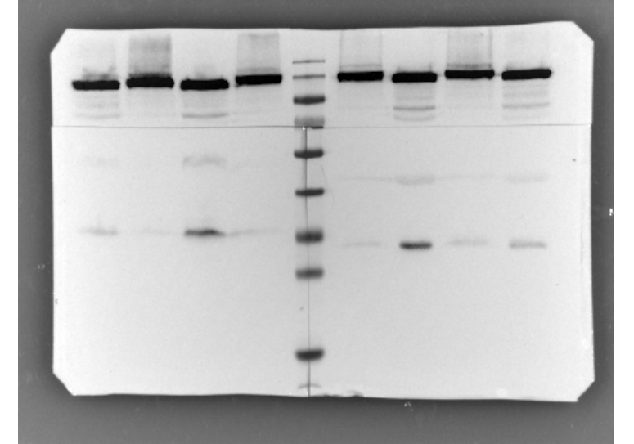
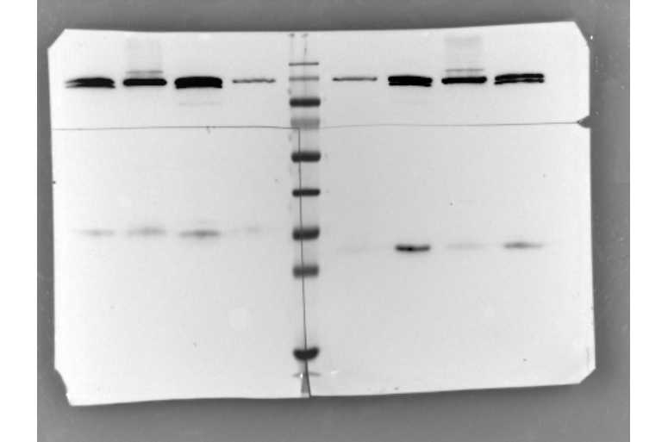
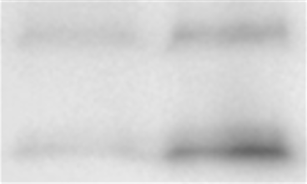
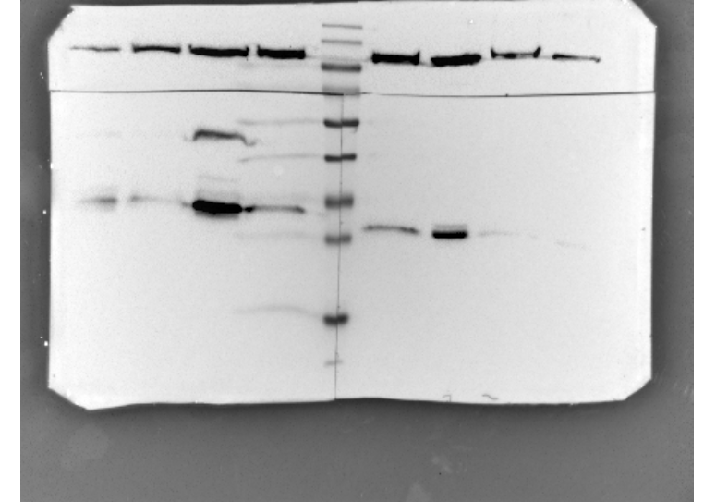
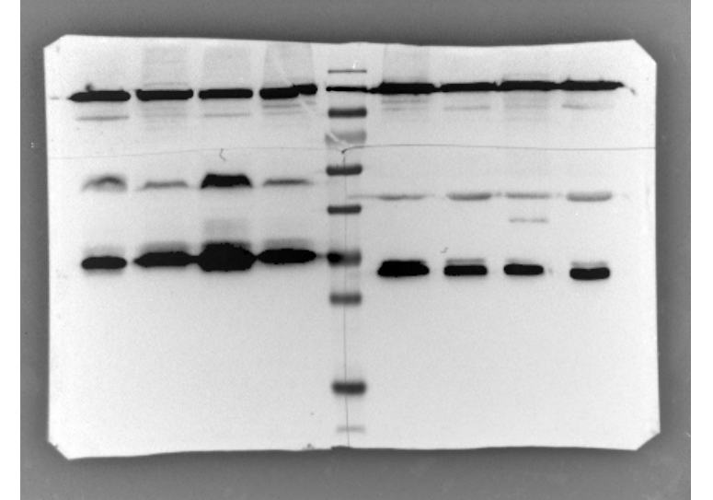

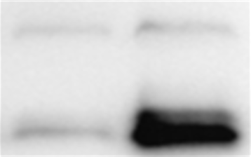
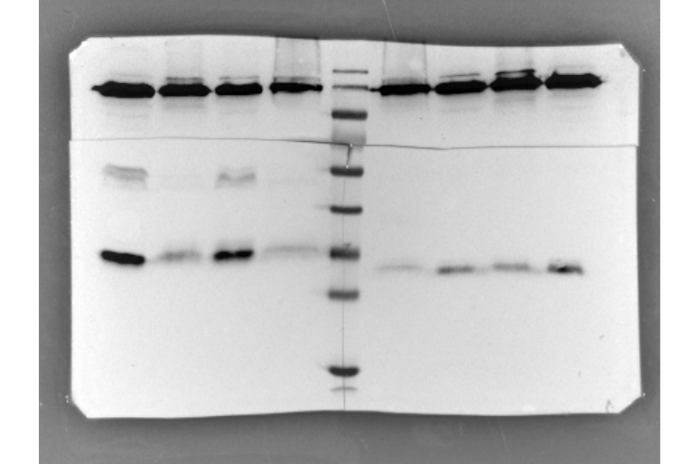
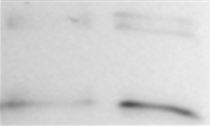


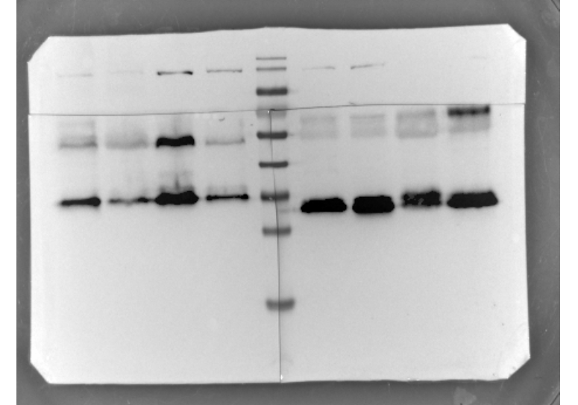
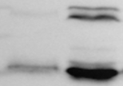
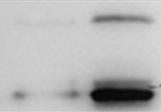
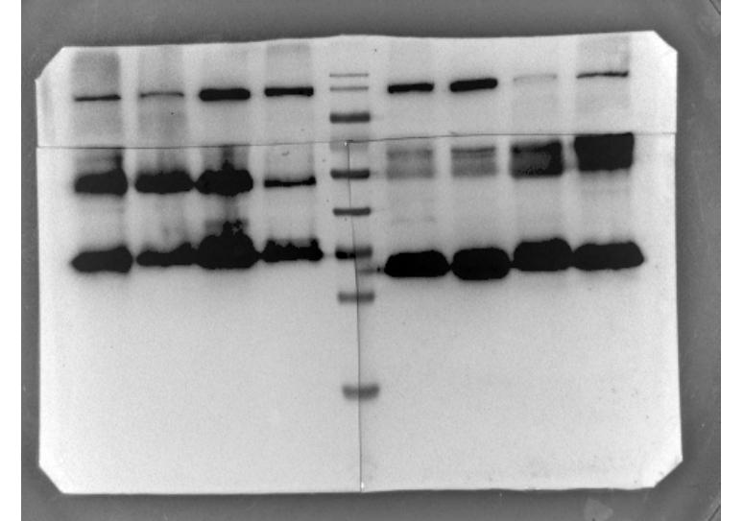


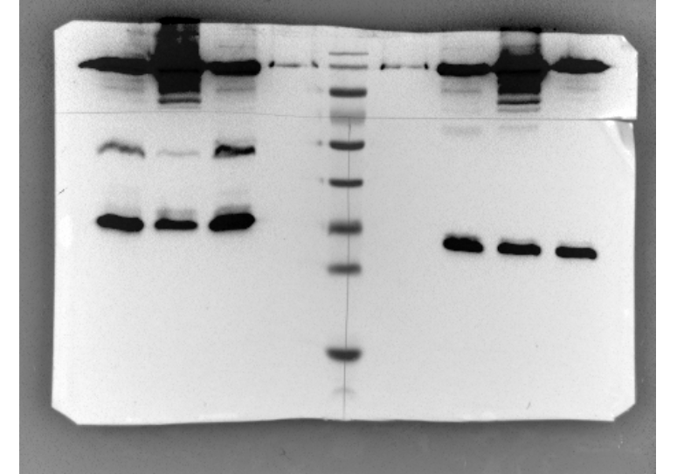

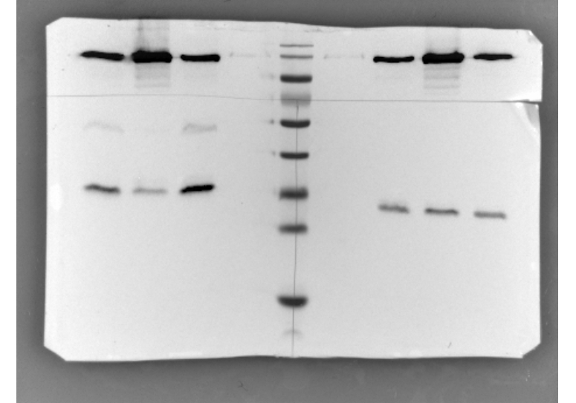

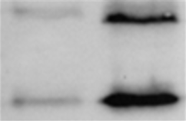
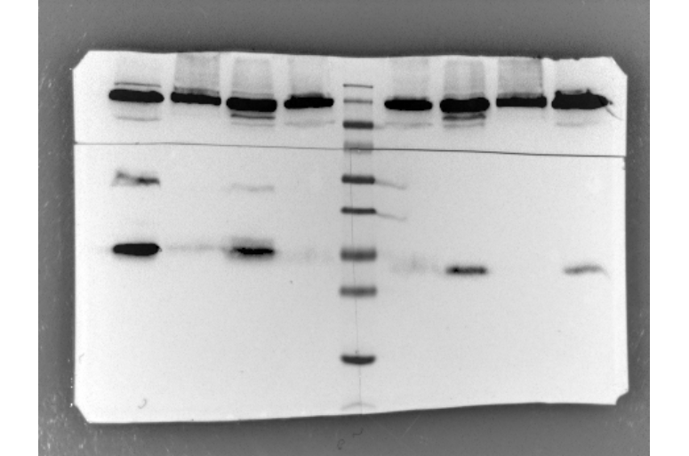

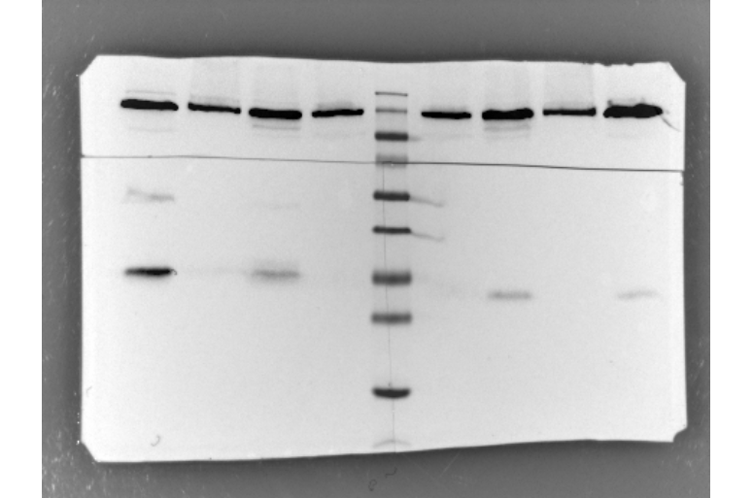
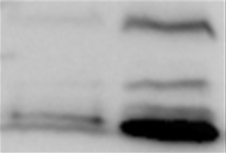
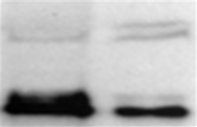
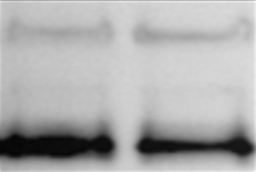
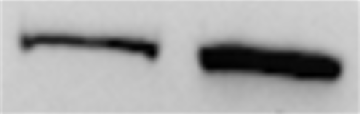
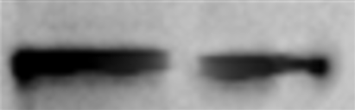

Figure S1.
A
B
C
D
ER⁺ PR⁺ HER2⁻
ER⁺ PR⁺ HER2⁺
ER⁻ PR⁻ HER2⁺
ER⁻ PR⁻ HER2⁻
N T
N T
N T
N T
N T
Bag-1L
Bag-1M
Bag-1S
Vinculin
Bag-1L
Bag-1M
Bag-1S
Vinculin
Bag-1L
Bag-1M
Bag-1S
Vinculin
Bag-1L
Bag-1M
Bag-1S
Vinculin
Bag-1L
Bag-1M
Bag-1S
Vinculin
Patient #1
Patient #8
Patient #14
Patient #21
Patient #24
Bag-1L
Bag-1M
Bag-1S
Vinculin
Bag-1L
Bag-1M
Bag-1S
Vinculin
Bag-1L
Bag-1M
Bag-1S
Vinculin
Bag-1L
Bag-1M
Bag-1S
Vinculin
Bag-1L
Bag-1M
Bag-1S
Vinculin
Patient #2
Patient #9
Patient #15
Patient #22
Patient #25
Bag-1L
Bag-1M
Bag-1S
Vinculin
Bag-1L
Bag-1M
Bag-1S
Vinculin
Bag-1L
Bag-1M
Bag-1S
Vinculin
Bag-1L
Bag-1M
Bag-1S
Vinculin
Bag-1L
Bag-1M
Bag-1S
Vinculin
Patient #3
Patient #10
Patient #16
Patient #23
Patient #26
Bag-1L
Bag-1M
Bag-1S
Vinculin
Bag-1L
Bag-1M
Bag-1S
Vinculin
Bag-1L
Bag-1M
Bag-1S
Vinculin
Bag-1L
Bag-1M
Bag-1S
Vinculin
Patient #4
Patient #11
Patient #17
Patient #27
Bag-1L
Bag-1M
Bag-1S
Vinculin
Bag-1L
Bag-1M
Bag-1S
Vinculin
Bag-1L
Bag-1M
Bag-1S
Vinculin
Bag-1L
Bag-1M
Bag-1S
Vinculin
Patient #5
Patient #12
Patient #18
Patient #28
Bag-1L
Bag-1M
Bag-1S
Vinculin
Bag-1L
Bag-1M
Bag-1S
Vinculin
Bag-1L
Bag-1M
Bag-1S
Vinculin
Bag-1L
Bag-1M
Bag-1S
Vinculin
Patient #6
Patient #13
Patient #19
Patient #29
Bag-1L
Bag-1M
Bag-1S
Vinculin
Bag-1L
Bag-1M
Bag-1S
Vinculin
Bag-1L
Bag-1M
Bag-1S
Vinculin
Patient #7
Patient #20
Patient #30

Slide 2
Suppl 1.
Figure S2.
A
Untransfected
Bag-1:TAP
Mock
siBag-1
ns-siRNA
Relative Cell Viability (%)
(hours)
B
Untransfected
Bag-1:TAP
Mock
siBag-1
ns-siRNA
Apoptotic Cell Death (Fold Change)
6
4
2
0
(hours)

Slide 3
Figure S3.
A
MCF-7
C-Raf
p-C-Raf ^{S338}
B-Raf
p-B-Raf ^{S445}
Akt
p-Akt ^{S473}
untransfected
Relative Expression Levels
Relative Expression Levels
Relative Expression Levels
Relative Expression Levels
Relative Expression Levels
Relative Expression Levels
Bag-1:TAP
24h siBag-1
48h siBag-1
B
MDA-MB-231
C-Raf
p-C-Raf ^{S338}
B-Raf
p-B-Raf ^{S445}
Akt
p-Akt ^{S473}
untransfected
Relative Expression Levels
Relative Expression Levels
Relative Expression Levels
Relative Expression Levels
Relative Expression Levels
Relative Expression Levels
Bag-1:TAP
24h siBag-1
48h siBag-1
C
MCF-10A
C-Raf
p-C-Raf ^{S338}
B-Raf
p-B-Raf ^{S445}
Akt
p-Akt ^{S473}
untransfected
Relative Expression Levels
Relative Expression Levels
Relative Expression Levels
Relative Expression Levels
Relative Expression Levels
Relative Expression Levels
Bag-1:TAP
24h siBag-1
48h siBag-1

Slide 4

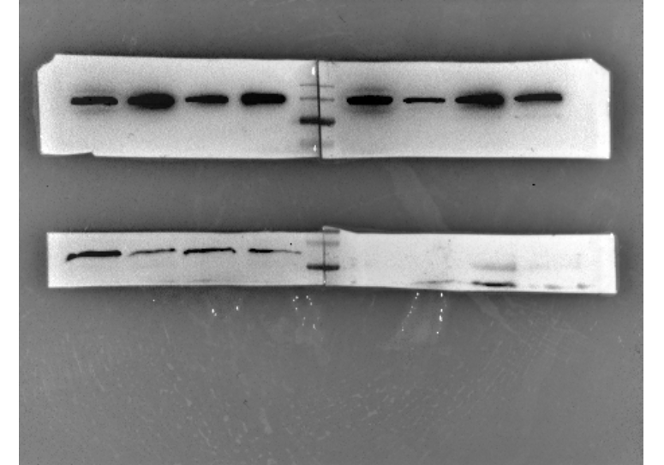
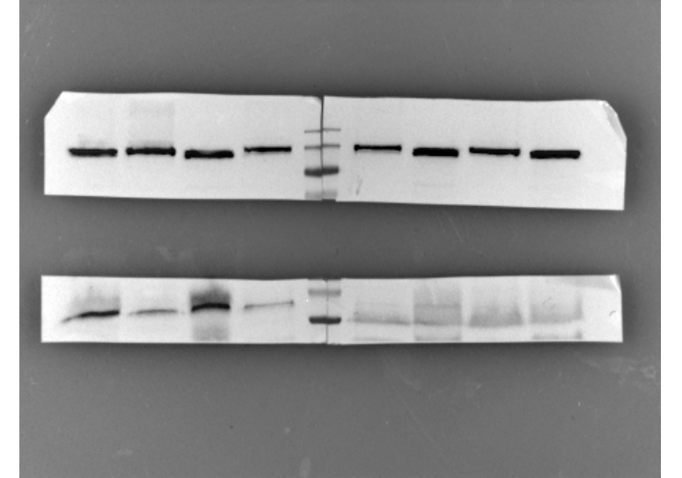
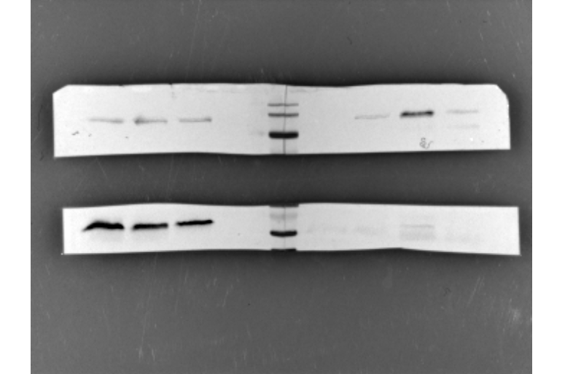
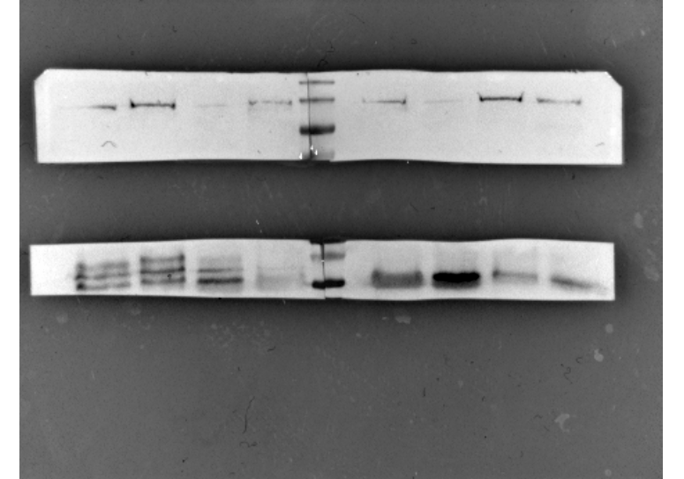

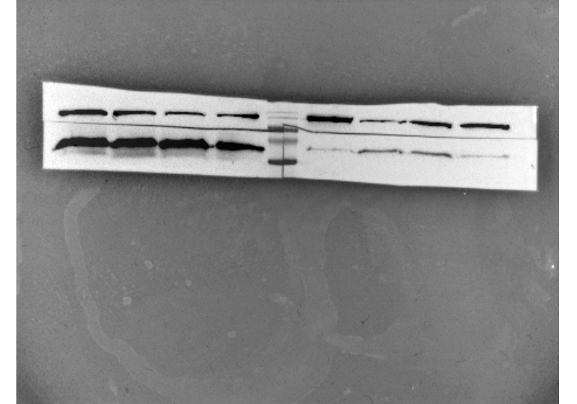
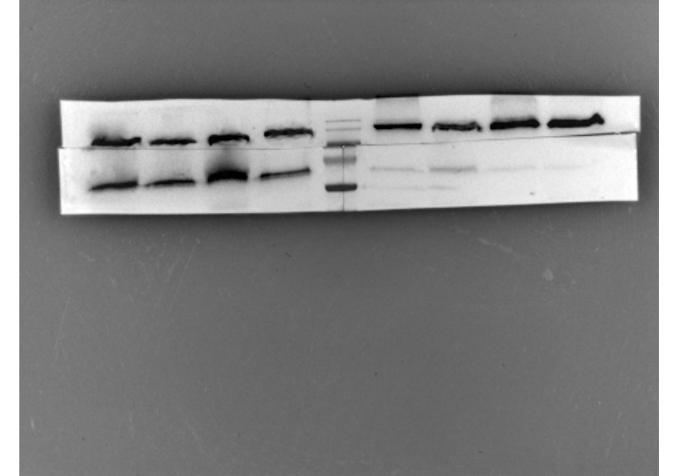
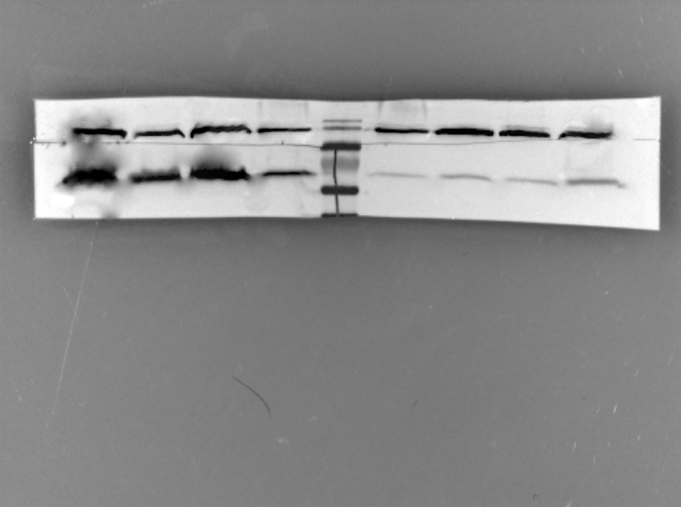
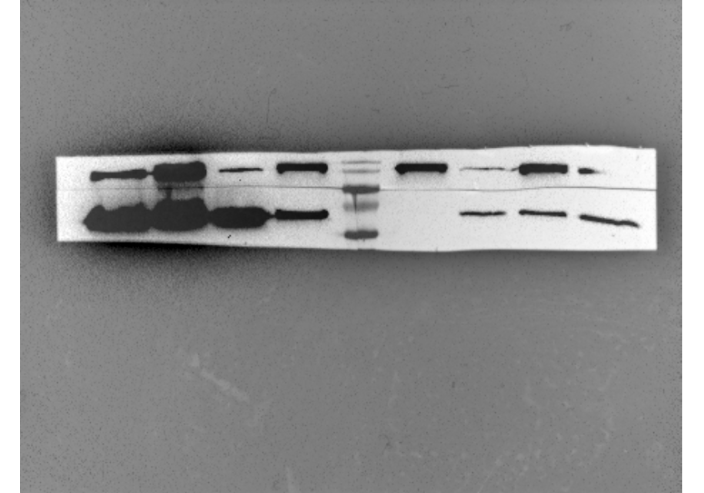

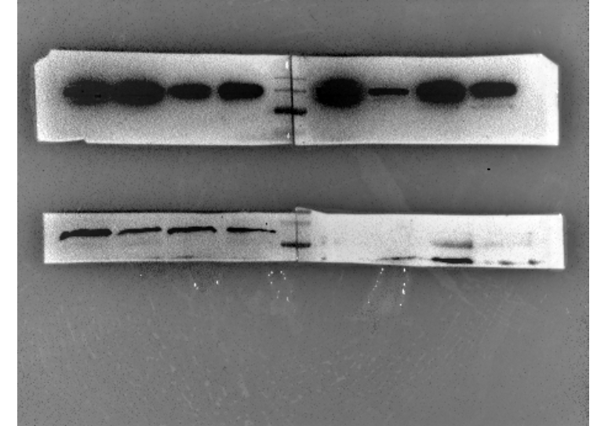
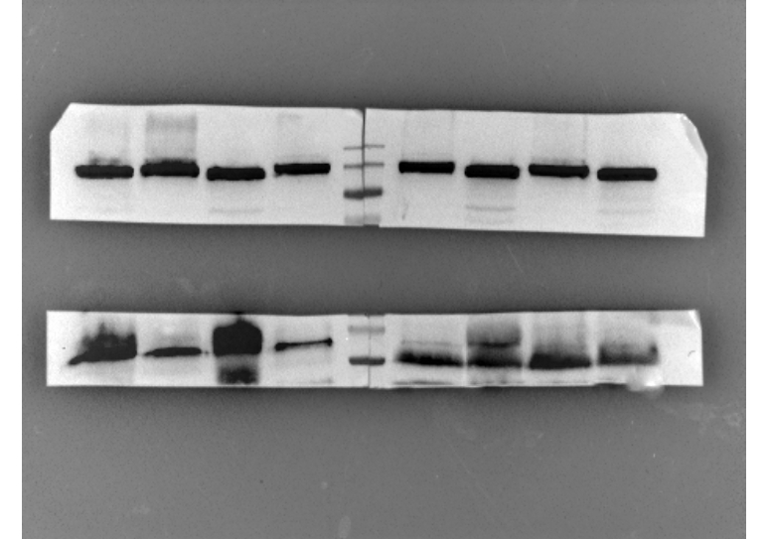
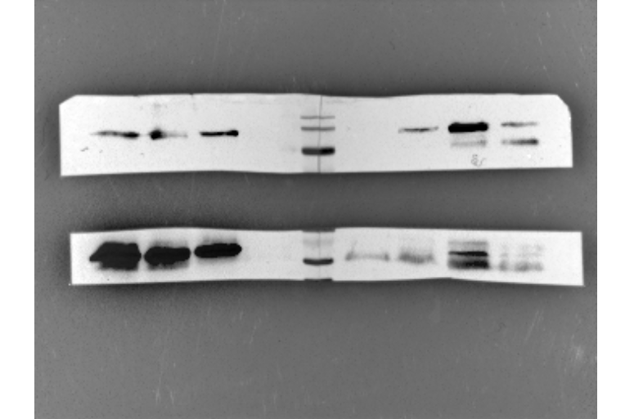
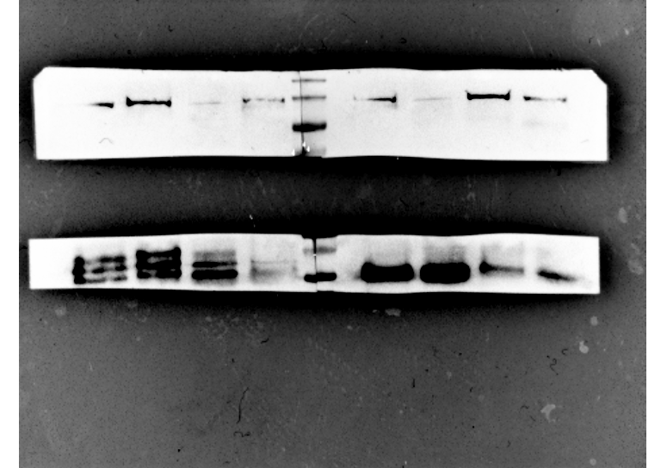

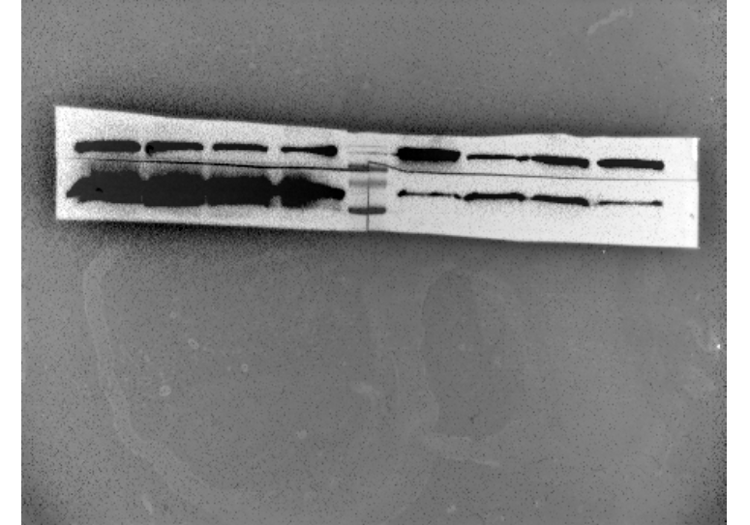
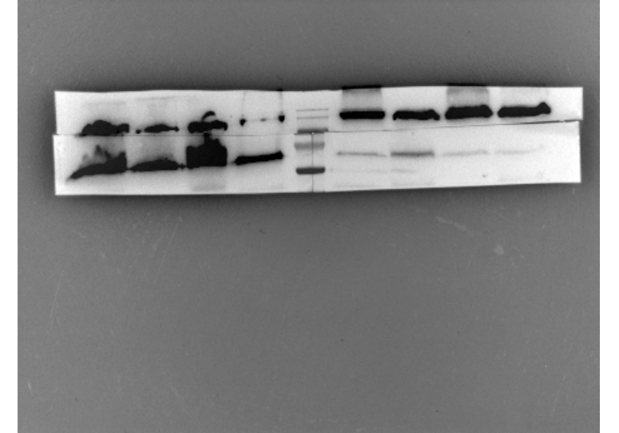

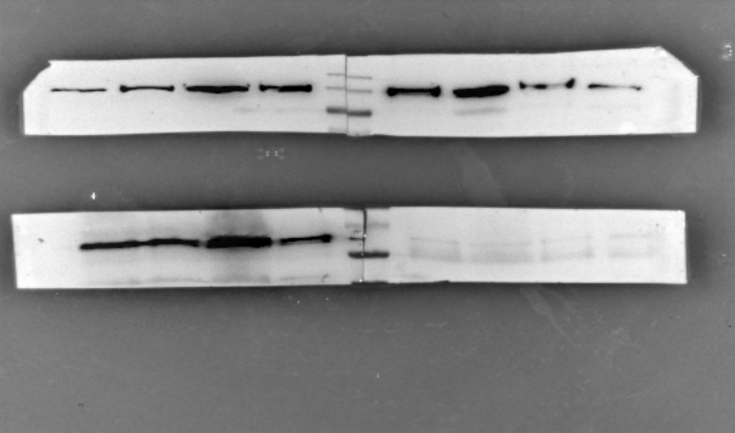
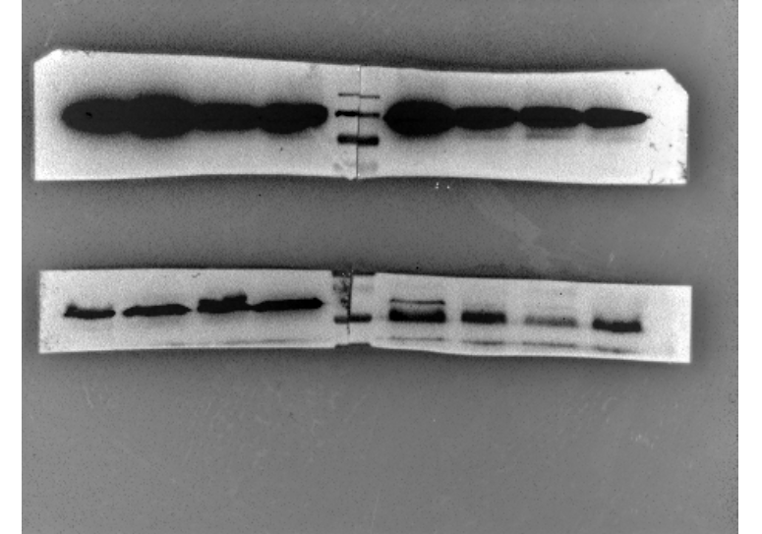

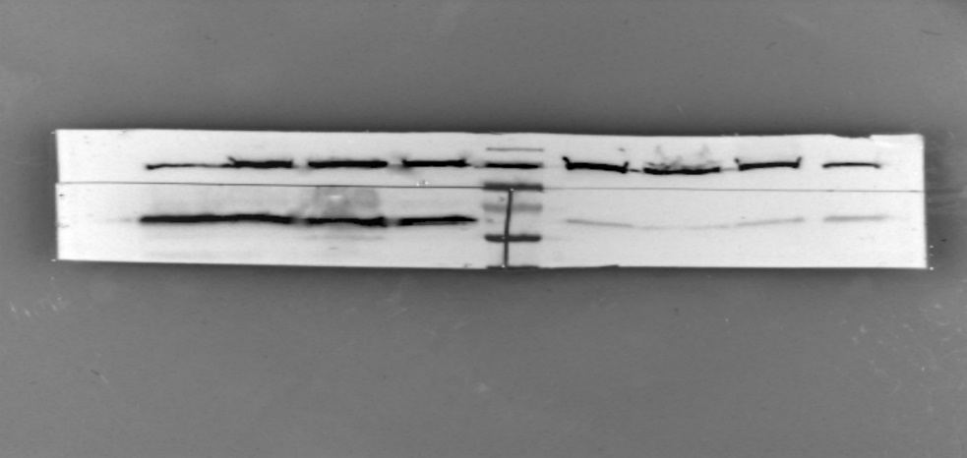

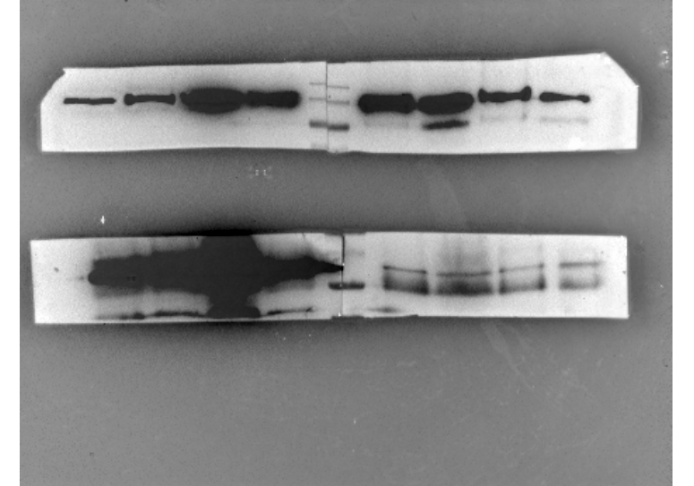

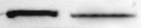


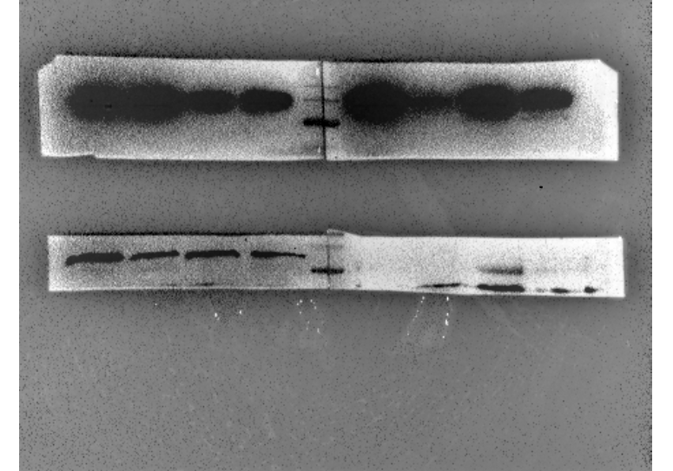








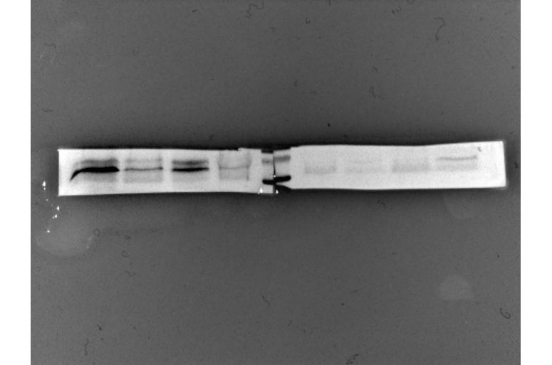

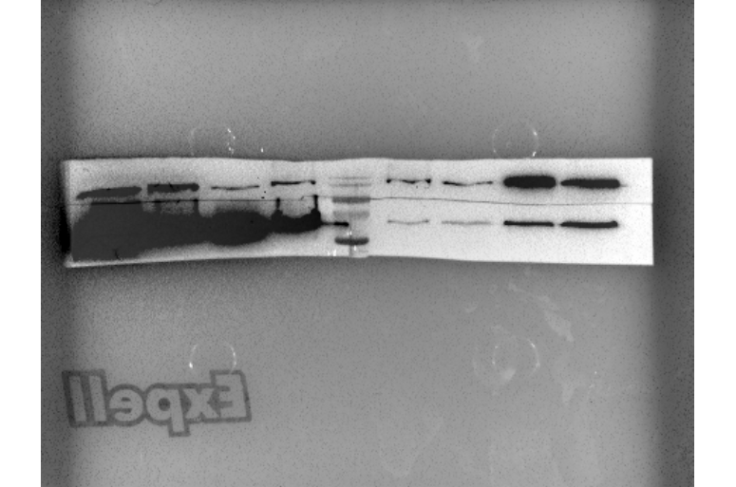

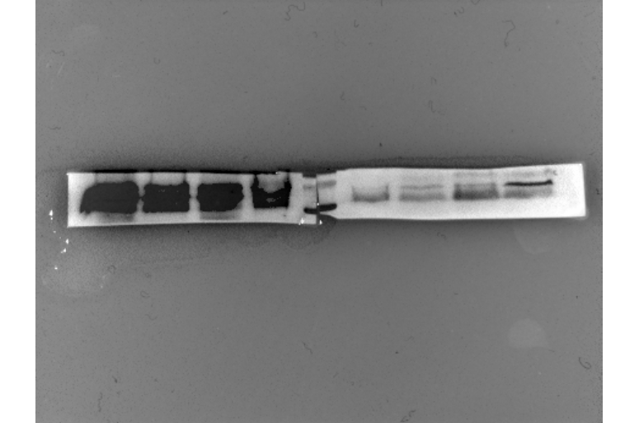




















Figure S4.
A
ER⁺ PR⁺ HER2⁻
B
ER⁺ PR⁺ HER2⁺
C
ER⁻ PR⁻ HER2⁺
D
ER⁻ PR⁻ HER2⁻
N T
C-Raf
Vinculin
p-C-Raf ^{S338}
Vinculin
N T
C-Raf
Vinculin
p-C-Raf ^{S338}
Vinculin
N T
C-Raf
Vinculin
p-C-Raf ^{S338}
Vinculin
N T
C-Raf
Vinculin
p-C-Raf ^{S338}
Vinculin
N T
C-Raf
Vinculin
p-C-Raf ^{S338}
Vinculin
Patient #2
Patient #8
Patient #14
Patient #21
Patient #24
C-Raf
Vinculin
p-C-Raf ^{S338}
Vinculin
C-Raf
Vinculin
p-C-Raf ^{S338}
Vinculin
C-Raf
Vinculin
p-C-Raf ^{S338}
Vinculin
C-Raf
Vinculin
p-C-Raf ^{S338}
Vinculin
C-Raf
Vinculin
p-C-Raf ^{S338}
Vinculin
Patient #3
Patient #9
Patient #15
Patient #22
Patient #25
C-Raf
Vinculin
p-C-Raf ^{S338}
Vinculin
C-Raf
Vinculin
p-C-Raf ^{S338}
Vinculin
C-Raf
Vinculin
p-C-Raf ^{S338}
Vinculin
C-Raf
Vinculin
p-C-Raf ^{S338}
Vinculin
C-Raf
Vinculin
p-C-Raf ^{S338}
Vinculin
Patient #4
Patient #10
Patient #16
Patient #23
Patient #30
C-Raf
Vinculin
p-C-Raf ^{S338}
Vinculin
C-Raf
Vinculin
p-C-Raf ^{S338}
Vinculin
C-Raf
Vinculin
p-C-Raf ^{S338}
Vinculin
Patient #5
Patient #11
Patient #18
C-Raf
Vinculin
p-C-Raf ^{S338}
Vinculin
C-Raf
Vinculin
p-C-Raf ^{S338}
Vinculin
C-Raf
Vinculin
p-C-Raf ^{S338}
Vinculin
Patient #6
Patient #12
Patient #19
C-Raf
Vinculin
p-C-Raf ^{S338}
Vinculin
C-Raf
Vinculin
p-C-Raf ^{S338}
Vinculin
C-Raf
Vinculin
p-C-Raf ^{S338}
Vinculin
Patient #7
Patient #13
Patient #20

Slide 5










































Figure S5.
A
ER⁺ PR⁺ HER2⁻
B
ER⁺ PR⁺ HER2⁺
C
ER⁻ PR⁻ HER2⁺
D
ER⁻ PR⁻ HER2⁻
N T
B-Raf
Vinculin
p-B-Raf ^{S445}
Vinculin
N T
B-Raf
Vinculin
p-B-Raf ^{S445}
Vinculin
N T
B-Raf
Vinculin
p-B-Raf ^{S445}
Vinculin
N T
B-Raf
Vinculin
p-B-Raf ^{S445}
Vinculin
N T
B-Raf
Vinculin
p-B-Raf ^{S445}
Vinculin
Patient #1
Patient #8
Patient #14
Patient #21
Patient #24
B-Raf
Vinculin
p-B-Raf ^{S445}
Vinculin
B-Raf
Vinculin
p-B-Raf ^{S445}
Vinculin
B-Raf
Vinculin
p-B-Raf ^{S445}
Vinculin
B-Raf
Vinculin
p-B-Raf ^{S445}
Vinculin
B-Raf
Vinculin
p-B-Raf ^{S445}
Vinculin
Patient #3
Patient #11
Patient #15
Patient #23
Patient #26
B-Raf
Vinculin
p-B-Raf ^{S445}
Vinculin
B-Raf
Vinculin
p-B-Raf ^{S445}
Vinculin
B-Raf
Vinculin
p-B-Raf ^{S445}
Vinculin
B-Raf
Vinculin
p-B-Raf ^{S445}
Vinculin
Patient #6
Patient #12
Patient #18
Patient #27
B-Raf
Vinculin
p-B-Raf ^{S445}
Vinculin
B-Raf
Vinculin
p-B-Raf ^{S445}
Vinculin
B-Raf
Vinculin
p-B-Raf ^{S445}
Vinculin
B-Raf
Vinculin
p-B-Raf ^{S445}
Vinculin
Patient #7
Patient #13
Patient #19
Patient #30

Slide 6
Figure S6.
A
MCF-7
Bad
p-Bad ^{S112}
p-Bad ^{S136}
14-3-3
untransfected
Relative Expression Levels
Relative Expression Levels
Relative Expression Levels
Relative Expression Levels
Bag-1:TAP
24h siBag-1
48h siBag-1
B
MDA-MB-231
Bad
p-Bad ^{S112}
p-Bad ^{S136}
14-3-3
untransfected
Relative Expression Levels
Relative Expression Levels
Relative Expression Levels
Relative Expression Levels
Bag-1:TAP
24h siBag-1
48h siBag-1

Slide 7










Figure S7.
A
MCF-7
MDA-MB-231
GW-5074 (µM)
0 10 25 50
0 10 25 50
C-Raf
p-C-Raf ^{S338}
p-Bad ^{S112}
p-Bad ^{S136}
β-actin
B
MCF-7
MDA-MB-231
MK-2206 (nM)
0 10 150 500
0 10 150 500
Akt
p-Akt ^{S473}
p-Bad ^{S112}
p-Bad ^{S136}
β-actin

Slide 8
Figure S8.
Pearson’s r

