Slide 1
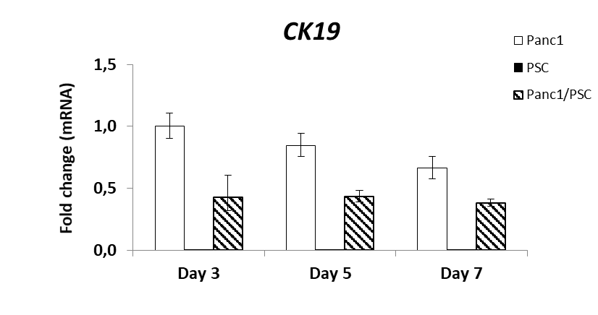
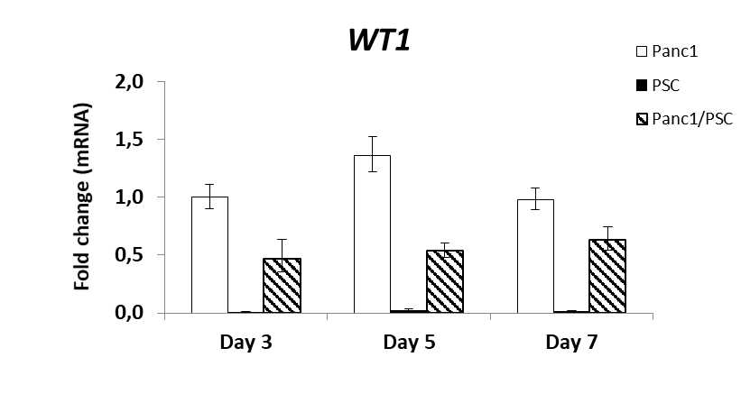
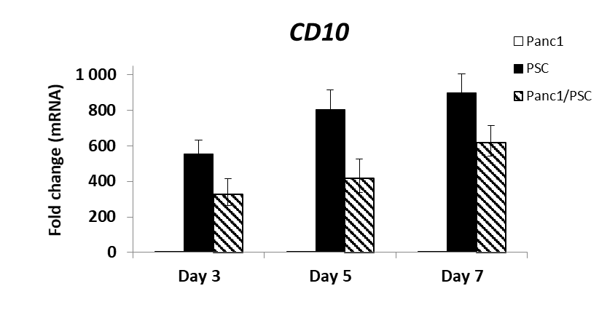
Suppl. Figure 2.
a)
b)
mRNA expression normalised to D3 Panc1-MC condition
mRNA expression normalised to D3 Panc1-MC condition
c)
mRNA expression normalised to D3 Panc1-MC condition

