Slide 1
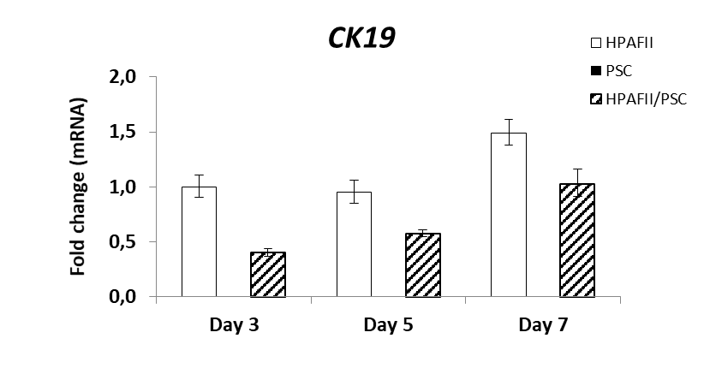
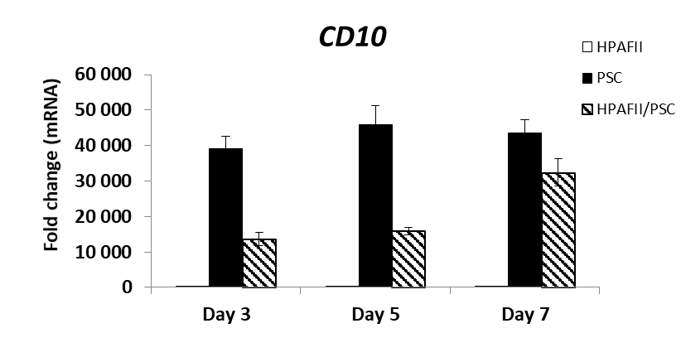
Suppl. Figure 3
a)
b)
mRNA expression normalised to D3 HPAFII-MC condition
mRNA expression normalised to D3 HPAFII-MC condition

