Slide 1
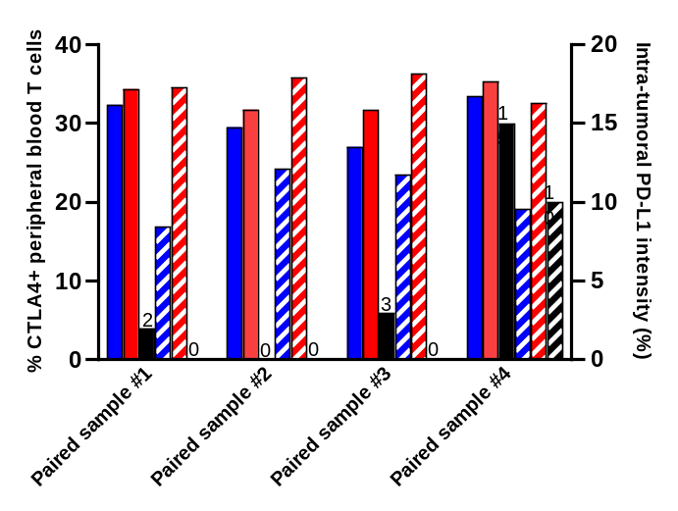
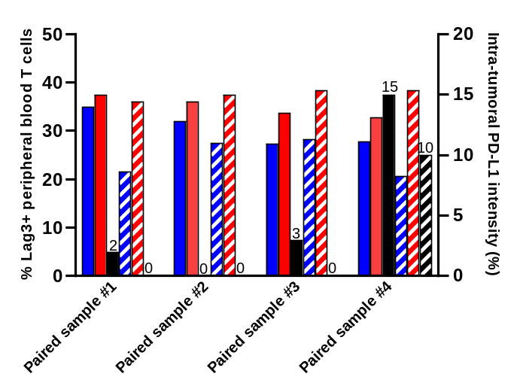
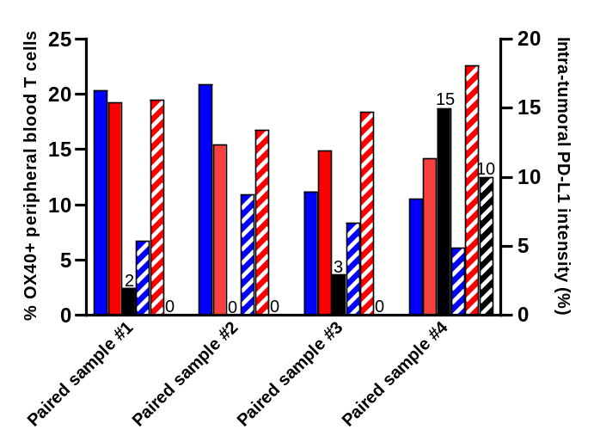
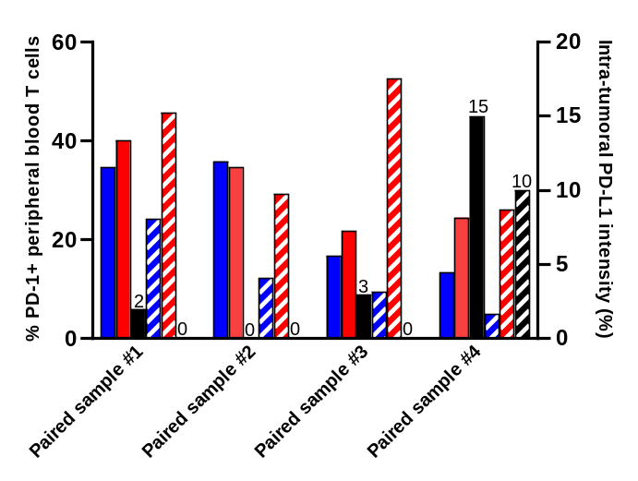
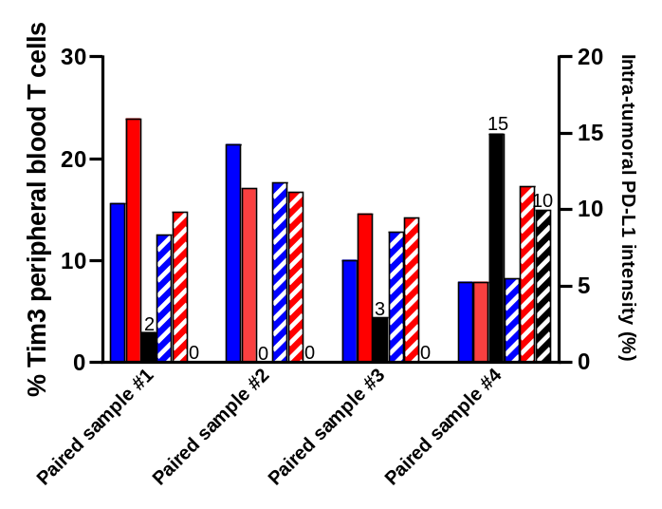
Additional file 8. Individual paired patient peripheral blood ICP expression and intra-tumoral PD-L1 expression
A
B
C
D
E
Pre-NAC CD4+ T cell ICP expression
Pre-NAC CD8+ T cell ICP expression
Pre-NAC intra-tumoral PD-L1 intensity
Post-NAC CD4+ T cell ICP expression
Post-NAC CD8+ T cell ICP expression
Post-NAC intra-tumoral PD-L1 intensity

