Slide 1
Figure S1.Data Distribution & DEG tests
55samples
PRE(41)
pCR(12)
Non-pCR(29)
POST(14)
pCR(6)
Relapse(16)
Non-relapse(13)
Relapse(4)
Non-pCR(8)
Non-relapse(4)
DEG Tests for POST
1.POST.relapse vs POST.pCR
2.POST.relapse vs POST.non-relapse
A DEG Test for PRE vs POST
3.PRE.relapse vs POST.relapse

Slide 2
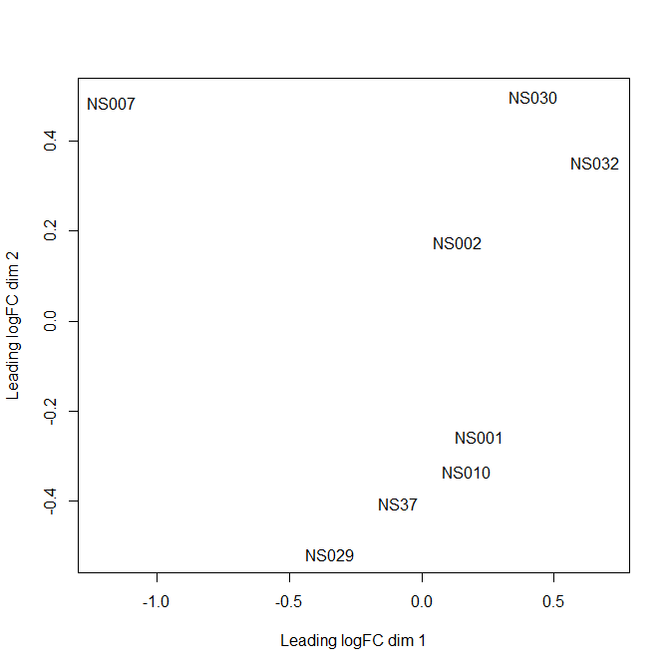
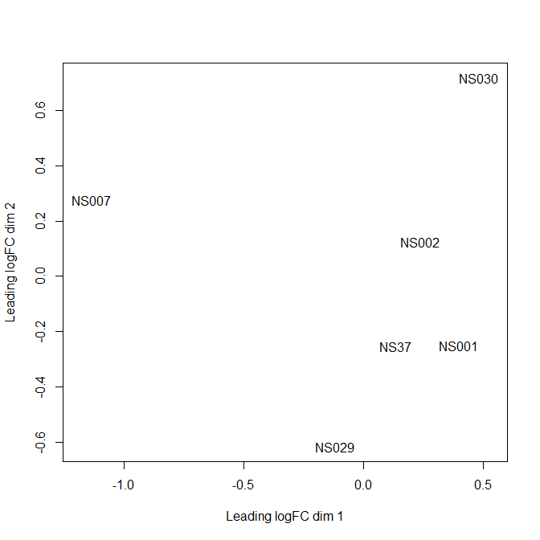
Figure S2. MDS plot for POST Relapse and POST non-relapse
Before removing samples (e.g., NS032 and NS010)
After removing the samples (e.g., NS032 and NS010)
Notes:
Left: 8 samples (removing 10, 32)
NS10 은 51번 sample 로 Pre/Post pCR정보가 일치되지 않아 생략.
Relapse: NS01 29 37 Ns 10
Non RELAPSE: NS2 NS 7 Ns30 ?NS 10
NS032 는 relapse 인데 non relapse sample 과 clusteirng 됨
NS10는 non-relapse이지만 relapse sample과 clustering되어 mix 됨.

Slide 3
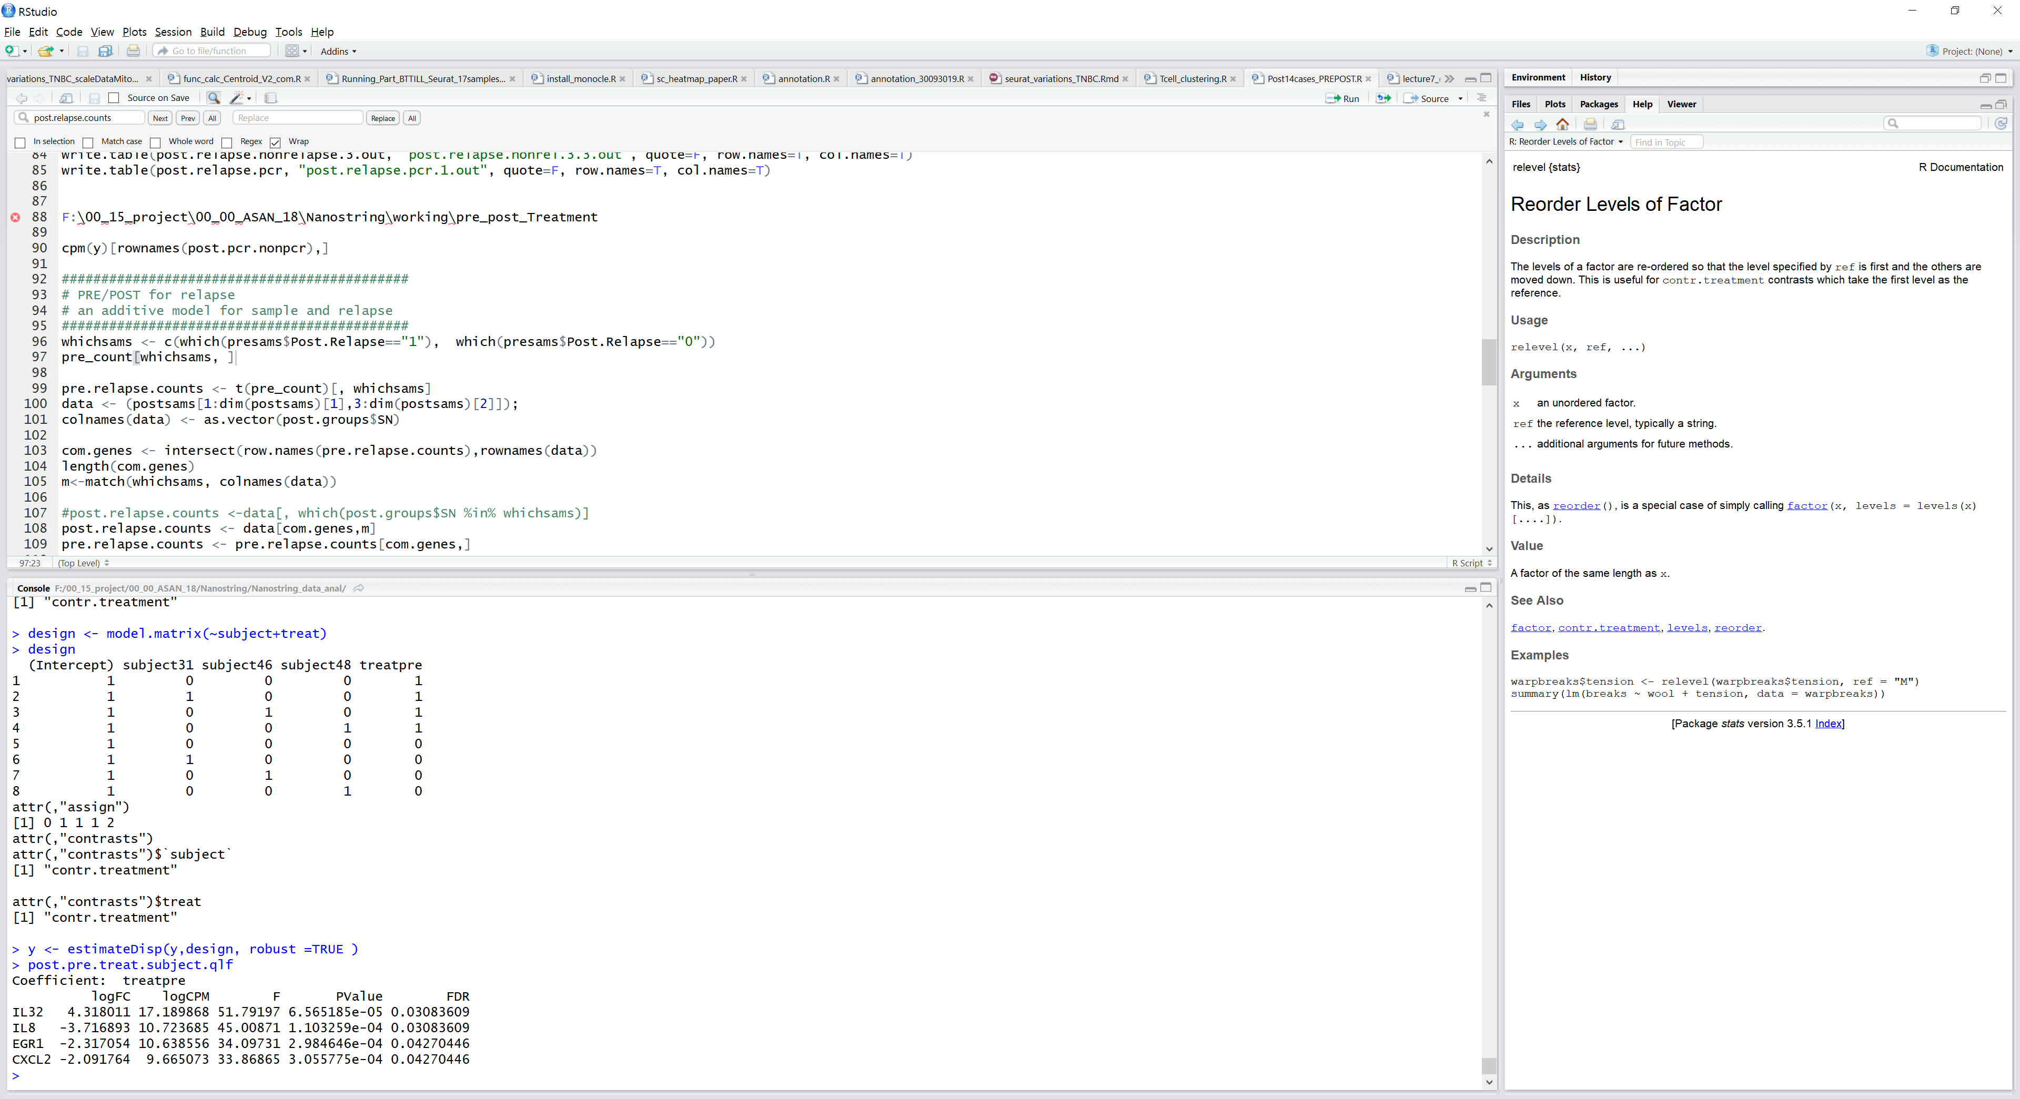
3. An Additive model for paired samples of pre/post in relapse

Slide 4
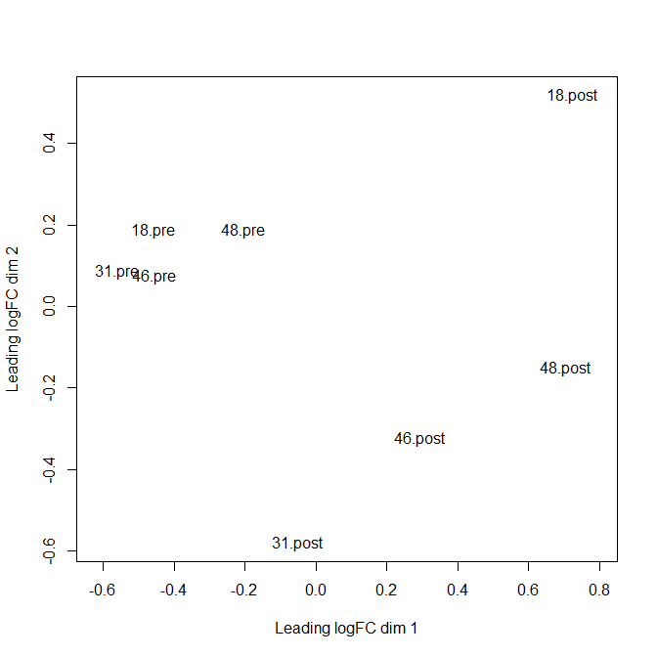
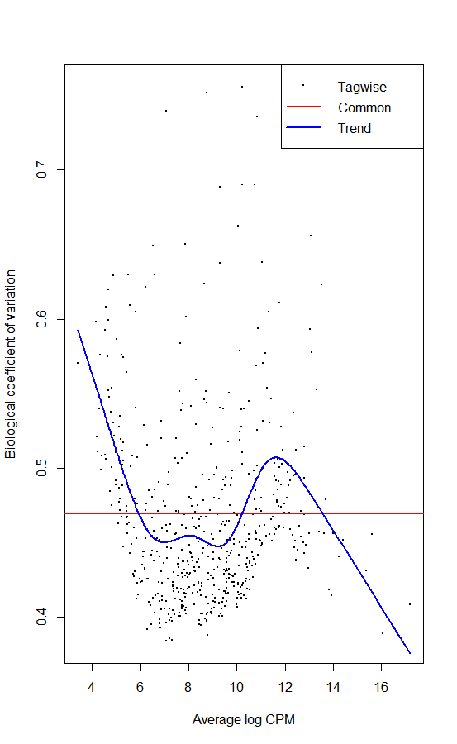
PRE.relapse vs POST.Relapse

Slide 5
Table S1 DEG for a Post vs PRE in relapse group
  Gene logFC logCPM LR PValue FDR
IL32 4.318005958 17.18986795 78.4777975 8.09E-19 4.52E-16
IL8 -3.717080134 10.72368484 39.7368718 2.91E-10 8.12E-08
EGR1 -2.31737568 10.63855571 22.8705399 1.73E-06 0.000322892
CXCL2 -2.091599132 9.665073116 20.41450745 6.24E-06 0.000871415
CD79B 2.079119411 8.153115146 18.13172125 2.06E-05 0.00230463
TGFBI -2.028478481 12.76654466 17.36156488 3.09E-05 0.002878963
CXCL13 1.908405831 9.6139943 15.48334321 8.32E-05 0.006646951
MS4A1 2.323399778 7.921867073 15.22514464 9.54E-05 0.006667778
RARRES3 1.691849516 10.20348768 14.87385432 0.000114945 0.007139372
MIF -1.76135897 14.23718392 13.67124089 0.000217764 0.011121293
CXCL9 2.015497797 12.41176763 13.58254247 0.000228299 0.011121293
KLRG2 -1.716351317 8.912433828 13.49861387 0.00023874 0.011121293
EBI3 1.768302932 6.86359963 12.86642985 0.000334529 0.01436648
CD22 1.549252333 7.651386098 12.50583917 0.000405682 0.01436648
CD6 1.680201703 8.009759729 12.41132801 0.000426737 0.01436648
CD7 1.580705741 7.355456421 12.39584756 0.00043029 0.01436648
sCTLA4 -2.024549344 6.218136466 12.36735775 0.000436905 0.01436648
CEACAM6 3.2373442 10.23207284 11.91303312 0.000557426 0.0155366
KLRC4 1.591960882 6.591594045 11.8665599 0.000571509 0.0155366
C1QBP -1.842490995 12.22120681 11.83907577 0.000580006 0.0155366
TNFRSF13B 2.021909963 5.759881331 11.82736682 0.000583665 0.0155366
MAP4K1 1.560851574 8.537298985 11.71146921 0.000621161 0.015783125
GBP5 1.907925895 9.060021467 11.47546022 0.000705212 0.017051566
KLRK1 1.771399665 8.727156044 11.40595978 0.000732089 0.017051566
CD5 1.550504681 7.380993389 11.07574761 0.000874641 0.019417825
CD74 1.541715663 15.35728286 11.01627326 0.000903155 0.019417825
CCL19 1.857522252 10.24037573 10.5752531 0.001146116 0.023728841
IL21R 1.459348093 7.964330021 10.31659038 0.001318396 0.026320841
CD45RA 1.432391329 6.81486895 10.22989577 0.001381825 0.026635863
NFIL3 -1.401920532 10.25591151 9.792928063 0.001751843 0.032642672
GZMB 1.53297611 8.782954627 9.611200939 0.001933941 0.034873328
GNLY 1.601791145 8.524304004 9.485975838 0.002070485 0.036168777
IL12RB1 1.433964865 7.940960317 9.385049338 0.002187622 0.037056985
CTLA4_all 1.339661198 7.712147221 9.285539856 0.002309698 0.037974159
IRF4 1.653850859 9.786293225 9.158202502 0.002476057 0.039389544
CD96 1.465212263 8.063170748 9.100066751 0.002556002 0.039389544
LILRB1 1.274032005 8.460216137 9.063811724 0.002607179 0.039389544
CD19 1.40143483 7.355411669 8.94251493 0.002786089 0.039510142
ATG10 -1.363763832 7.784183061 8.936520231 0.002795247 0.039510142
ZAP70 1.473617205 8.410462821 8.915759822 0.002827202 0.039510142
CD247 1.321223697 8.242990661 8.517888163 0.003516724 0.047947523
41 DEG using LRT

Slide 6
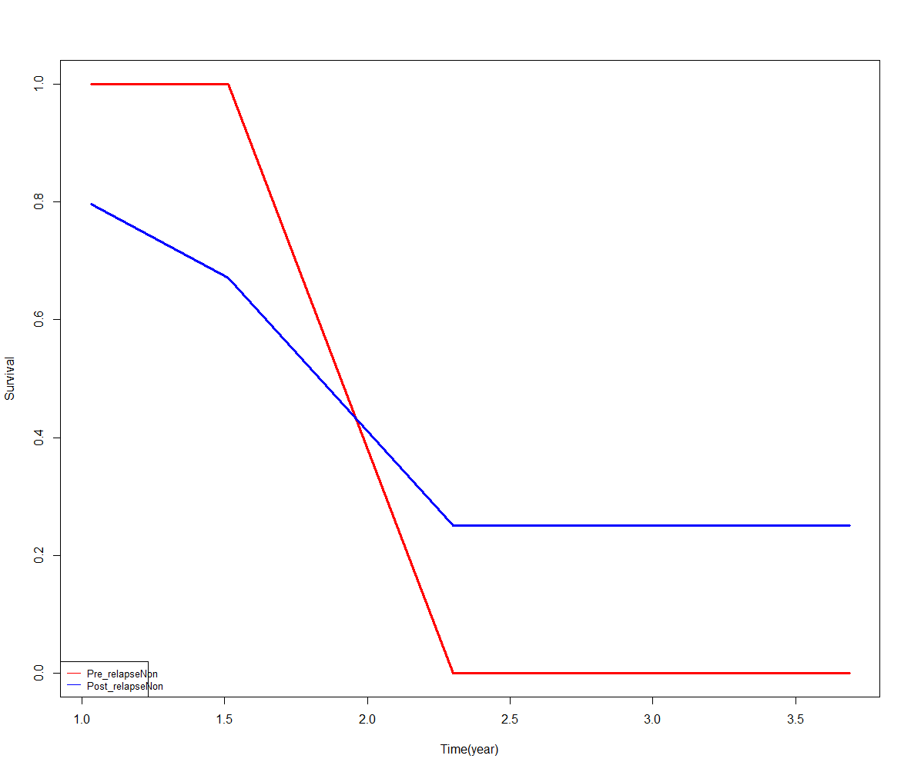
Survival test for pre.relapse (4samples) vs post.relapse (4samples)

