Slide 1
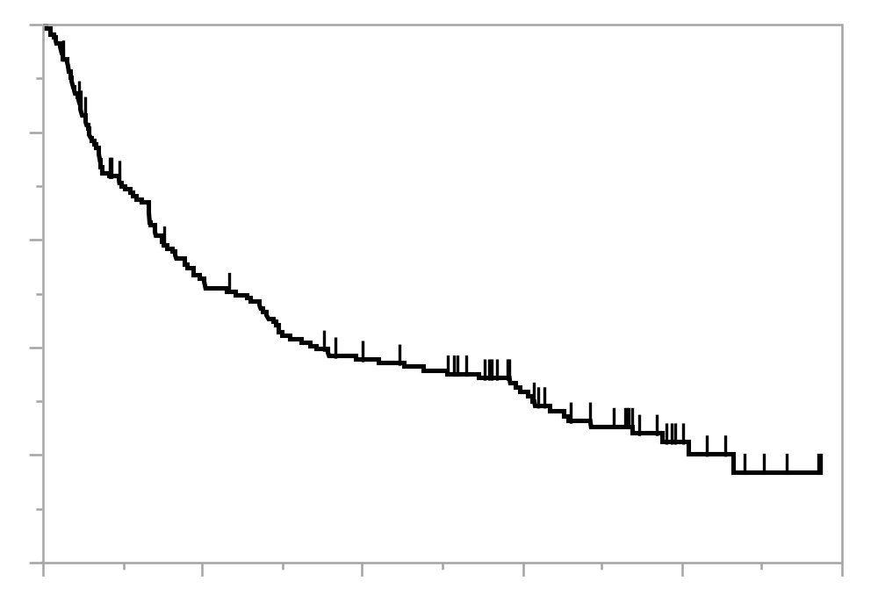
eFigure 1A: Progression-free survival (PFS) in all patients who received
first-line pembrolizumab
100
Progression-free survival (%)
80
60
40
20
0
0
6
12
18
24
30
Number at risk
Time (months)
174
86
58
37
11
0

Slide 2
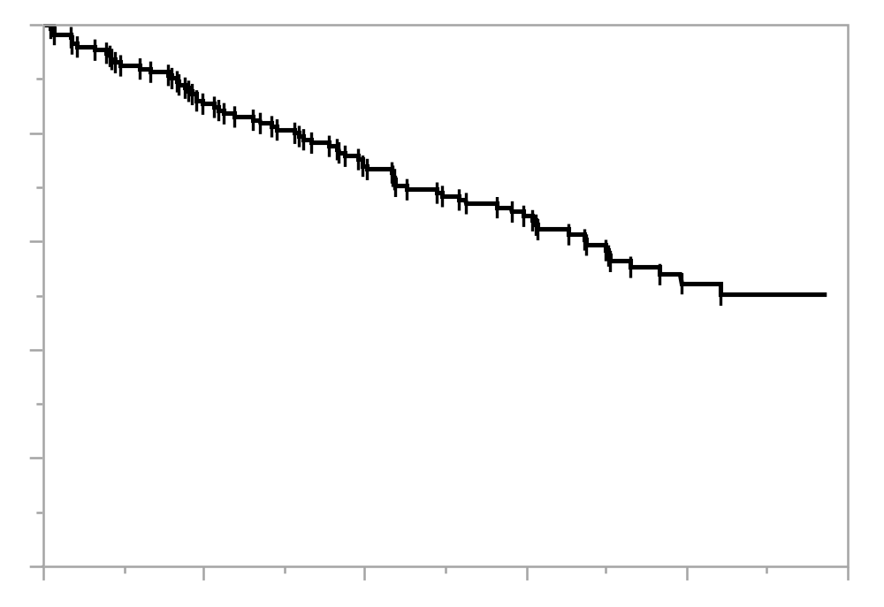
eFigure 1B: Overall survival (OS) in all patients who received pembrolizumab
100
Overall survival (%)
80
60
40
20
0
0
6
12
18
24
30
Number at risk
Time (months)
174
145
121
80
31
0

Slide 3
eFigure 2: Flow chart of the study patients
Patients with stage IIIB or IV NSCLC with PD-L1 TPS of ≥50%
who received first-line pembrolizumab
between February 2017 and August 2018
(n=174)
Patients who did not experience response (n=86)
Patients who experienced response
(n=88)
49 had progression or death until July 2019
46 developed AR
2 died without tumor regrowth
1 lost to follow-off
39 had sustained response until July 2019

Slide 4
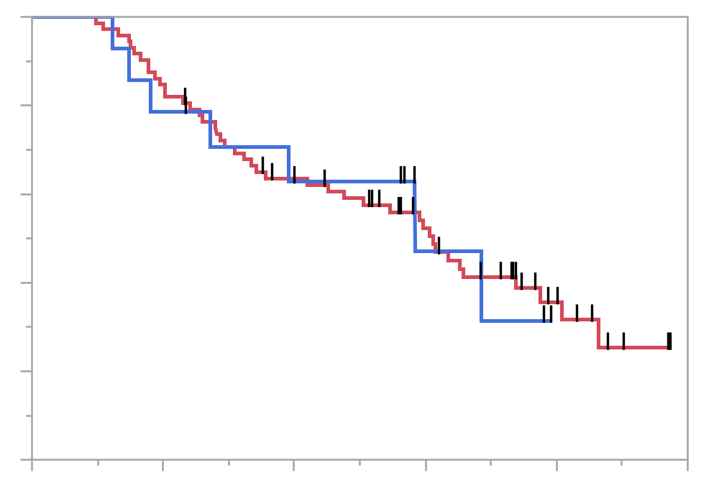
eFigure 3A: Progression-free survival (PFS) in patients with response,
stratified by sex
100
Male
Female
Progression-free survival (%)
80
60
40
20
HR: 1.02 (95% CI: 0.42-2.14)
P = 0.955
0
0
6
12
18
24
30
Number at risk
Time (months)
Male
74
61
43
29
10
0
Female
14
11
8
3
0
0

Slide 5
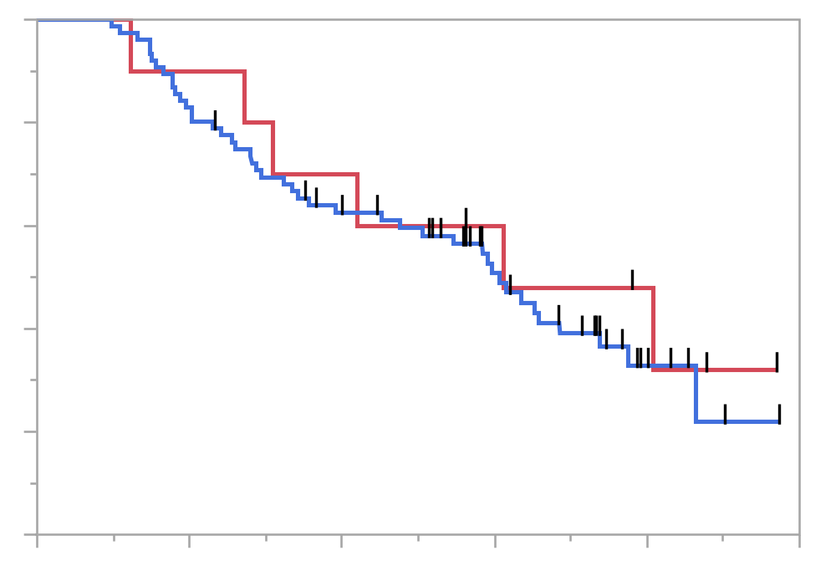
eFigure 3B: Progression-free survival (PFS) in patients with response,
stratified by smoking history (never smoker or smoker)
100
Never smoker
Smoker
Progression-free survival (%)
80
60
40
20
HR: 1.24 (95% CI: 0.57-3.29)
P = 0.614
0
0
6
12
18
24
30
Number at risk
Time (months)
Never smoker
10
9
7
5
3
0
Smoker
78
63
44
27
7
0

Slide 6
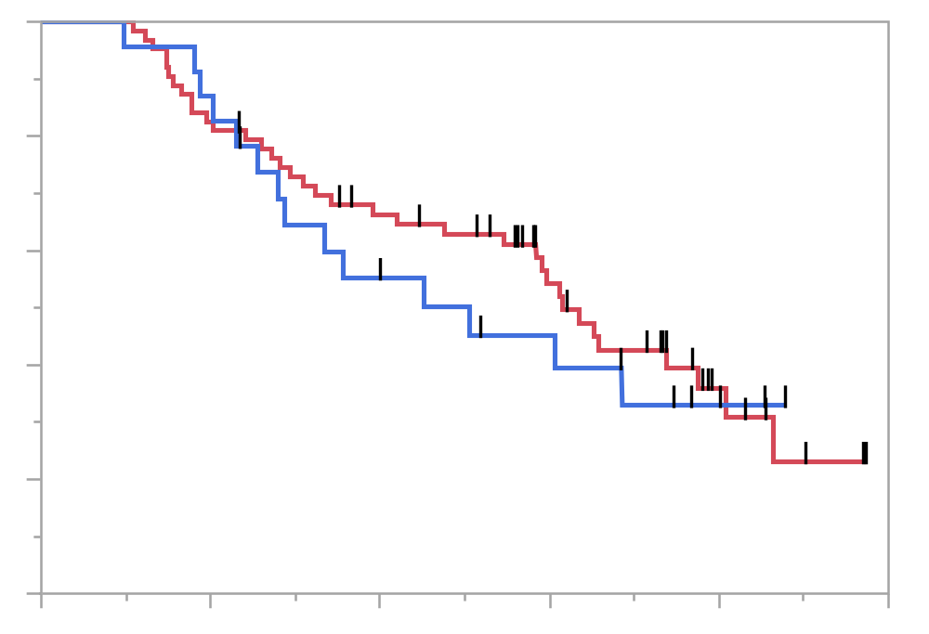
eFigure 3C: Progression-free survival (PFS) in patients with response,
stratified by histology (non-squamous or squamous)
100
Non-squamous
Squamous
Progression-free survival (%)
80
60
40
20
HR: 1.16 (95% CI: 0.61-2.12)
P = 0.623
0
0
6
12
18
24
30
Number at risk
Time (months)
Non-squamous
64
52
39
24
7
0
Squamous
24
20
12
8
3
0

Slide 7
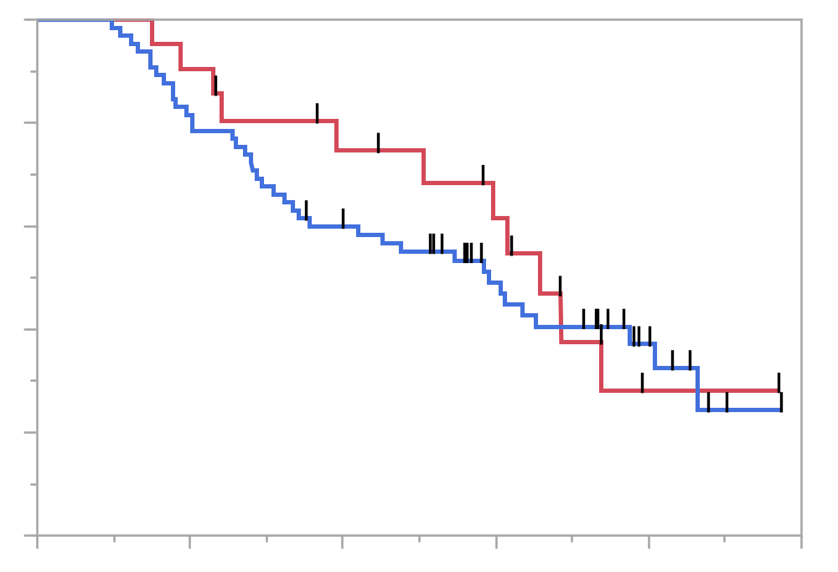
eFigure 3D: Progression-free survival (PFS) in patients with response,
stratified by stage (IIIB or IV)
100
Stage IIIB
Stage IV
Progression-free survival (%)
80
60
40
20
HR: 1.19 (95% CI: 0.63-2.45)
P = 0.604
0
0
6
12
18
24
30
Number at risk
Time (months)
Stage IIIB
21
19
13
9
1
0
Stage IV
67
53
38
23
9
0

Slide 8
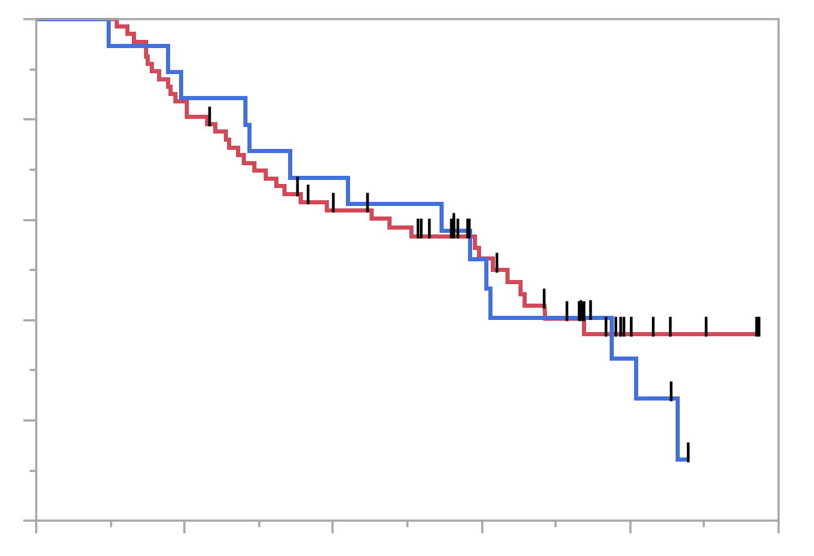
eFigure 3E: Progression-free survival (PFS) in patients with response,
stratified by presence of pleural effusion or dissemination
100
Without pleural effusion or dissemination
With pleural effusion or dissemination
Progression-free survival (%)
80
60
40
20
HR: 1.13 (95% CI: 0.61-2.12)
P = 0.682
0
0
6
12
18
24
30
Number at risk
Time (months)
Without
67
56
38
23
6
0
With
21
16
13
9
4
0

Slide 9
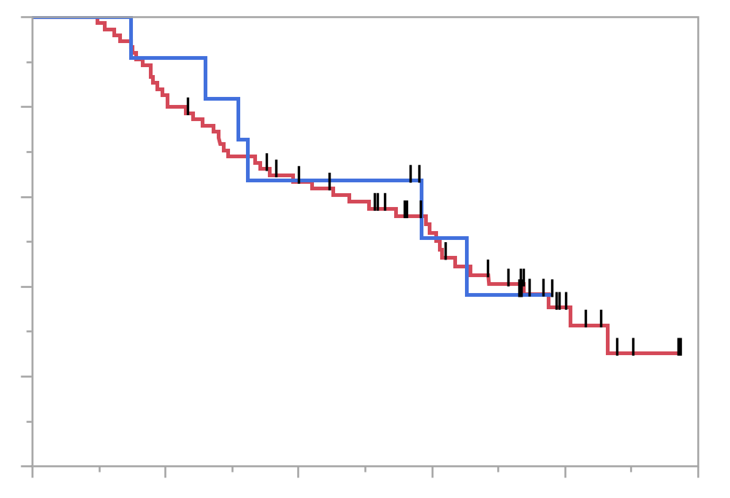
eFigure 3F: Progression-free survival (PFS) in patients with response,
stratified by presence of brain metastasis
100
Without brain metastasis
With brain metastasis
Progression-free survival (%)
80
60
40
20
HR: 0.93 (95% CI: 0.39-2.18)
P = 0.860
0
0
6
12
18
24
30
Number at risk
Time (months)
Without
77
62
44
28
10
0
With
11
10
7
4
0
0

Slide 10
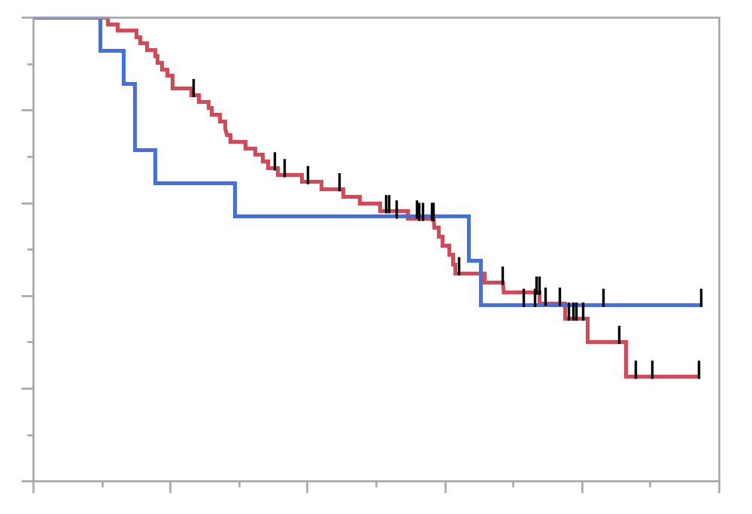
eFigure 3G: Progression-free survival (PFS) in patients with response,
stratified by presence of adrenal grand metastasis
100
Without adrenal grand metastasis
With adrenal grand metastasis
Progression-free survival (%)
80
60
40
20
HR: 1.06 (95% CI: 0.50-2.26)
P = 0.886
0
0
6
12
18
24
30
Number at risk
Time (months)
Without
74
63
43
26
8
0
With
14
9
8
6
2
0

Slide 11
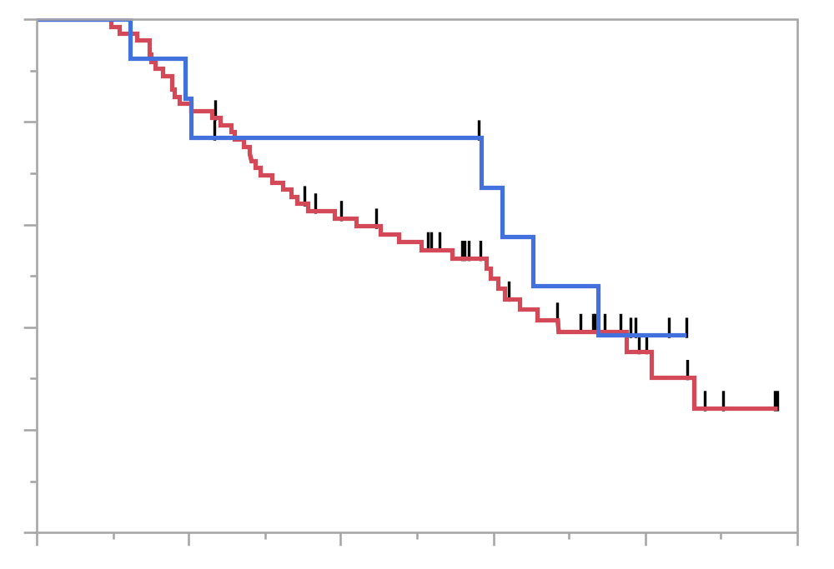
eFigure 3H: Progression-free survival (PFS) in patients with response,
stratified by presence of liver metastasis
100
Without liver metastasis
With liver metastasis
Progression-free survival (%)
80
60
40
20
HR: 0.78 (95% CI: 0.35-1.75)
P = 0.553
0
0
6
12
18
24
30
Number at risk
Time (months)
Without
74
61
42
25
8
0
With
14
11
9
7
2
0

Slide 12
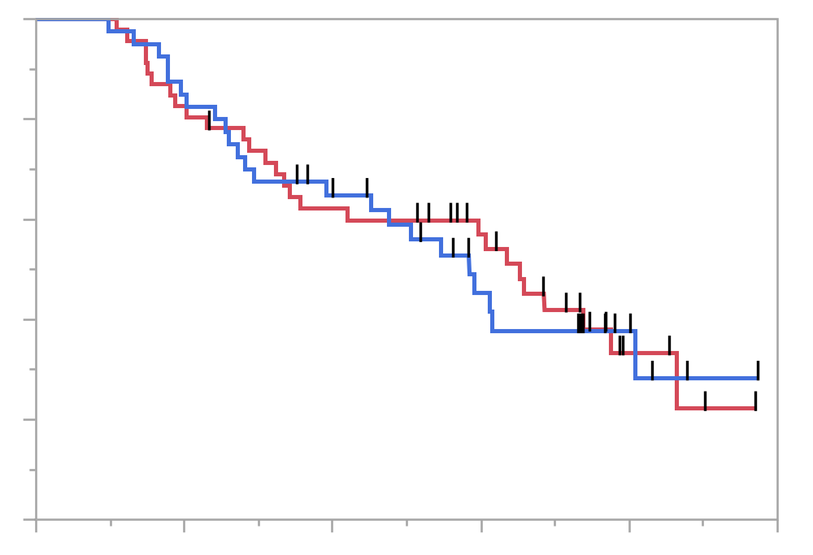
eFigure 3I: Progression-free survival (PFS) in patients with response,
stratified by presence of early immune-related adverse event (irAE)
100
Without early irAE
With early irAE
Progression-free survival (%)
80
60
40
20
HR: 1.05 (95% CI: 0.60-1.84)
P = 0.857
0
0
6
12
18
24
30
Number at risk
Time (months)
Without
47
38
27
20
5
0
With
41
34
24
12
5
0

Slide 13
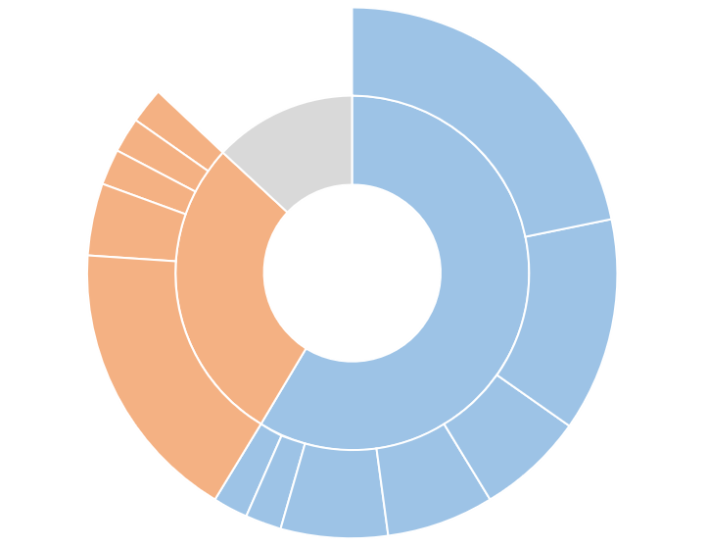
eFigure 4: Pie-chart summarizing the organs with progressive lesions.
Patients with progression in one organ (blue), 2 organs (orange), or 3 or more organs (grey).
Lung
LN, thoracic / LN, axillary
LN, thoracic / LN, neck
≥3
Lung / LN, abdominal
(20%)
Lung / Bone
Organs of AR
2
1
(24%)
(57%)
Bone
Lung / LN, thoracic
Pleural dissemination
LN, thoracic
Adrenal gland
LN, neck
Kidney

Slide 14
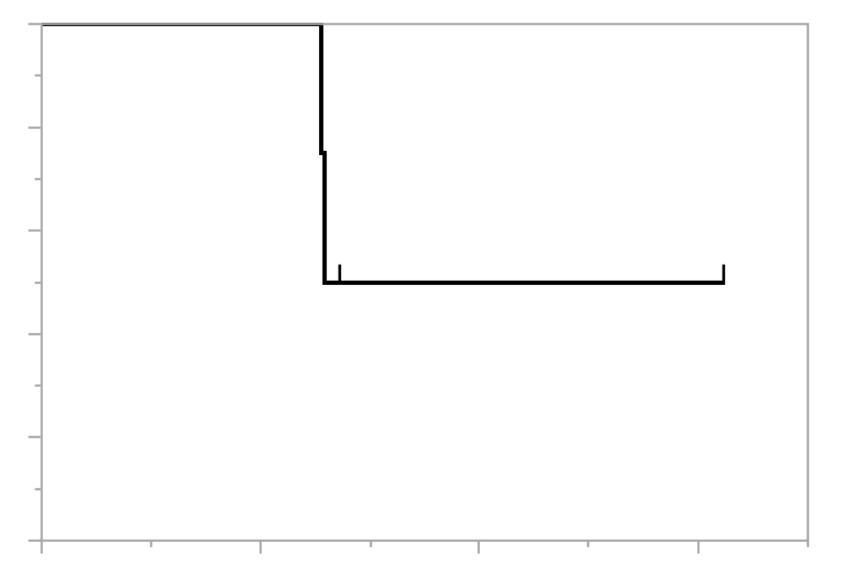
eFigure 5: The 2nd progression-free survival of patients who developed
acquired resistance (AR), received local ablative therapy and pembrolizumab therapy beyond 1st PD
100
2nd Progression-free survival (%)
80
60
40
20
0
0
6
12
18
Number at risk
Time (months)
4
4
1
1

