Slide 1
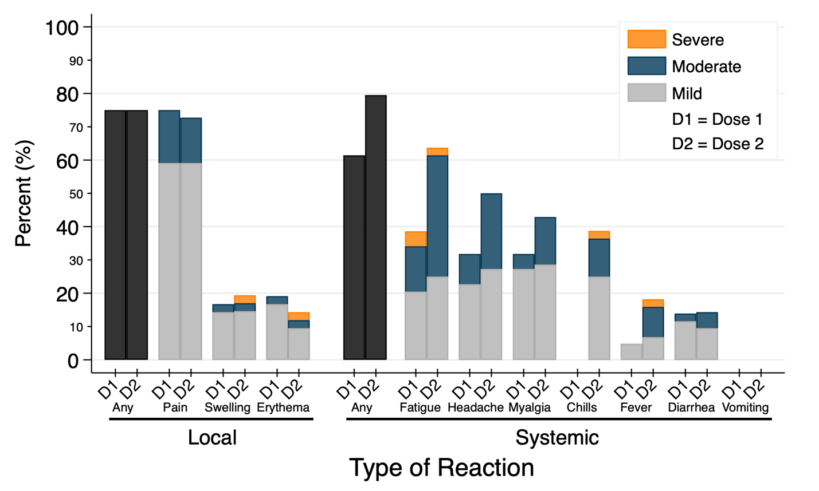
Supplemental Figure 1. Local site and systemic adverse reactions in 44 patients with multiple myeloma within 7 days of dose 1 and dose 2 of the SARS-CoV-2 mRNA vaccine.

Slide 2
Supplemental Table 1. Anti-SARS-CoV-2 RBD antibody titer of 44 patients multiple myeloma one month after two-dose SARS-CoV-2 mRNA vaccination by demographics and clinical characteristics.
 | N | Titer,¹ median U/mL (IQR)
Overall | 44 | >250 (239, >250)
Age >55² | 38 | >250 (176, >250)
Female sex | 30 | >250 (>250, >250)
Vaccine
Pfizer/BioNTech | 22 | >250 (154, >250)
Moderna | 22 | >250 (>250, >250)
Therapy
Not on therapy | 17 | >250 (228, >250)
On therapy³ | 27 | >250 (>250, >250)
Bortezomib | 1 | >250
Carfilzomib | 1 | >250
Daratumumab | 7 | >250 (>250, >250)
Ixazomib | 2 | 125 (<0.4, >250)
Lenalidomide | 17 | >250 (>250, >250)
Pomalidomide | 4 | >250 (202, >250)
Teclistamab | 1 | <0.4
¹ Results range from <0.4 to >250 U/mL with detectable antibody defined as an anti-SARS-CoV-2 RBD antibody titer >0.79 U/mL by the manufacturer.
² Age was dichotomized into ≤55 and >55 based on early vaccine trials (Ref. 4).
³ Since participants could report more than one therapy, the sum of the therapies is greater than the total N.

