Slide 1
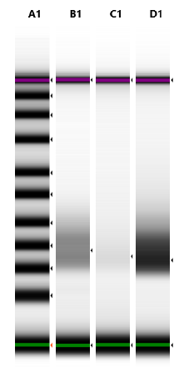
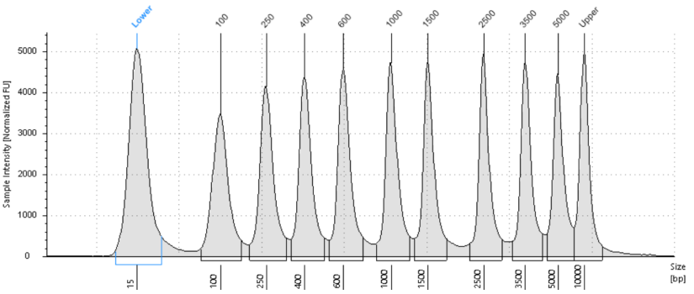
SF1
A
B
M
SiHa
HeLa
C33a
SiHa
10000
1000
HeLa
100
15
C33a
SF1: Exosomal RNA characterization: A. RNA Library tape station profile indicating the total RNA start-end regions, and average bp size for each exosomal RNA preparation B. Total RNA electropherogram of exosomal RNA on Agilent 2100 Bioanalyzer wherein Y-axis of electropherogram represents the arbitrary fluorescence unit (FU) intensity and X-axis represents size of transcripts (bp).

Slide 2
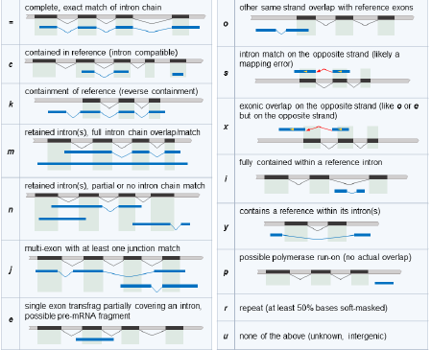
SF2
A
B
SF2: Relationship between the assembled transcripts and closely related reference transcripts: A. Summary of assembled transcripts and the relation with reference transcripts. B. Key for relationship codes of assembled transcripts with reference transcripts.

Slide 3
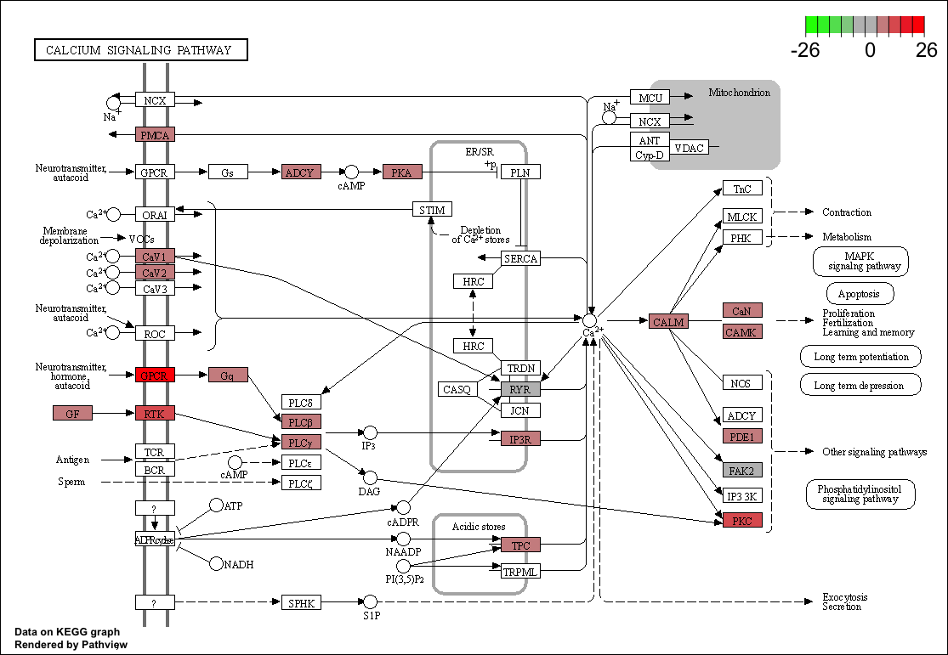
A
SF3
CALCIUM SIGNALING PATHWAY
SF3: KEGG Analysis of differentially expressed transcripts in exosomal RNA of HPV-negative vs. HPV-positive cervical cancer cells.

Slide 4
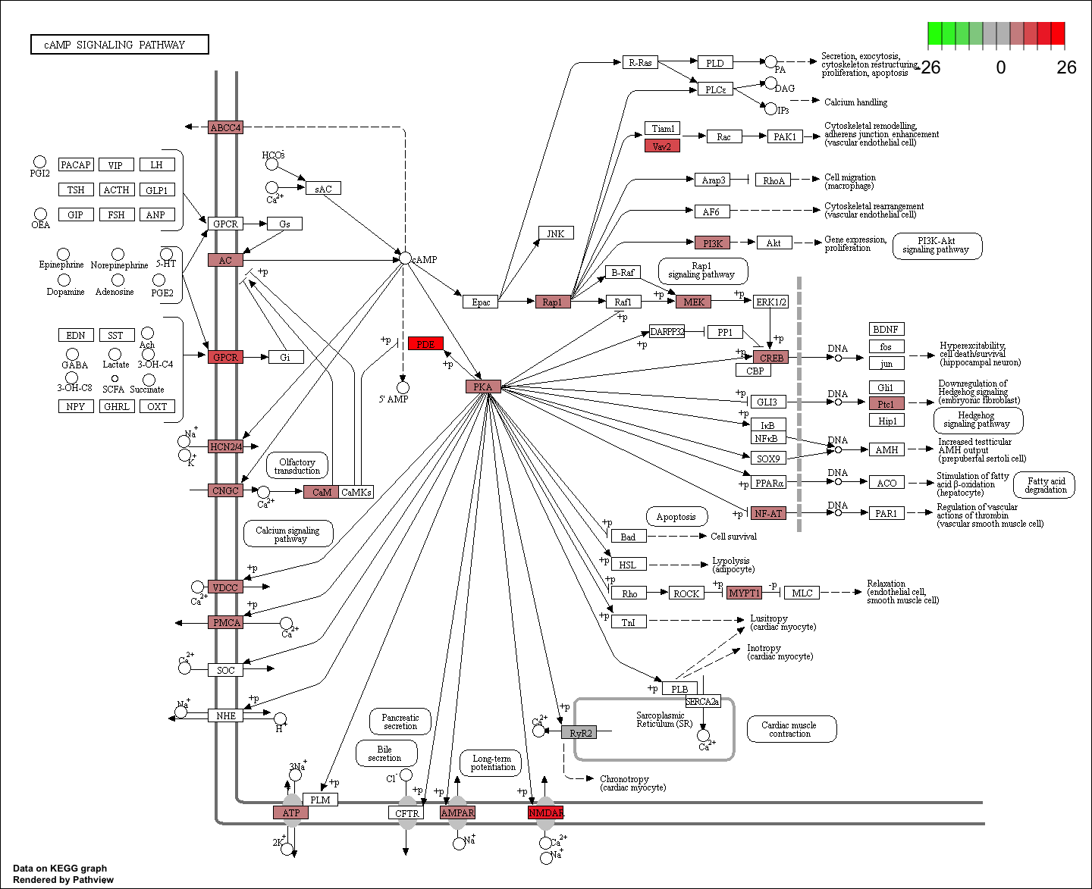
B
cAMP SIGNALING PATHWAY
SF3
SF3: KEGG Analysis of differentially expressed transcripts in exosomal RNA of HPV-negative vs. HPV-positive cervical cancer cells.

Slide 5
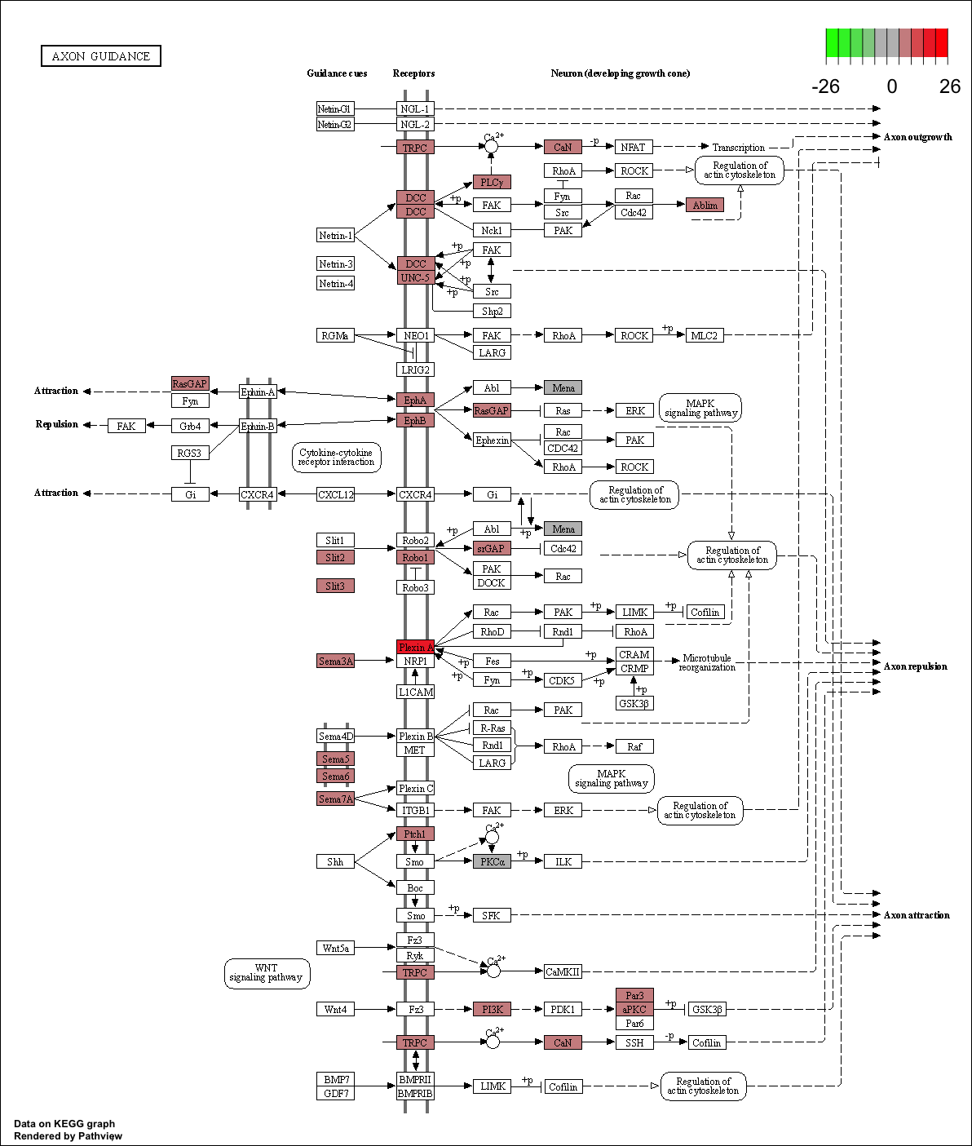
C
AXON GUIDANCE SIGNALING PATHWAY
SF3
SF3: KEGG Analysis of differentially expressed transcripts in exosomal RNA of HPV-negative vs. HPV-positive cervical cancer cells.

Slide 6
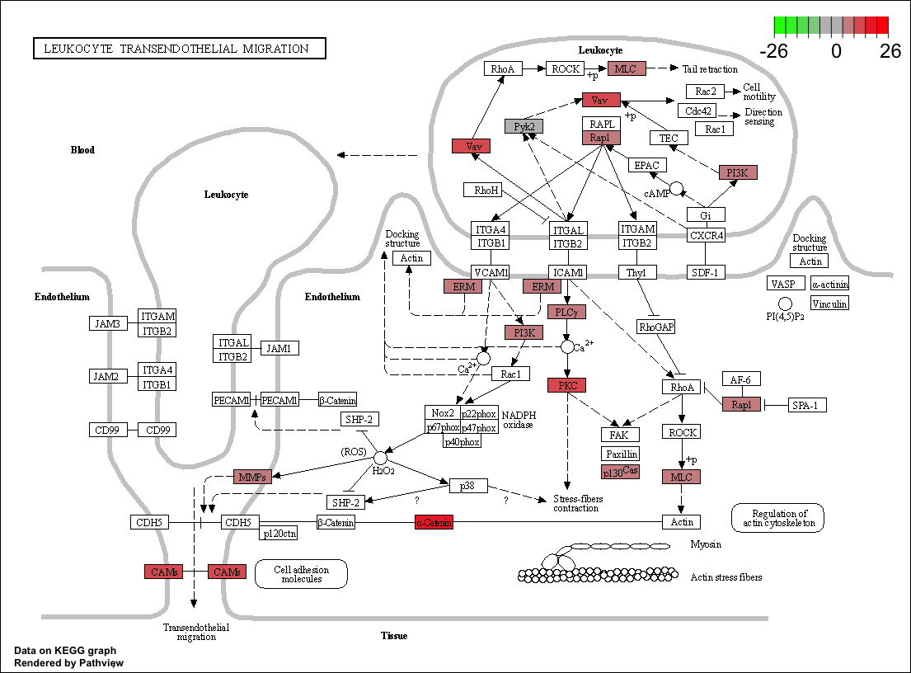
D
SF3
LEUKOCYTE TRANSENDOTHELIAL MIGRATION
SF3: KEGG Analysis of differentially expressed transcripts in exosomal RNA of HPV-negative vs. HPV-positive cervical cancer cells.

Slide 7
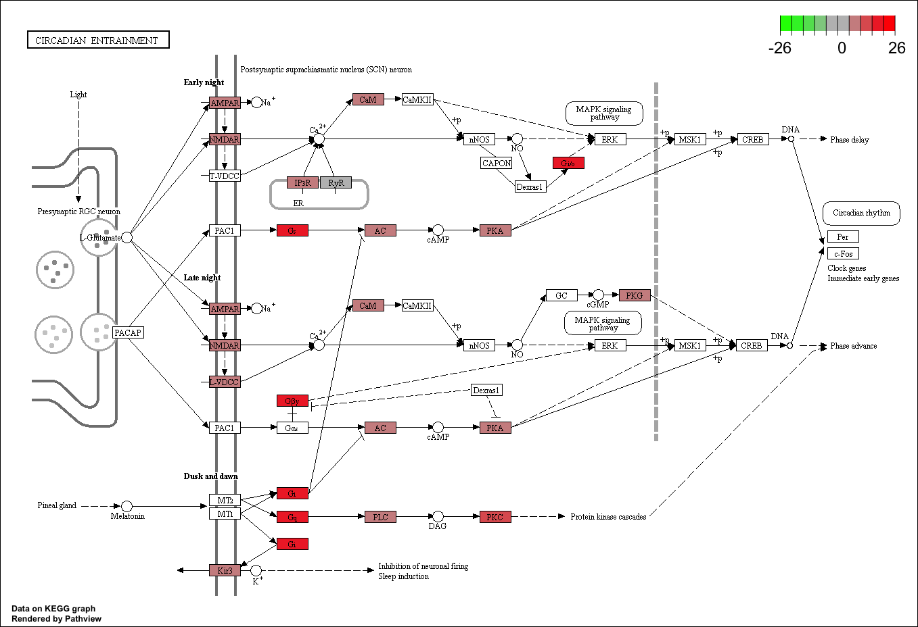
E
CIRCADIAN ENTRAINMENT
SF3
SF3: KEGG Analysis of differentially expressed transcripts in exosomal RNA of HPV-negative vs. HPV-positive cervical cancer cells.

Slide 8
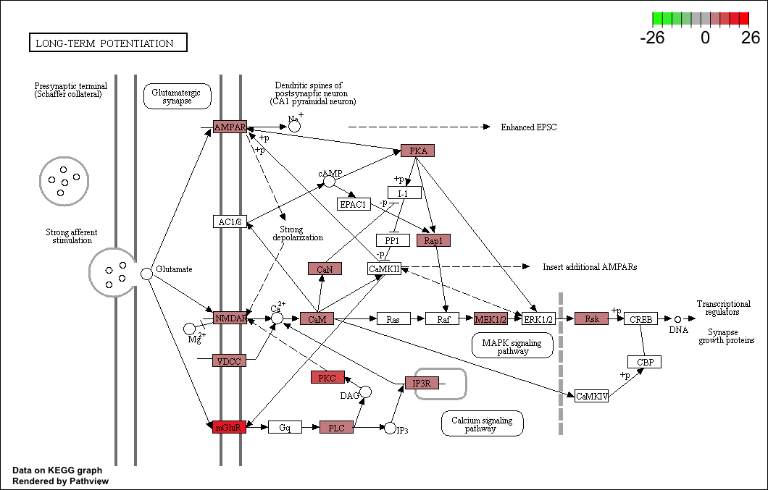
F
LONG-TERM POTENTIATION
SF3
SF3: KEGG Analysis of differentially expressed transcripts in exosomal RNA of HPV-negative vs. HPV-positive cervical cancer cells.

Slide 9
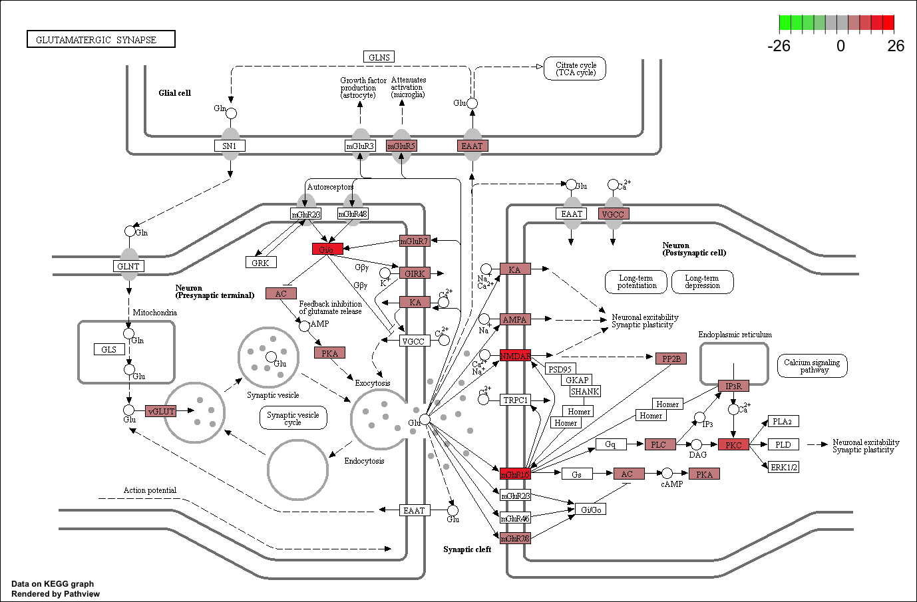
G
GLUTAMATERGIC SYNAPSE
SF3
SF3: KEGG Analysis of differentially expressed transcripts in exosomal RNA of HPV-negative vs. HPV-positive cervical cancer cells.

Slide 10
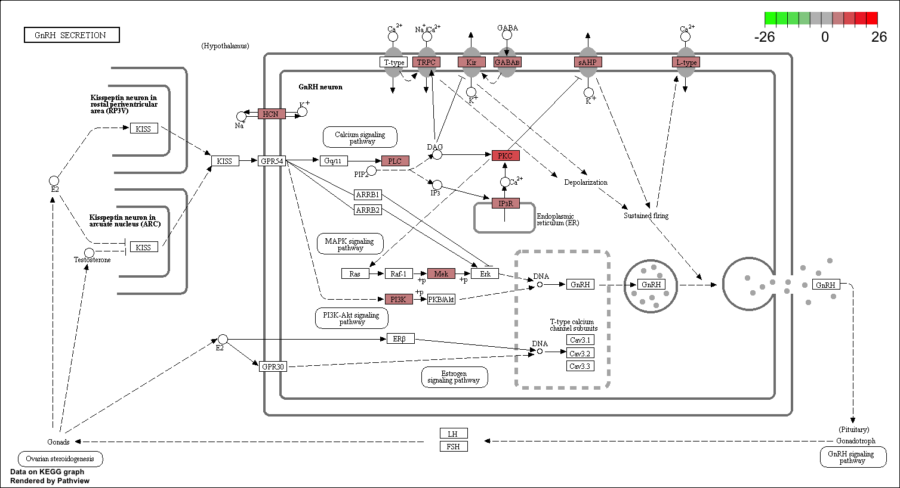
H
SF3
GnRH SECRETION
SF3: KEGG Analysis of differentially expressed transcripts in exosomal RNA of HPV-negative vs. HPV-positive cervical cancer cells.

Slide 11
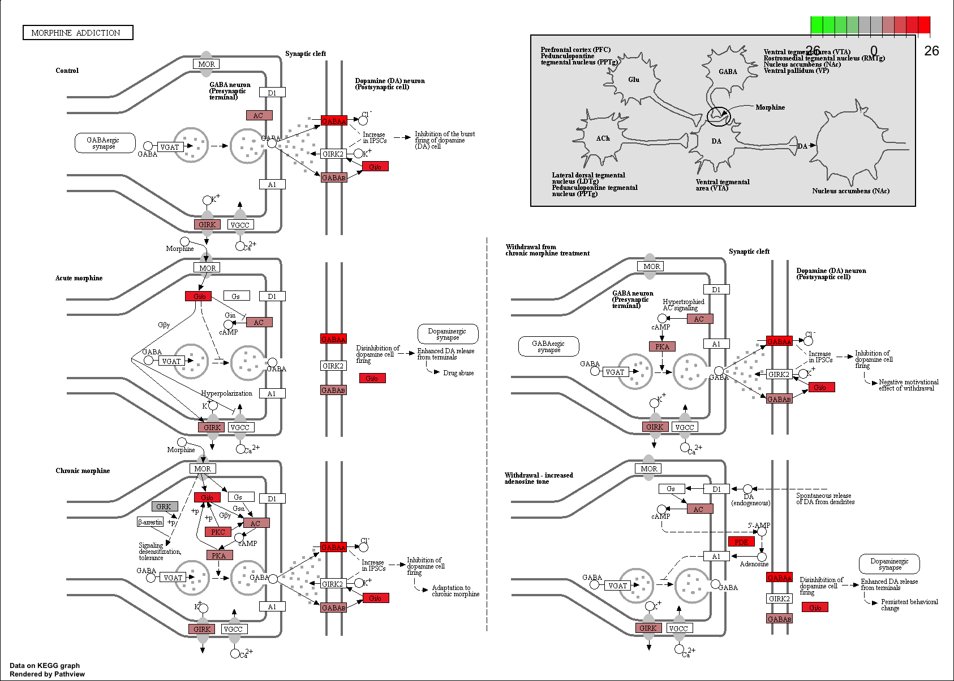
I
MORPHINE ADDICTION
SF3
SF3: KEGG Analysis of differentially expressed transcripts in exosomal RNA of HPV-negative vs. HPV-positive cervical cancer cells.

Slide 12
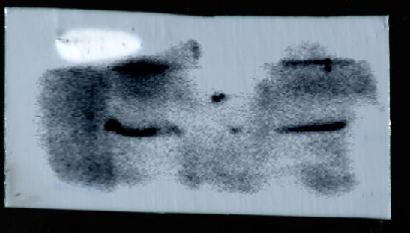
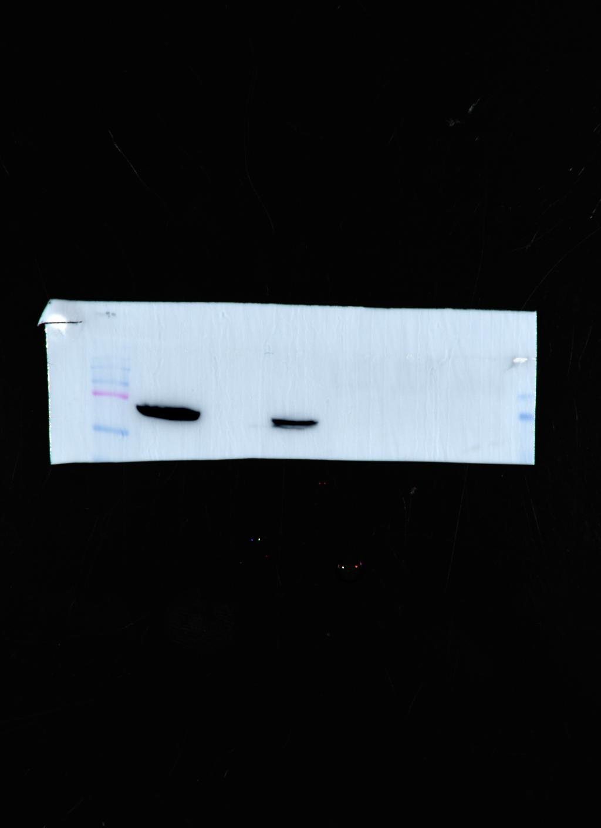
Immunoblots for Figure 1B
SiHa
HeLa
C33a
SF4
Alix (97KDa)
SiHa
HeLa
C33a
HSP70 (70KDa)
SiHa
HeLa
C33a
Flotillin 2 (43 kDa)

