Slide 1
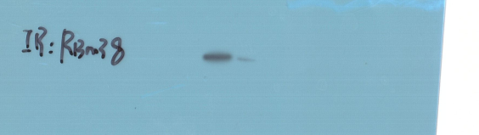
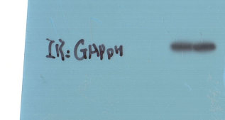
miR-20a-5p mimics
miR-20a-5p mimics
miR-NC
miR-NC
RBM38
25KD
GAPDH
37KD
Supplementary WB-1 for Figure 4C (upper panel RBM38 and GAPDH in BCPAP cells)

Slide 2
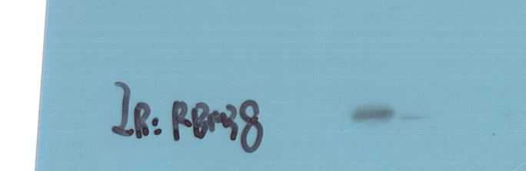
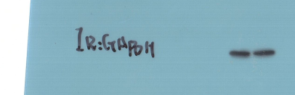
miR-20a-5p mimics
miR-20a-5p mimics
miR-NC
miR-NC
RBM38
25KD
GAPDH
37KD
Supplementary WB-2 for Figure 4C (upper panel RBM38 and GAPDH in K1 cells)

Slide 3
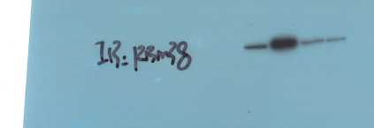
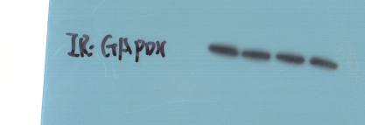
CALML3-AS1 OE+
miR-20a-5p mimics
CALML3-AS1 OE+
miR-20a-5p mimics
CALML3-AS1 OE
CALML3-AS1 OE
CALML3-AS1 OE+
si-RBM38#1
CALML3-AS1 OE+
si-RBM38#1
si-NC
si-NC
RBM38
25KD
GAPDH
37KD
Supplementary WB-3 for Figure 5C (upper panel RBM38 and GAPDH in BCPAP cells)

Slide 4
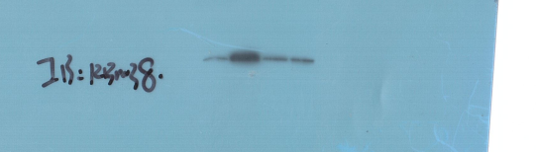
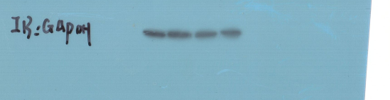
CALML3-AS1 OE+
miR-20a-5p mimics
CALML3-AS1 OE
CALML3-AS1 OE+
miR-20a-5p mimics
CALML3-AS1 OE+
si-RBM38#1
CALML3-AS1 OE
CALML3-AS1 OE+
si-RBM38#1
si-NC
si-NC
RBM38
25KD
GAPDH
37KD
Supplementary WB-4 for Figure 5C (upper panel RBM38 and GAPDH in K1 cells)

