Slide 1
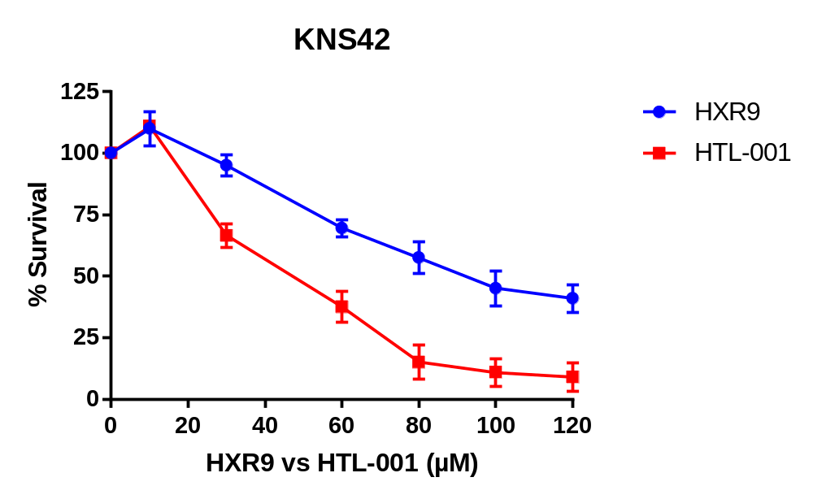
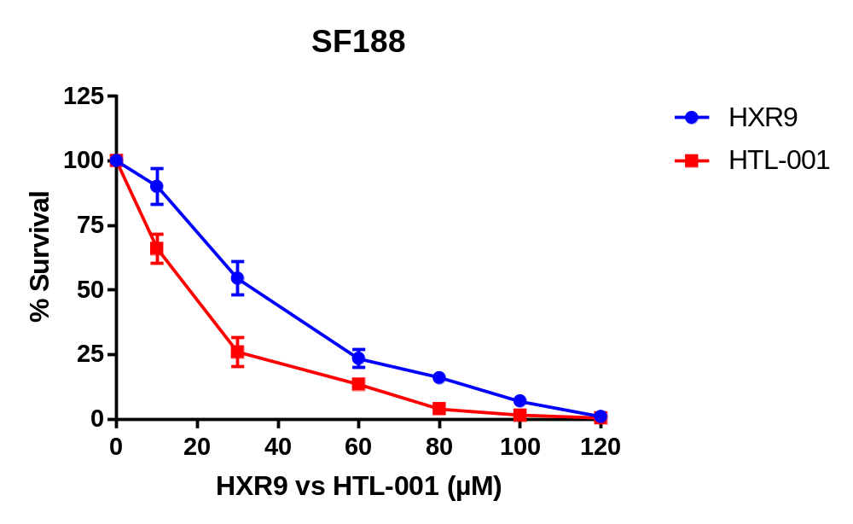
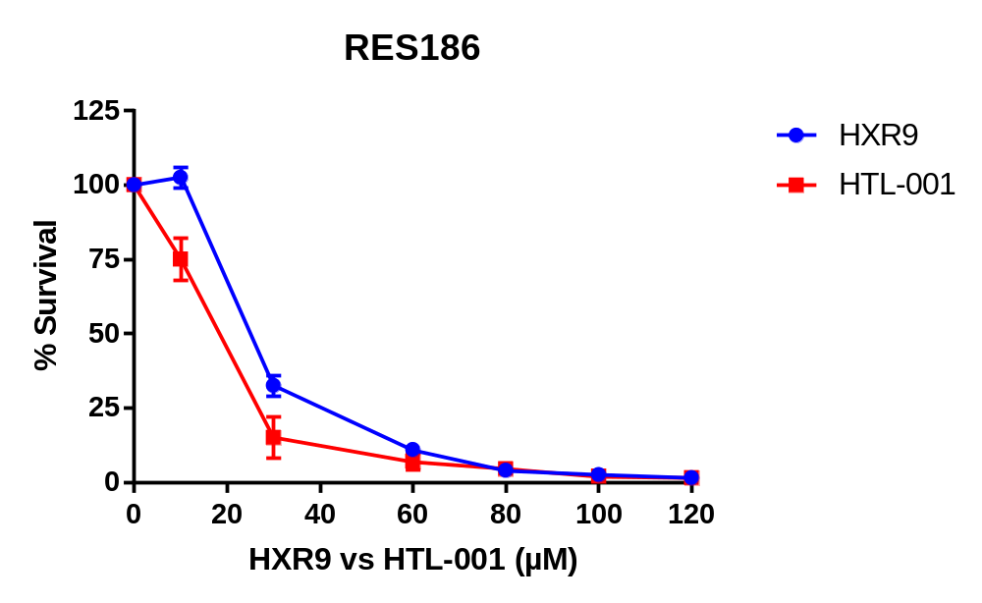
Cell Line | HXR9 IC50 (µM) | HTL-001 IC50 (µM)
KNS42 | 64.31 | 40.79
SF188 | 39.05 | 17.29
RES186 | 24.43 | 14.88
Additional File 2.

